Slide 1
Occupant Preference-Aware Load Scheduling for Resilient Communities
Wangda Zuo, Ph.D., IBPSA Fellow
Professor, Department of Architectural Engineering
Associate Director for Research, Global Building Network
Pennsylvania State University
Notes:
Arial 24; 20; 16
10:10-10:30 on October 28
20 mins in total16 mini presentation + 4 minutes Q&A
8-10 slides

Slide 2
Acknowledgment
This research was supported by the National Science Foundation under Awards No. IIS-1802017. This research was also supported by U.S. Department of Energy under Contract No. DE-AC05-76RL01830.

Slide 3
Outline
Motivation
Methodology
Simulation Results
Conclusion

Slide 4

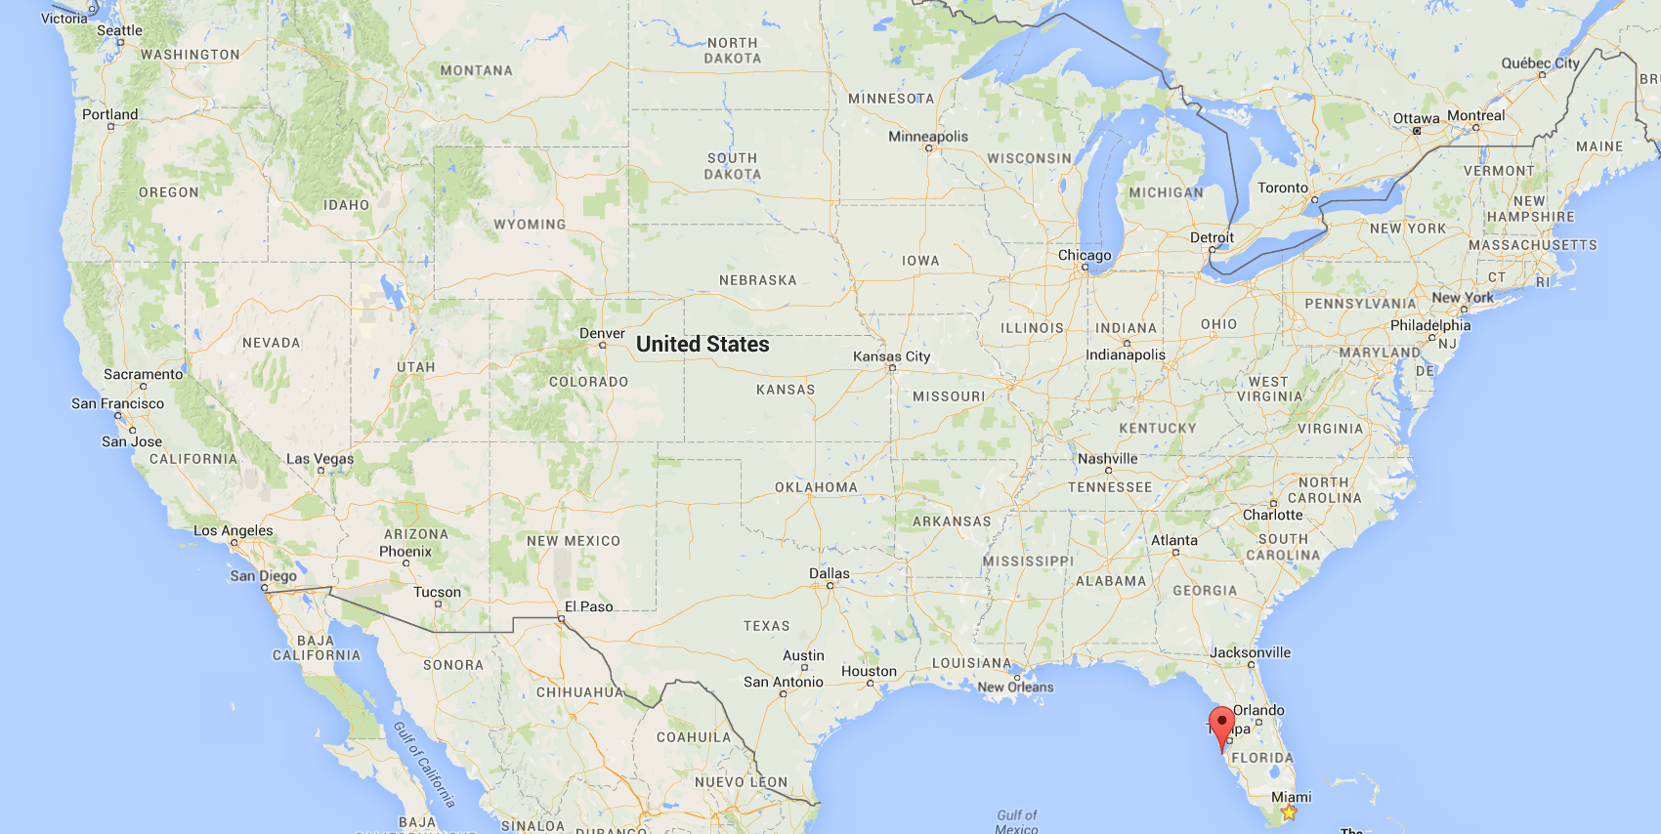

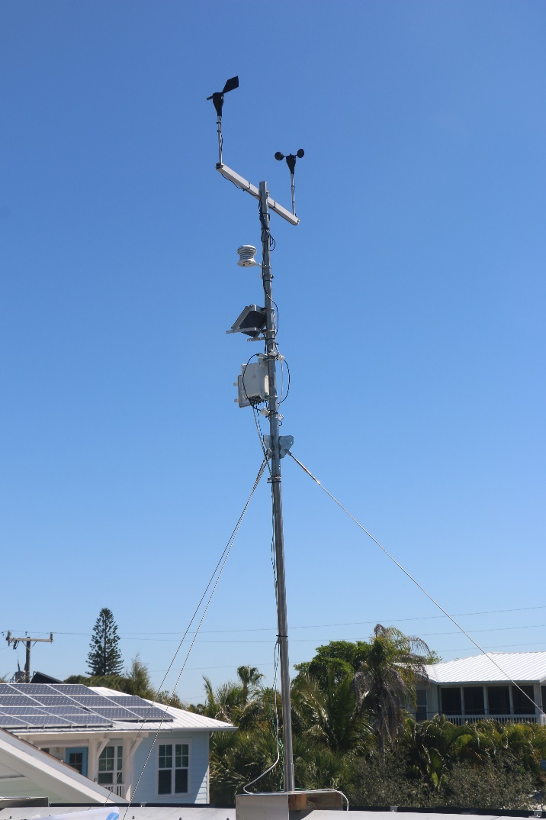


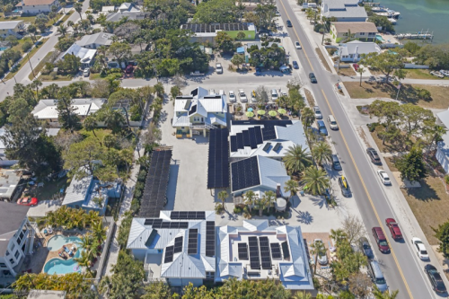
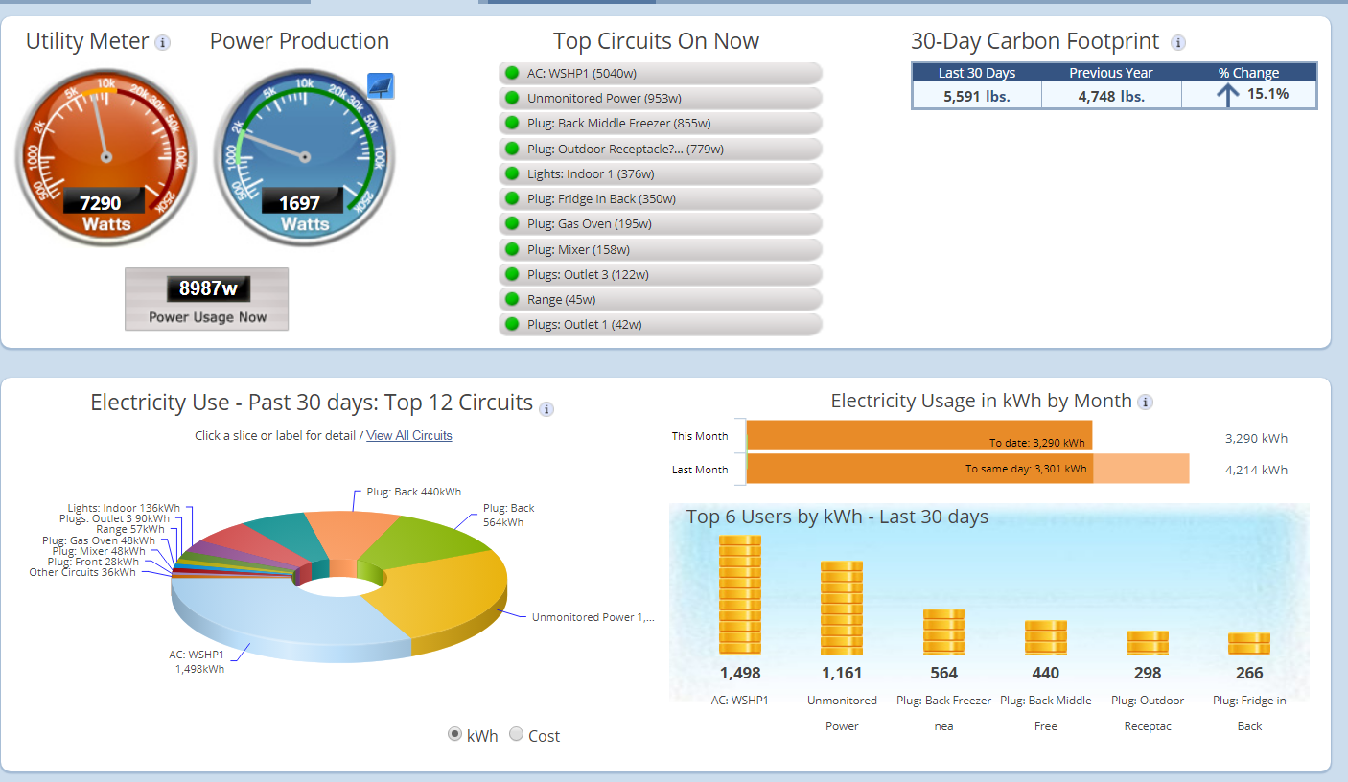
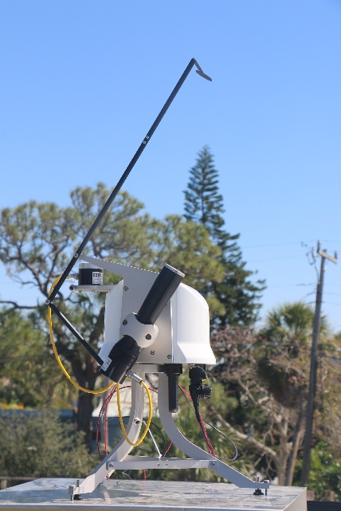
Historic Green Village: Net Zero Energy Community (NZEC)
https://sites.psu.edu/sbslab/research/city/net-zero-energy-community/
Anna Maria Island, FL
4

Slide 5
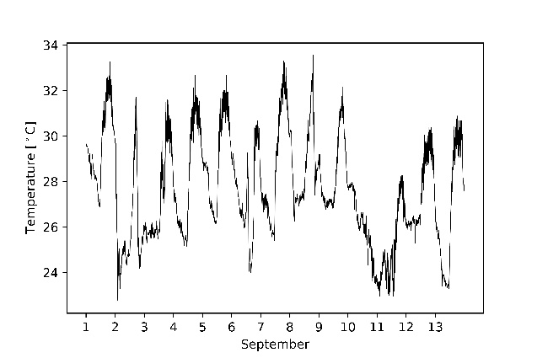
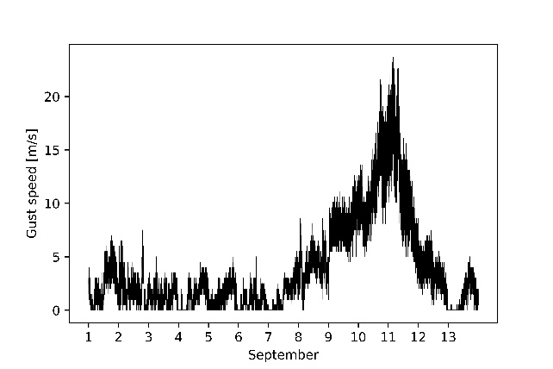
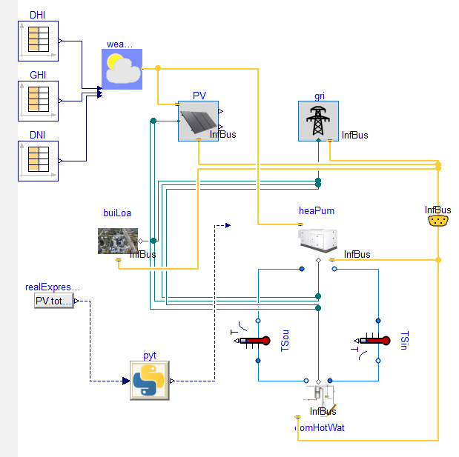
Operation of NZEC in Islanded Mode
After 2017 Hurricane Irma, Ana Maria island had power outage for 10+ days.
Temperature and wind speed data from HGV during the hurricane
Top-level model of HGV in Modelica
J. Wang, W. Zuo, L. Rhode-Barbarigos, X. Lu, J. Wang, Y. Lin 2019. “Literature Review on Modeling and Simulation of Energy Infrastructures from a Resilience Perspective.” Reliability Engineering and System Safety, 183, pp. 360-373

Slide 6
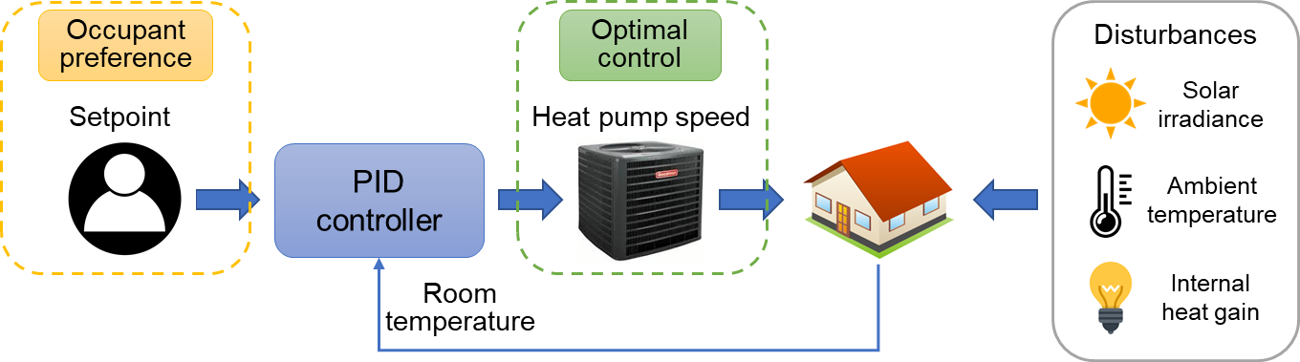
Research Challenges
The load scheduling of resilient communities in the islanded mode is subject to many uncertainties.
The uncertainty from the power generation side mainly lies in weather forecast errors (i.e., outdoor dry-bulb temperature, solar irradiance).
The uncertainty from the energy consumption side is mostly due to occupant behavior stochasticity.
Notes:
To date, it remains unclear how occupant preferences affect the effectiveness of the load scheduling of resilient communities.

Slide 7
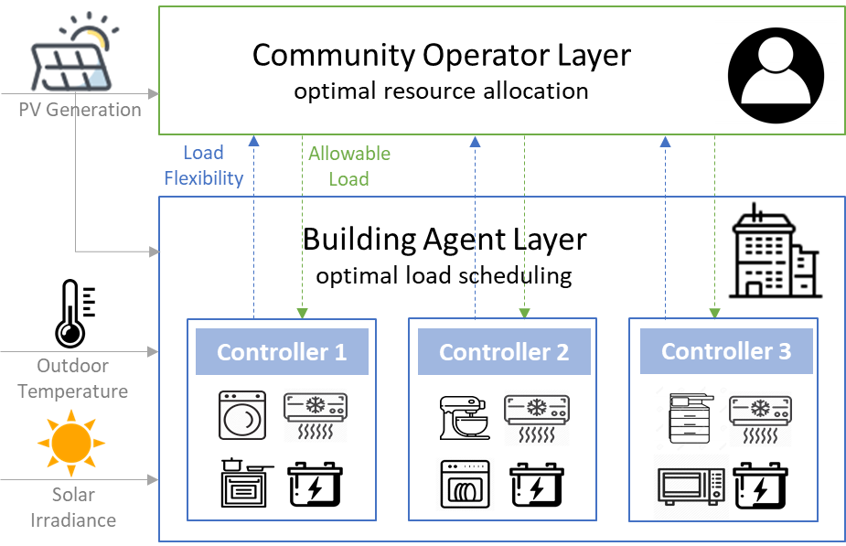
Methodology: Optimal Control for Resilient Community Operation
J. Wang, K. Garifi, K. Baker, W. Zuo, Y. Zhang, S. Huang, D. Vrabie 2020. "Optimal Renewable Resource Allocation and Load Scheduling of Resilient Communities." Energies, 13, pp. 5683.

Slide 8
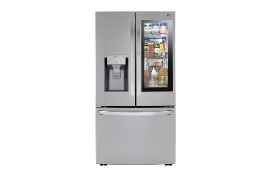

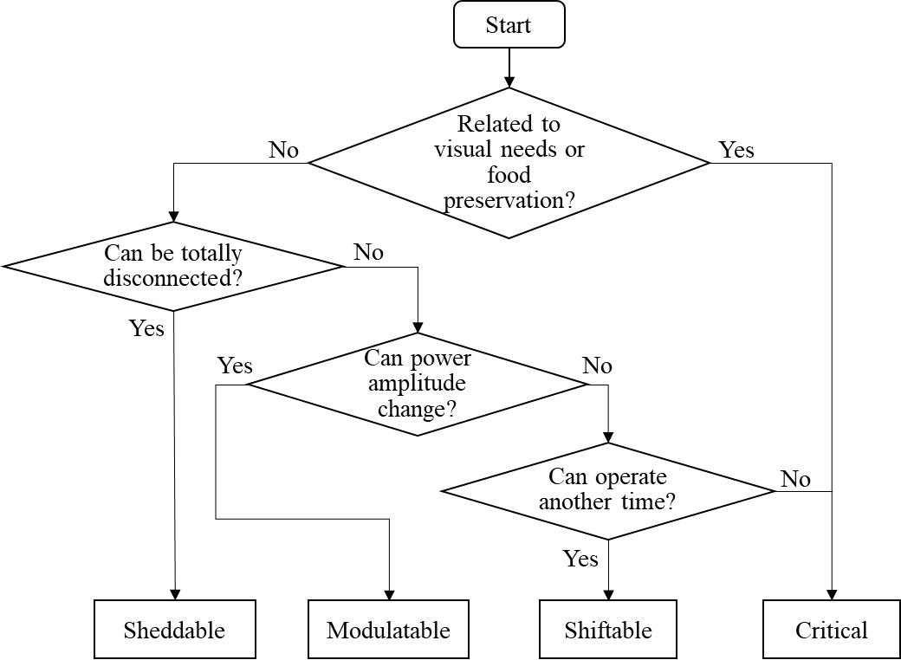
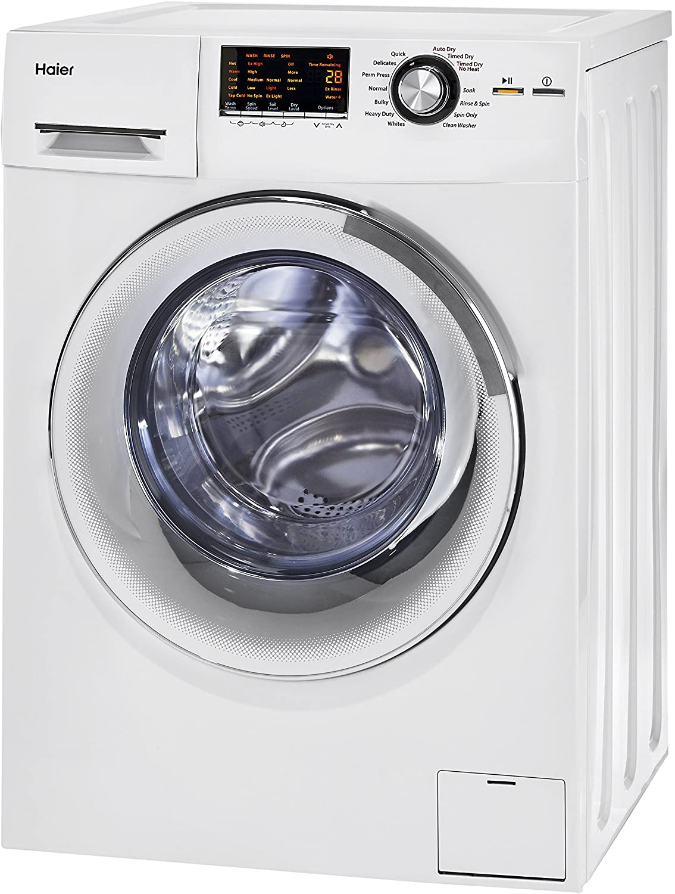

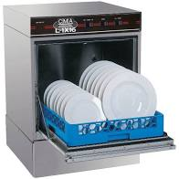

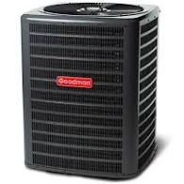
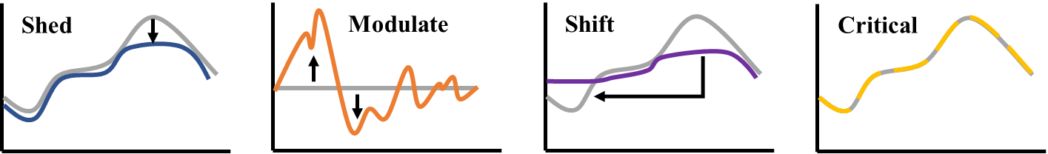
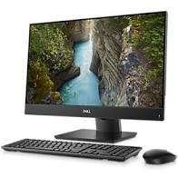
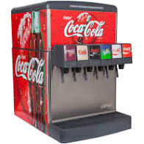
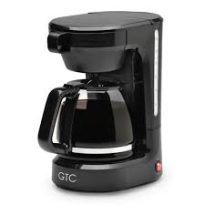
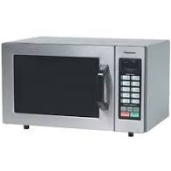
Methodology: Load Categorization
Critical loads
Shiftable loads
Modulatable loads
Sheddable loads
Figure adapted from: https://www.energy.gov/sites/default/files/2020/05/f74/bto-geb-webinar-CSMA-051920.pdf.
Notes:
Separate the two figures. Pictures of the loads.

Slide 9
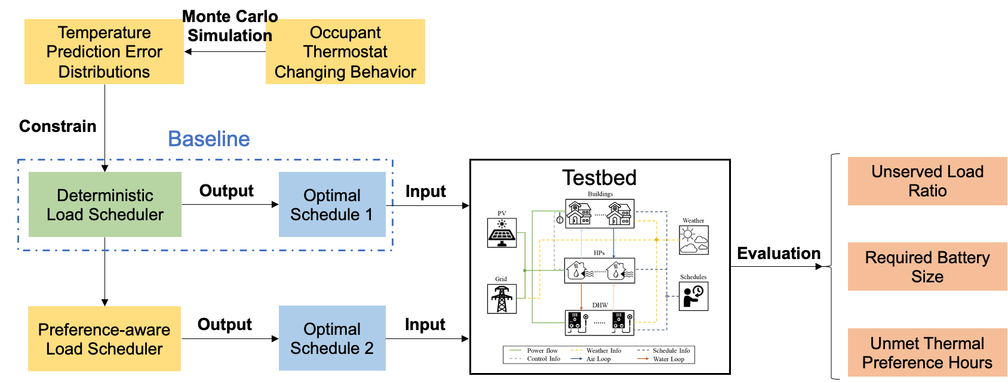
Methodology: Impact of Occupant Behavior
Occupant Preference Aware Load Scheduling
J. Wang, S. Huang, W. Zuo, D. Vrabie 2021. "Occupant Preference-Aware Load Scheduling for Resilient Communities." Energy & Buildings, 252, pp. 111399.

Slide 10
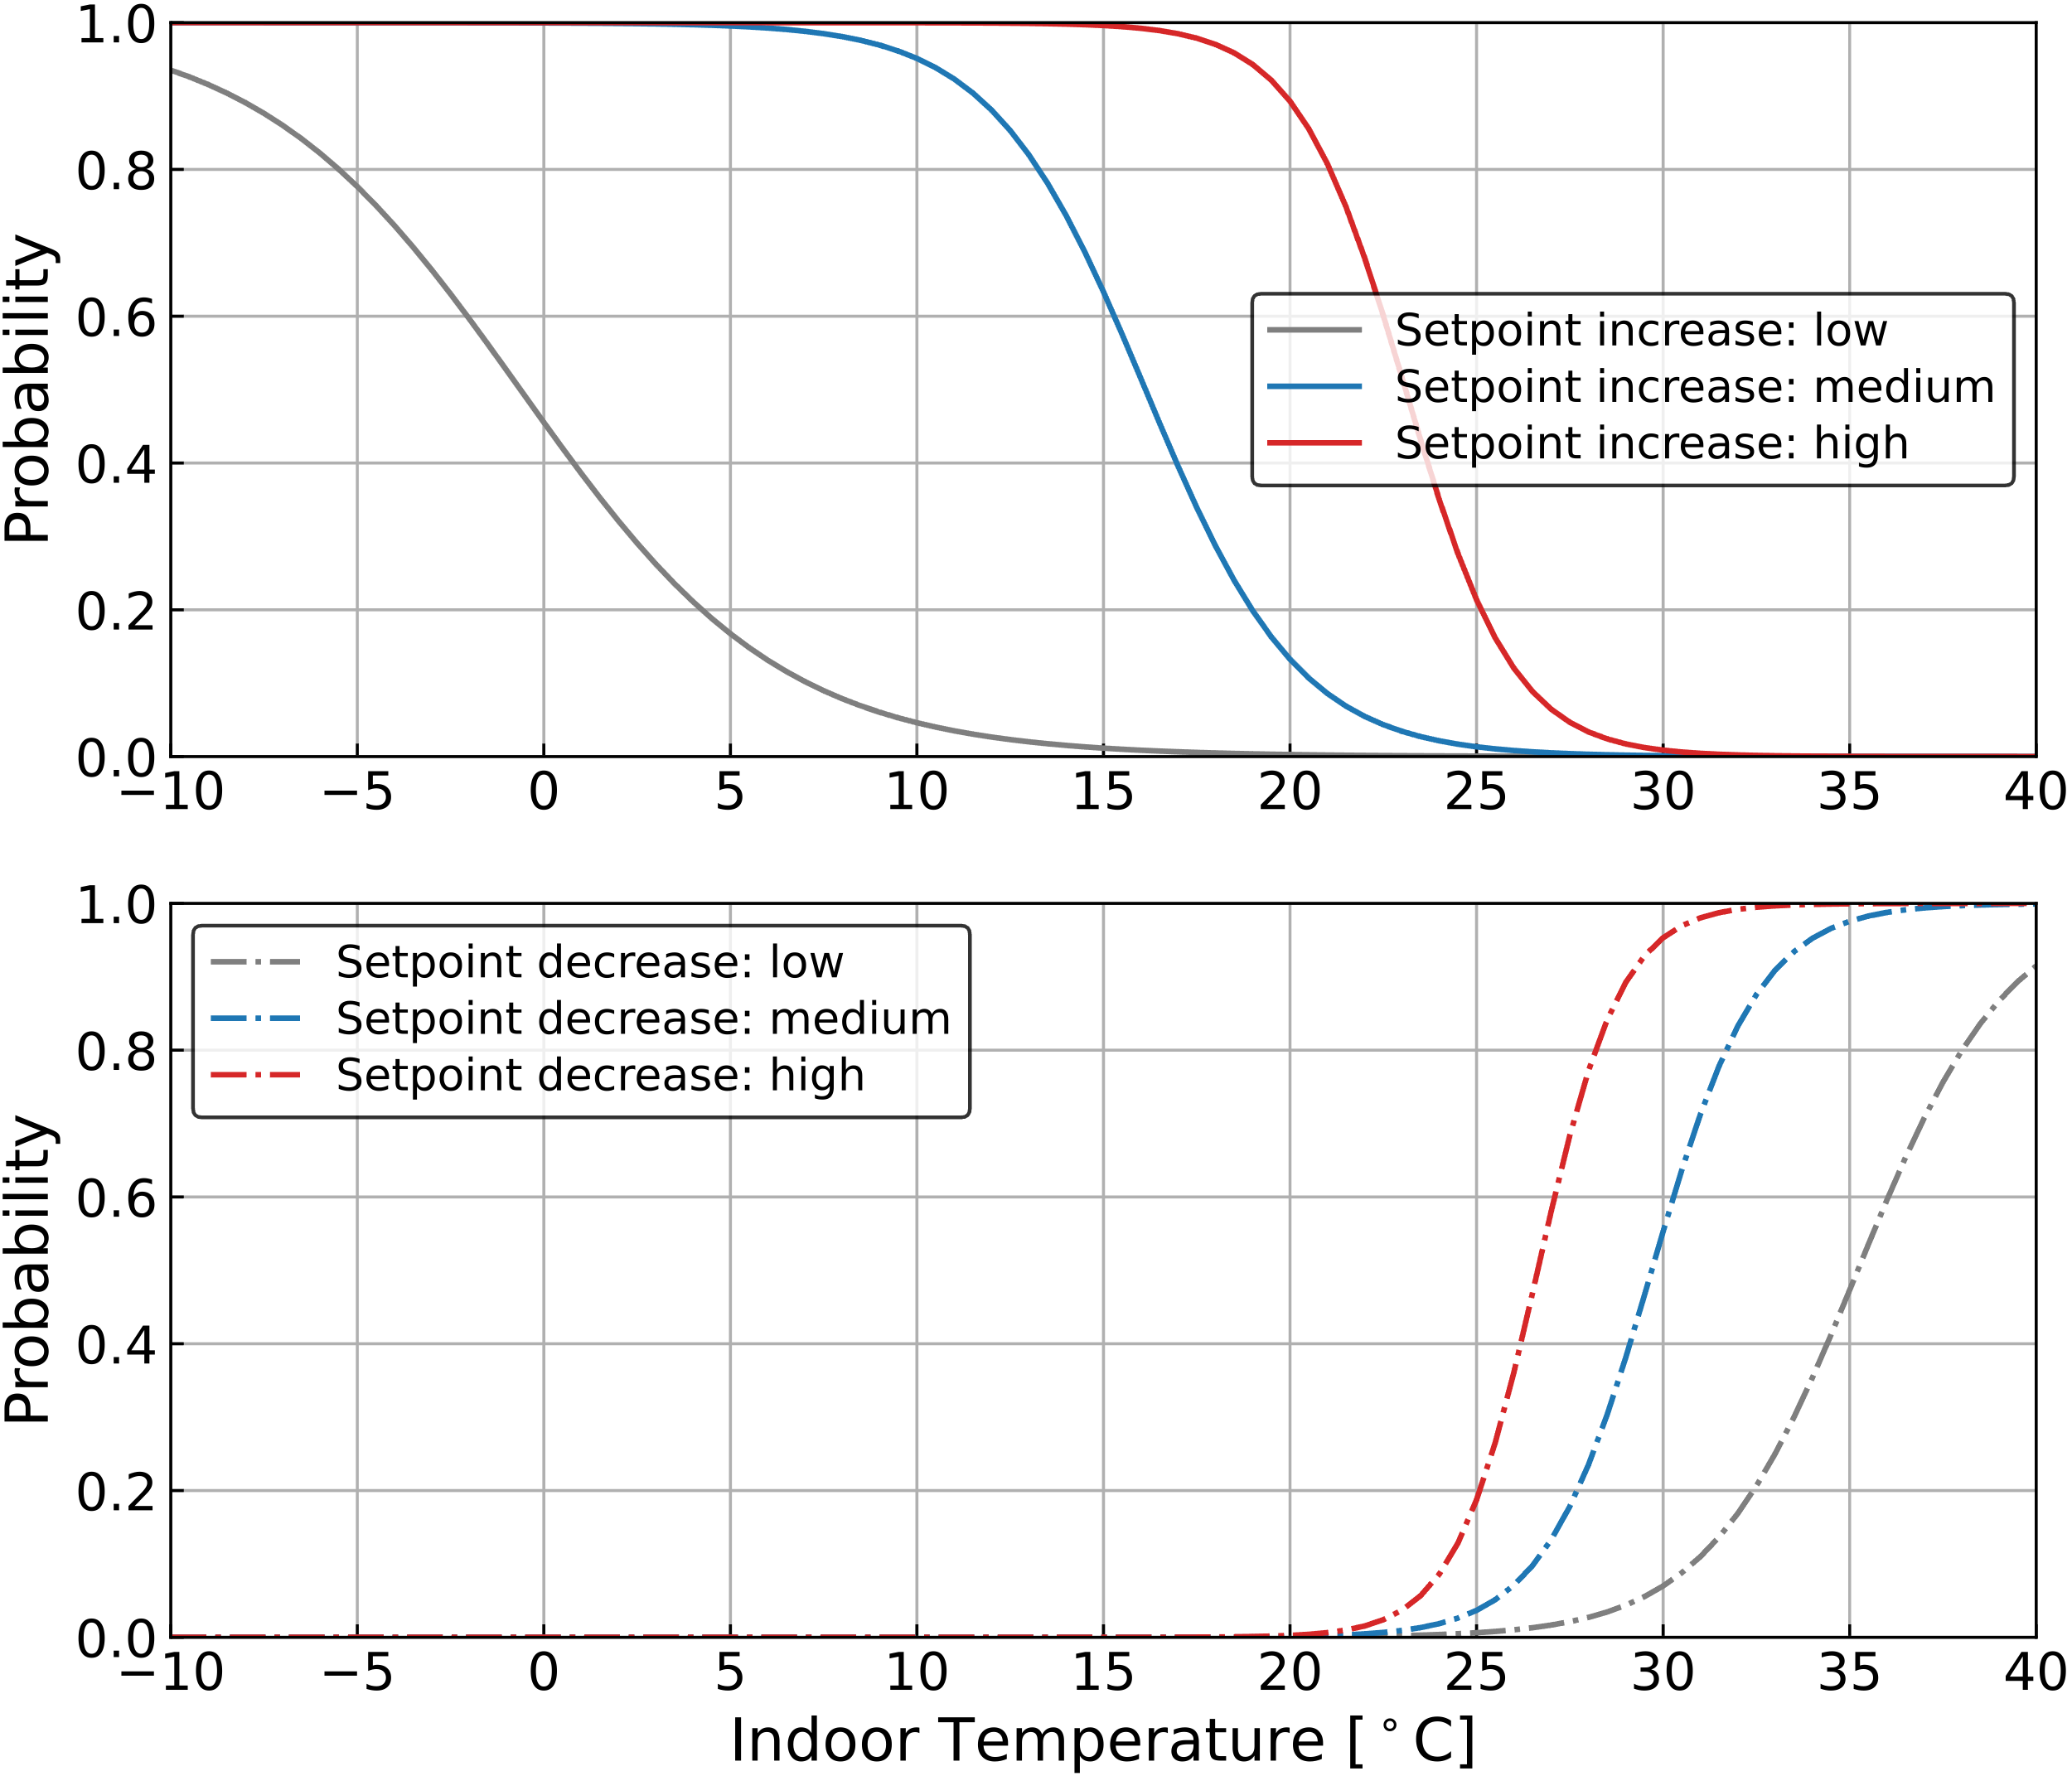
Methodology: Stochastic Occupant Thermostat Changing Models
Logistic regression models adopted from literature to simulate low, medium, and high frequencies of changing actions.
a – intercept; b – slope.
Same probability values at indoor temperatures of 16ºC or 40ºC.
Active Level | Coefficients
 | Increasing |  | Decreasing
 | a | b | a | b
Low (Gunay et al.) | -0.179 | -0.285 | -17.467 | 0.496
Medium | 7.821 | -0.485 | -20.667 | 0.696
High | 15.821 | -0.685 | -23.867 | 0.896

Slide 11
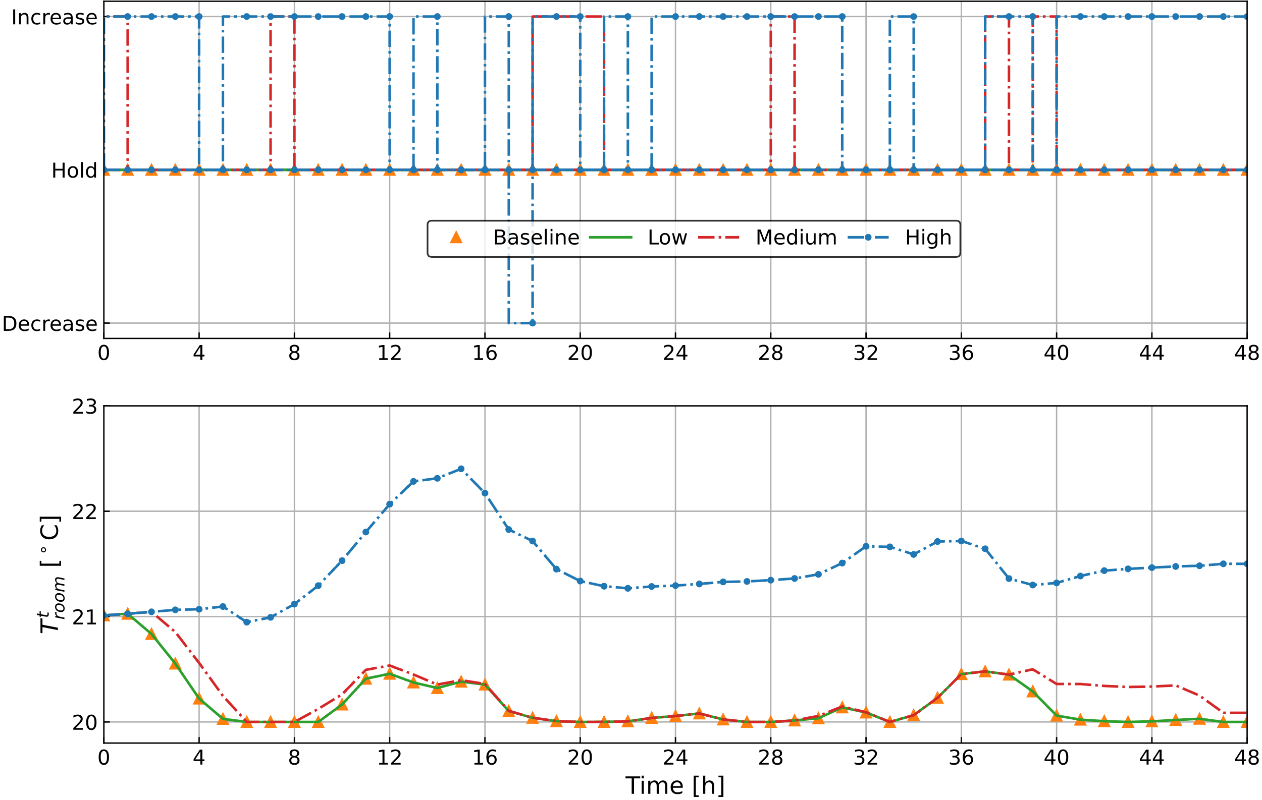
Results and Discussions
Scenarios
Impact visualization (Residential Building)
Scenario | 1 | 2 | 3 | 4 | 5 | 6 | 7 | 8 | 9
Building | Residential |  |  | Ice Cream Shop |  |  | Bakery
Uncertainty Level | Low | Med. | High | Low | Med. | High | Low | Med. | High
Baseline scenario overlaps with the low uncertainty scenario.
More frequent setpoint increasing actions than decreasing.
Noticeable room temperature rising with the uncertainty level.
For the whole community, when considering the highest occupant behavior uncertainty, the consumed HVAC energy can be 57.2% less and the battery 8.08% smaller.
Notes:
Impact of introducing the different levels of uncertainties.

Slide 12
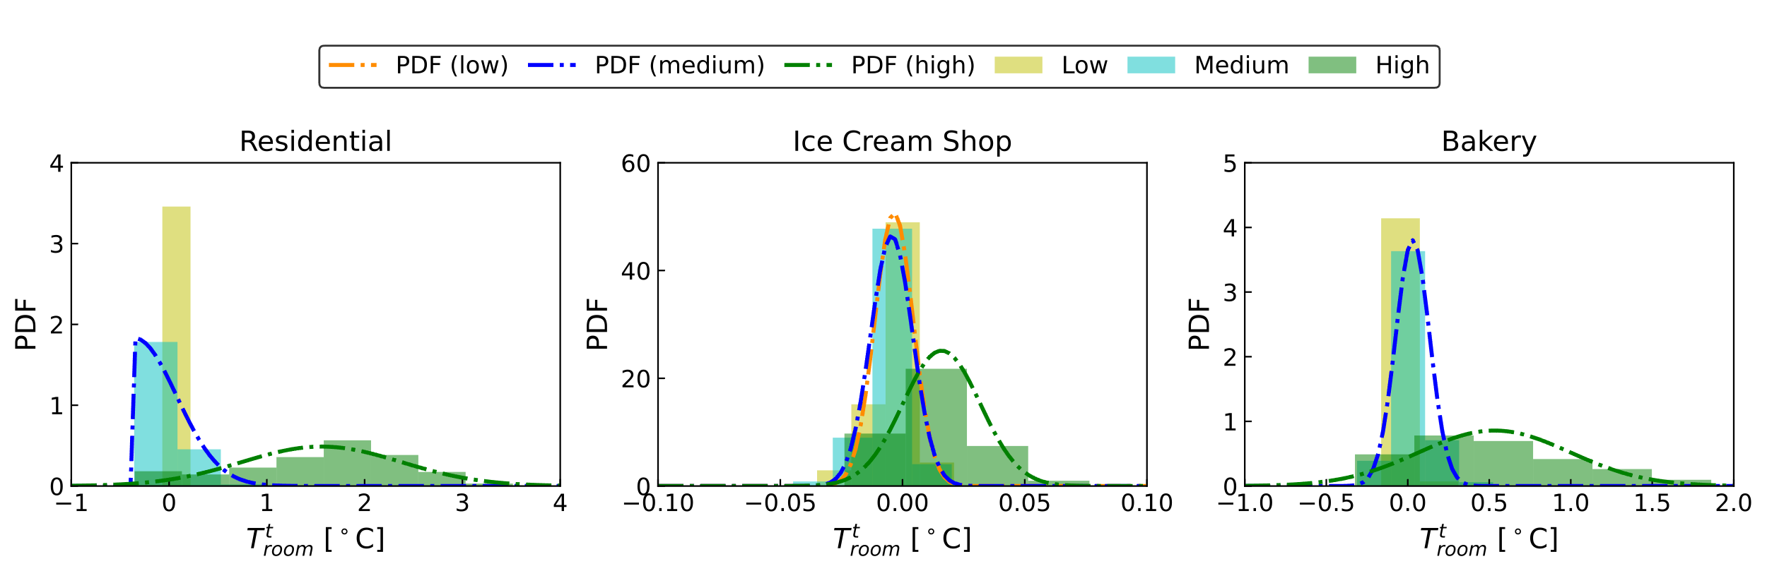
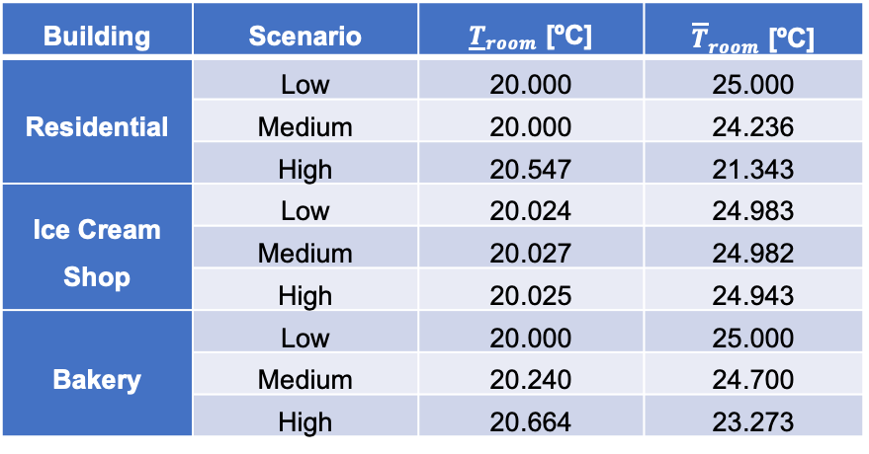
Room Temperature Prediction Error Distributions
Considering the occupant thermostat changing behavior as a source of room temperature prediction error, we developed the error distributions from the Monte Carlo simulation data.
Normal distribution, half-normal distribution, and constant.
Chance constraints:
Limitation: not impactful for buildings with large thermal mass.
$$Pr\left({\underline{T}}_{room}≤T_{room}^{t+1}\right)≥1−ε_{T}, Pr\left({\overline{T}}_{room}≥T_{room}^{t+1}\right)≥1−ε_{T}$$
Building | Scenario | ${\underline{T}}_{room}$ [ºC] | ${\overline{T}}_{room}$ [ºC]
Residential | Low | 20.000 | 25.000
 | Medium | 20.000 | 24.236
 | High | 20.547 | 21.343
Ice Cream Shop | Low | 20.024 | 24.983
 | Medium | 20.027 | 24.982
 | High | 20.025 | 24.943
Bakery | Low | 20.000 | 25.000
 | Medium | 20.240 | 24.700
 | High | 20.664 | 23.273
Notes:
Ran each scenario for 100 times (Monte Carlo) to get the room temperature distributions.
Change the slide title.

Slide 13
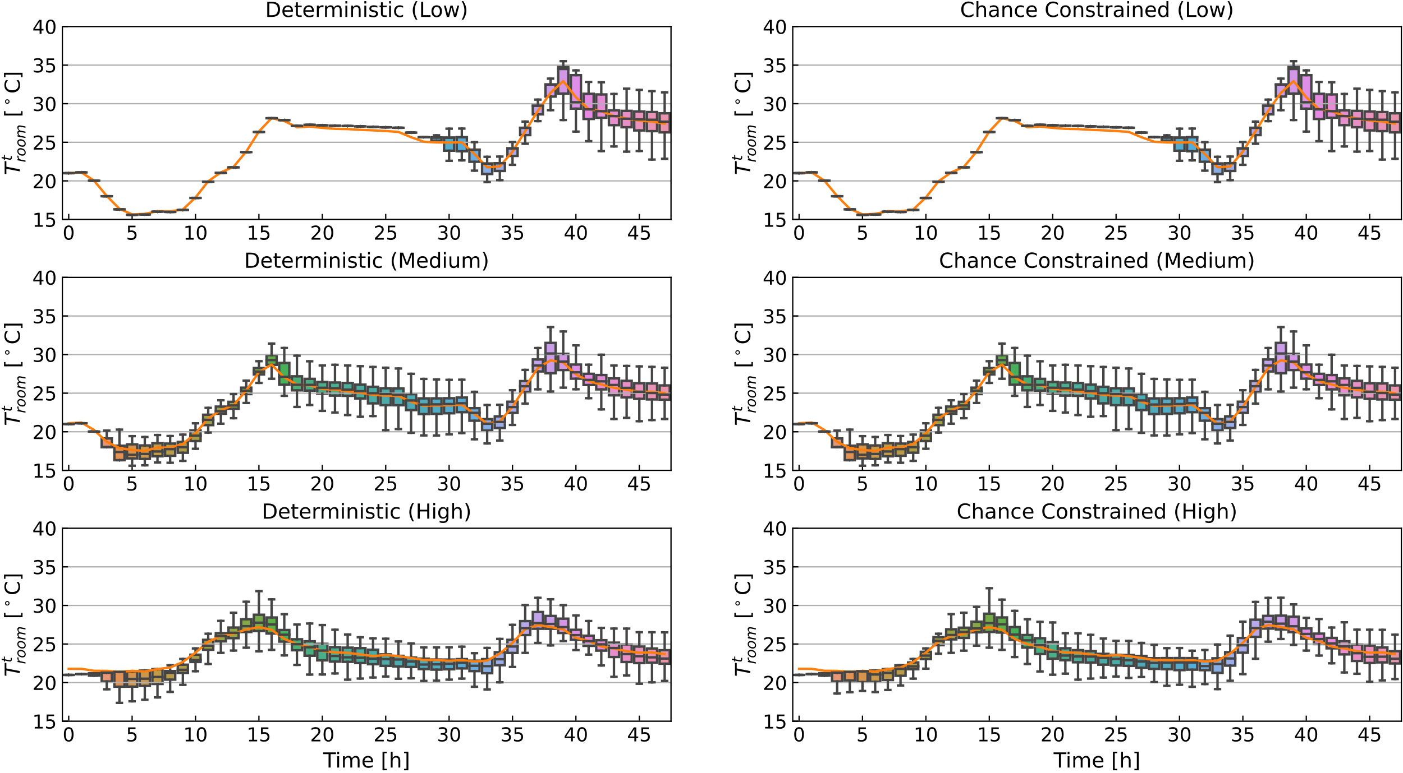
Control Testing Results (Residential Building)
Findings
Plant-model mismatching.
Narrower room temperature ranges from the low uncertainty scenarios to high uncertainty scenarios.
Same unserved load ratios.
Chance constrained controller leads to a savings of 6.7 kWh of battery capacity for the community.
With the increase in the occupant thermostat-changing uncertainties, the room temperatures tend to get closer to the occupants’ preferred room temperature.

Slide 14
Conclusion
Three levels of stochastic occupant thermostat changing behavior models were introduced into a deterministic load scheduling framework as a source of uncertainty.
A preference-aware scheduler was proposed to address the uncertainty through chance constraints.
Generally, the proposed controller performs better in terms of serving the occupants’ thermal preference and reducing the required battery size compared to the baseline controller.

Slide 15
References
J. Wang 2021. “Occupant-Centric Modeling and Control for Low-Carbon and Resilient Communities.” Ph.D. Thesis. Department of Civil, Environmental, and Architectural Engineering, University of Colorado Boulder.
J. Wang, K. Garifi, K. Baker, W. Zuo, Y. Zhang, S. Huang, D. Vrabie 2020. "Optimal Renewable Resource Allocation and Load Scheduling of Resilient Communities." Energies, 13, pp. 5683.
J. Wang, S. Huang, W. Zuo, D. Vrabie 2021. "Occupant Preference-Aware Load Scheduling for Resilient Communities." Energy & Buildings, 252, pp. 111399.

Slide 16

Contact Information
Wangda Zuo, Ph.D., IBPSA Fellow
Professor, Department of Architectural Engineering
Associate Director for Research, Global Building Network
Pennsylvania State University
Email: Wangda.Zuo@psu.edu
Lab Website: https://sites.psu.edu/sbslab/

