Slide 1

Bring Biophilic art to intelligent buildings
BY
Dr. Anthony Adole
Email: anthony.adole@ntu.ac.uk
Sponsored By
Innovate UK, NTU, Vieunite
Academic Teams:
Dr. Yangang Xing, Dr. Jordan Bird, Professor Ahmad Lotfi, Dr. Benedict Carpenter van Barthold, Dr. Andrew Knight, Dr. Alexander Sumich, and Mrs. Carolyn Thomas.
Industrial Teams:
Dr. Baoli Zhao, Mrs Jing Dong, Mr. Yang Zhou
Private & conﬁdential. Property of Vieunite Ltd

Slide 2
Bring Biophilic art to intelligent buildings
Vieunite is a new online art community that combines an alternative platform for artists to sell their work digitally with an innovative digital canvas that has texture-accurate display technology.
Bringing art into everyone’s lives in a unique way gives people the chance to creatively express themselves.
The Vieunite platform would also have the functionality of an all-in-one therapeutic Display System for care homes and art lovers.
Private & conﬁdential. Property of Vieunite Ltd

Slide 3

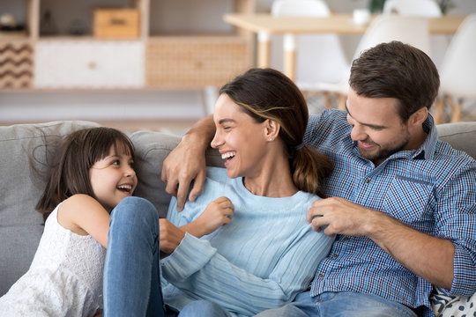
Who is the Therapeutic Display System?
Art lovers – the digital canvas, combined with the constantly updated library of artwork, provides an opportunity for anyone who adorns the walls of their home with any kind of art in a novel way to keep their home décor fresh.
The public - to improve the mental health and well-being of people using biophilic artwork displayed in the Vieunite Textura Digital Canvas positioned within the environment of public space.
Private & conﬁdential. Property of Vieunite Ltd

Slide 4
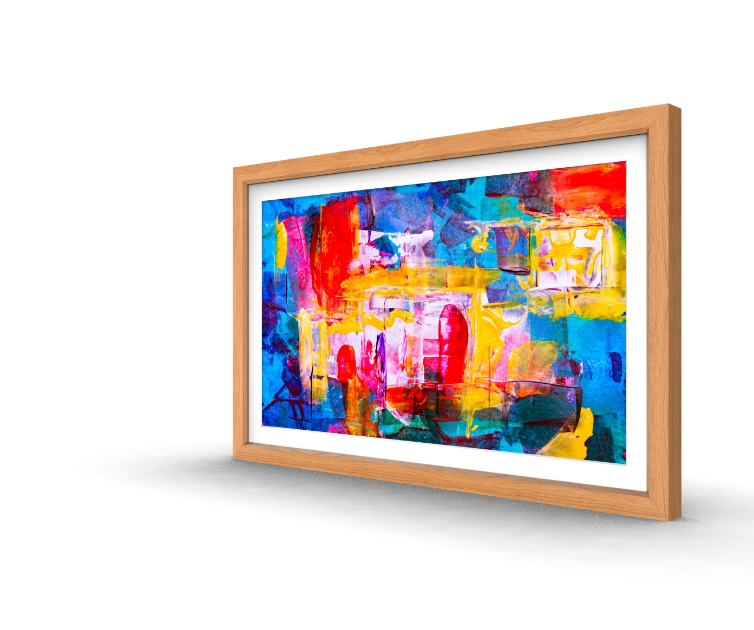
Textura™ Digital Canvas
Using specially developed technology, optimised for viewing art and videos.
Texture accurate technology for displaying realistic artwork
Super-rich colour accuracy and optimised luminance
Maximised omnidirectional viewing angle
Specialised soft matte panel finish
Range of four frame finish options
Private & conﬁdential. Property of Vieunite Ltd

Slide 5
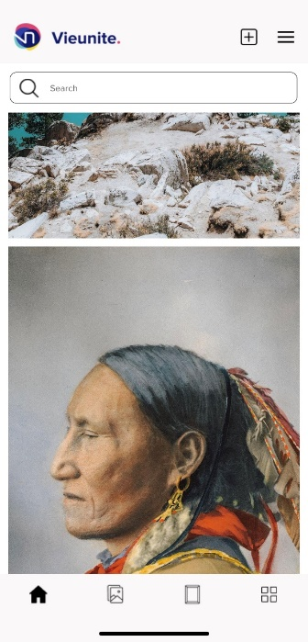
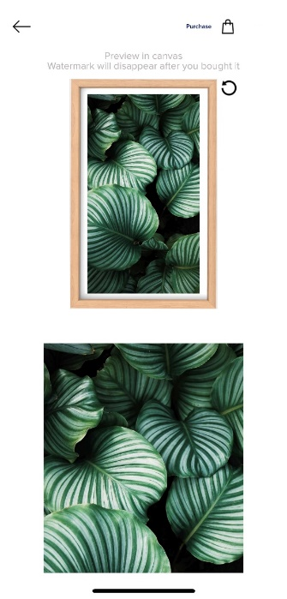
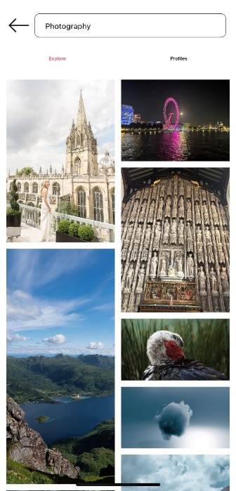
Human Emotion and Biophilic Attribute Artwork recommendation for intelligent buildings
Data Collation –
Attribute for Biophilic artworks- we used the 14 basic biophilic attributes. Then created a survey that aided the classification of artworks by artists into each of the attributes. However, we also made use of a computer vision algorithm to categorize the artworks based on the survey text response.
Human emotion categorization - we used the 20 basic Human emotions. Then created a survey that aided the classification of artworks by artists into each of the emotions. However, we also made use of a computer vision algorithm to categorize the artworks based on the survey text response.
Private & conﬁdential. Property of Vieunite Ltd

Slide 6
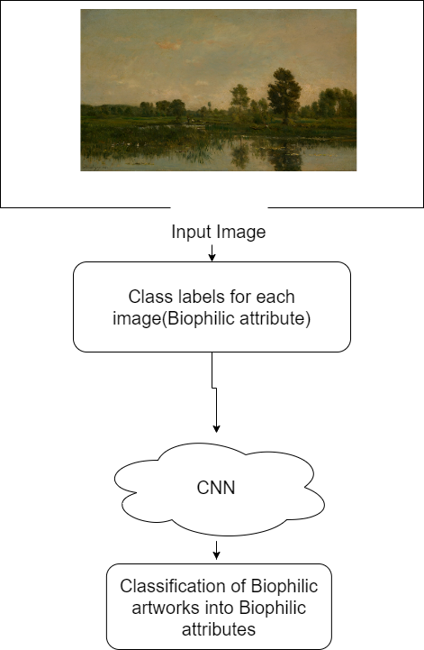
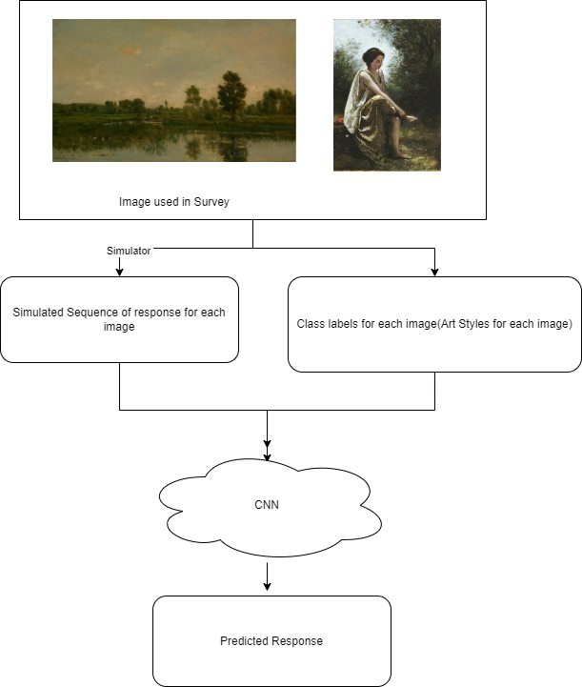
Biophilic Artwork Classification using our DL model
First Approach
Second Approach
Private & conﬁdential. Property of Vieunite Ltd

Slide 7
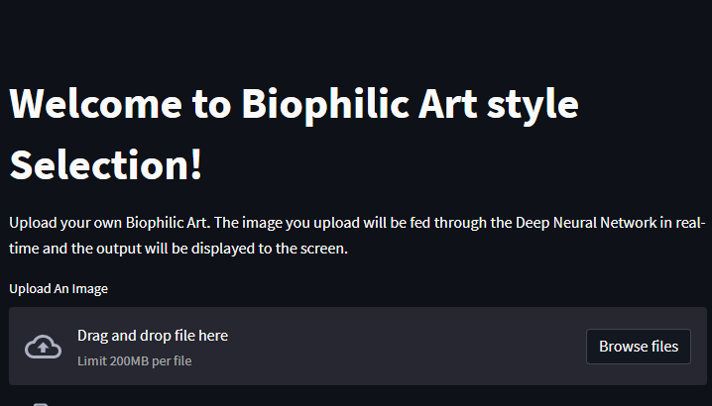
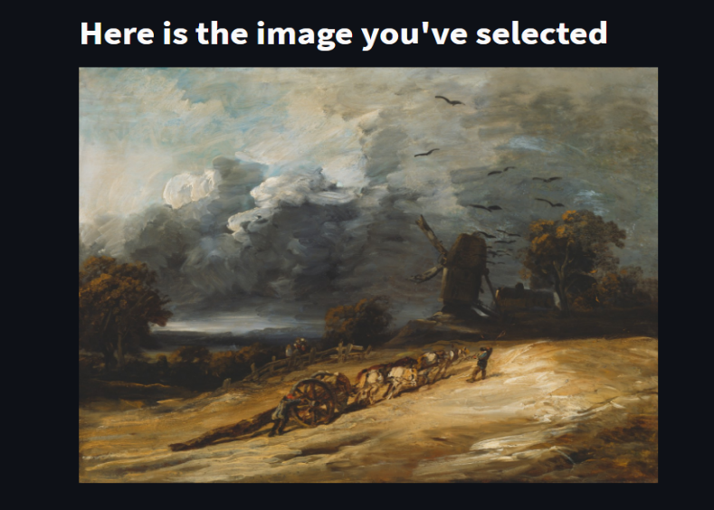
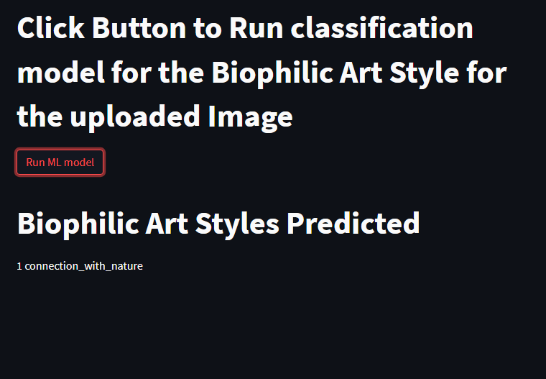
Biophilic Artwork Classification using our DL model
Private & conﬁdential. Property of Vieunite Ltd

Slide 8
Biophilic Artwork Classification using our DL model
Final output result
Private & conﬁdential. Property of Vieunite Ltd

Slide 9

Thank you.
Dr. Anthony Adole
Anthony.adole@ntu.ac.uk
+44 (0)7443069363
Private & conﬁdential. Property of Vieunite Ltd

