Slide 1

SHBE-RCN
Wellbeing-Centric Sustainable Built Environment Ecosystems
Yong Tao, PhD, PE
Dept of Mechanical Engineering
Cleveland State University
Overview
Current Understanding
Future Ideas
SHBE.ORG
Nottingham Trent University, Nottingham, UK, October 27-28, 2022

Slide 2

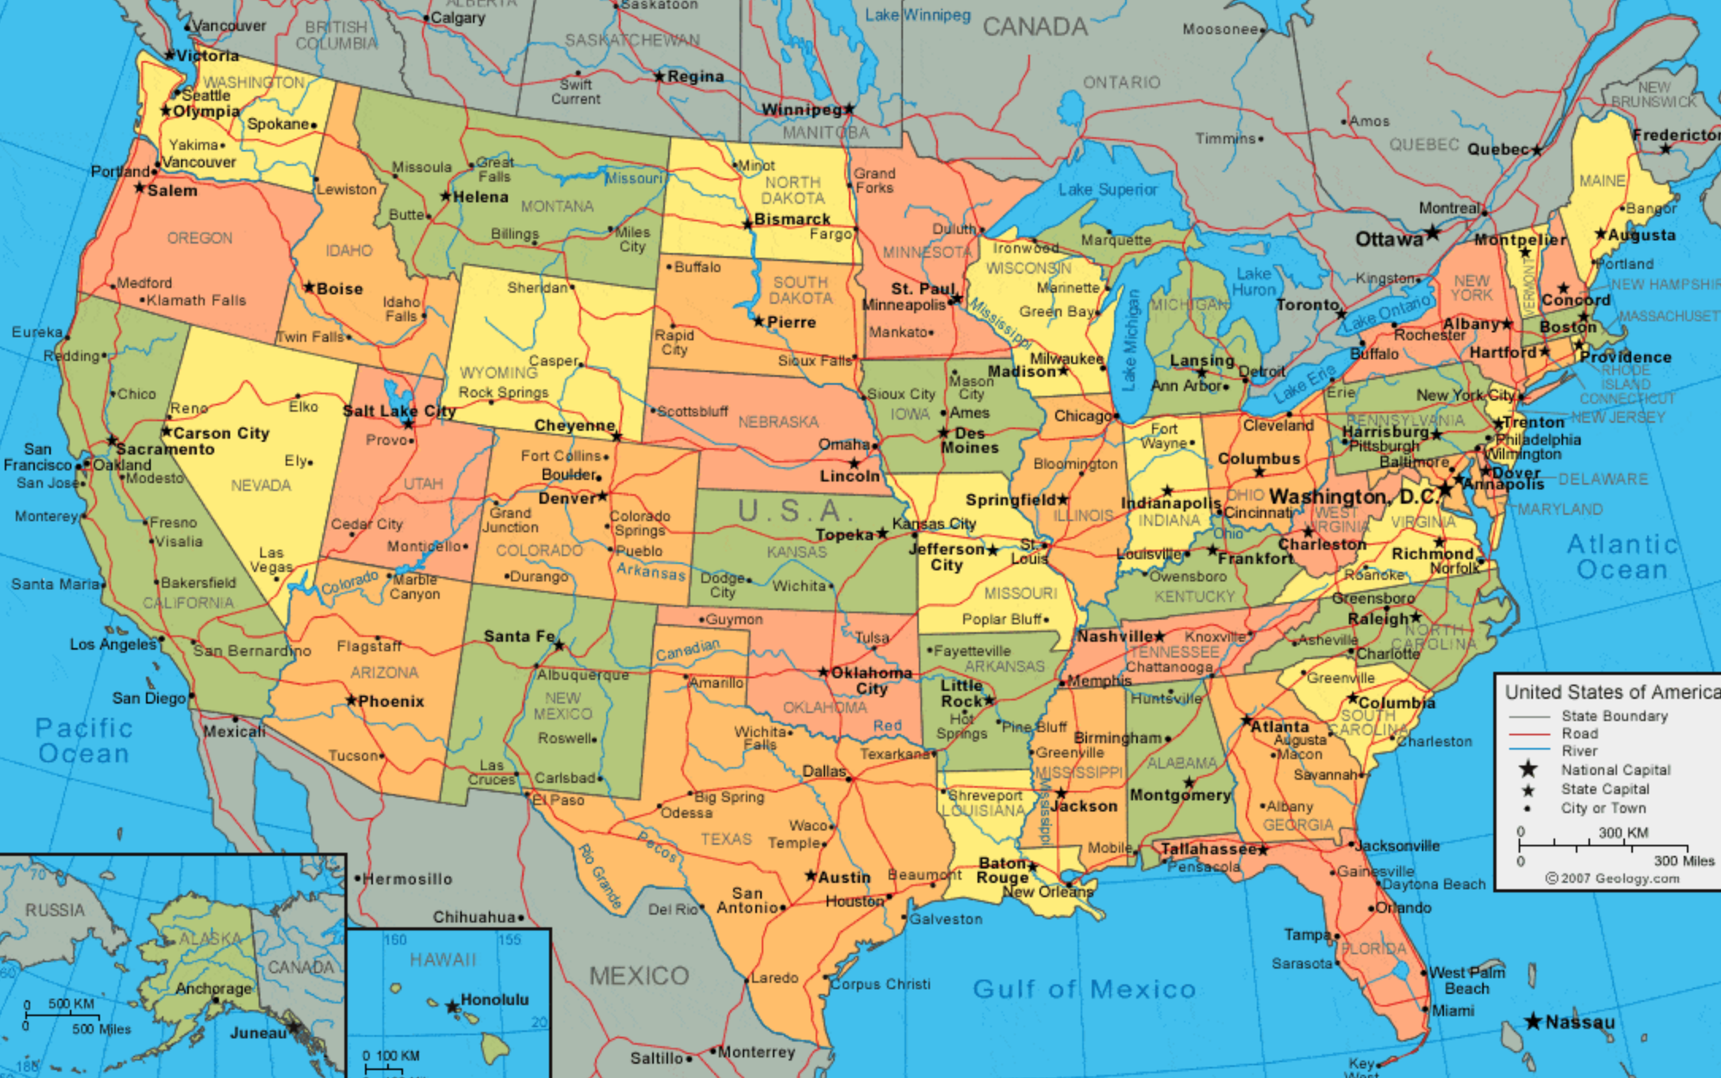
Cleveland, Ohio, USA

Slide 3
What is SHBE-RCN
Predictive Modeling Network for Sustainable Human-Building Ecosystems (SHBE)
A Research Coordination Network (RCN): Science, Engineering and Education for Sustainability, sponsored by NSF (2014-2022)
Key Points:
Hypothesis
Focus on how to collaborate on the research agenda
Key deliverables:
  Workshops and symposium
  Education and outreach
  Building partnership

Slide 4
















Key Network Participants

Slide 5
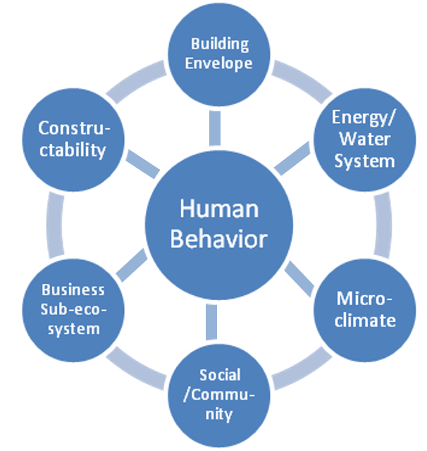
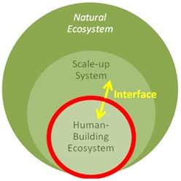
Sustainable Human-Building Ecosystem
(a) (b)
(a) Relation to natural ecosystem; the interface acts as I/O between human habitat system and natural ecosystem of the planet Earth, and (b) science of Sustainable Human-Building Ecosystem (SHBE Network Concept)
Notes:
Discuss phrasing of two voting questions:
1. Which technology has the most realistic chance to impact the 2030 Windows &Envelope R&D Program goal (25% reduction in energy lost to the building envelope) if progress is incremental?
2. Which technology has the greatest potential impact on the 2030 Windows &Envelope R&D Program goal, even if it requires a game-changing breakthrough technology?

Slide 6
Hypothesis
Integrating occupant behaviors with built environment performances validated from large field data sets can lead to significant reductions of the uncertainty in predictive models for human adaptation to energy efficiency and sustainability of building ecosystems.

Slide 7
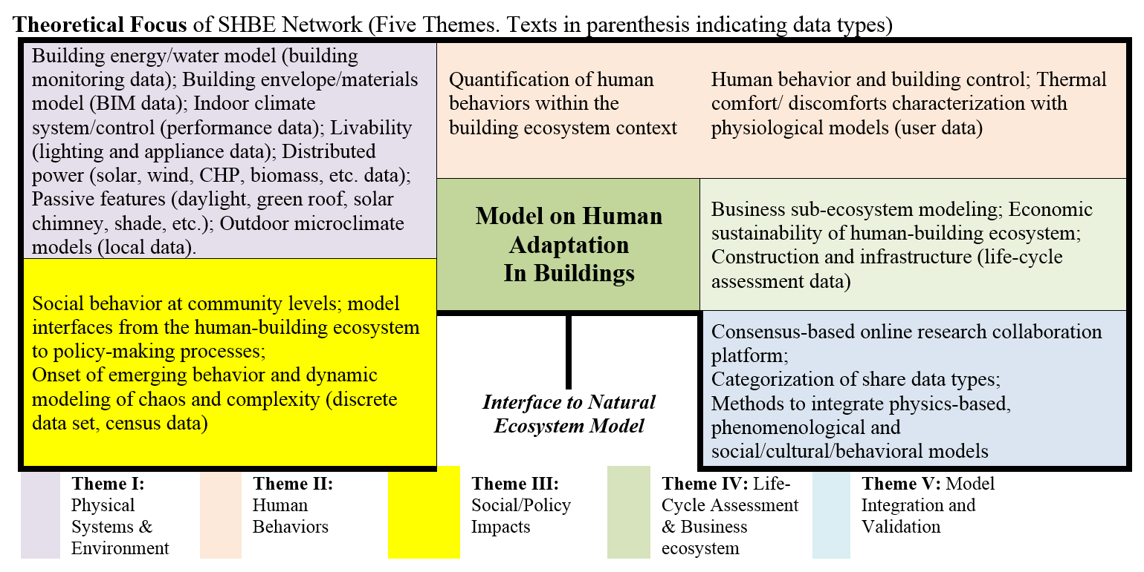
Five Themes as Theoretical Focus of SHBE
Theme VI: Collaboration in Education (SHBE’s multidisciplinary approach)

Slide 8
Achievements
Workshops:
University of North Texas (Theme I), March 18-19, 2014
University of North Carolina at Charlotte (Theme II), May 27-28, 2014
Laurence Berkley National Lab (Theme V), April 2-3, 2015
Carnegie-Mellon University (Theme IV), October 8-9, 2015
Florida State University (Theme III), May 19-20, 2016
University of Tennessee (Theme VI), September 30-October 1, 2016
Nova Southeastern University (Data Structure), June 5-6, 2017
Carnegie-Mellon University (Theme IV), May 17-18, 2018
Florida State University (Theme III), April 15-16, 2019
University of North Carolina, Charlotte (Sustainment), July 22-23, 2019

Slide 9
Achievements – cont’d
The First International Symposium on Sustainable Human-Building Ecosystems (SHBE), Carnegie-Mellon University Pittsburgh, PA, October 5-7, 2015
International Workshop on Smart Cities, Human Behavior, and Sustainable Development Central University of Finance and Economics, Beijing, China, September 28-30, 2017
International Workshop on Putting Sustainability into Convergence: Connecting Data, People, and Systems, Singapore, January 28-29, 2019.

Slide 10
RECENT EVENTS
2020
Virtual Workshop on COVID-19 and the built environment, October 9, 2020
2022
US-UK Workshop on Biosensing-enabled, Wellbeing-Centric SHBE, Nottingham Trent University (NTU), October 17-18, 2022

Slide 11
Wellbeing-Centric Human Building Ecosystems
- Human-Technology Convergence
Wellbeing:
Human-Technology Convergence for Sustainability
Policy
Urban Planning
Architecture/ Construction
Engineering (ME, EE, CE, EnvE, CpE.)
Social Science/ Computer Science
Transportation

Slide 12
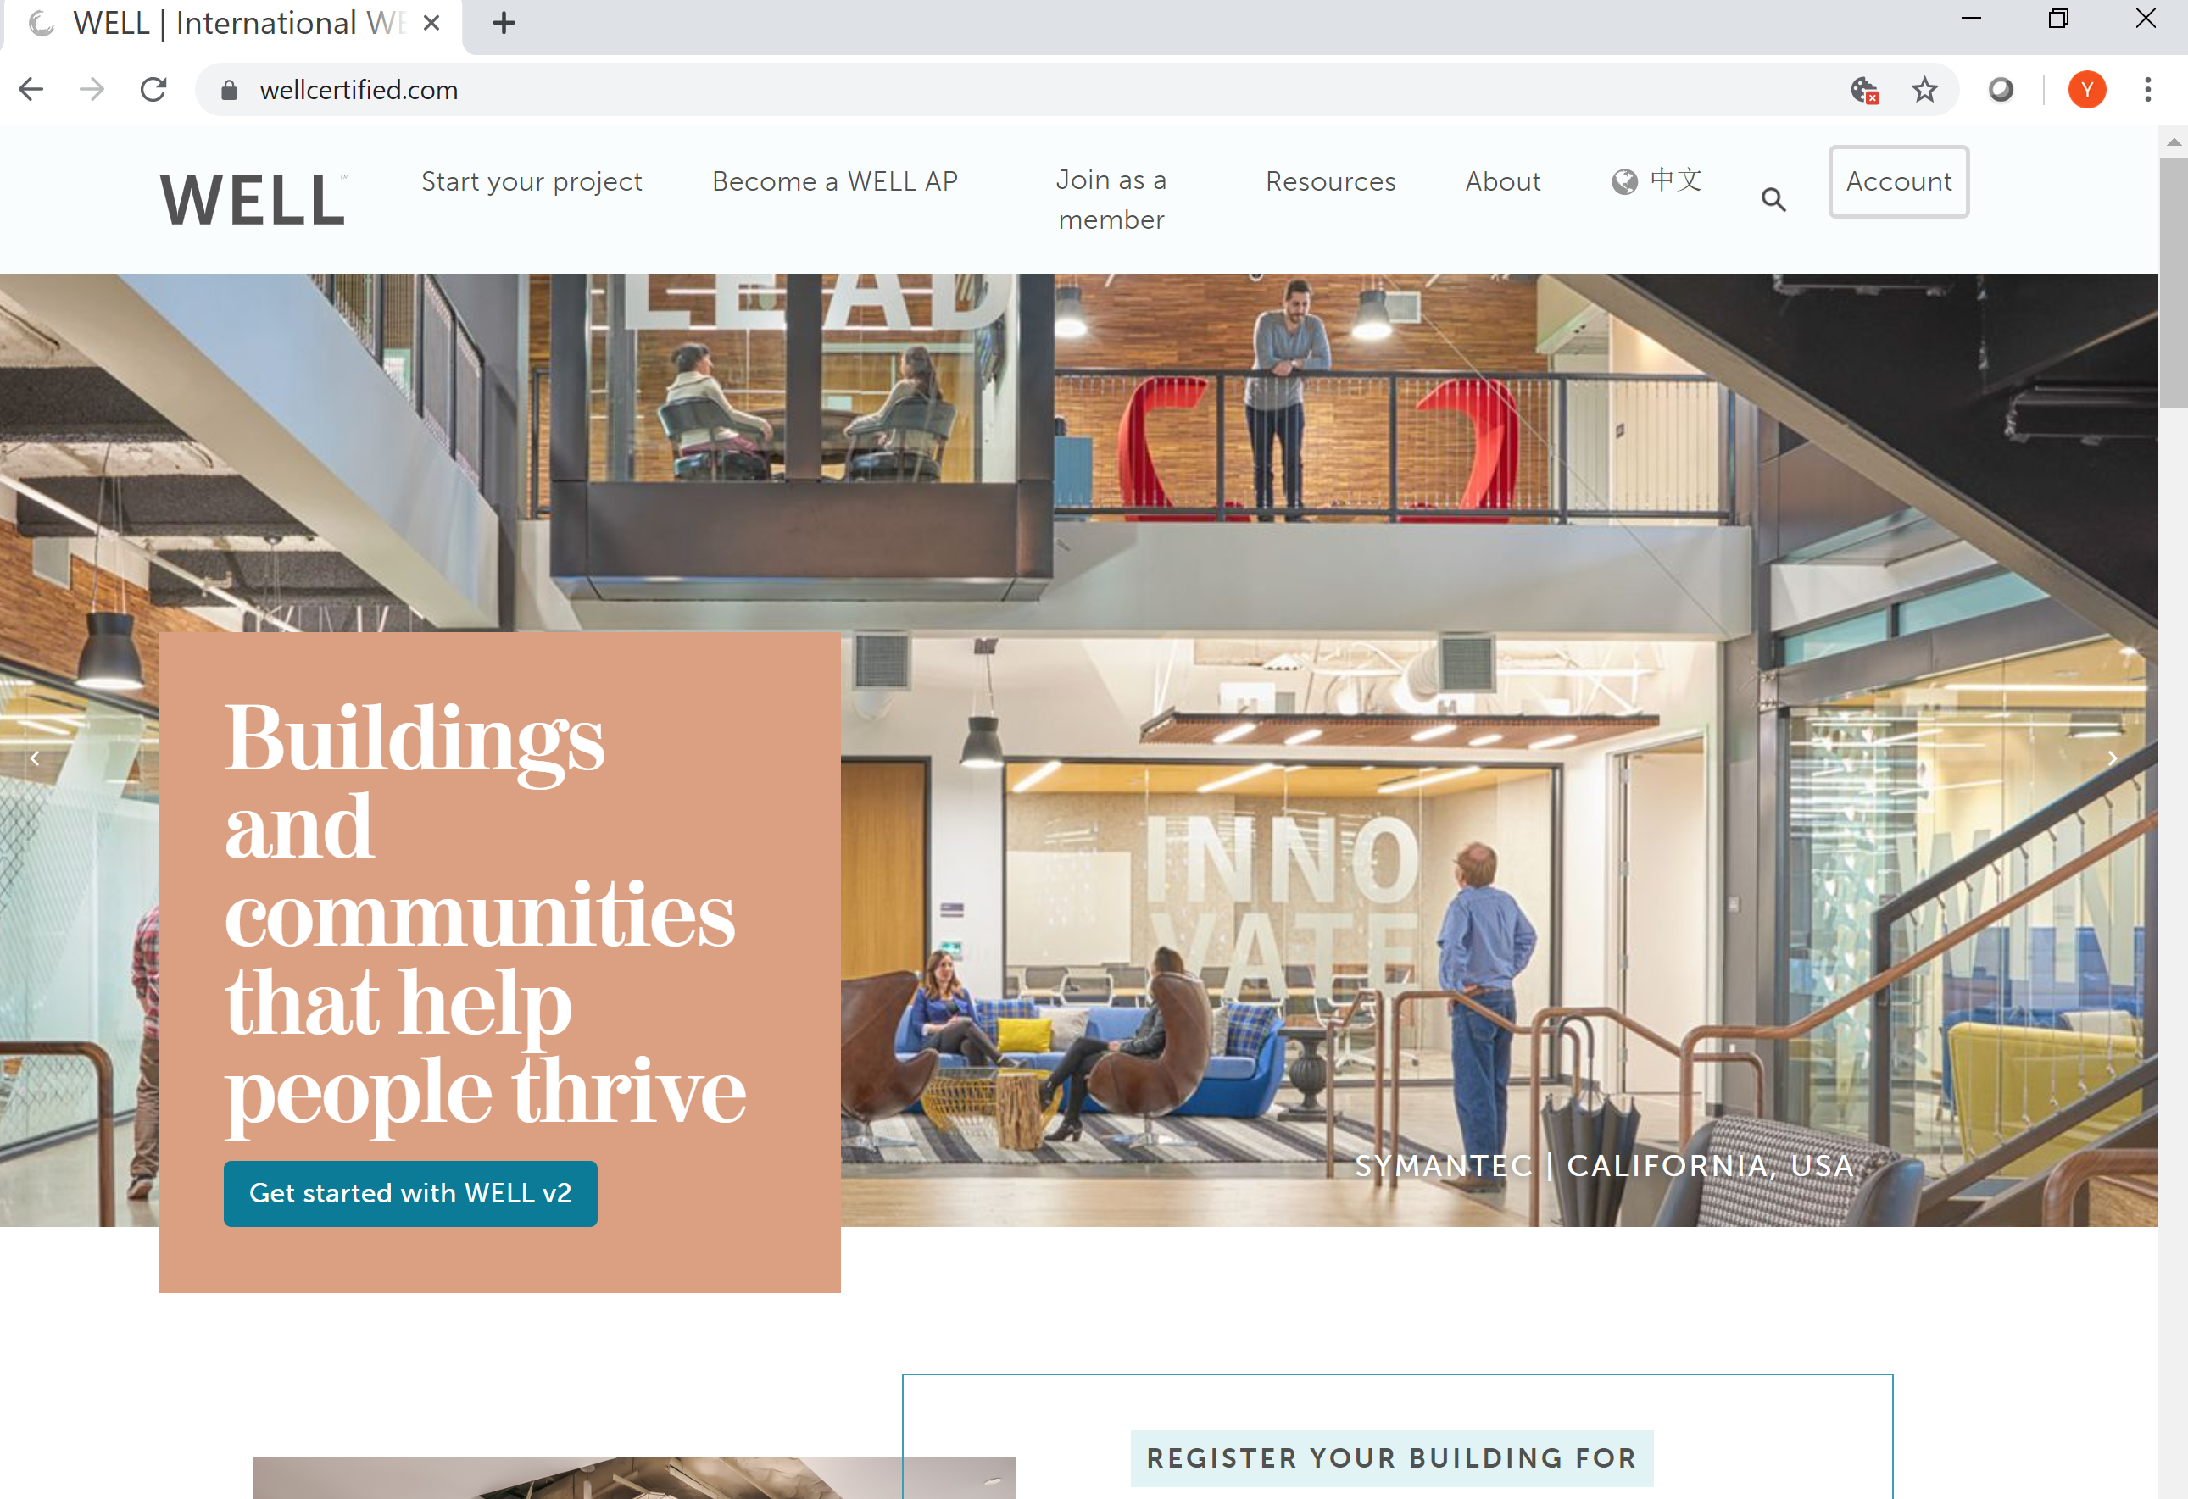
WELL Building Standard
The first, systematic attempt to define criteria which measure, certify, and monitor built environment features that impact human health and wellness, through air, water, nourishment, light, fitness, comfort, sound and mind.
The research background for WELL standards has been derived primarily from medical research into individual health and wellness and their relations with the built environment.

Slide 13
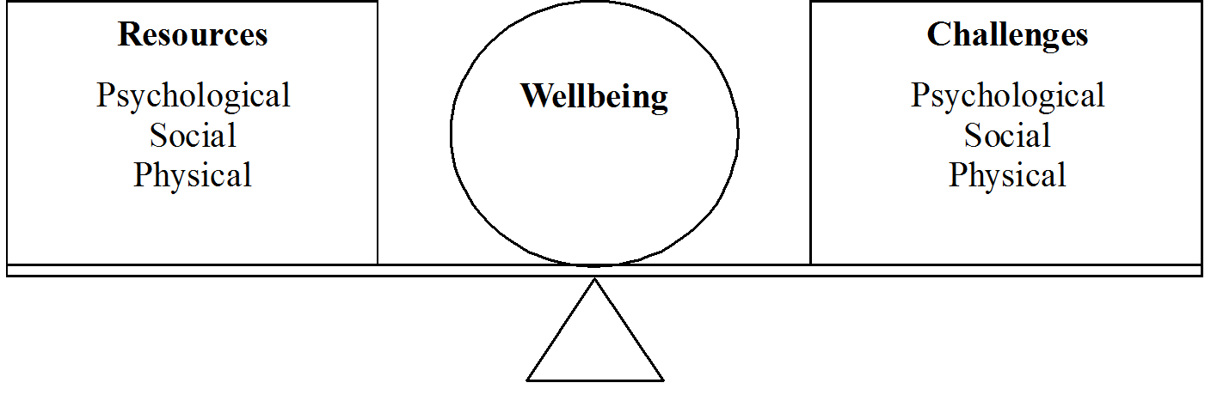
a simple, measureable definition of wellbeing
Stable well-being is when individuals have the psychological, social and physical resources they need to meet a particular psychological, social and/or physical challenge.
When individuals have more challenges than resources, the see-saw dips, along with their wellbeing, and vice-versa
R. Dodge, A. Daly, J. Huyton, and L. Sanders, “The challenge of defining wellbeing,” Int. J. Wellbeing, vol. 2, no. 3, pp. 222–235, 2012.

Slide 14
Vision
A data infrastructure allows the development of a coherent data analytics methodology that is available for key stakeholders to link individual human well-being indicators and collectively, allows the scaling up to a community scale for social and economic decisions, no matter where the community is located [1]
[1] Y. Tao, Y. Zhu and U. Passe, “Modeling and data infrastructure for human-centric design and operation of sustainable, healthy buildings through a case study” submitted to special issue of Building and Environment, 2020.

Slide 15
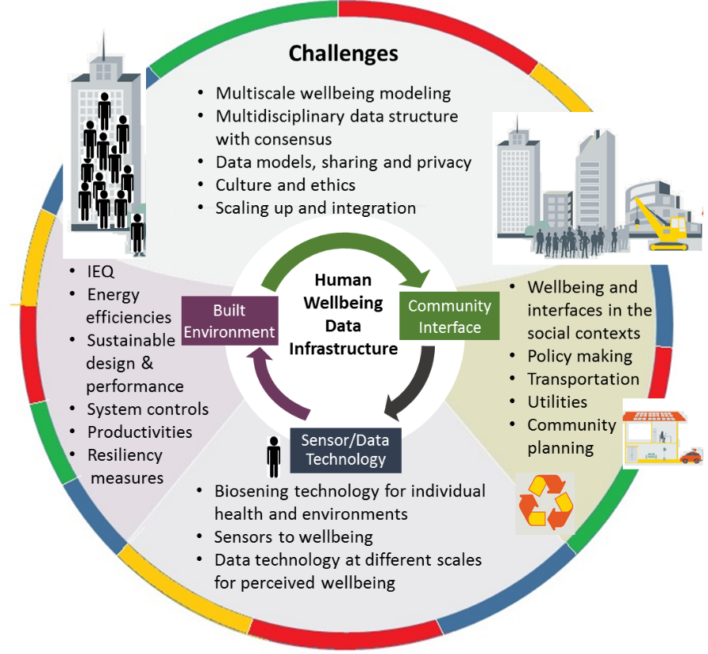
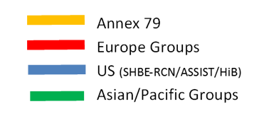
Three-scale, multi-disciplinary modeling of human wellbeing from sensors to policy making with the focus on sustainable built environment
Data Infrastructure for Wellbeing-Centric Sustainable Built Environment Ecosystems
- A International Network Vision

Slide 16
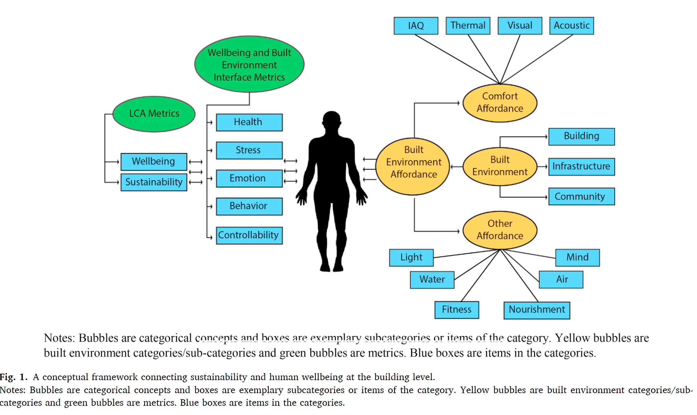
A conceptual framework connecting sustainability, wellbeing and human at the building level [1]
[1] Y. Tao, Y. Zhu and U. Passe, “Modeling and data infrastructure for human-centric design and operation of sustainable, healthy buildings through a case study” submitted to special issue of Building and Environment, 2020.

Slide 17
Outcomes of SHBE Activities
Framework for Research Questions
Human wellbeing-centric technology
City-scale research on sustainable human building ecosystems
Multi-scales analysis: building, neighborhoods, cities, metros and states
Efforts to influence individual behavior related to sustainability
Economic and social equity and the spatial benefits from sustainability technology
Disaster resilience and sustainability.

Slide 18
Outcomes of SHBE Activities – Cont’d
Outreach, information dissemination and communication
Shared vocabulary and translation of technical information
Repository of challenges and research questions, multi-scale, interactive reference data sets
Join symposia/special issue of interdisciplinary publication (journal)
Impact of RCN on public/research community
Trusted academic-industrial partnership.
Education and talent development
New ways to engage young researchers
Additional resource for multi-disciplinary studies.

Slide 19
Topics of Discussion for This Workshop (not limited to)
Measurements and validate human wellbeing and productivity indicators.
Data-driven, decision-making processes for sustainable and resilient building and community development that benefit to all people.
Validation and verification of comparative models that utilize data from affordable, reliable biosensing technology.

Slide 20
Acknowledgements
Steering committee and working groups and all the participants
The Grant supports from US NSF are greatly appreciated:
  Award 1338851 (RCN-SEES-SHBE): Predictive Modeling Network for Sustainable Human-Building Ecosystems
  Award 1640818: VIFI: Virtual Information-Fabric Infrastructure (VIFI) for Data-Driven Decisions from Distributed Data, PI: Dr. William Tolone

