Slide 1

US-UK Workshop On:
Biosensing-enabled, Wellbeing-centric Sustainable Built Environment Ecosystems
Nottingham, UK
BUILDING AUTONOMY:
RE-ENVISIONING BUILT ENVIRONMENTS
vision
Sez Atamturktur, October 27th, 2022
Pennsylvania State University
Department of Architectural Engineering
SEZ@PSU.EDU

Slide 2





Mechanical Engineering
Electrical Engineering
Mechanical Engineering
Electrical Engineering
Structural Engineering
Structural Engineering
Acoustics Engineering
Construction Engineering
Acoustics Engineering
Construction Engineering
Energy
Health
Advanced Materials
Sustainability & Resilience
Big Data & Cyber Infrastructure
We focus on the questions our graduates can solve rather than the solutions they can devise.
A completely different model for higher education;
Penn State
Arch Eng

Slide 3

The 5-year Engineering Degree
General Engineering
Yr. 1
Yr. 2
Basics of AE
Architecture
Yr. 3
Introduction to All Options
- Structural - Mechanical
- Construction - Lighting/Electrical
Yr. 4
Option Specific Focus
Architecture
Yr. 5
Option Specific Focus
Capstone

Slide 4

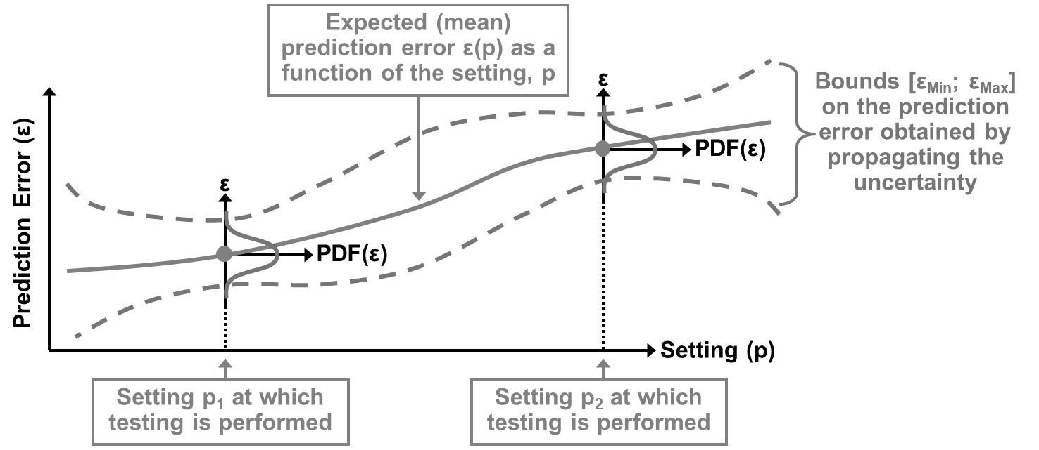
My preparation at-a-glance
Penn State University: PhD in Civil Engineering (CE)
Los Alamos National Laboratory: Scientific Modeling and Simulation (X Division) (ME, Aero, NE, Stat)
Clemson University: Civil Engineering, jointly appointed in Mechanical Engineering (CE, ME, IE, Env)
My scholarly work:
mitigate uncertainties and systemic errors in computer models of engineering systems

Slide 5
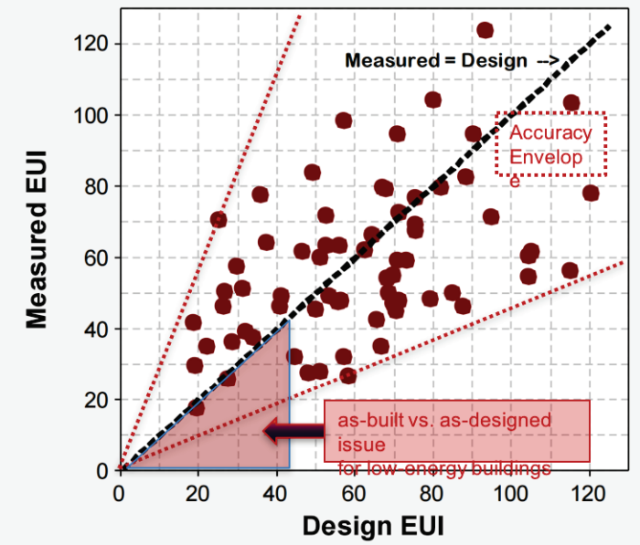
Design (Simulated) Vs.
Measured EUI for LEED Buildings
Building energy models are not sufficiently predictive!
Building energy models with high predictive capabilities are needed for advanced controls and energy management.
Available:http://www.usgbc.org/Docs/Archive/General/Docs3930.pdf

Slide 6
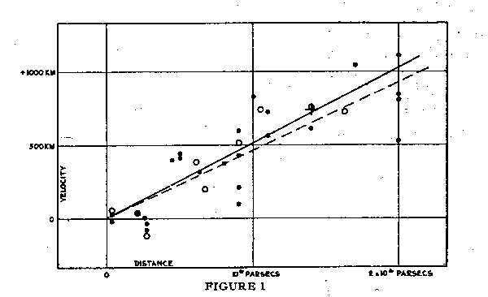
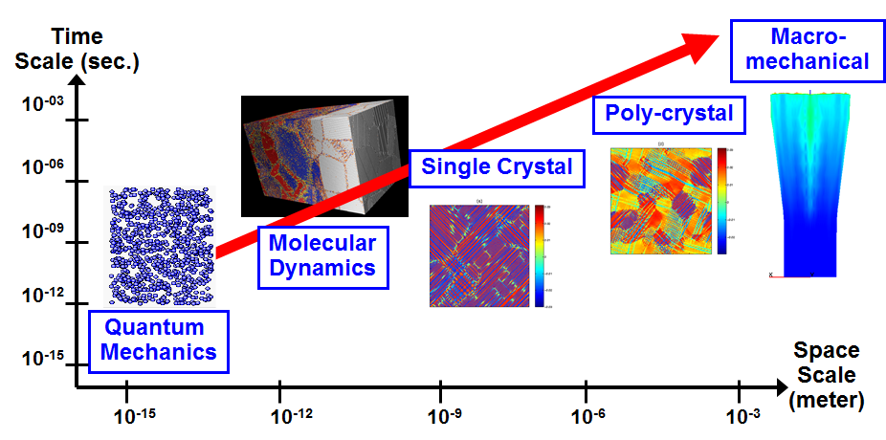
Paradigm shifts in scientific inquiries between experiment, theory and simulation…
Empirical paradigm: A large number of experiments are conducted to determine the behavior of a system, which is then represented with an empirically trained function to understand the experimentally observed behavior.
Simulation paradigm: A small number of experiments are conducted to calibrate simulation models built with first-principle physics and validate their predictions. Simulations are then used to predict with quantifiable confidence across the application domain.
The purpose of models is to reduce the dependency on experiments.

Slide 7
Paradigm shifts in scientific inquiries between experiment, theory and simulation…
Convergent paradigm: Observations are leveraged to identify the unforeseen or insufficiently understood relationships between input parameters and state variables - marrying the mechanistic approach of improving models’ predictive capability using first-principle physics and the empirical approach of training statistical emulators to explain the discrepancies between model simulations and observations.
Big data revolution: simulation models are augmented by data-driven representations of ‘unknown principles.’

Slide 8
A popular approach to determining the imperfect, biased nature of a numerical model , known as Kennedy and O’Hagan (2001) (KOH) model.
y(x^{i}) = ζ (x^{i}) + ε(x^{i})
The input x corresponds to known state conditions in the physical system called control inputs.
The calibration parameters are the model parameters that are not known with certainty and are represented by t.
Denote true physical system as ξ(x), then the model bias is defined as δ(x) = ξ(x) - η(x,θ), where θ is the best input to the computer code to make it agree with reality as close as possible.
ζ(x^{i}) = ƞ(x^{i}, t) + ψ (x^{i})
y(x^{i}) = ƞ(x^{i}, θ) + δ(x^{i}) + ε(x^{i})

Slide 9
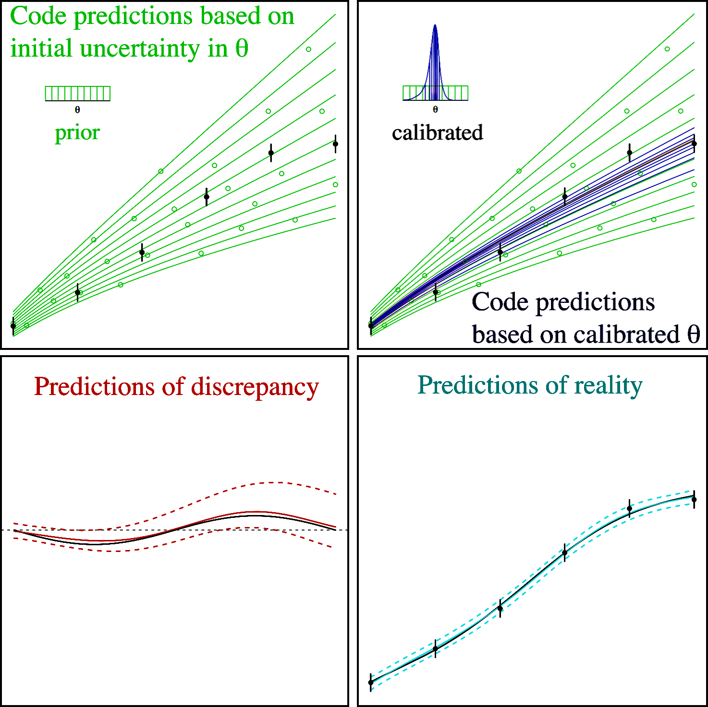
KOH-style calibration methods proposed in the literature assume that the calibrated parameter values are fixed throughout the input domain.
GP model emulator for model predictions:
GP model emulator for discrepancy predictions:
λ and ρ represent GPM hyper-parameters
Posterior distributions are conditioned on experimental data (D represents vector of model outputs and experimental data):
Bayesian treatment of the problem permits putting prior distribution on $θ$ to constrain it to elicited, plausible values. A Gaussian process prior is typically used to model the bias function.

Slide 10
In certain applications, however, the calibration parameters vary over the input domain so that θ≡θ(x) is not constant but a function over x.
x_{c}
θ_{c}
Computer Model
ƞ
θ_{f}
x_{c}
θ_{c}
Computer Model
ƞ
Unmodeled relationship
θ_{f}(x_{f})
x_{f}
Two sets of physical input parameters:
constant parameters, θ_{c}
functional parameters, θ_{f} (reliant upon operational conditions)
Two types of operational parameters:
independent operational parameters, x_{c}
dependent operational parameters, x_{f} (control underlying relationships)
Failing to account for functional dependence of the parameters can be viewed as a form of model misspecification, leading to model bias that can be absorbed by δ(x).
Notes:
Mapping slide for the presentation (note that a background slide or a slide justifying the importance might precede this slide). A common mistake with mapping slides is to give the audience simply a boring and unmemorable vertical list of topics (including the names “Introduction” and “Conclusion” and “Questions”). Such a list is quickly forgotten after the slide is removed.
On a mapping slide, take the opportunity to show a key image or perhaps a representative image for each major section of the presentation. In the second case, each image would be repeated on the first visual of the corresponding section and would remind the audience that they have arrived to a major section of the presentation’s middle.
In regards to the names “Introduction” and “Conclusion,” every talk has those sections, and the names are ignored by audiences. So why state them? Also, for the divisions that you do have, find a logical and parallel grouping. Note that groups of two’s, three’s, and four’s are much easier to remember and are not so nearly intimidating as groups of five’s, six’s, and seven’s. See the example mapping slide in the textbook. (CSP, pages 55-56, 74-75, 86, 143, 147, and 148)

Slide 11
In certain applications, however, the calibration parameters vary over the input domain so that θ≡θ(x) is not constant but a function over x.
Constituent Inference Approach
For state-aware problems, θ(x) can, for example, represent one or more sub-systems in a multi-physics system.
State-aware calibration then amounts to estimating unknown and unobservable constituent models, thereby allowing a practitioner to learn about the underlying physics so that they can be more adequately modeled.
y(x^{i}) = ƞ(x^{i}, θ(x^{i})) + δ(x^{i}) + ε(x^{i})
Traditional Approach
y(x^{i}) = ƞ(x^{i}, θ) + δ(x^{i}) + ε(x^{i})
Brown A. and Atamturktur S. (2018), “Nonparametric Functional Calibration of Computer Models,” Statistica Sinica (Institute of Statistical Science), Vol. 28, No. 2, pp. 721-742.
Notes:
ADD full references on this slide

Slide 12
In certain applications, however, the calibration parameters vary over the input domain so that θ≡θ(x) is not constant but a function over x.
One at a time sampling of:
θ_{c}
GP hyperparameters
Repeated Metropolis substeps for θ_{f} (x_{f})
Evaluate Model
Acceptance criteria met?
Evaluate θ_{f} GP
Evaluate Model
Acceptance criteria met?
no
yes
θ_{c2}
Randomly
Reject
ρ
no
yes
θ_{c1}
Accept
λ
θ_{f}
Randomly
Reject
Accept
x_{f}
Posterior Distributions
Define prior distributions
λ_{θf}
ρ_{θf}
θ_{c}
Termination criteria met?
θ_{f}
no
λ_{θf}
ρ_{θf}
θ_{c}
θ_{f} (x_{f1})
θ_{f} (x_{f2})
θ_{f} (x_{fn})
x_{f}
yes
θ_{f} (x_{f1})
θ_{f} (x_{f2})
θ_{f} (x_{fn})
Start
End
Bayesian modeling can mitigate the problem of identifiability through informative prior distributions, imposed constraints, such as monotonicity and dimensionality reduction approaches.
Notes:
Point out that evaluating theta_f and theta_c requires model evaluations and that evaluating GP hyperparameters requires GP evaluation (therefore cov inversion). This point will be important for slides 44 and 45

Slide 13
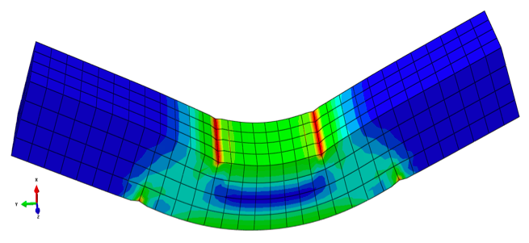
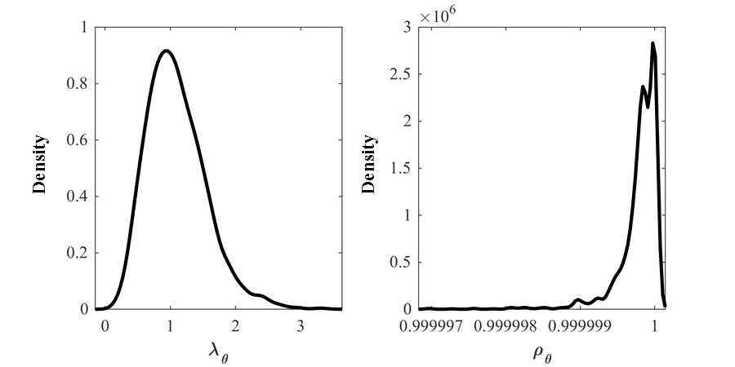
Empirically derived thermal relationship is integrated into the VPSC model to consider the operational temperature.
Uncertain Hardening Parameters
Calibrated VPSC model predictions for varying temperature levels
GP Hyperparameters
Reference: Stevens G.*and Atamturktur S., (2017), "Mitigating Error and Uncertainty in Partitioned Analysis: A Review of Verification, Calibration and Validation Methods for Coupled Simulations," Archives of Computational Methods in Engineering, Vol. 24, No. 3, pp. 557-571.

Slide 14
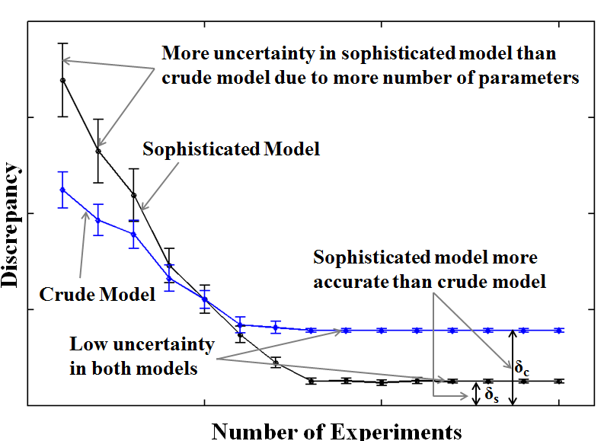
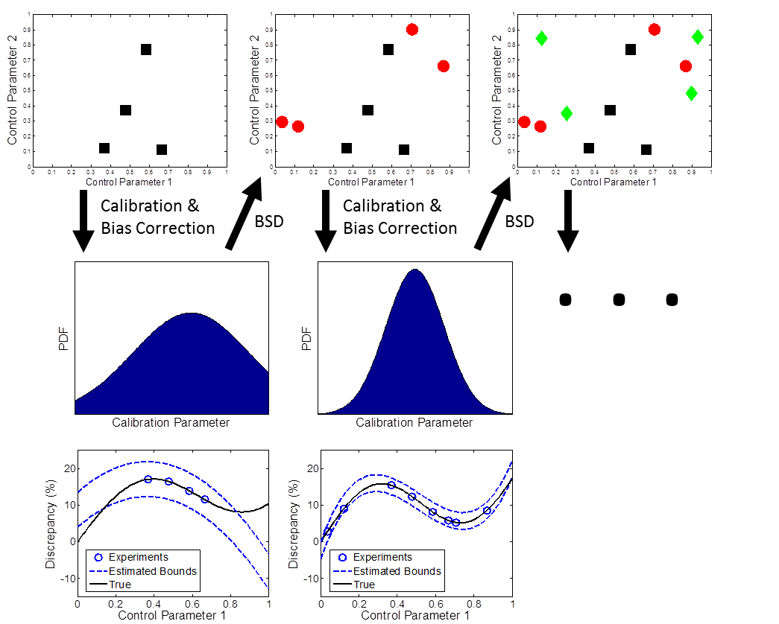
Batch Sequential Design (BSD) searches for new experimental settings that optimize a design criterion.
BSD uses an iterative process, the modified Fedorov exchange algorithm, to select optimal settings that maximizes improvement in the design criterion until experimental resources are exhausted.
Atamturktur S., Williams, B., Egeberg, M., and Unal, C., (2013), “Batch Sequential Design of Optimal Experiments for Improved Predictive Maturity in Physics-Based Modeling,” Structural and Multidisciplinary Optimization; Atamturktur S., Hegenderfer J., Williams B., and Egeberg, M. (2014), “A Selection Criterion Based on Exploration-Exploitation Approach for Batch Sequential Design,” Journal of Engineering Mechanics; Williams B.J., Loeppky J.K., Moore L.M., Macklem, M.S. Batch sequential design to achieve predictive maturity with calibrated computer models. Reliability Engineering and System Safety, 2011; 96 (9): 1208-19.

Slide 15
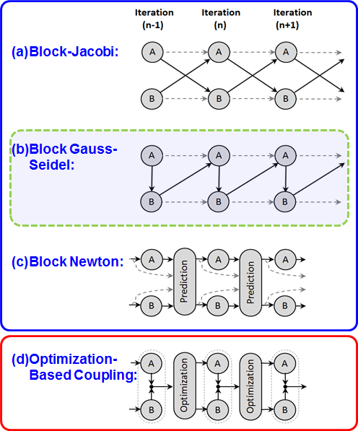
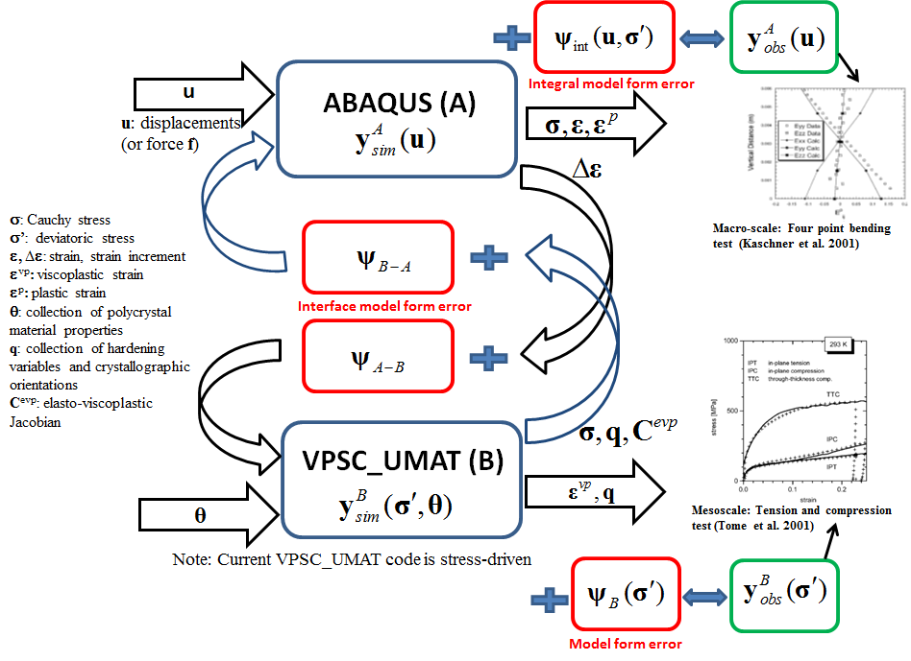
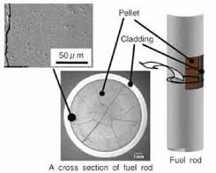
The interface also introduces uncertainties and biases due to the unavoidably incomplete nature of coupling.
Before parameter calibration
After parameter calibration
Stevens G. and Atamturktur S., (2017), "Mitigating Error and Uncertainty in Partitioned Analysis: A Review of Verification, Calibration and Validation Methods for Coupled Simulations," Archives of Computational Methods in Engineering, Vol. 24, No. 3, pp. 557-571.
Notes:
Mapping slide for the presentation (note that a background slide or a slide justifying the importance might precede this slide). A common mistake with mapping slides is to give the audience simply a boring and unmemorable vertical list of topics (including the names “Introduction” and “Conclusion” and “Questions”). Such a list is quickly forgotten after the slide is removed.
On a mapping slide, take the opportunity to show a key image or perhaps a representative image for each major section of the presentation. In the second case, each image would be repeated on the first visual of the corresponding section and would remind the audience that they have arrived to a major section of the presentation’s middle.
In regards to the names “Introduction” and “Conclusion,” every talk has those sections, and the names are ignored by audiences. So why state them? Also, for the divisions that you do have, find a logical and parallel grouping. Note that groups of two’s, three’s, and four’s are much easier to remember and are not so nearly intimidating as groups of five’s, six’s, and seven’s. See the example mapping slide in the textbook. (CSP, pages 55-56, 74-75, 86, 143, 147, and 148)

Slide 16

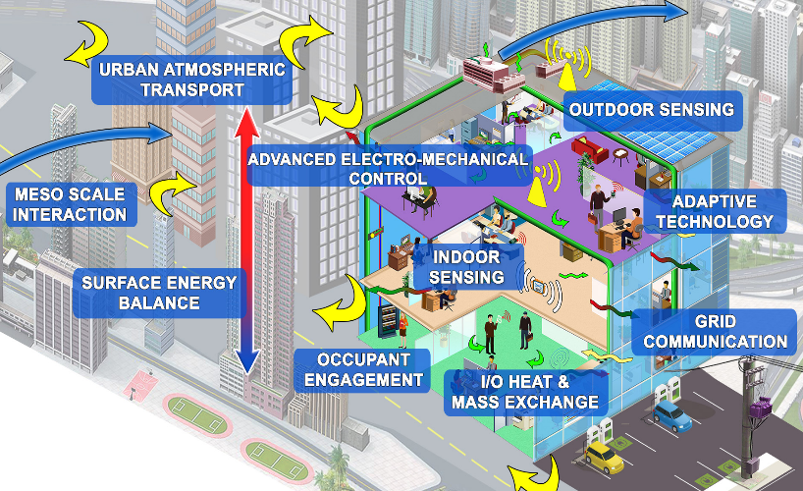
National Science Foundation
Engineering Research Center
Transform buildings into intelligent entities with situational and social awareness, autonomous responsiveness, and operational connectedness.

Slide 17
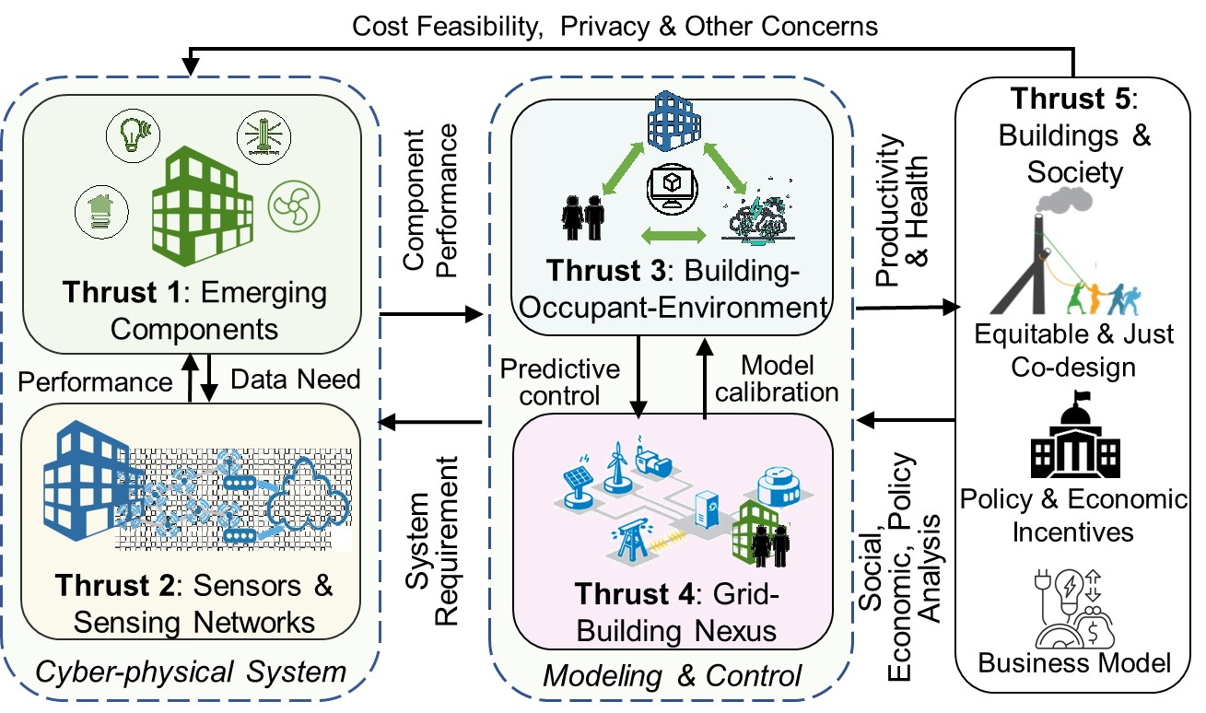

Slide 18

PENNSYLVANIA STATE
UNIVERSITY
COLLEGE OF ENGINEERING
New building planning, design and fundraising.
SEZ@PSU.EDU
partnerships

Slide 19

THANK YOU
SEZ@PSU.EDU
Sez Atamturktur, October 27th, 2022
Pennsylvania State University
Department of Architectural Engineering

