Slide 1






Distributed Data Visual Analytics Framework (for Wellbeing Centric Sustainable Built Environment Ecosystems)
Isaac Cho, Ph.D.
Assistant Professor, Computer Science Department
Utah State University
isaac.cho@usu.edu

Slide 2
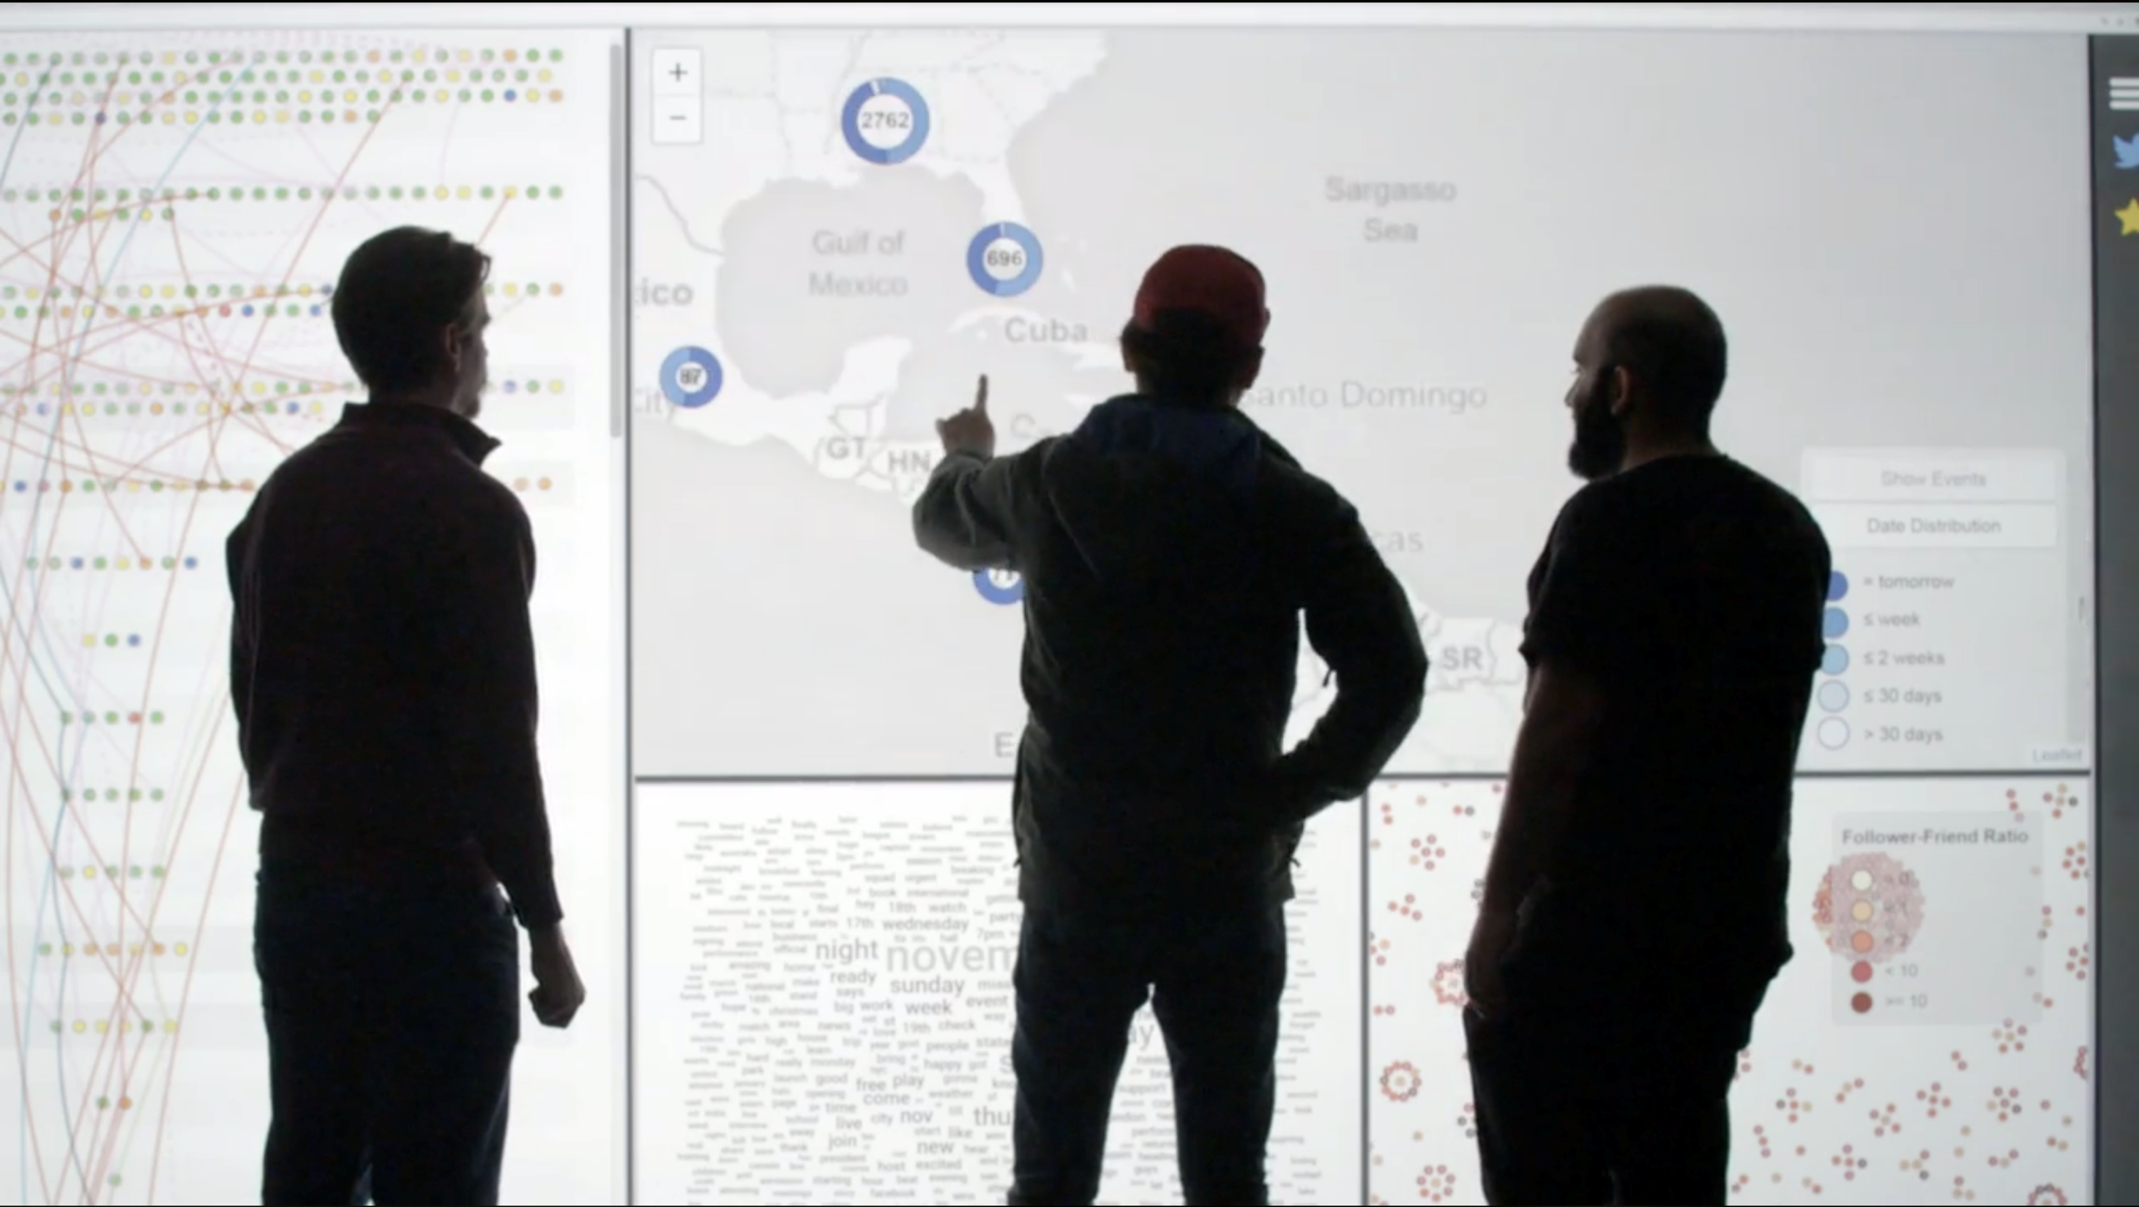
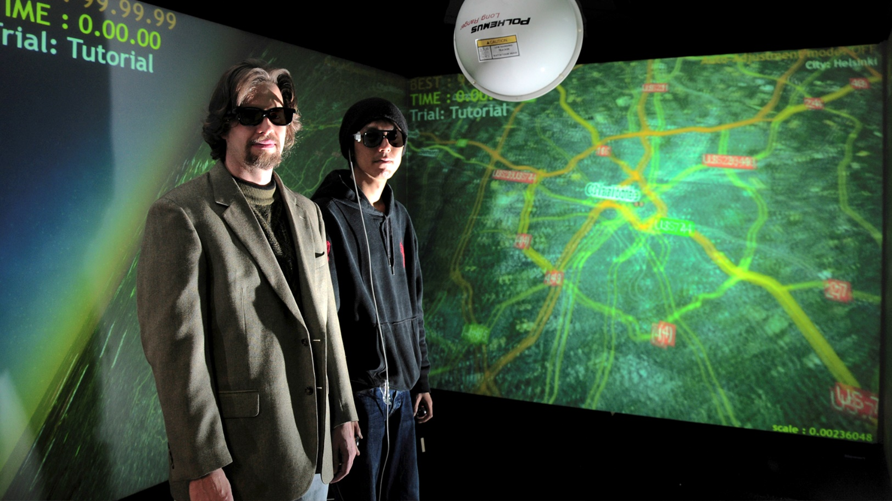
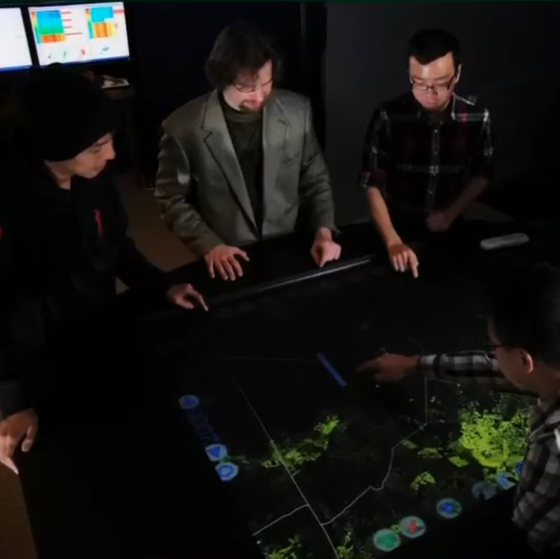
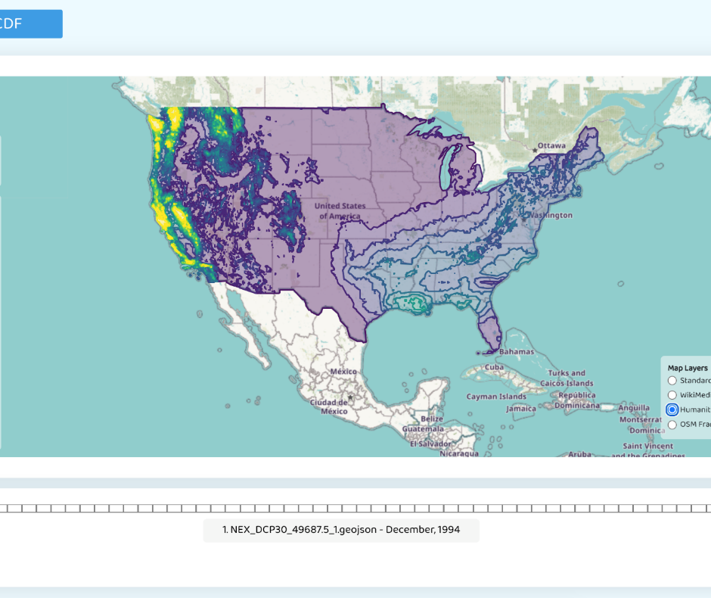
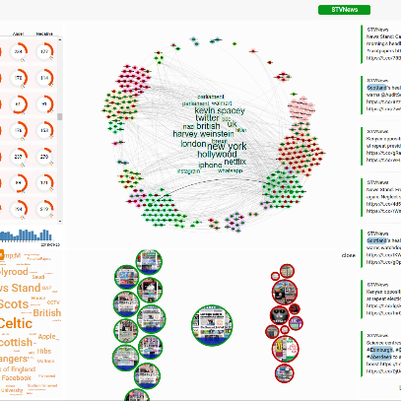
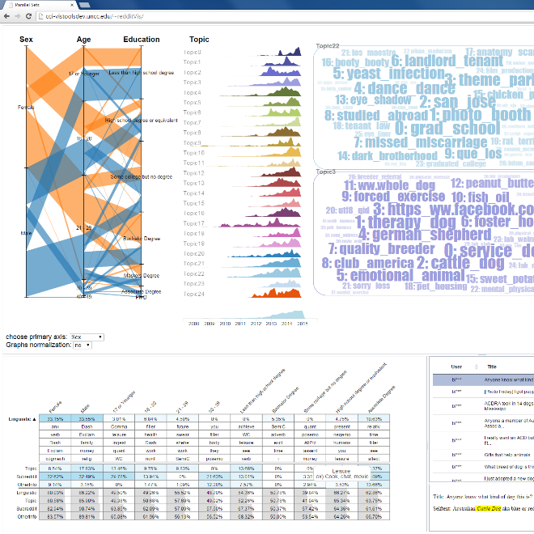
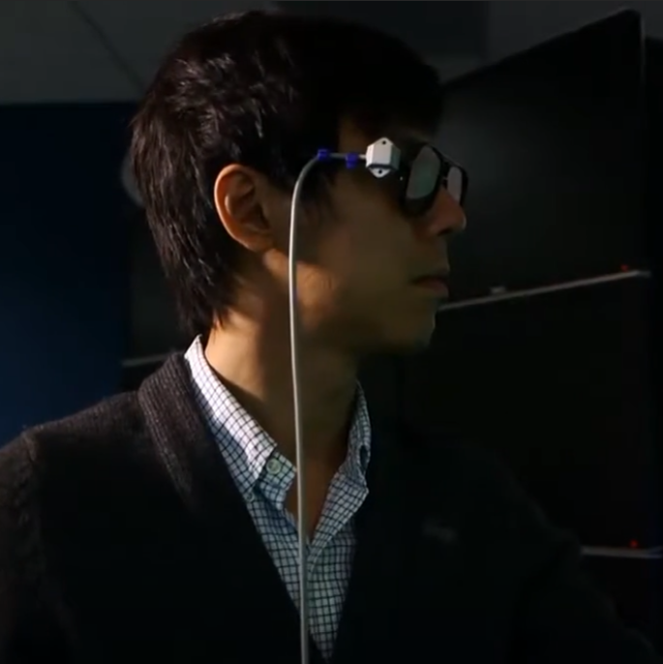
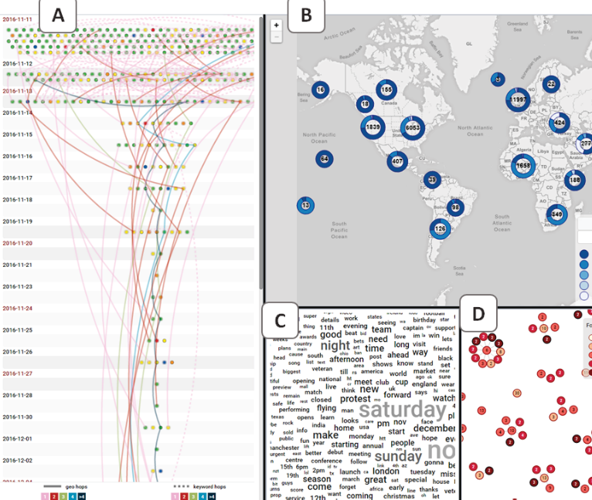
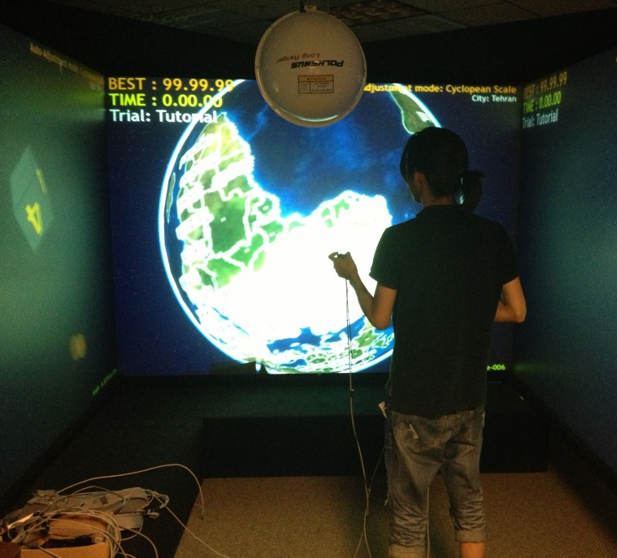

Slide 3
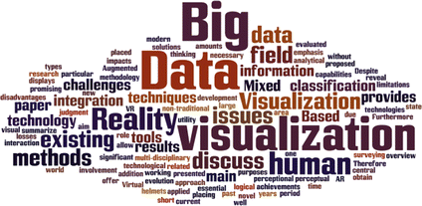
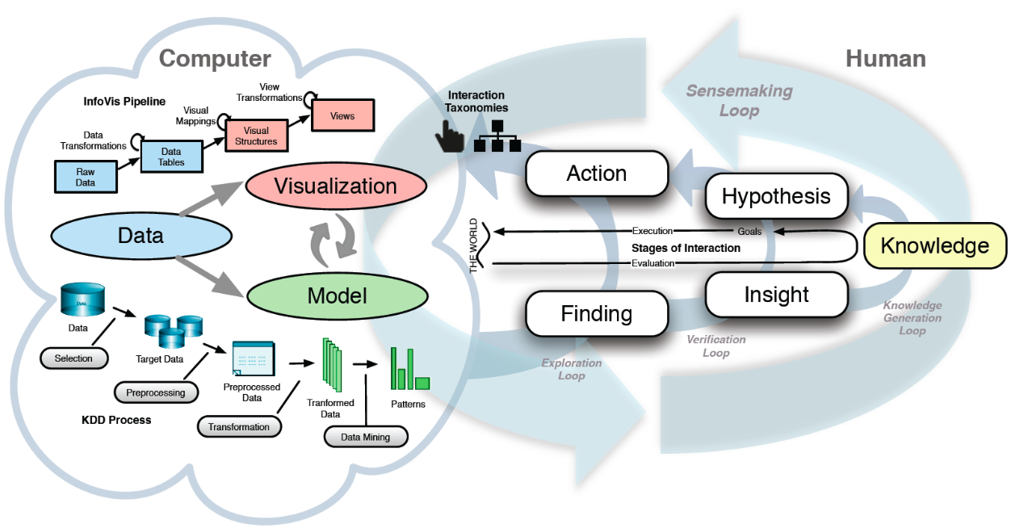
Interactive Visual Analytics
Visual Analytics
Interactive Visualization + Automated Data Analytics methods (ML, AI)
Human in the loop
Sacha et al. 2014

Slide 4
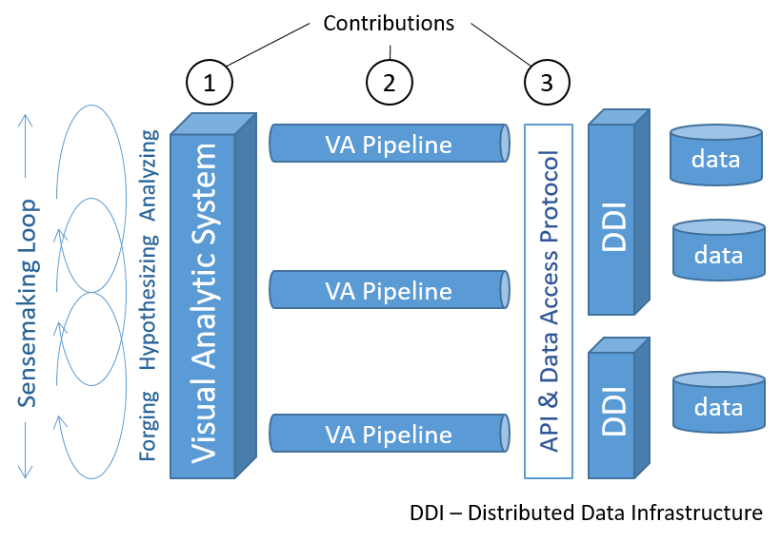
Visual Analytics Framework (VAF)
Provide access to distributed servers from the user interface.
Enable integration with infrastructures that enable analytics over distributed data.
Assist preparing the analytical scripts.
Explore resulting data.
Visual analytic system pipelines for distributed analysis systems.
AA-Nayeem et al. A Visual Analytics Framework for Distributed Data Analysis Systems. In2021 IEEE International Conference on Big Data (Big Data) 2021 Dec 1 (pp. 229-240). IEEE Computer Society.

Slide 5
Virtual Information Fabric Infrastructure (VIFI)
CIF21 DIBBS: EI: VIFI: Virtual Information-Fabric Infrastructure (VIFI) for Data-Driven Decisions from Distributed Data (PI: William J. Tolone)

Slide 6
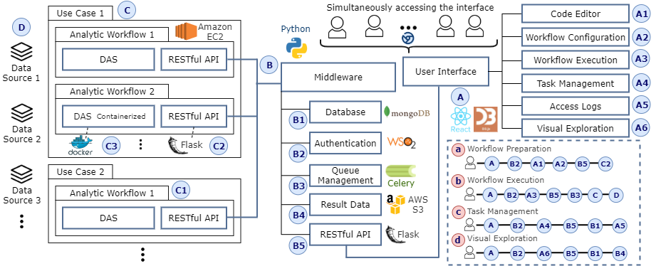
VAF Pipeline
Proposed VAF pipeline for DAS

Slide 7
VAF Pipeline: Data Source
Proposed VAF pipeline for DAS

Slide 8
VAF Pipeline: Distributed Analysis System
Proposed VAF pipeline for DAS

Slide 9
System Pipeline: Middleware
Proposed VAF pipeline for DAS.

Slide 10
VAF Pipeline: Visual Analytics Interface
Proposed VAF pipeline for DAS.

Slide 11
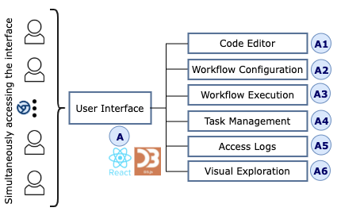
User Interface
Workflow Management
Task Management
Visual Analytics module
Interactive visualizations
Components in the visual analytics interface for DAS.

Slide 12
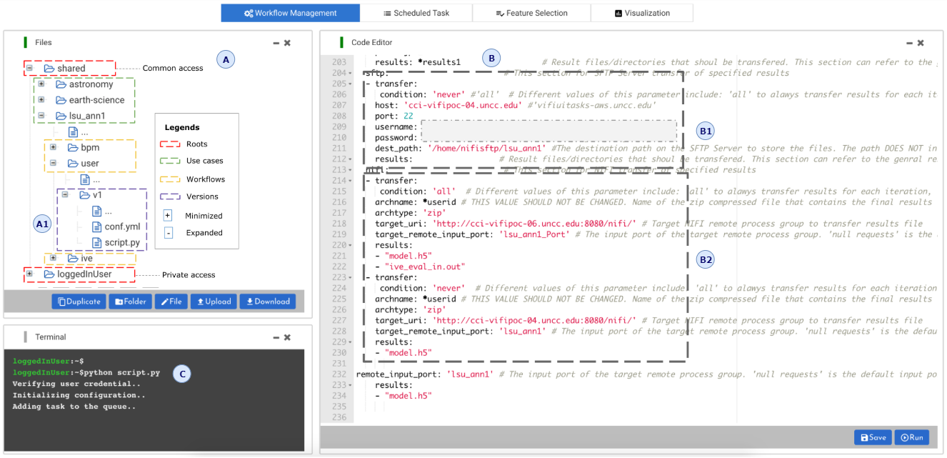
VAF: Workflow Management
Code Editor
File Browser
Terminal View
Manages configuration
Executes workflows
Analytic workflow management through our visual analytics interface.

Slide 13
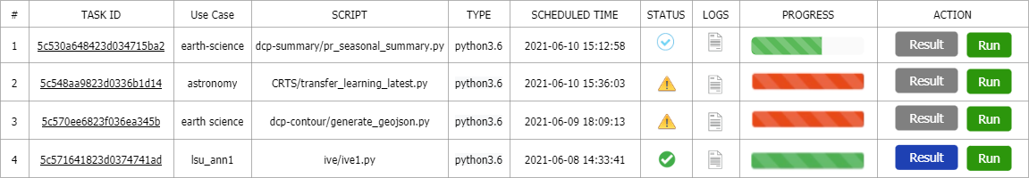
VAF: Task Management
Unique task ID for each executed scheduled workflows.
Provides indication for the task progression.
Each task linked to the runtime logs, script directory, and results, etc
Task management interface allows the user to interact with the scheduled tasks for inspecting logs, tracking progress, visual exploration of the results or re-running the workflow.

Slide 14
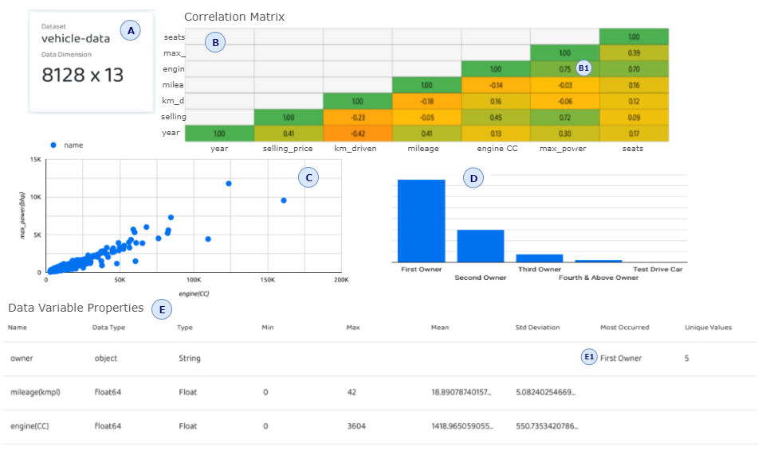
User Interface

Slide 15
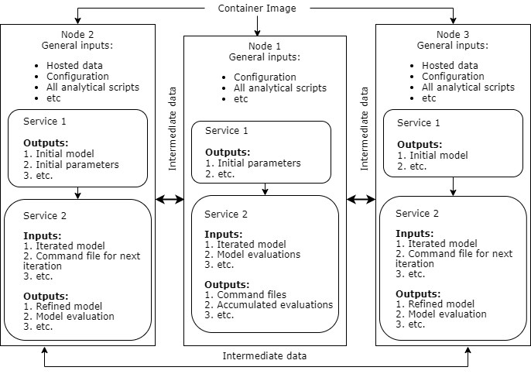
SHBE Use Case
Workflows for light switching on-off probabilities for the work area illuminance in a smart building.
It illustrates a more complex workflow design in the proposed VAF.
It involves analysis over three distributed data sites for training and prediction.
Sequential workflow execution until satisfies the stopping condition.
Workflow implementation for SHBE light switch on-off probability in smart buildings.

Slide 16
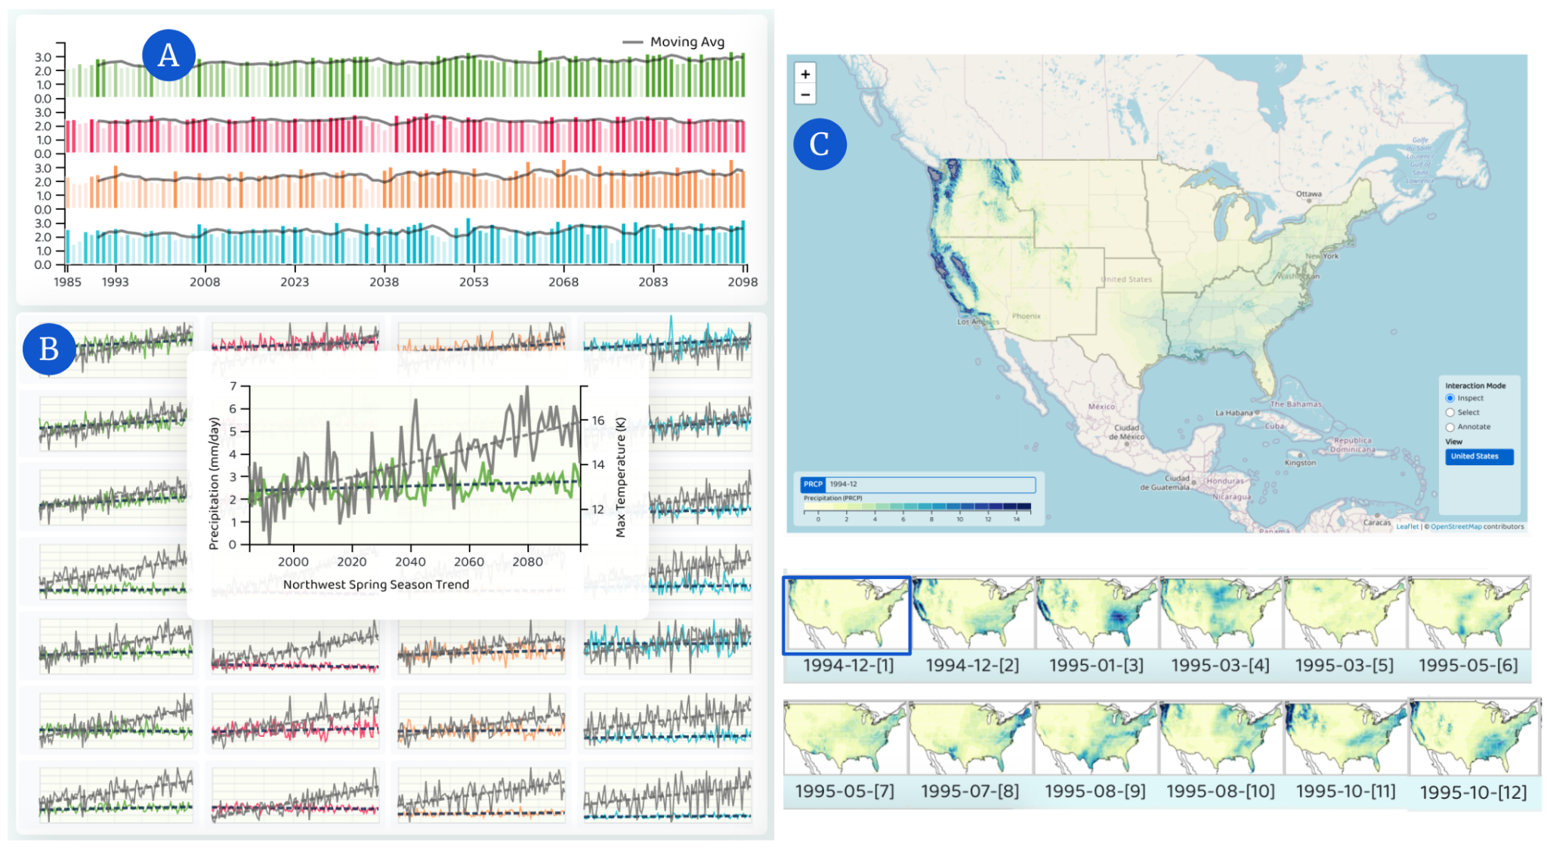
Visual Analytics User Interface
Visual Analytics for Climate Change
A-A-R Nayeem, H. Lee, D. Han, M. Elshambakey, W. Tolone, T. Dobbs, D. Crichton, and I. Cho. DCPViz: A Visual Analytics Approach for
Downscaled Climate Projections. In 2022 IEEE Conference on Big Data (to appear). IEEE.

Slide 17
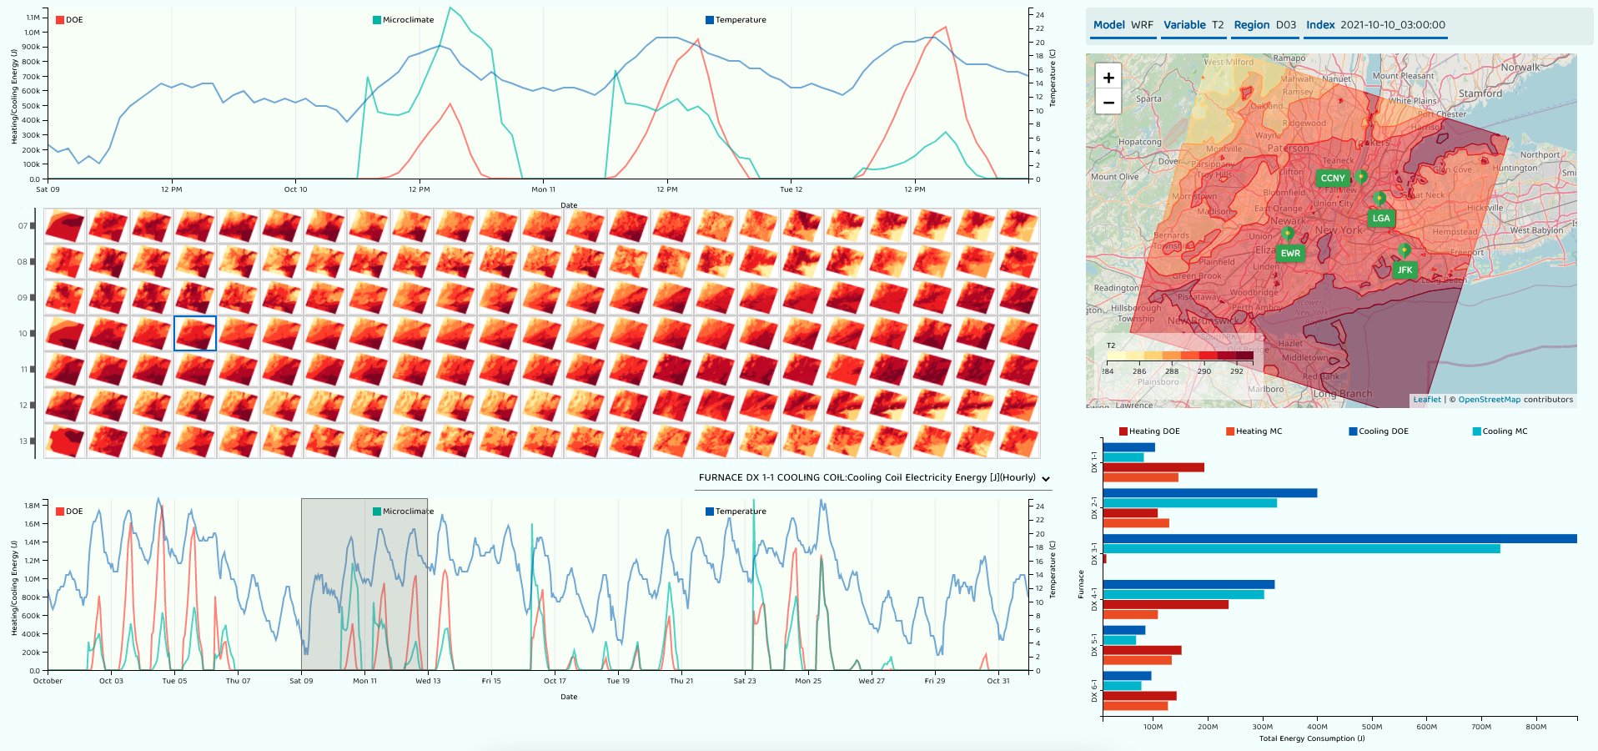
Visual Analytics User Interface

Slide 18
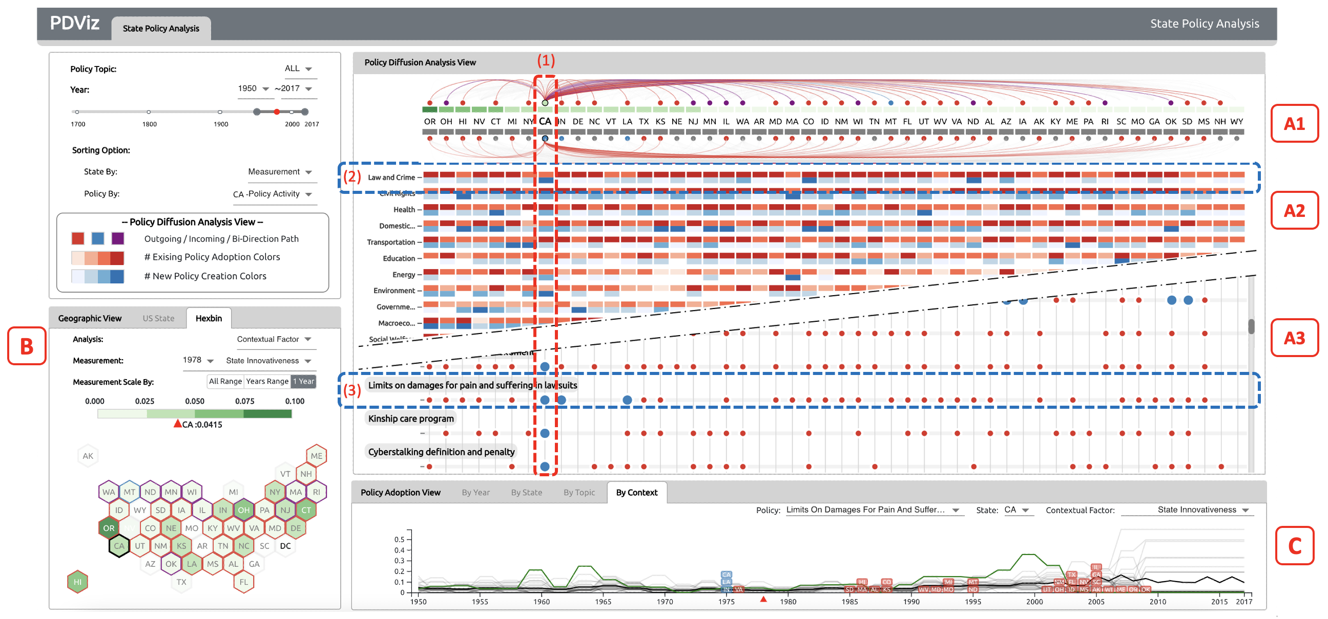
Visual Analytics for State Policies
https://vizus.cs.usu.edu/app/pdviz/
D. Han, A-A-R Nayeem, J. Windett, and I. Cho. PDViz: a Visual Analytics Approach for State Policy Diffusion. Eurographics Computer Graphics Forum (to appear)

Slide 19
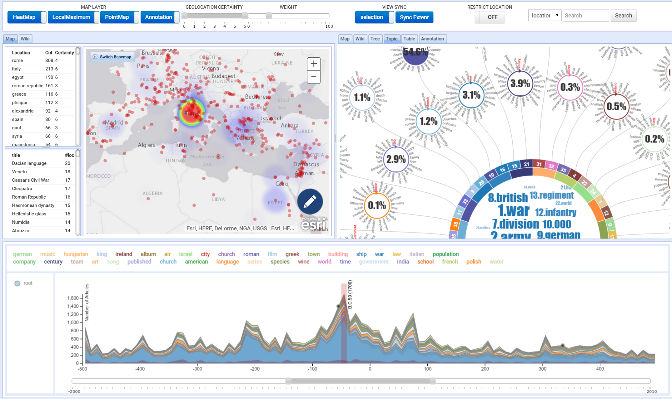
Event Detection from Unstructured Data
Cho, I., Dou, W., Wang, D.X., Sauda, E. and Ribarsky, W., 2016. “VAiRoma: A visual analytics system for making sense of places, times, and events in roman history”. IEEE transactions on visualization and computer graphics, 22(1), pp.210-219.

Slide 20

DemographicVis
Dou, W., Cho, I., ElTayeby, O., Choo, J., Wang, X., & Ribarsky, W. (2015, October). DemographicVis: Analyzing demographic information based on user generated content. In 2015 IEEE Conference on Visual Analytics Science and Technology (VAST) (pp. 57-64). IEEE.

Slide 21
Urban Space Explorer
Urban Space Explorer
http://urbanactivityexplorer.com/
Karduni, A., Cho, I., Wessel, G., Ribarsky, W., Sauda, E., & Dou, W. (2017). Urban Space Explorer: A Visual Analytics System for Urban Planning. IEEE computer graphics and applications, 37(5), 50-60.

Slide 22
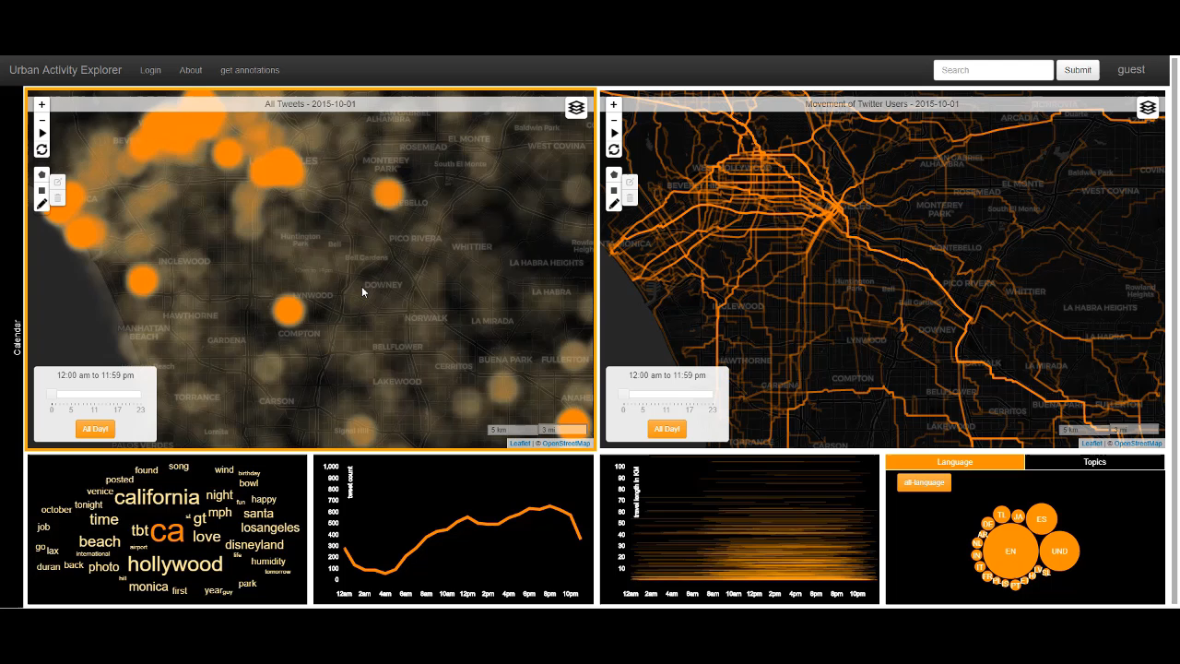

Slide 23
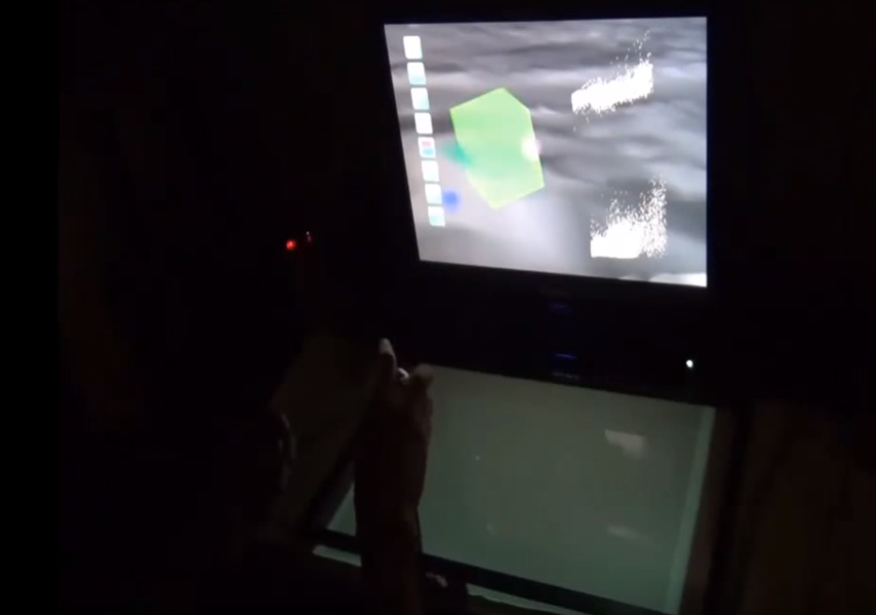
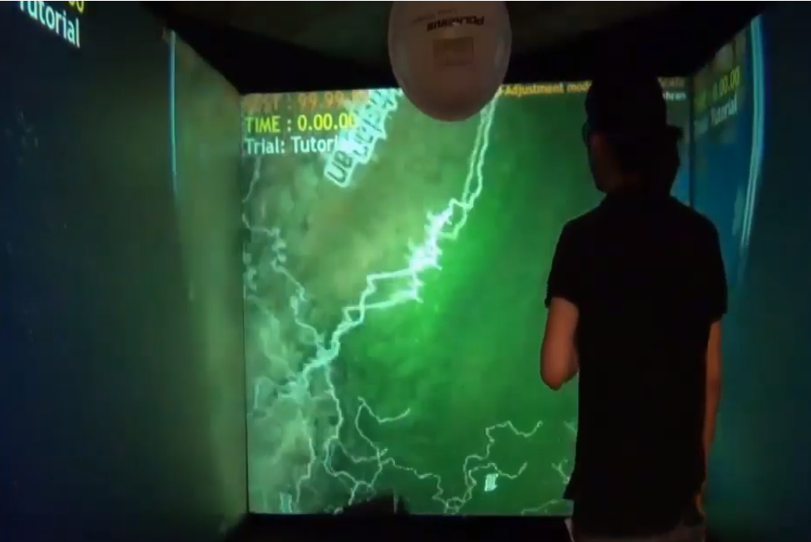
Immersive Visual Analytics
Notes:
Espcially dataset and tasks require spatial features.
Immersive technologies, stereoscopic and headtracking and 3d user interfaces

Slide 24
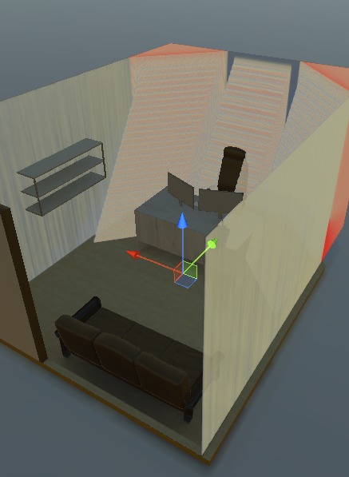
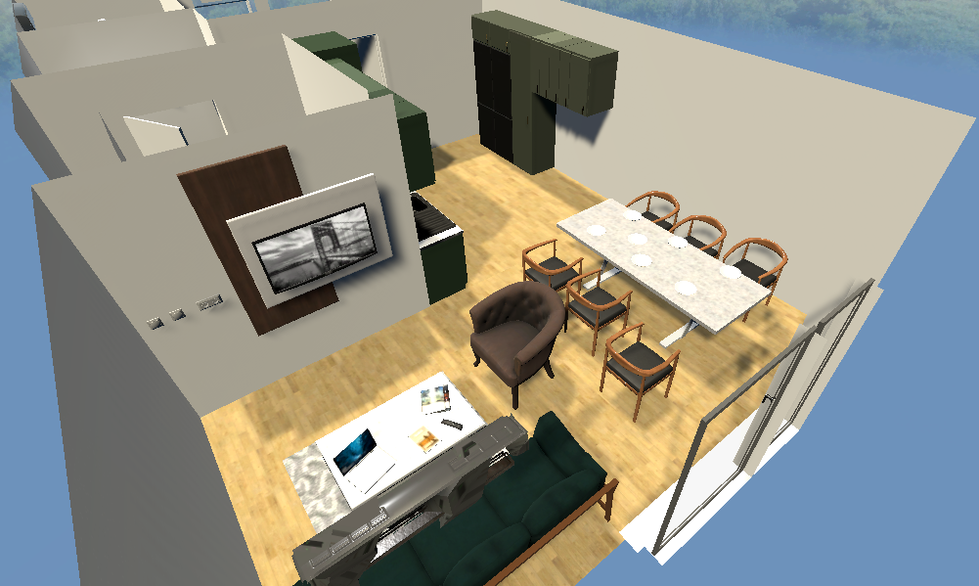
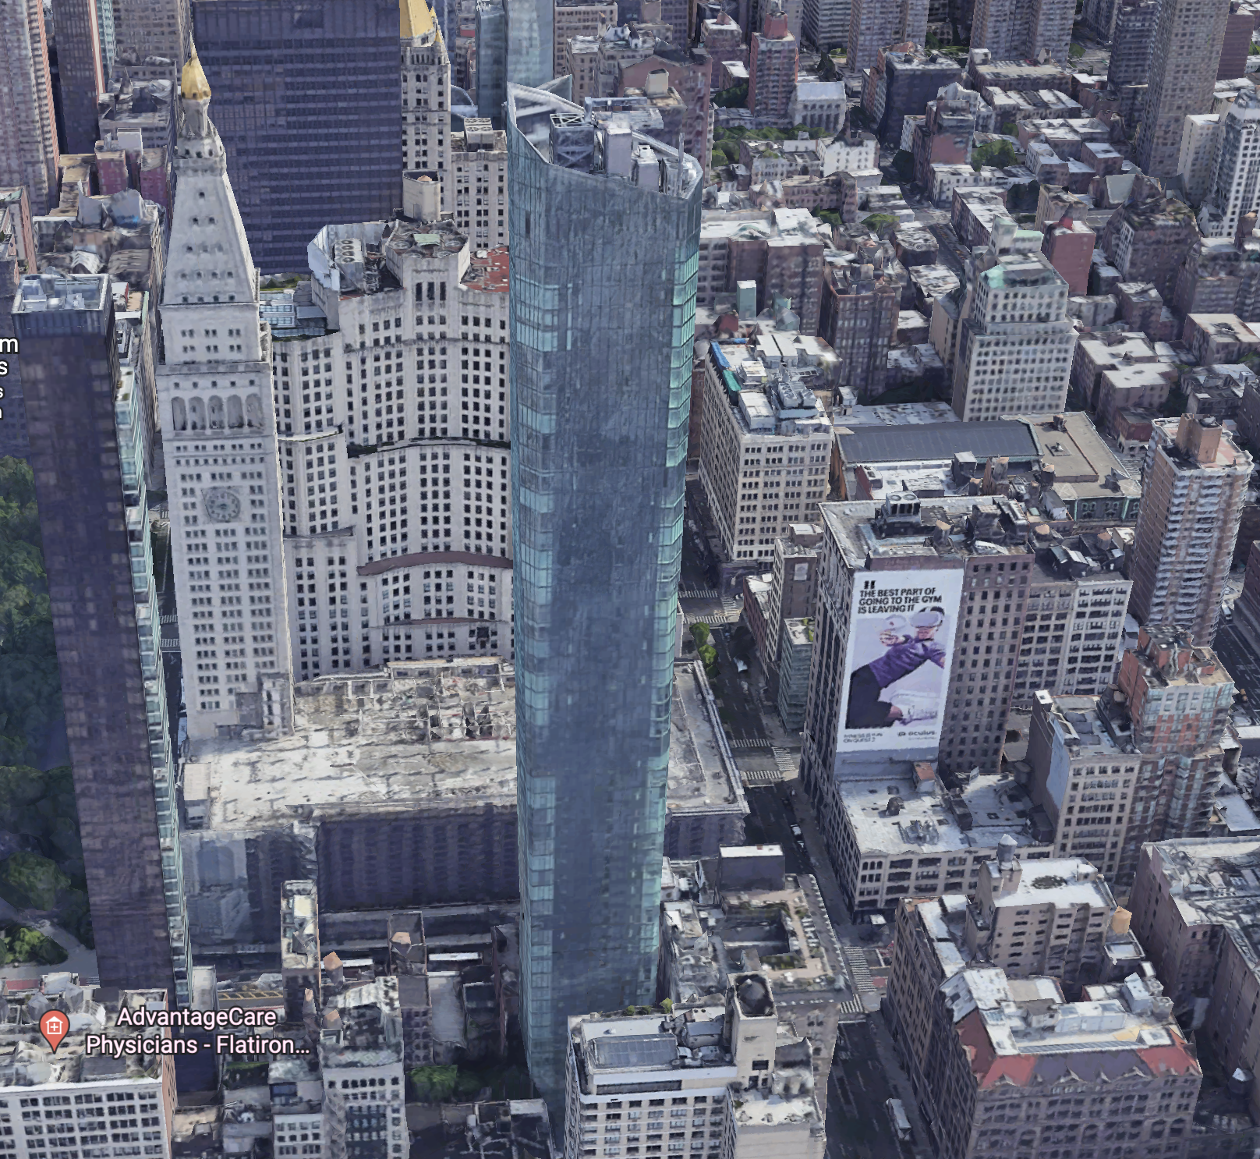
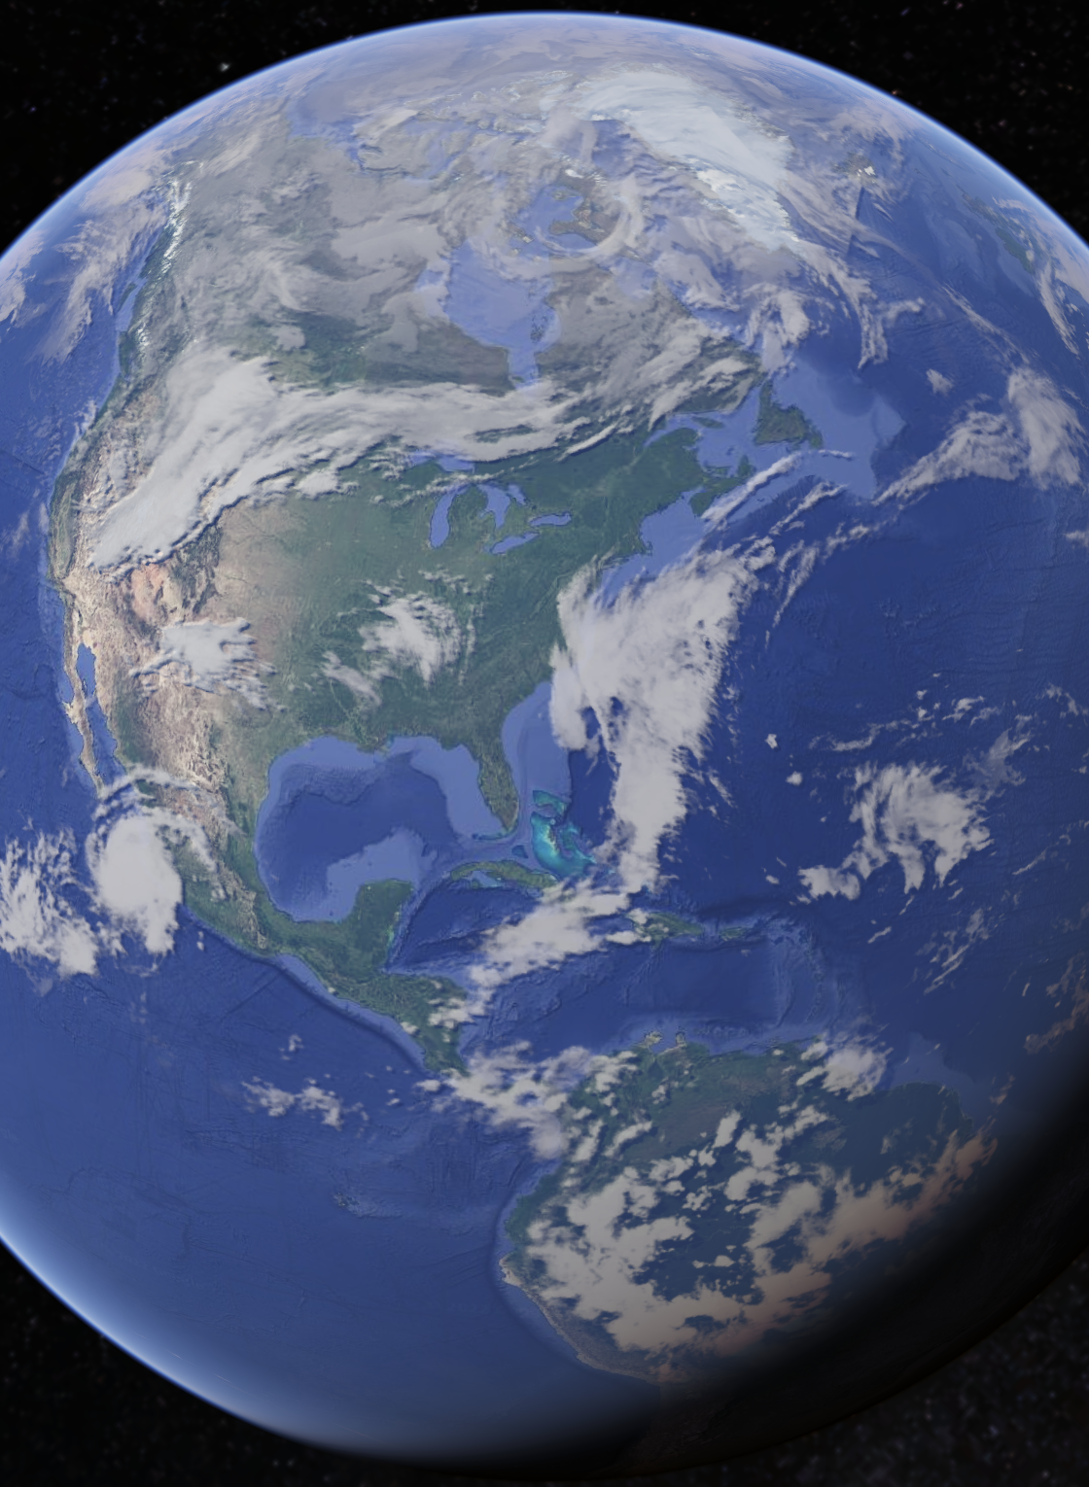
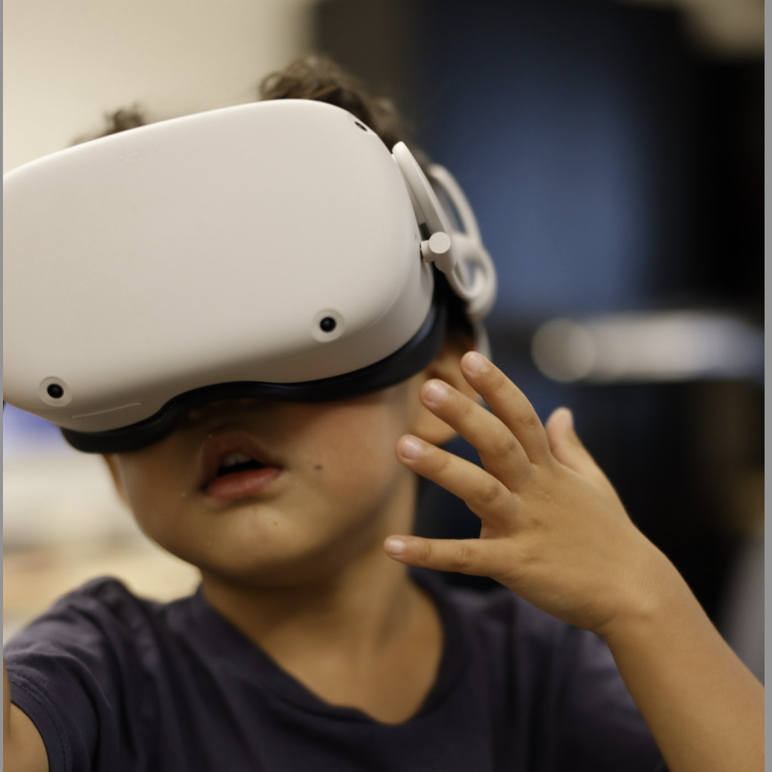
Multi-scale (immersive) visual analytics

Slide 25
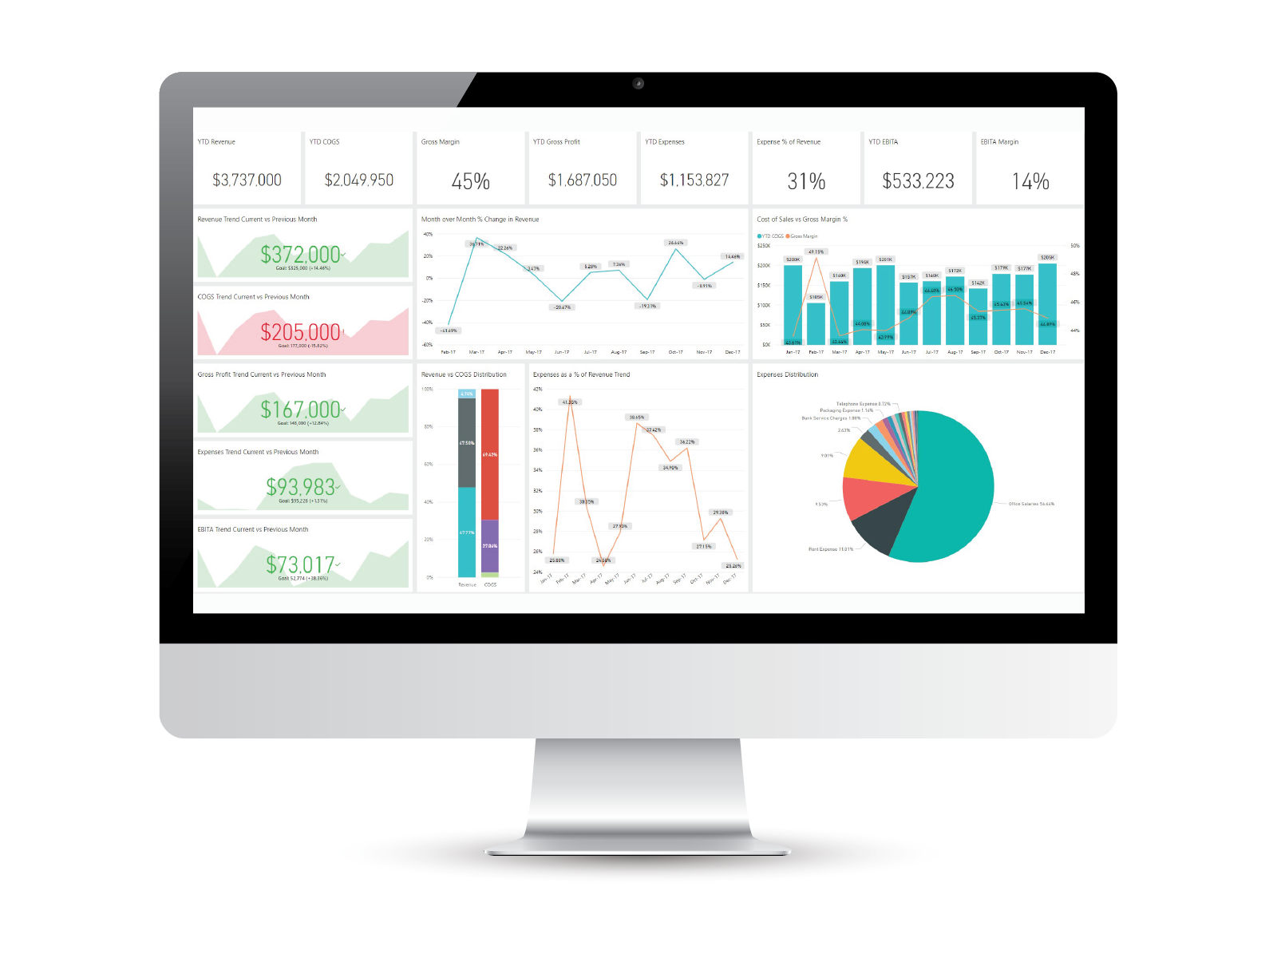

Multimodal Visual Analytics

Slide 26
Thank you
Isaac Cho, Ph.D.
Isaac.cho@usu.edu https://vizus.usu.edu

