Slide 1

School of Architecture, Design and the Built Environment
Are people the problem or the solution?
Reflections on the role of people in buildings & cities
Professor Richard Bull
Notes:
Not just DD
Research professor Uk and EU projects

Slide 2

Sicinius: What is the city but the people?
Citizens: True, the people are the city.
William Shakespeare, Coriolanus, Act 3, Scene 1
Notes:
Majority of World’s pop now live in cities
Huge challenges around mobility, energy, water, health and wellbeing
Are smart cities – digitally interconnected systems - the solution?
We have emerging examples of the role of ICT enabled solutions –energy management systems, smart buildings, travel apps, smart lighting solutions with associated challenges around governance, privacy and security.
What about the people who live in the cities – what do they want?
Have we asked them?
Should we ask them?

Slide 3

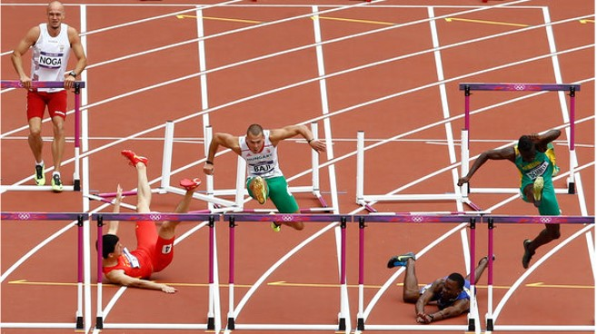
Notes:
The sense, in both cities and buildings, is that people, are hurdle to overcome . . . Rather than a resource to be utilized. A positive force for good, of knowledge
Lost times I’ve heard it said – this building would function perfectly if it wasn’t for the people! Remind who our buildings are for?

Slide 4
The challenge of energy & behaviour in non-domestic buildings
Organisations (including commercial, public and industrial) account for between 50% and 60% of energy use worldwide
Buildings (non-dom) constituting 18% of emissions from buildings in the UK and 20% globally
More complex – in terms of building type/agency/control/ethics/organizational culture/hierarchies
Increasing research and interest in digital economy and ICT based solutions, e.g. visualisation of data (feedback/dashboards) and SMART/Intelligent Buildings relating behaviour change
Notes:
My research has focused here . . .
More complex than residential
Many of these approaches still rely on a ‘information deficit’ model whereby the building users are a hurdle to be overcome rather than a resource to be utilised –
Though some excellent recent papers coming out starting to indentify the organisational barriers around hierarchies in organisations, cost of enegry and culture (Andrews and Johnston 2016, ) and the need to move beyond feedback towards engagement.

Slide 5


Slide 6
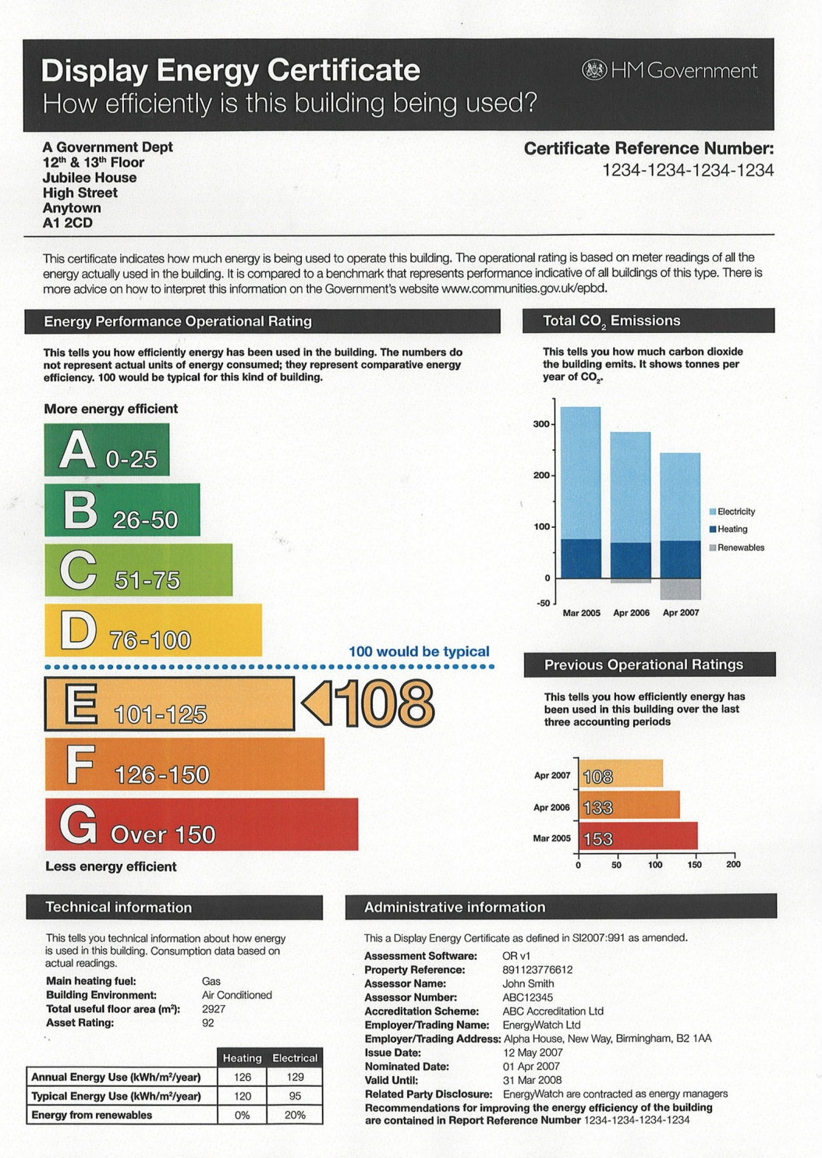
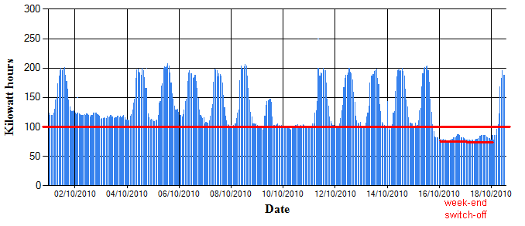
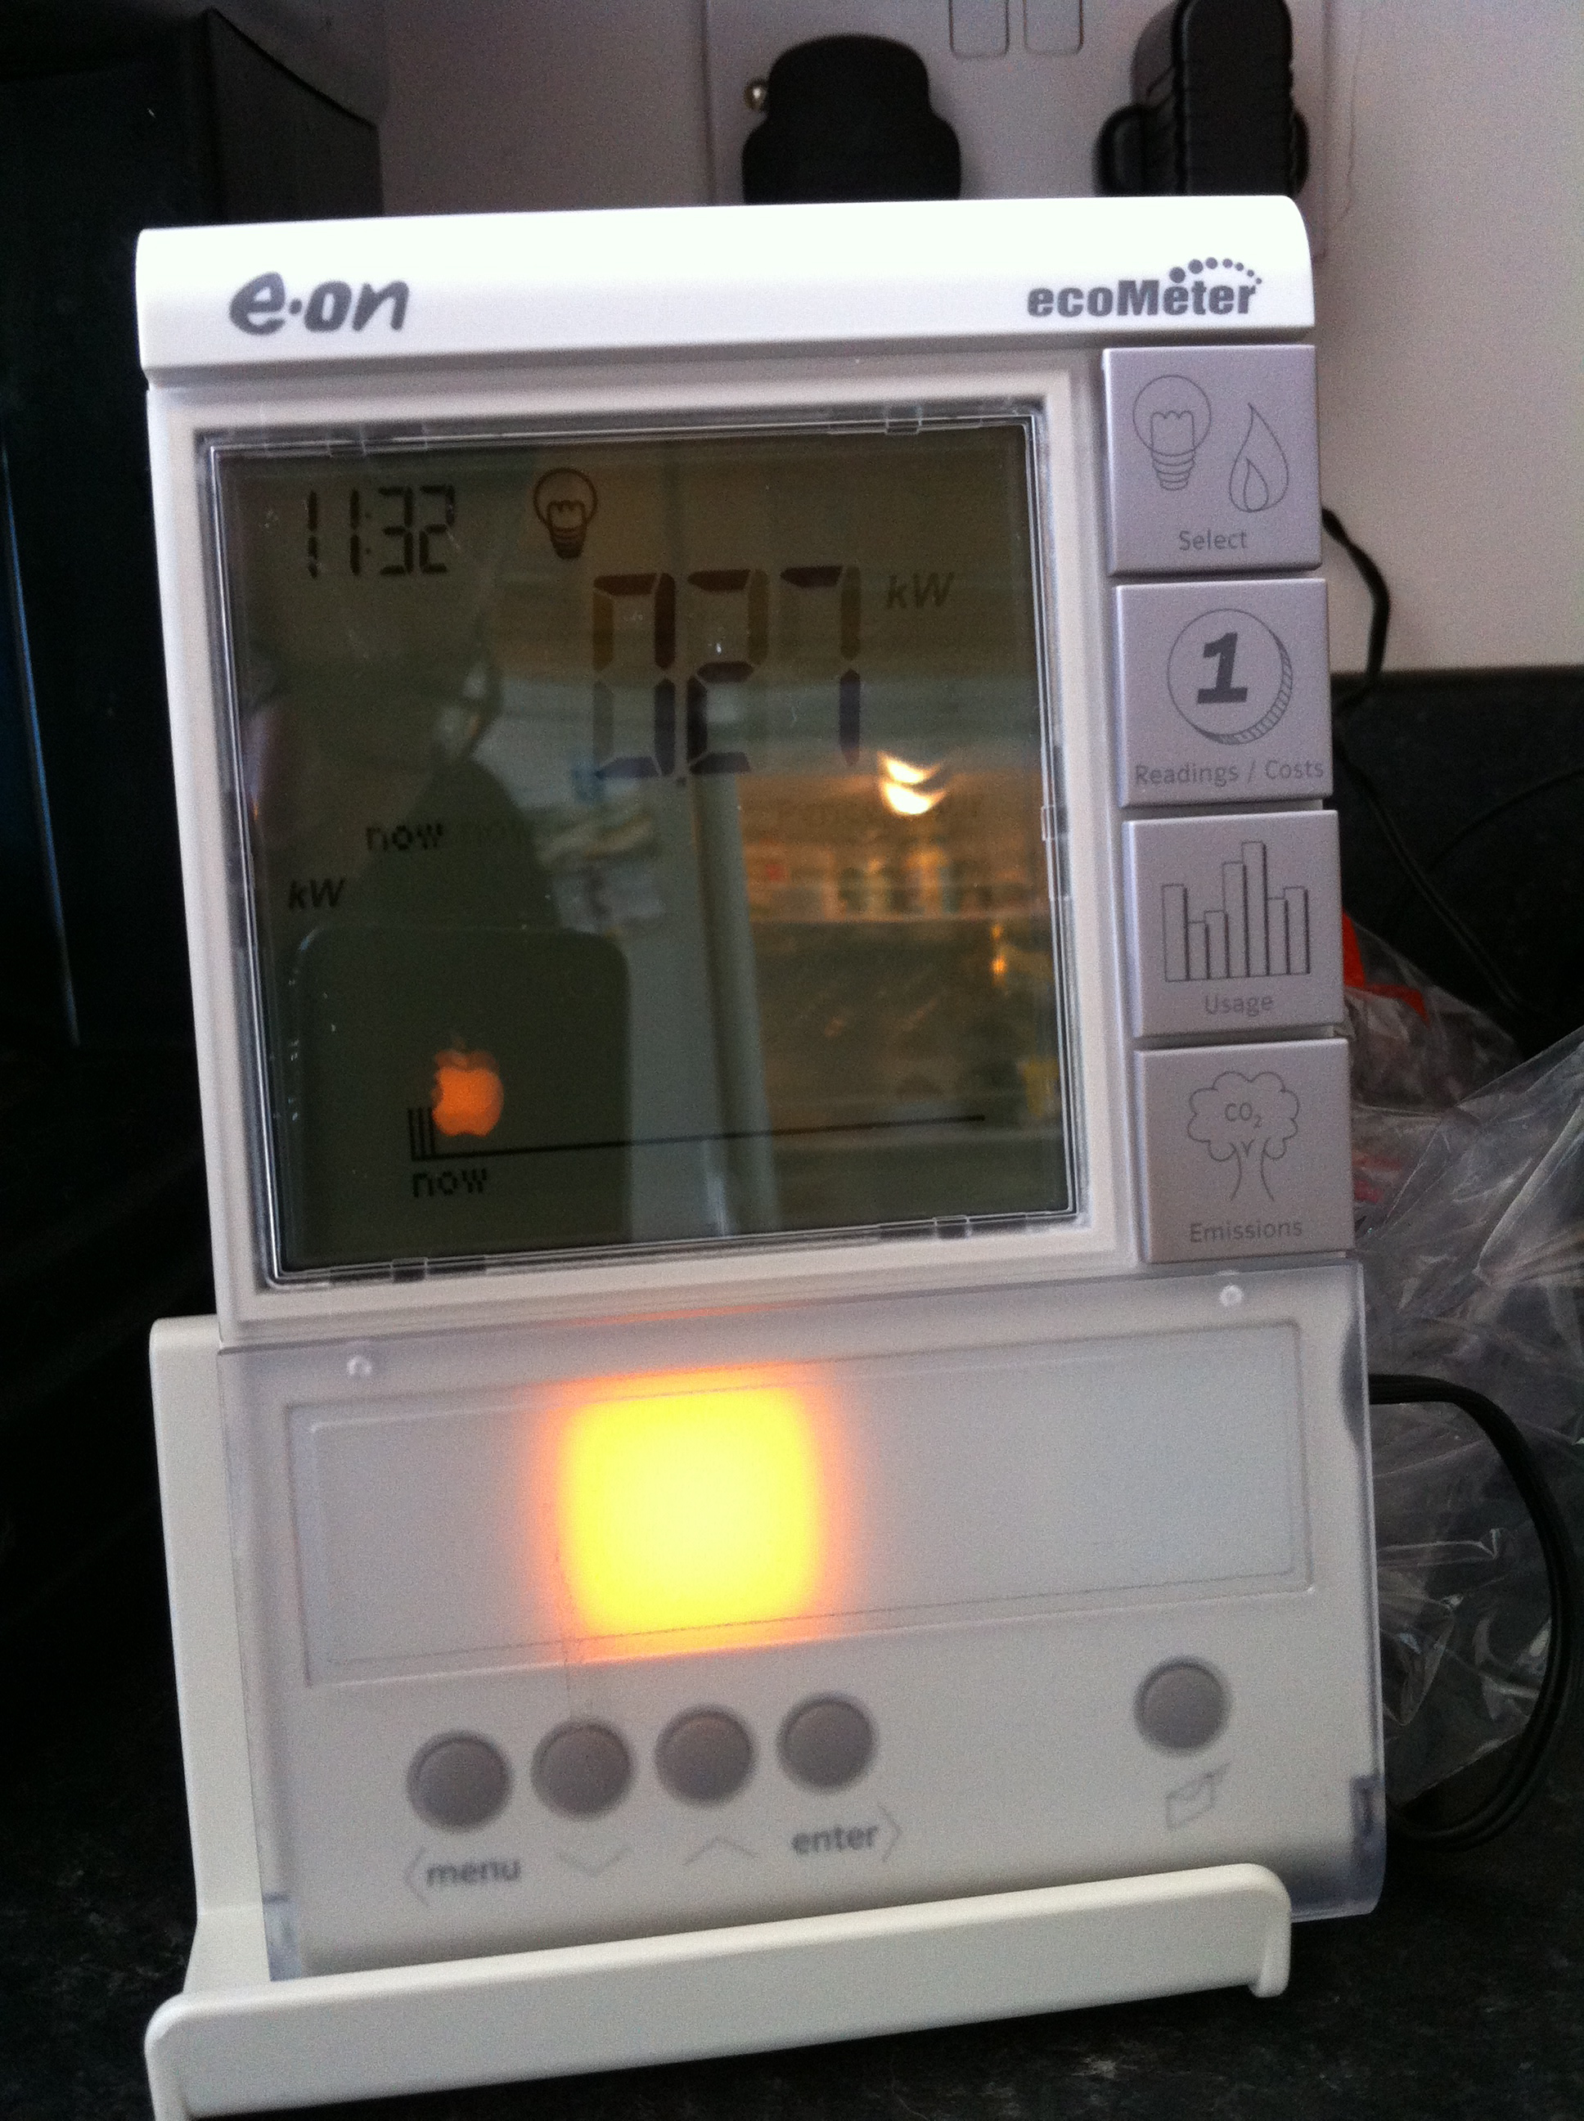
If ‘they’ have the right information ‘they’ will change behaviour . . . ?

Slide 7
Three benefits of engagement
Democracy is increased as all citizens have a right to participate and be represented in environmental decision making
Non-experts are often more attune to the ethical issues of a situation
Greater acceptance can often be achieved by involving all those affected by the particular situation
B, Sovacool, “What are we doing here? Analyzing fifteen years of energy scholarship and proposing a social science research agenda.” Energy Research & Social Science 1: pp. 1-29 (2014).

Slide 8
Genuine opportunities for engagement: citizens fora, workplace networks
ICT Platforms to actually share information
Creative visualisations
Meaningful data
Rethinking roles and responsibilities
Notes:
Arnstein’s ladder of participation
An increasingly popular model for conceptualising empowerment is Shelly Arnstein’s Ladder of Participation.
In her model Arnstein argued that citizen involvement is a fairer way of distributing power in our society, especially within the planning context.
At the bottom of the ladder are one-dimensional forms of communication that act as a substitute for more authentic types of interaction.
Arnstein believed that “citizen control” should be the top of the ladder thus signifying a redistribution of power to those who are often excluded from the decision-making processes within society [43]. This model has been successfully applied to a range of disciplines, most recently energy behaviours in buildings and organisations [44].

Slide 9
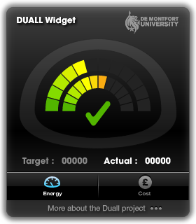
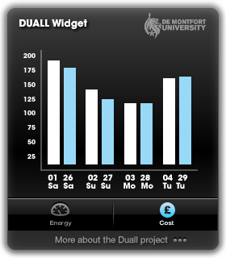
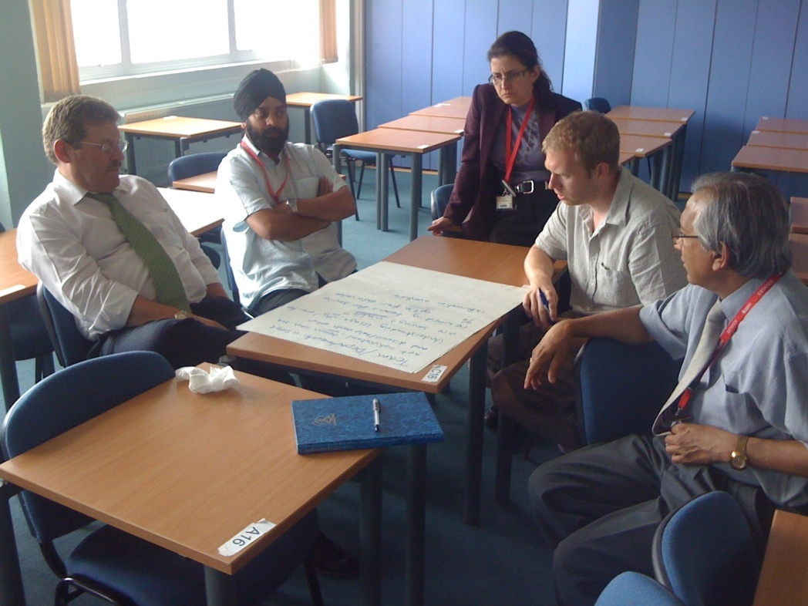
Duall

Slide 10
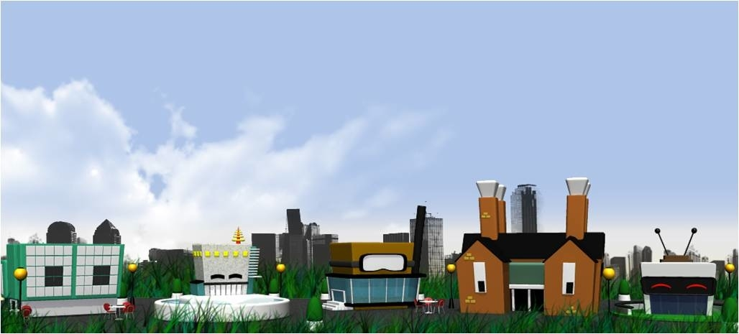

Slide 11
The Gooddee²ds responsive webapp

Slide 13
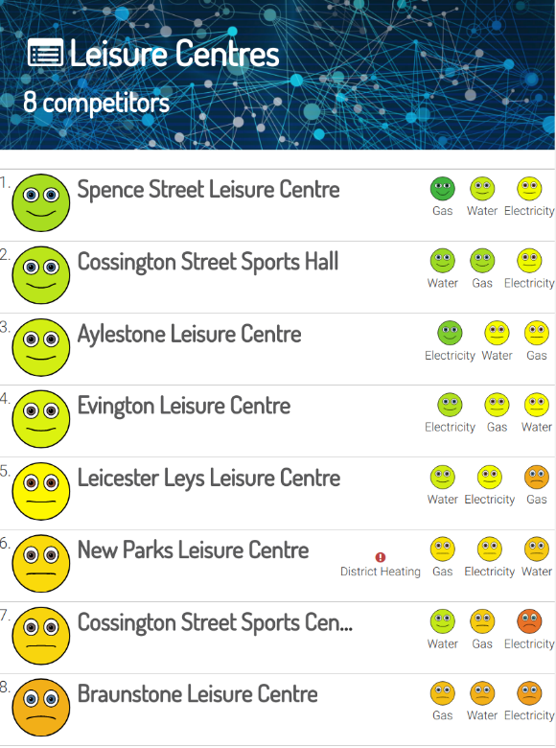
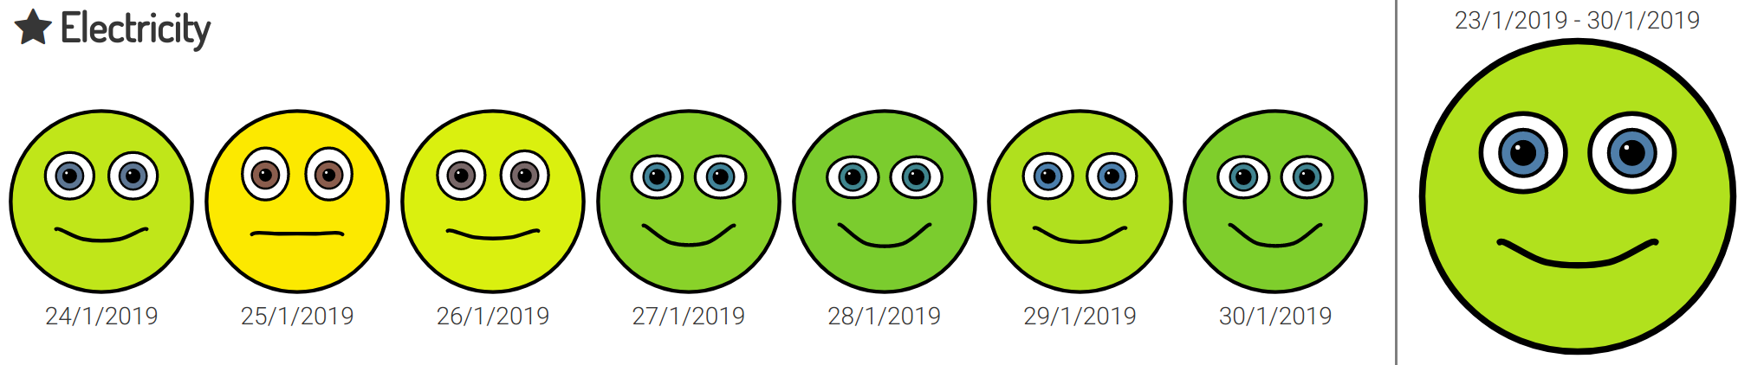
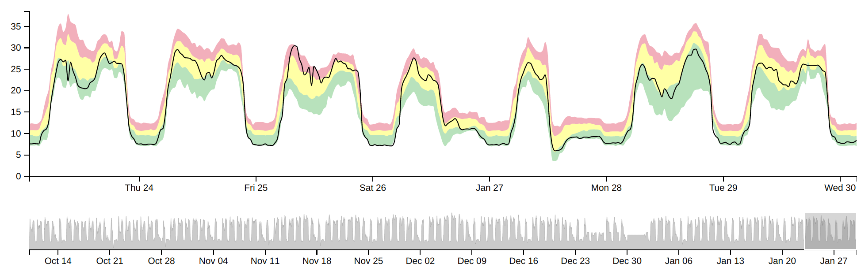
Notes:
The EDI-Net system is a powerful analysis tool that enables monitoring of the entire building portfolio from a single dashboard (https://dashboard.edi-net.eu). Consumption data is automatically imported into the system and then analysed on the EDI-Net server so that the results are updated daily and displayed in near real time.
The dashboard helps with your day to day energy and water management. Easy to understand performance indicators are key though - these smiley faces [CLICK] show how metered consumption compares to the expected level. Green smiley faces show low consumption, red sad faces show high consumption. Public league tables allow energy managers to communicate energy performance to building users in a user-friendly manner [CLICK]. More detailed graphs are available for those who want to look more closely [CLICK).

Slide 14
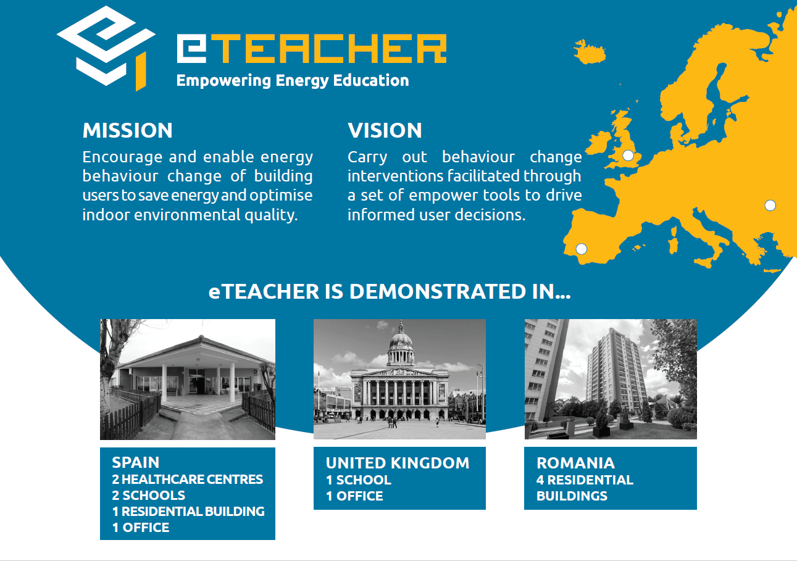

Slide 15
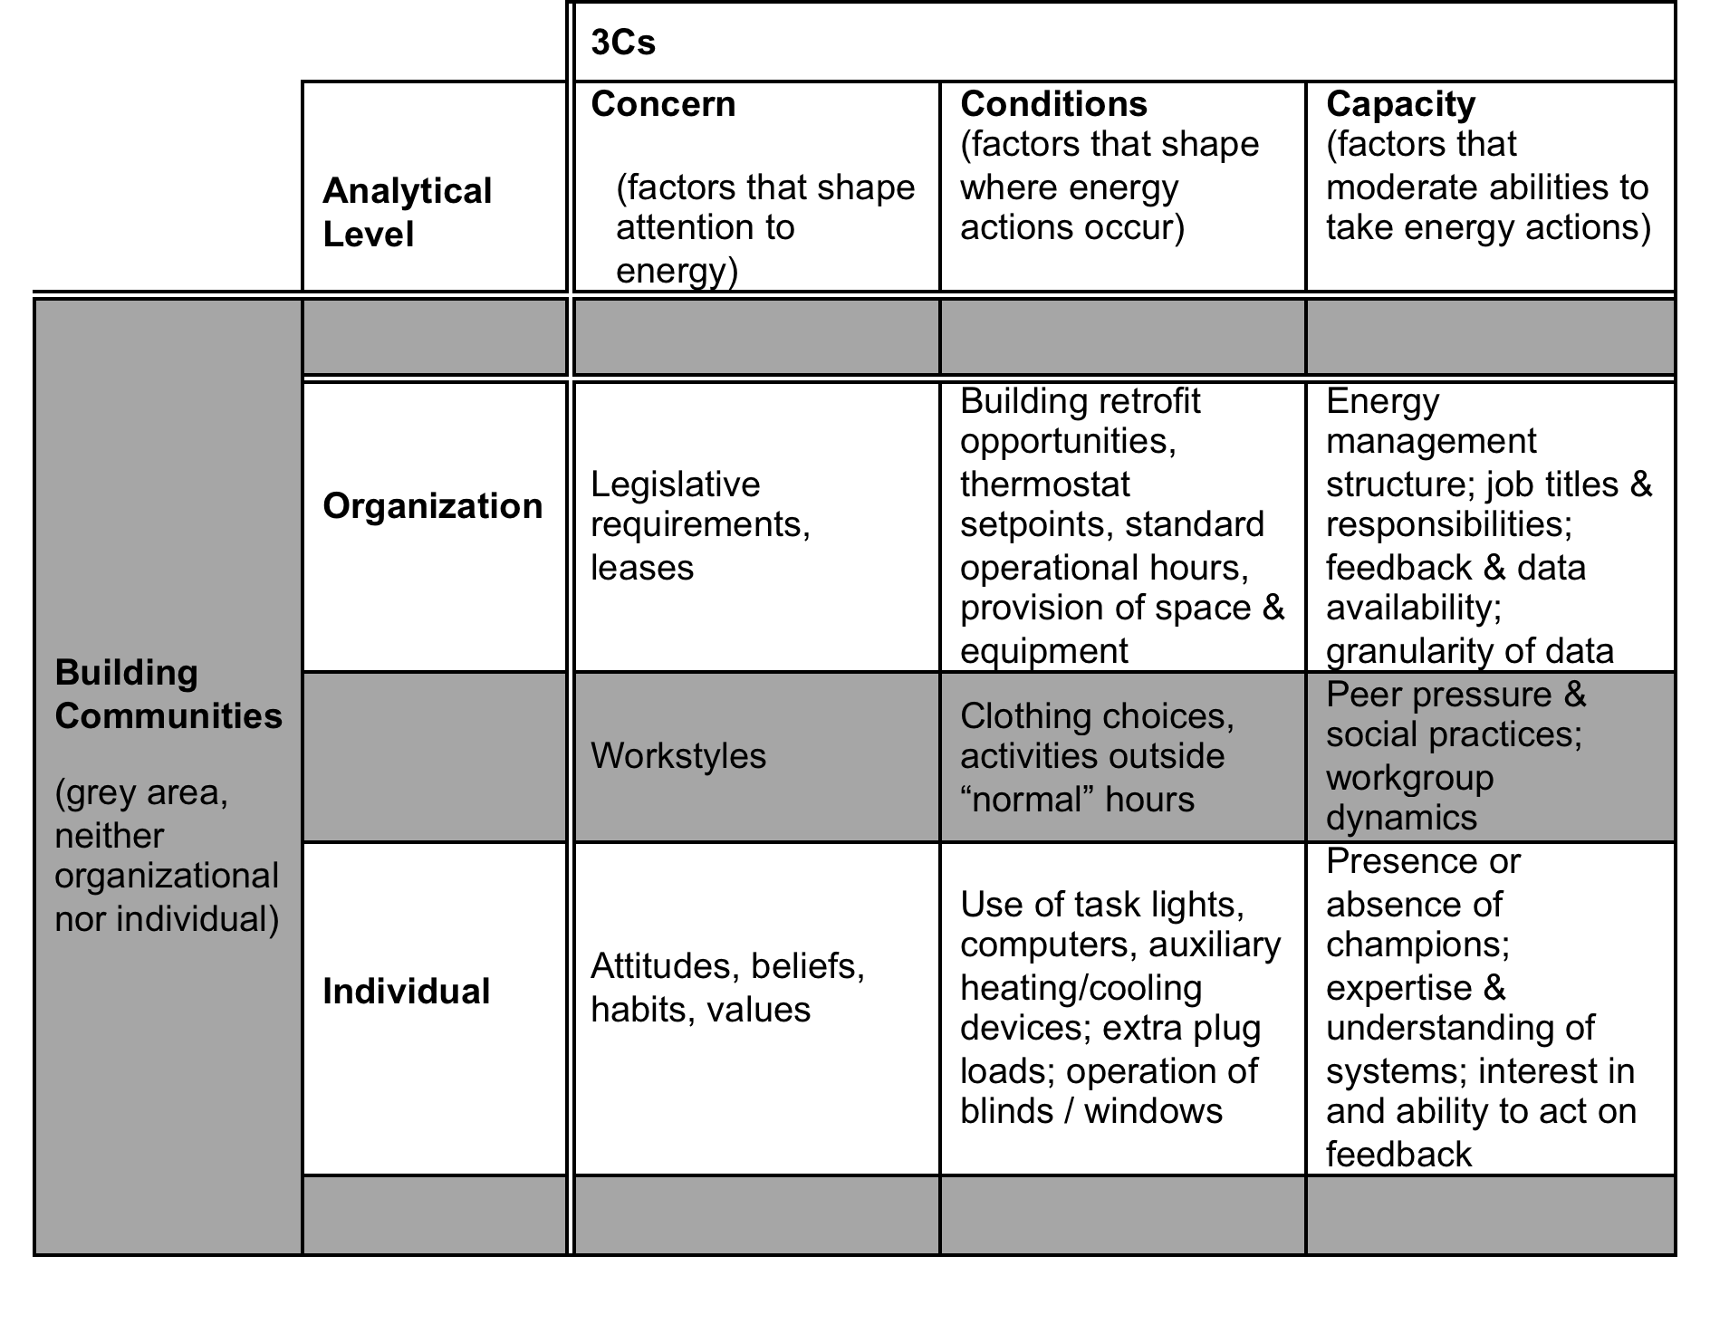
Variations in concern, conditions, capacity + priorities
Notes:
From Katy's work 3 'c's were identified
From the public sector we then drew in the notion of priorities . . .

Slide 16
Variations in Priorities

Slide 17
The Participation Gap
Engaging employees at different levels across the organisation
participation gap
Energy feedback
Nudge
Notes:
With a colleague at UCL We’ve been comparing our case studies in the non-domestic sector as we’ve explored increasing participation in organisations.
We’ve identified this participation gap . . .

Slide 18
Bridging the participation gap
The core strategy of an organisation matters.
Engagement [and partnerships] around energy efficiency needs to happen within, and be aligned to, existing organisational capacities.
Technical conditions across an organisation’s building portfolio can affect the ways in which buildings are seen, clustered and managed.
A “partnership” approach for energy within organisations has implications for the socially ideal level of centralised automation and control, as well as who has access to data displays, both publicly and privately
Notes:
Firstly, the core strategy of an organisation matters. Thus engagement around energy efficiency needs to happen within, and be aligned to, existing relationships, roles and teams. Further research is needed into how different internal organisational cultures frame employee duties, behaviours, and expectations, particularly with regard to data, analytics, and feedback.
This also applies to how budgets are managed and financial targets are set for organisations. If energy efficiency targets are going to compete with core business activities and profitability then there will be only one winner.
Second, we need to move beyond the ‘them and us’ culture and ‘information-deficit’ approach intrinsic in the narrow interpretation of energy efficiency as dashboards and feedback. Employee engagement should be framed in a way that acknowledges the positive contribution they can make to energy efficiency, rather than treating them as a ‘problem to be solved’ or another management project.
Finally, the challenge of organizing and achieving greater participation in the workplace is ever-present and the technical challenges that exist for smaller organisations, around both accessing the energy data via metering and makings sense of the data once its received, should not be dismissed. Relationships take time, trust and technical competency.

Slide 19
Questions
We need innovation in advanced controls AND affordable tools that offer increased engagement and participation
Re-shape the effectiveness of public services through changing the relationship between building energy managers and building users.
Who’s responsible for our built environment?
Do building-users (citizens? want greater control of their buildings (cities?)? . . . ‘just get on with it’?
Notes:
Original conceptions of smart or intelligent buildings envisaged buildings that would take into account the preferences and experiences of the building-users, yet a techno-centric approach has tended to dominate –
It is neither desirable nor democratic for the large ICT players to shape our cities without the clear engagement and involvement
of the people who live in them, especially given legitimate concerns around data privacy and security, as these new data-sharing platforms, from smart meters to sharing platforms, harvest personal information.

Slide 20
Further reading . . . .
Morton, A., Bull, R., Reeves, A. (2020). Empowering and Engaging European building users for energy efficiency. Energy Research and Social Science. Vol 70, Dec 2020.
Bull, R., Dooley, K., & Mazhar, M. (2019) The Crucial Role of Citizen Involvement in Smart City Development and Operation. Energy and Mobility in Smart Cities. (Eds.) WJ Nuttall, DV Gibson, A Ibarra-Yunez and D Trzmielak Institution of Civil Engineers Publishing.
Bull, R., & Janda, K. (2018). Beyond feedback: introducing the 'participation gap' in organisational energy management. Building Research and Information 46 (3), pp. 200-215.
Bull, R., & Azennoud, M. (2016) Smart participation- social learning: a model of participation. Energy – Proceedings of ICE. http://www.icevirtuallibrary.com/doi/abs/10.1680/jener.15.00030 1-8.
Bull, R., Lemon, M., Everitt, D., & Stuart, G. (2015). Moving beyond feedback: Energy behaviour and local engagement in the United Kingdom. Energy Research & Social Science 8 32-40
Bull, R., J. Petts, et al. (2008). "Social Learning from Public Engagement: Dreaming the impossible?" Journal of Environmental Management and Planning 51(5): 703-718.
          Contact: richard.bull@ntu.ac.uk
          Twitter: @richbull

