Slide 1
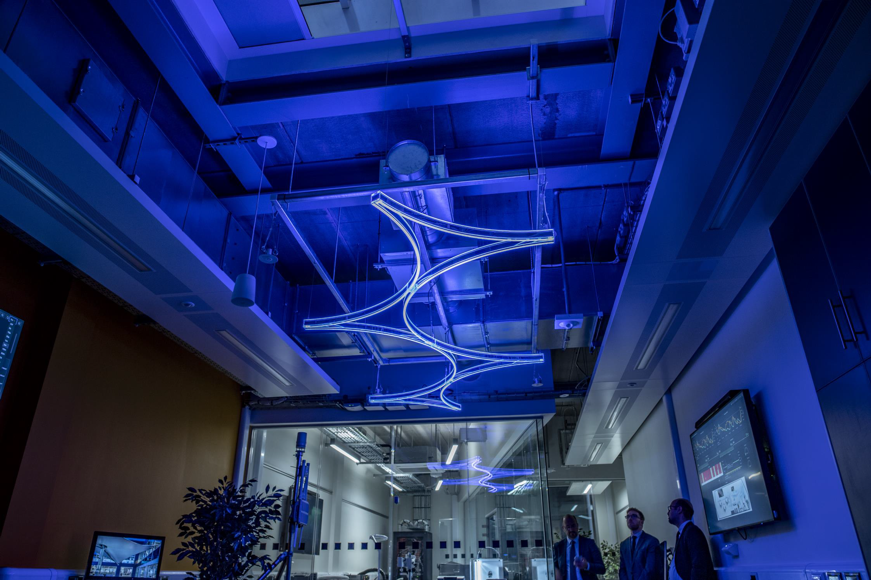
SWIFt - Smart Wireless Innovation Facility
Accelerating Wireless Innovation
October 2022

Slide 2



Contents
What is SWIFt?
Facilities
The Team
The Testbed
Vertical market Focus
How to Engage with SWIFt
Project Examples
Summary

Slide 3
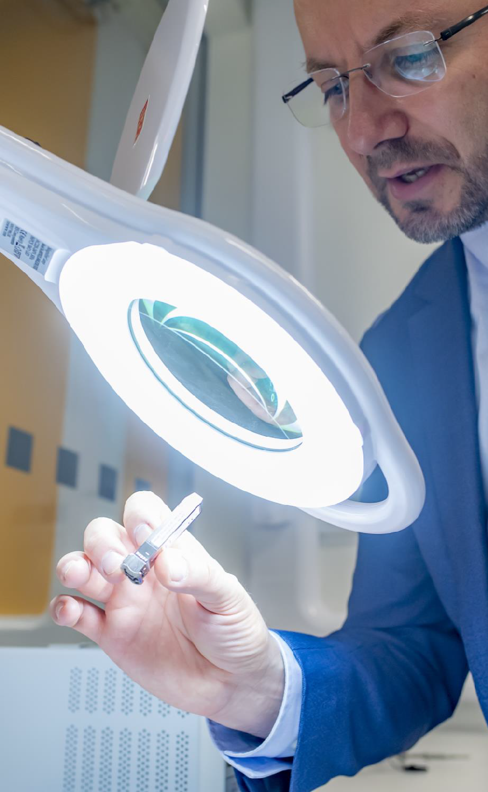
WHAT IS SWIFT?
SWIFt
A £1.6M investment by the D2N2 Local Enterprise Partnership and Nottingham Trent University
Commercial
Testbed
A commercial focused 5G and LoRaWAN testbed designed to help industry develop, trial and commercialize innovative solutions.
A living lab to safely trial and develop solutions in a real world environment with access to technical specialists.
Living Lab
An opportunity to do blue sky research with access to NTU academics, SWIFt technical specialists for joint commercial research or grant funding opportunities.
Research Facility
Workshop
An electronics workshop with state of the art equipment available for commercial
use or hire
A BRAND-NEW STATE OF THE ART 5G AND IOT ENABLED
SMART LAB AND TESTBED LOCATED IN NOTTINGHAM

Slide 4
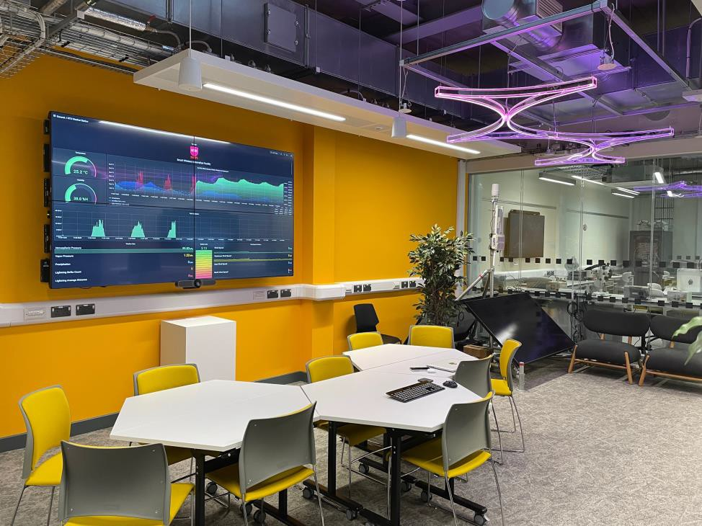
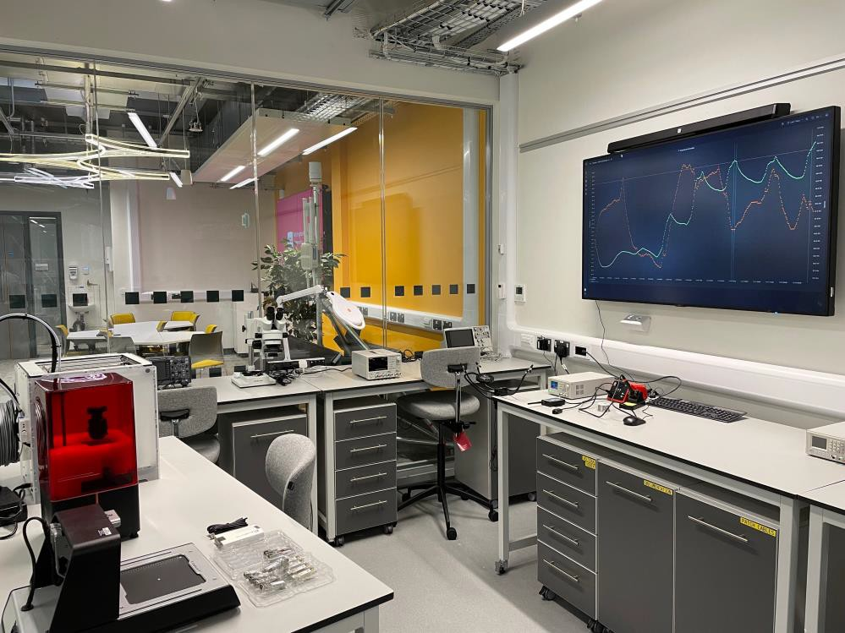
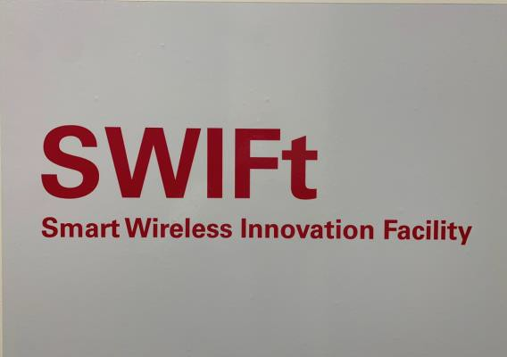
FACILITIES
Demonstrator Area
A demonstrator area to showcase solutions in real time
Electronics Workshop
A state-of-the art electronics workshop with a variety of high- tech equipment
Living Lab
Meeting Area
A living real-world environment to trial and develop solutions
Areas to hold meeting or training courses with clients and partners

Slide 5

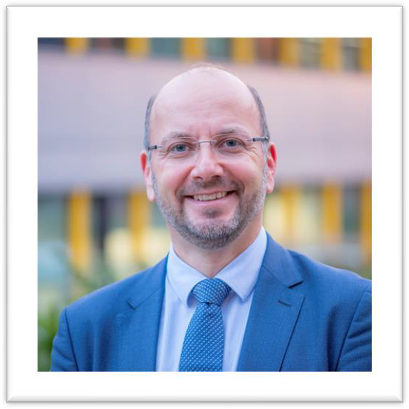
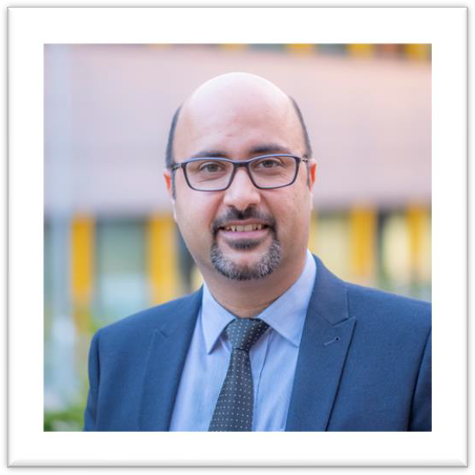

THE TEAM
Stuart Fenton
Managing Director
Ivan Marjanovic
Technical Director
Reza Khosravi
IOT Specialist
Syeed Aqeel Raza
5G Specialist

Slide 6

THE TESTBED
The SWIFt testbed offers access to a state-of-the art private 5G network internally and externally on a Non-Stand Alone (NSA) and Stand Alone (SA) basis.
NSA features:
5G NR on Band 78
LTE anchor point on band 7
NB-IoT Service
Nokia NDAC 4G/5G core
SA Features:
5G NR on Band 78 3.6-3.8GHz for indoor
5G NR on Band 77 3.8-4.2 for outdoor
ORAN architecture (CD and DU deployment)
Druid 5G Core
The SWIFt testbed includes low-power wide-area network (LPWAN) capabilities. More specifically, the network protocol that was provisioned is LoRaWAN, which is designed to connect wirelessly resource- constrained devices to the internet over very long distances at very low power.

Slide 7
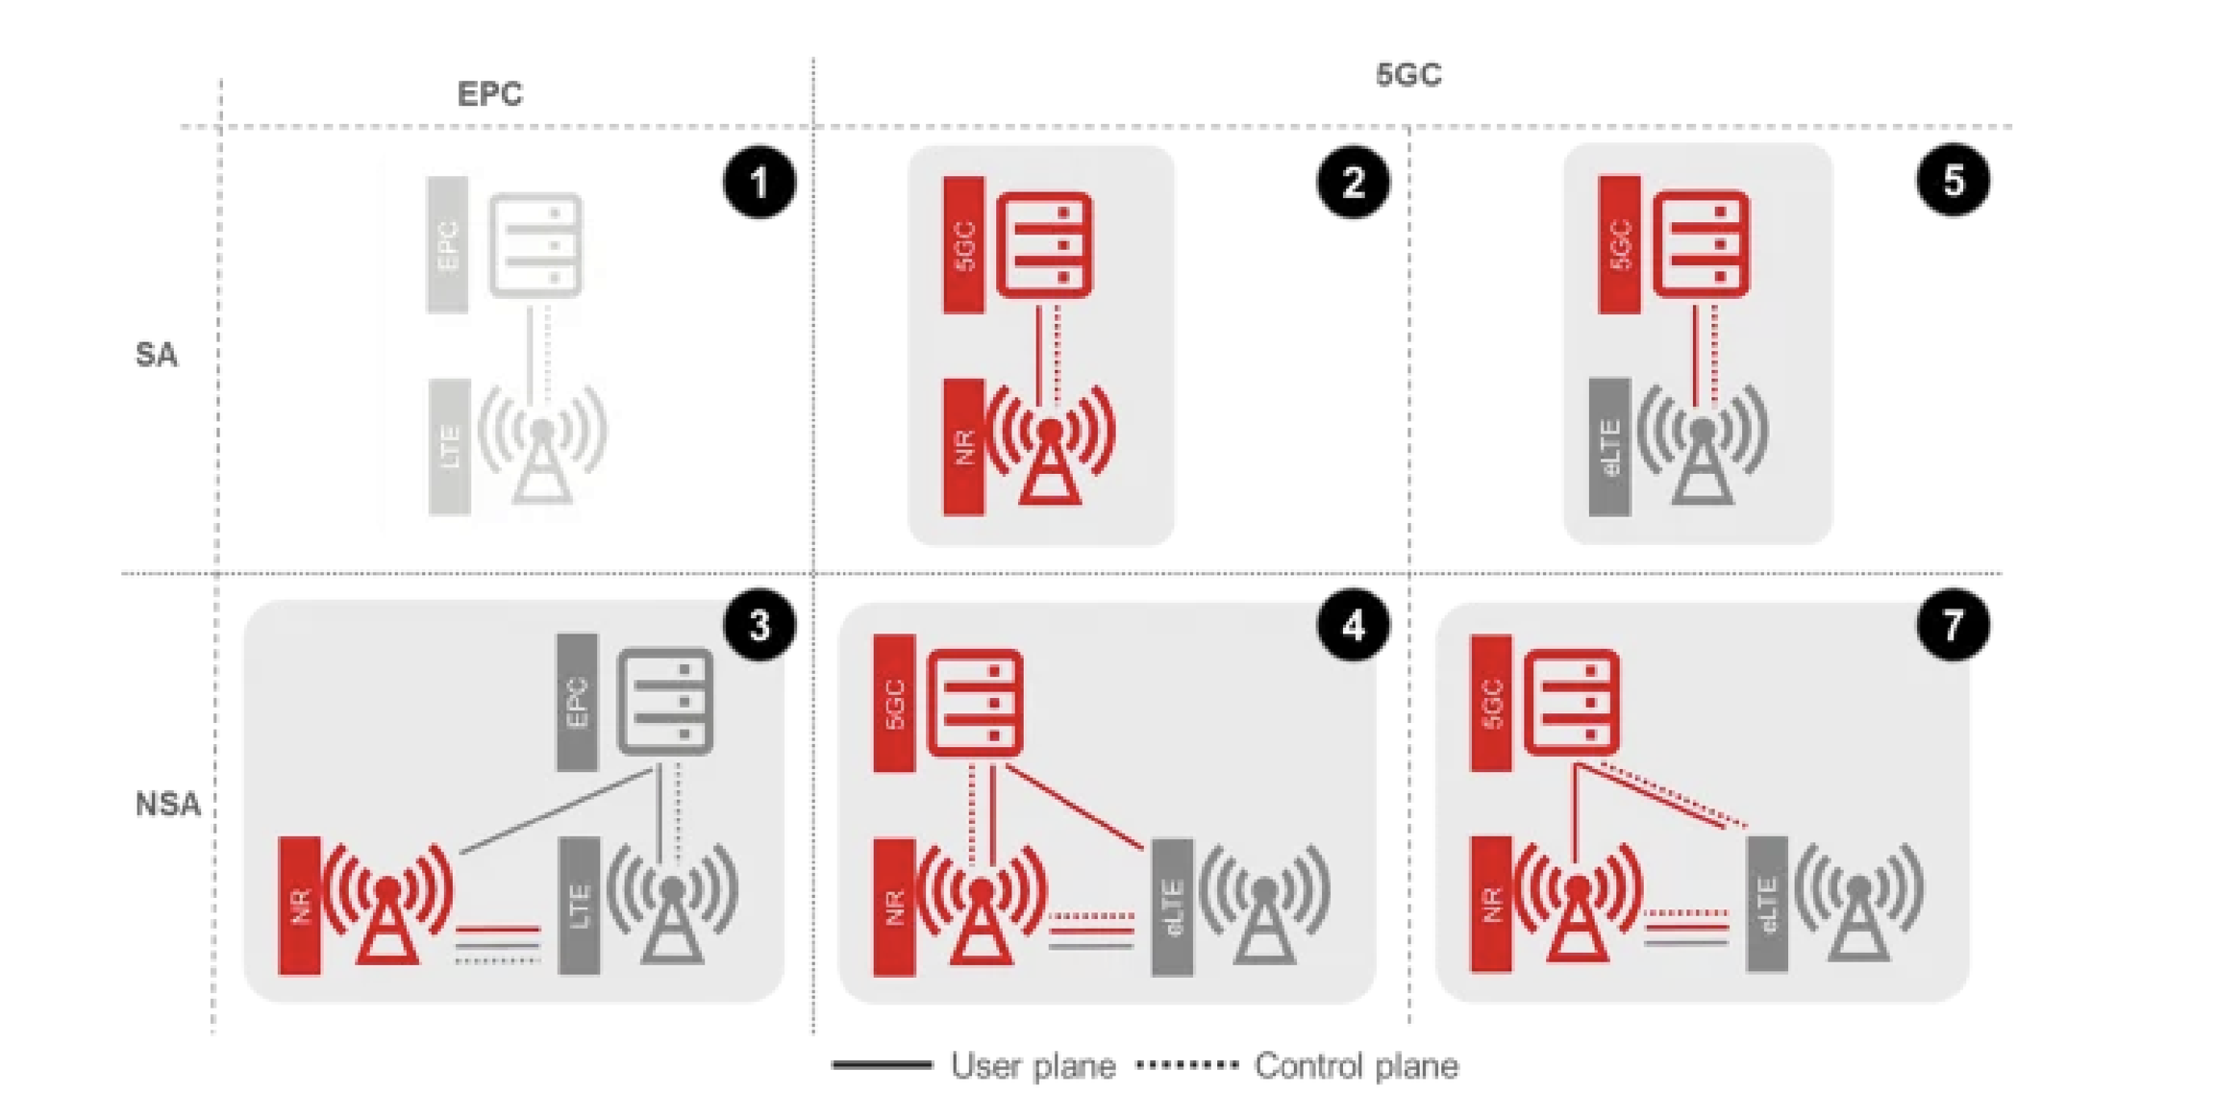
5G Deployment Architectures
Airspan –
Nokia –
2
3

Slide 8
SWIFt 5G & IoT NTU Network
NTU Clifton Campus
NTU City Campus
NTU Brackenhurst Campus
Future NTU Campus
SWIFt 5G & IoT Network is covering 3 different geographic sites and can be extended
to other locations utilising the JANET6 network.

Slide 9
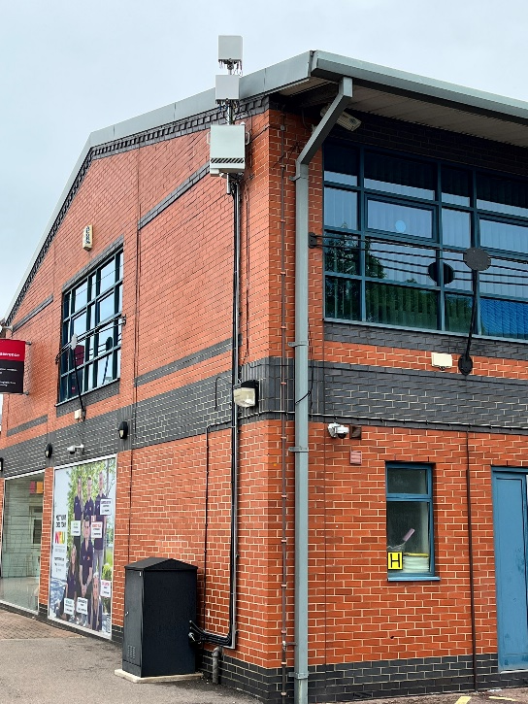
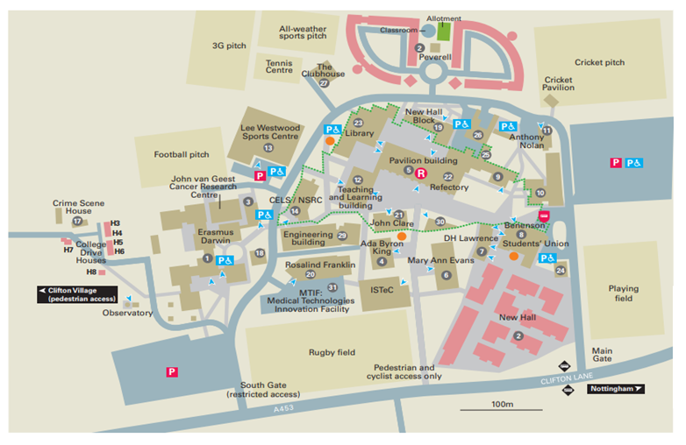
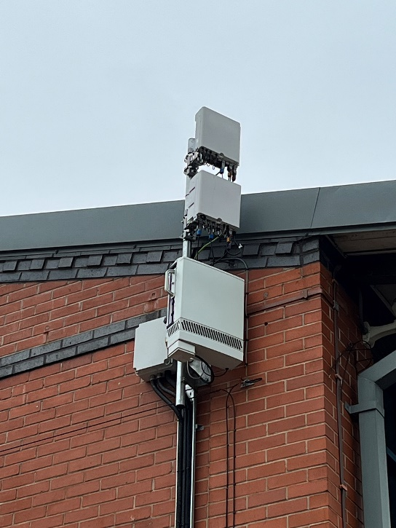
Clifton Campus 5G Outdoor Network

Slide 10
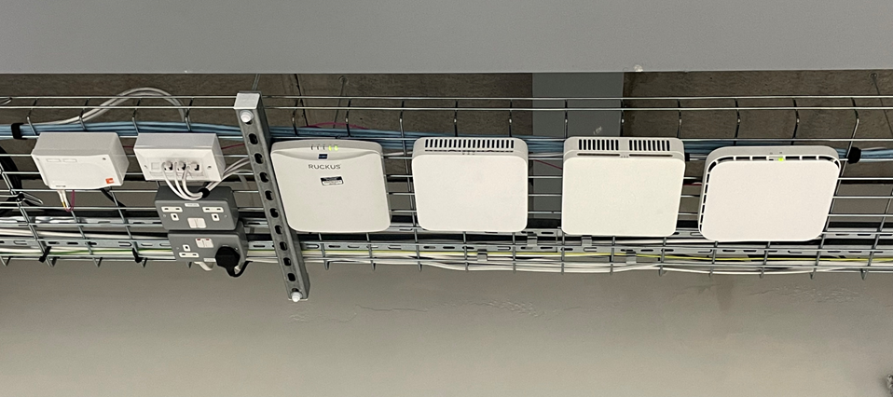
Clifton Campus 5G Indoor Network
Nokia Airspan
5G indoor coverage is available in three rooms within the engineering building.
Each room has Nokia 4G & 5G and Airspan 5G indoor coverage, a total of 9 radios

Slide 11
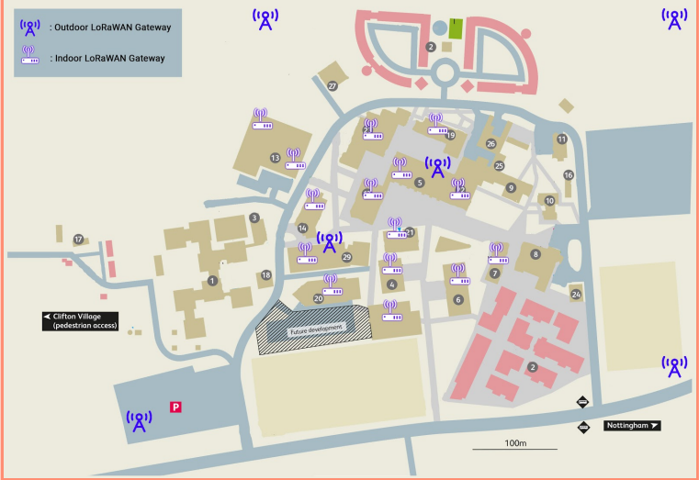

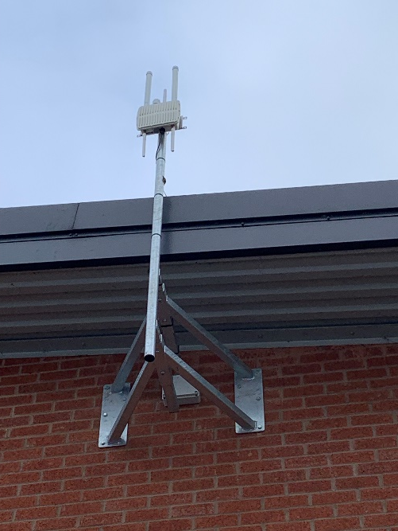
LoRaWAN Network
6 x Outdoor LoRaWAN gateways deployed
15 x Indoor LoRaWAN gateways deployed

Slide 12
Engaging with SWIFt can accelerate your product / service to market
Idea Generation/ Research
Concept Development
Product Definition
Design
Validation & Testing
Commercialisation / Launch
NTU Academic entry point
NTU Research funding support
Potential industry partnerships
SWIFt Innovation workshops
Working with
NTU & D2N2
SME’s to define
Product
SWIFt Design Support
SWIFt test bed for validation
SWIFt funding access
There are various points in the product / service lifecycle that SWIFt can engage and support
SWIFt is a ‘living lab’ for researchers, businesses and policymakers and showcase and demonstrate how these technologies can be translated into everyday life and commercialised
SWIFt has access to NTU investment funding and also institutional investment partners who are keen to invest in UK products and solutions

Slide 13
SWIFt Vertical Market Focus
SWIFt Test Bed Capabilities
5G Indoor & Outdoor
Shared Spectrum
LoRaWAN / IoT
NTU 5 key research areas
D2N2 Industry Strategy
Sustainable futures
Safety & Security of citizens
Medical Technologies &
Advanced materials
Global Heritage
Health & Wellbeing
Upskilling for Productivity
Clean Growth
Connectivity and Inclusion
The objective is to maximise the SWIFt test bed capabilities, so we are identifying a focussed approach that will leverage
the NTU research activities and address the D2N2 industry strategy Guiding principals.

Slide 14
Vertical markets to focus on

Slide 15
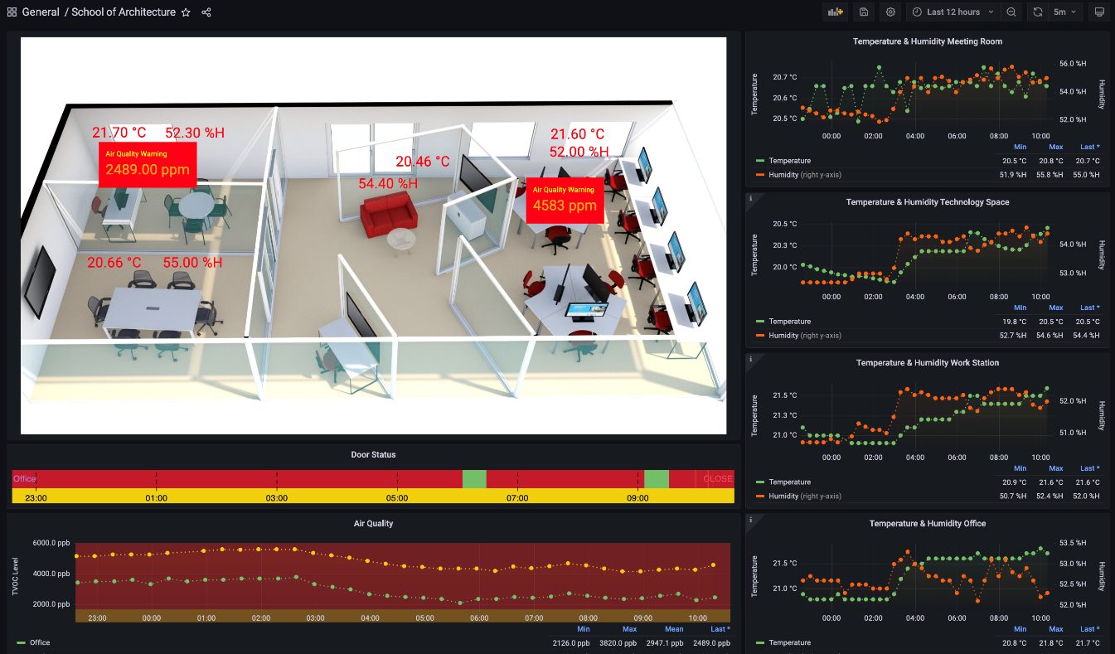
Project Examples
Objective:
To support NTU research into air quality in buildings, how it affects productivity and how it can be regulated.
SWIFt Role:
Deploy numerous air quality sensors around the City Campus offices and develop a dashboard to monitor the air quality.
Entry Point:
NTU Research
Deliverables:
A working system that monitors air quality in a real time basis, sends alarms when air quality drops below key metric.
Next Steps:
Work with NTU to leverage 5G technology in a maintenance capability with Augmented Reality and / or Holograms to support maintenance activities when poor air quality is detected.

Slide 16
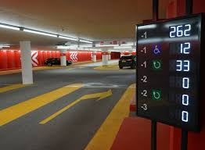
Project Example#2 Local Authority Car Parking Solution
Objective:
Local authority (LA) requires some support in identifying how 5G and IoT can be leveraged to provide an advanced car parking solution across all their public car parks.
SWIFt Role:
With SWIFts expertise in 5G and IoT we have been able to provide a detailed background on 5G and IoT that will inform the LA on how the technologies can be used.
Entry Point:
Solution Design
Deliverables:
5G & IoT technology report
Next Steps:
Support the LA from design to launch

Slide 17

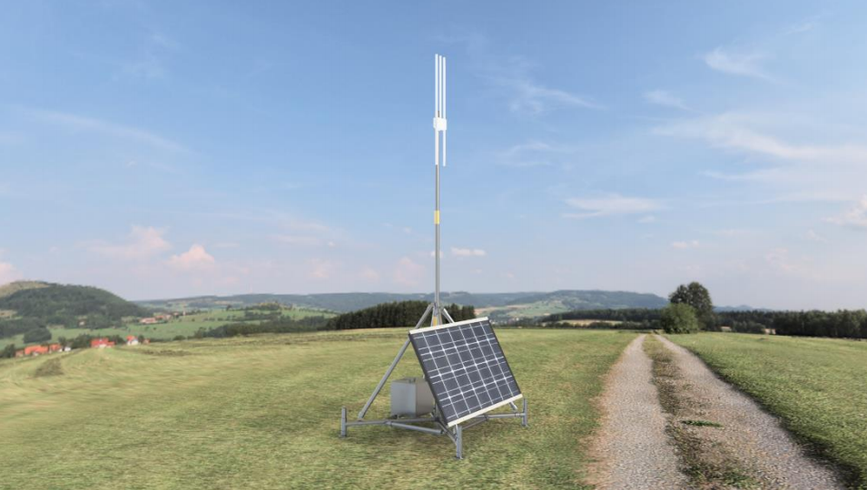
Project Example#3 Construction Site IoT Pop-up Solution
Objective:
Provide a “pop-up” LoRaWAN solution for construction sites. Applications could include, asset tracking, noise level monitoring and air quality monitoring,
SWIFt Role:
With SWIFts expertise in IoT we have been able to provide a pop-up LoRaWAN gateway that is solar powered for ease of use on a construction site.
Entry Point:
Concept & product
Definition support
Deliverables:
IoT technology support, LoRaWAN pop-up gateway solution.
Next Steps:
Support construction company to focus on the right
application

Slide 18





SUMMARY
PRICE
Opportunity to develop the solution from feasibility study/proof of concept to delivery cost efficiently with SWIFt.
PRODUCT
Opportunity to develop the solutions with specialized technical experts and access to University researchers and expertise if required.
PLACE
Trialed in a real-world environment with access to 5G and IOT networks to ensure solutions are future proofed and future ready.
PROMOTION
Ability to showcase a real working pilot in a live environment to potential customers.

Slide 19
SWIFt - Smart Wireless Innovation Facility Accelerating Wireless Innovation THANK YOU
STUART FENTON MANAGING DIRECTOR
STUART.FENTON@NTU.AC.UK

