Slide 1
Measuring Wellbeing of Building Occupants
Professor Ming Sun
School of Architecture, Design and the Built Environment
Nottingham Trent University

Slide 2
My Interest in Wellbeing Measurement
Housing adaption for elderly people
A conceptual framework to assess the age-friendliness of a built environment
Characteristics of built Environment physical activities of old people their wellbeing
Smart occupant-building interaction system
Real-time occupant feedback to create personal thermal preference model
Personal profile model helps to control building services
Benefit measurement for housing retrofits to quantify:
Economic benefits
Environmental benefits
Social benefits, including occupant wellbeing

Slide 3
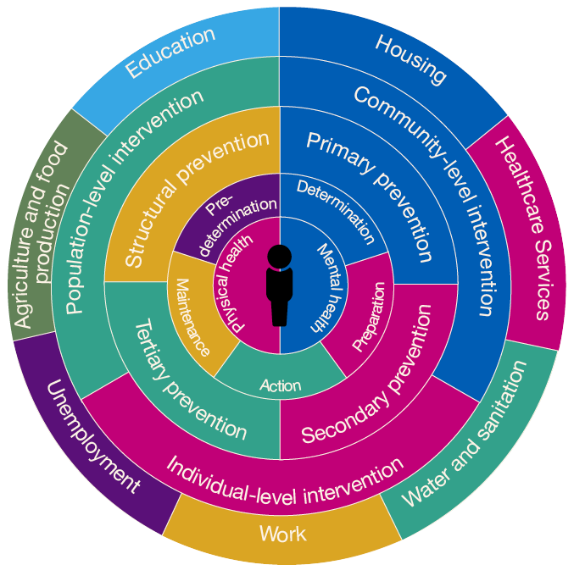
Health and Wellbeing
The World Health Organisation (WHO) defined health as “a state of complete physical, mental, social well-being and not merely the absence of disease and infirmity”.
Wellbeing is about people feeling good and functioning well.
Citizen’s wellbeing is one of the main drivers for policy making at different levels
Joint Health and Wellbeing Strategy for Nottingham | April 2022-March 2025

Slide 4
Subjective vs Objective Wellbeing
Subjective wellbeing describes how people think and feel about their own wellbeing, and includes aspects such as life satisfaction, positive emotions, and whether their life is meaningful. Subjective wellbeing is usually measured through self-report.
Objective wellbeing describes how basic human needs and rights are met; these may include aspects such as adequate food, physical health, education, safety etc. Objective wellbeing can be measured through self-report (e.g., asking people whether they have a specific health condition), or through more objective measures (e.g., income level, health indicators, mortality rates and life expectancy)

Slide 5
How to Measure Wellbeing
Cooke et al (2016) presented a review of existing wellbeing measurement instruments:
42 instruments were covered in the review
They are classified into 5 categories – hedonic, eudaimonic, quality of life, wellness, composite
All use self-reporting questionnaire as data collection method
Number of measured items ranged from 1 to 135, with 81% having fewer than 36 items
Cooke, P.J., Melchert, T.P. and Connor, K., 2016. Measuring well-being: A review of instruments. The Counseling Psychologist, 44(5), pp.730-757.

Slide 6
Hedonic Approaches
Well-being is how people feel about life, focusing on pleasure and happiness.
Tripartite model of Subjective Well-Being (SWB) by Ed Diener, consisting of:
Satisfaction with life
Absence of negative affect (emotions, moods, and feelings)
Presence of positive affect
Life satisfaction and Affect balance can be measured separately and independently, or
A single SWB question is used to capture a overall picture, such as the Cantril ladder survey by the World Happiness Report.
Respondents are asked to think of a ladder, with the best possible life for them being a 10, and the worst possible life being a 0. They are then asked to rate their own current lives on that 0 to 10 scale.

Slide 7
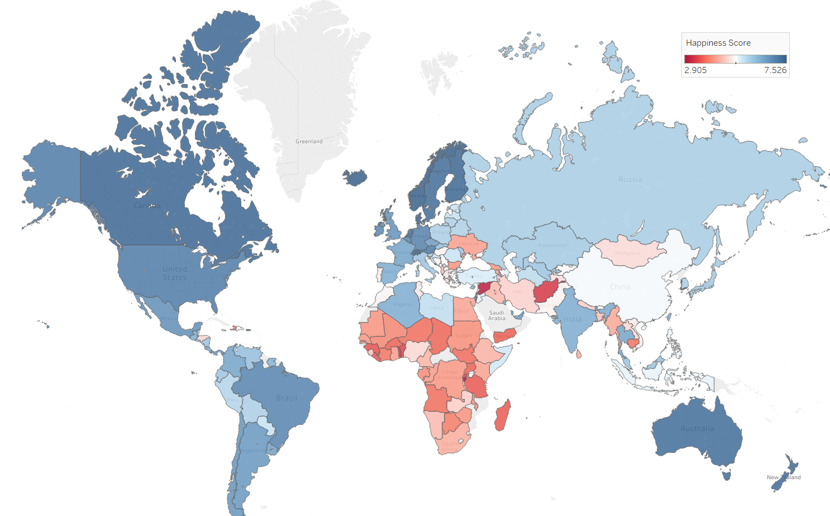

Slide 8

Hedonic approaches establish whether people are happy or unhappy
They do not answer what make people happy/unhappy

Slide 9
Eudaimonic Approaches
Well-being is about whether life is meaningful, focusing on fulfilling one’s potential, functioning at an optimal level or realising one’s true nature.
Focus on a large number of life domains, such as the following suggested by Carol Ryff:
self-acceptance (positive evaluation of oneself and one’s life),
personal growth,
purpose in life,
positive relations with others,
environmental mastery (the capacity to effectively manage one’s life and the surrounding environment),
and autonomy.

Slide 10
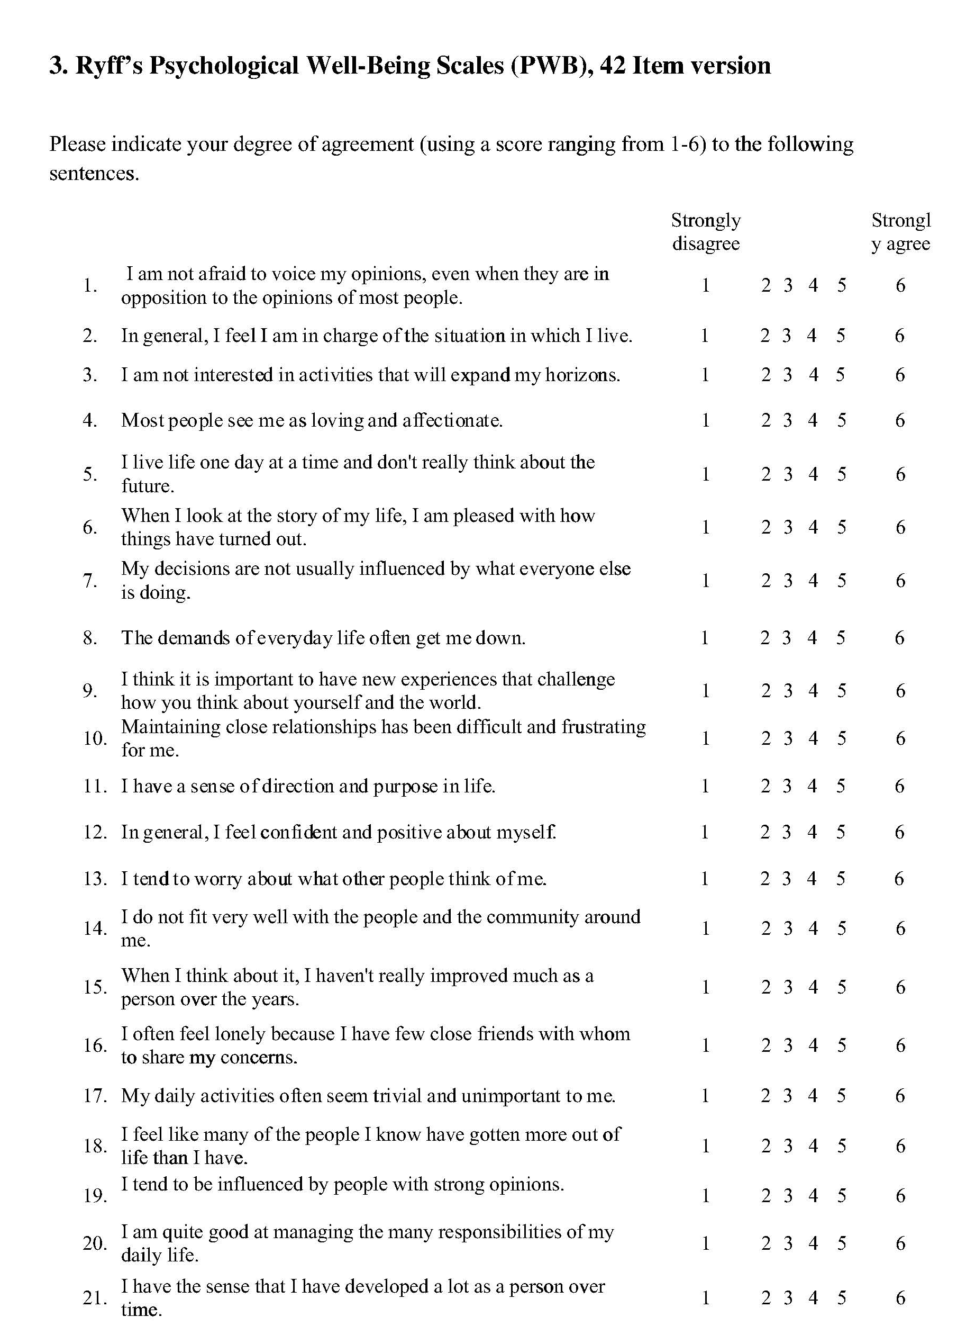
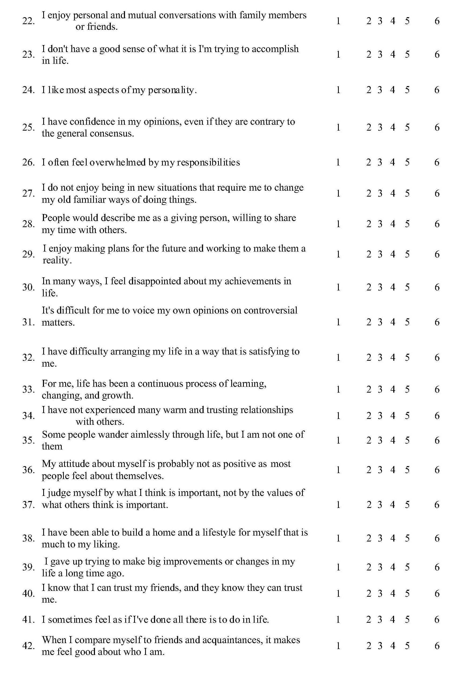
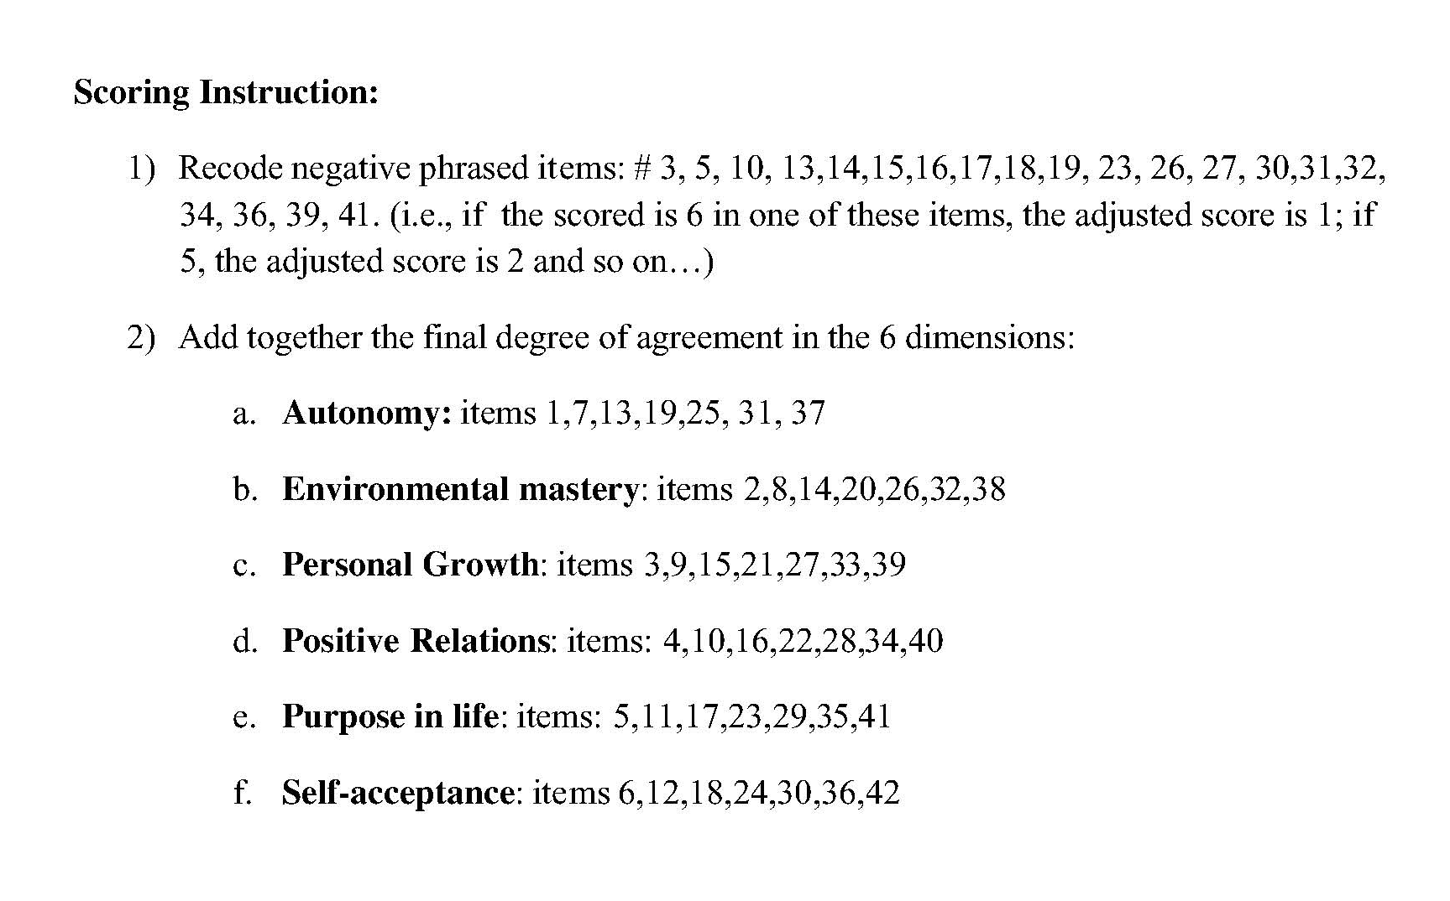

Slide 11
Quality of Life Approaches
WHO defines QoL as a “broad range of concept affected in a complex way by the persons’ physical health, psychological state, level of independence, social relationships and their relationship to salient features of their environment”.

Slide 12

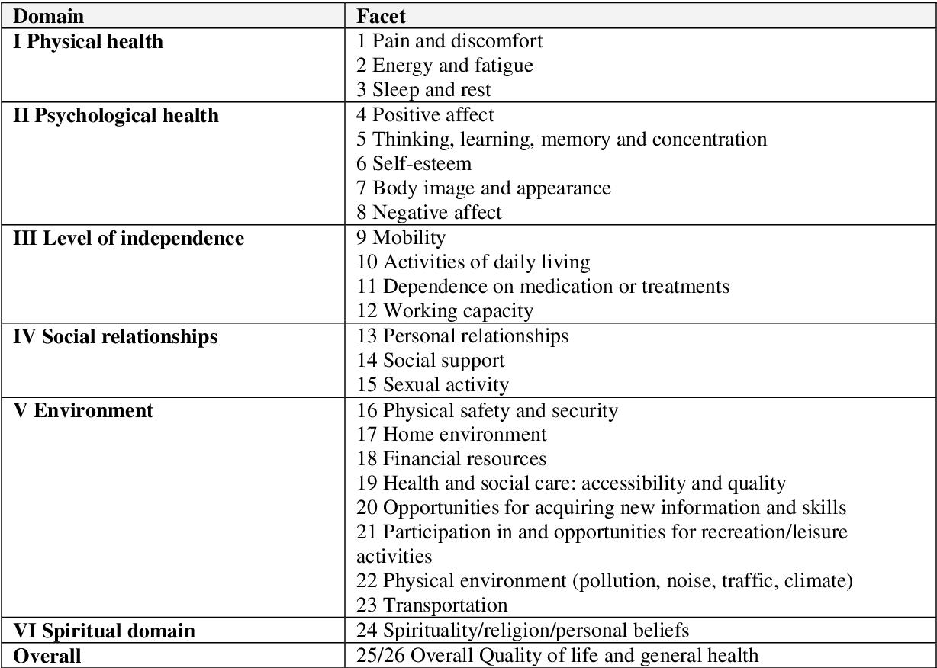
Measuring Quality of Life

Slide 14
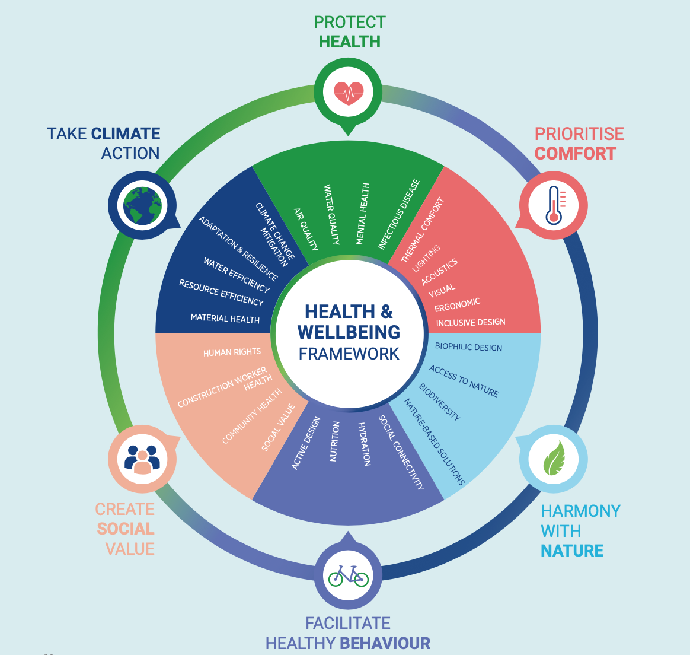
Health & Wellbeing and the Built Environment
Health & Wellbeing Framework from World Green Building Council - Six Principles for a Healthy, Sustainable Built Environment
Improving “health and wellbeing” through the built environment for building occupants and beyond

Slide 16
Observations
Existing wellbeing measurement methods overly rely on self-reporting with inherent limitations
There is a disconnect between wellbeing assessment and building assessment (BREEAM, LEED, etc)
There is no standard dataset on building occupant wellbeing surveys
There is a need for new building occupant wellbeing measurement system(s) (indicators, data collection protocol, analysis methods)

