Slide 1
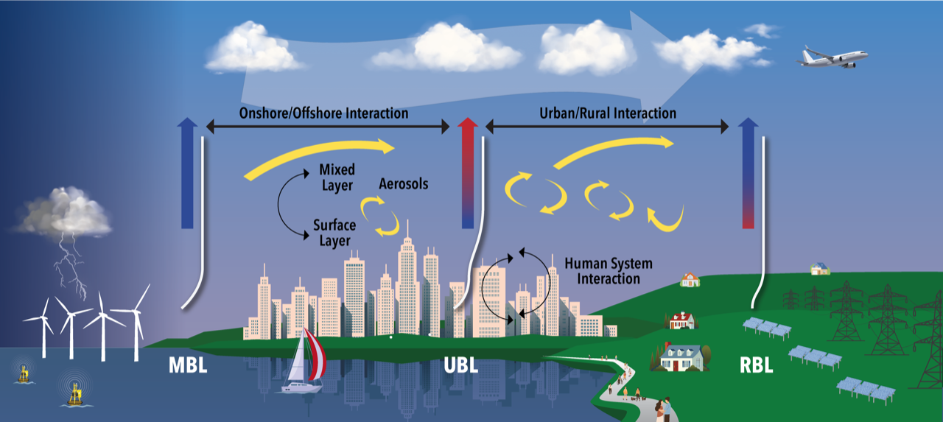
Coastal-Cities in a Warming Climate
Jorge E. González
SUNY Empire Innovation Professor
Atmospheric Science Research Center
&
CUNY Presidential Professor
jgonzalez-cruz@albany.edu
http://cuerg.ccny.cuny.edu

Slide 2
Outline
SCIENCE QUESTIONS
SJU CASE
LAX CASE
NYC CASE
SUMMARY AND CONCLUSIONS
QUESTIONS AND COMMENTS

Slide 3
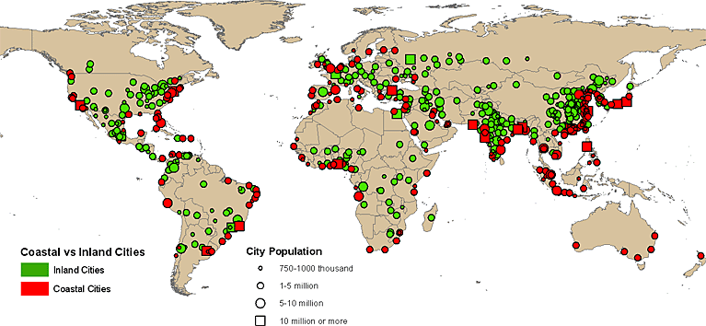
Urban agglomerations by size class and inland or coastal location (UN Economics & Social Affairs)

Slide 4
Emerging Mega-regions in US. Source US 2050

Slide 5
Research questions: relative contributions to observed climate-trends in coastal-urban areas from GHG-warming &/or LCLU-changes?
In coastal/urban regions, how the changing local climate interacts with a changing global climate –?
How do these combined changes influence coastal-flows and hydrological cycles?
What may be the societal-implications of these changes (health, AQ, Energy)?

Slide 6
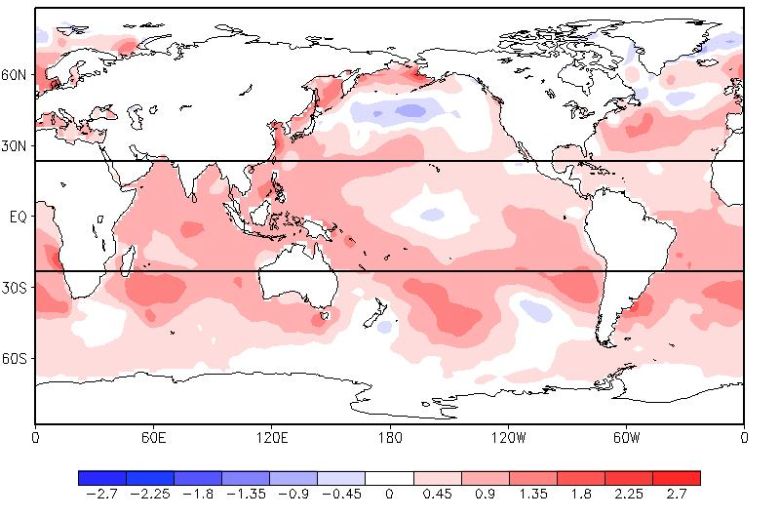
Global Sea Surface Temperature Change (˚C)
1955-59 to 2000-04
LAX
NYC
SJU
Global SST differences (˚C) between the periods of 1955-59 and 2000-04, calculated from the Smith and Reynolds ERSST for the three-month period encompassing the Caribbean ERS.

Slide 7
Case-I: SJMA, Puerto Rico
San Juan, Puerto Rico offers a great opportunity for environmental change impact studies because of:
Evidence of combined global and local effects on regional climate
The close proximity of the San Juan Metropolitan Area (SJMA) to the Luquillo Experimental Forest (LEF), and the Central Mountain range
Historical LCLU practices
(agriculture → urbanization)
(deforestation ↔ reforestation).

Slide 8
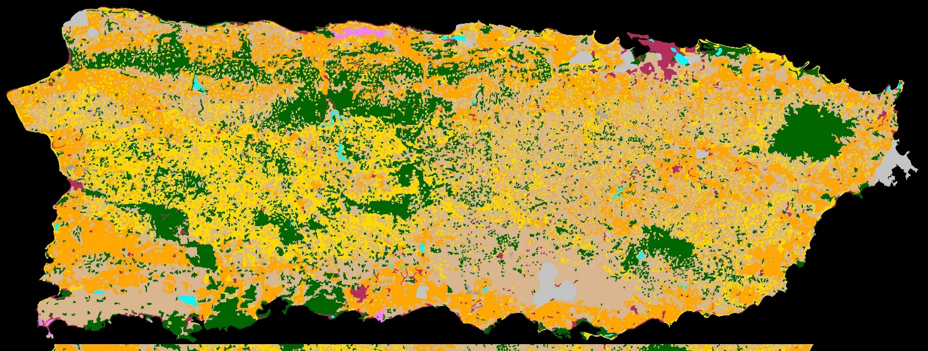
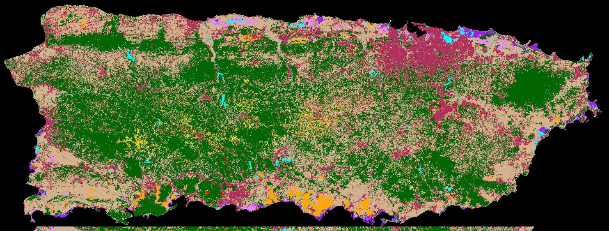
LCLU Specifications 1951 & 2000
From Kennaway, T., and E. H. Helmer, 2007: The Forest Types and Ages Cleared for Land Development in Puerto Rico. GIScience and Remote Sensing, 44, 4, 356-382.
1951
Original 1951 hard copy map:
Brockman, V. M., 1952
2000

Slide 9
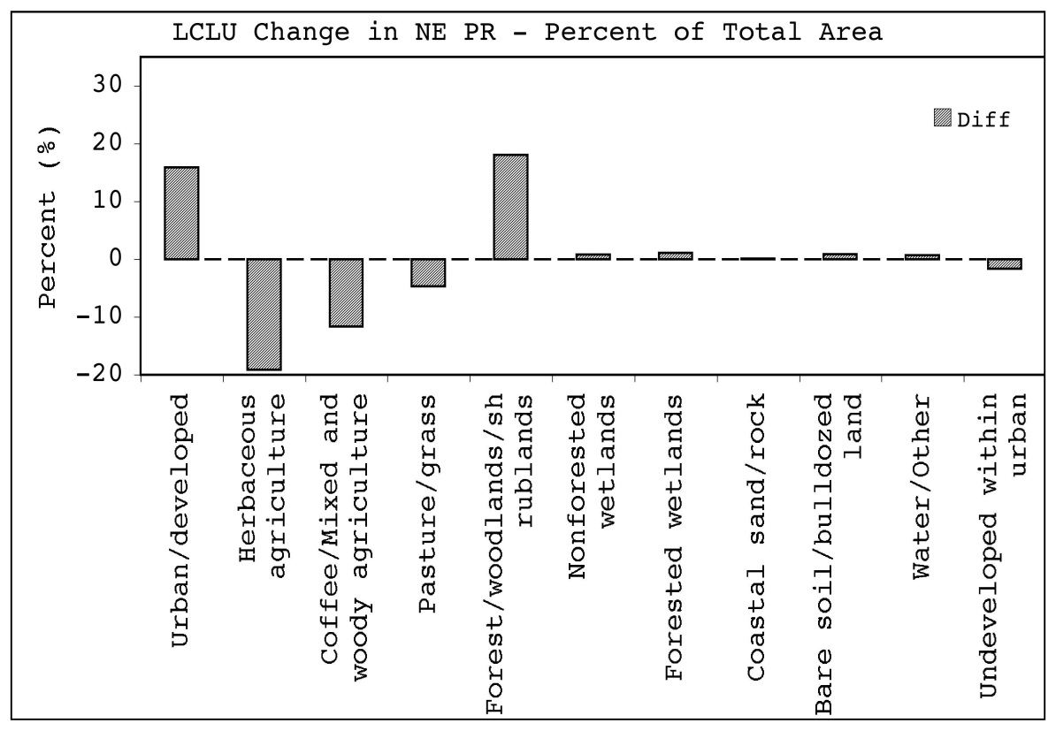
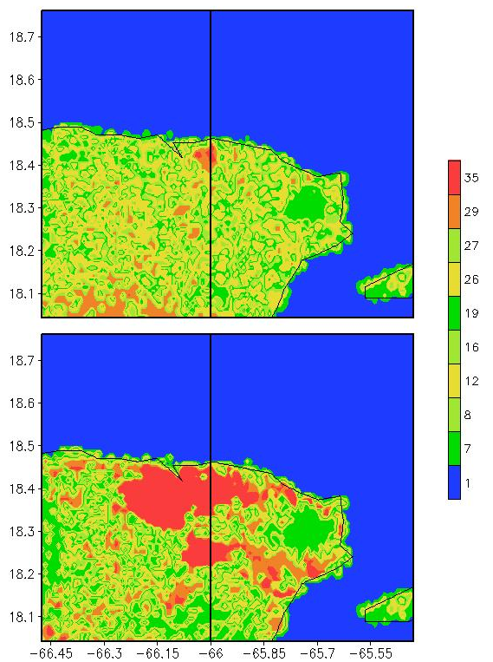
LCLU Changes - Northeastern PR
1951
PRESENT

Slide 10

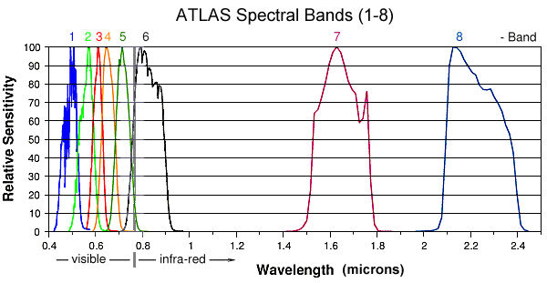
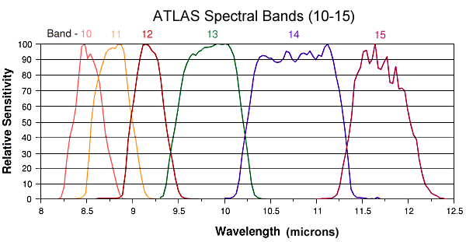
OBSERVING THE UHI OF SJMA -ATLAS CAMPAIGN-
The Airborne Thermal and Land Applications Sensor (ATLAS) from NASA/Stennis operates in the visual and IR bands. It flies on a Lear 23 jet for flexibility and produces high resolution images.
ATLAS visual and IR spectrum. The mission also operated a 9 inch Zeiss camera for high resolution photographic work.
Notes:
http://www.esad.ssc.nasa.gov/srf/

Slide 11
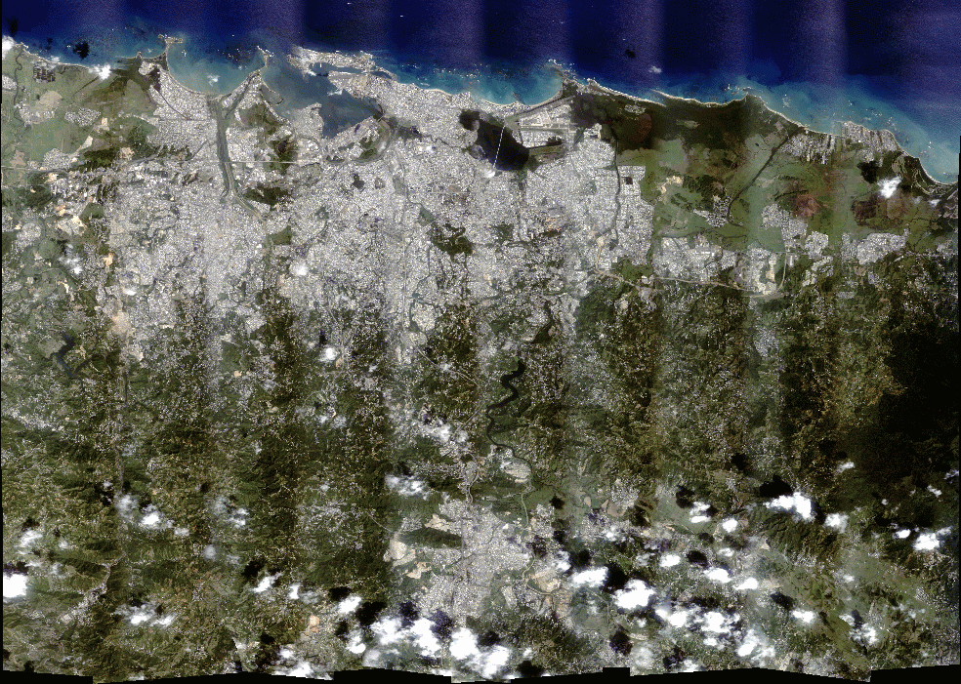
San Juan F5 Mosaic (True Color)

Slide 12
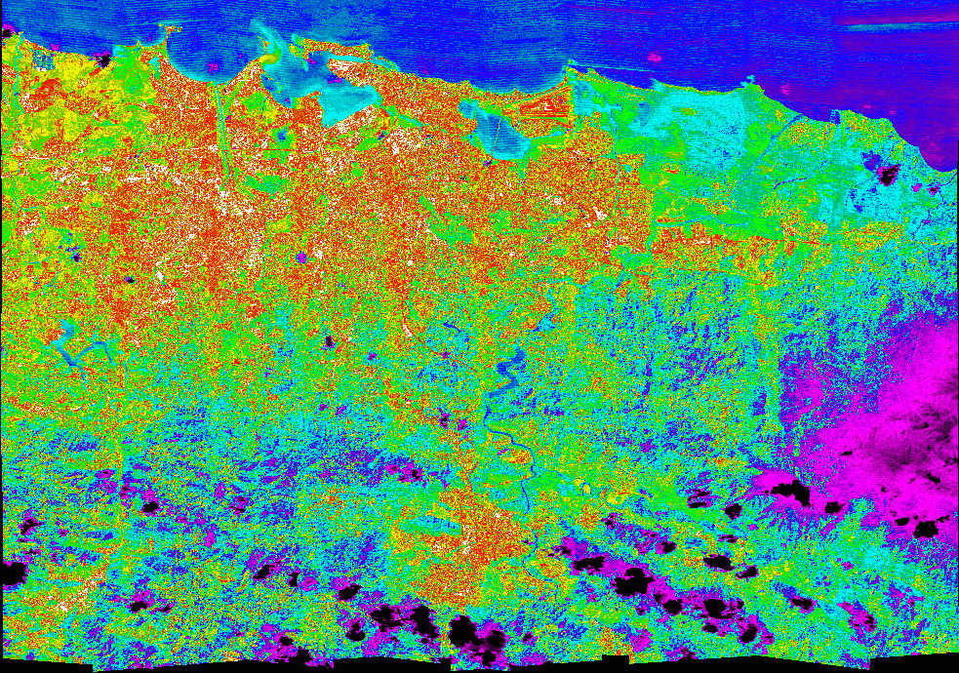

San Juan F5 Mosaic-Temperature
10 20 26 27 28 32 39 41 48

Slide 13
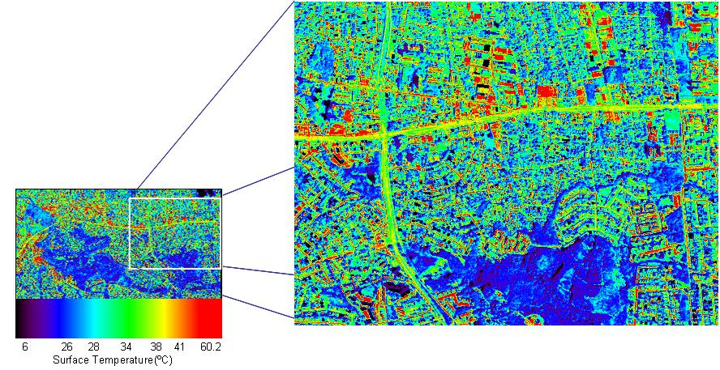
Sample DAYTIME ATLAS image for San Juan
Daytime image from ATLAS sensor, taken at 10 meter resolution. 16 February 2004. (f1.231)

Slide 14
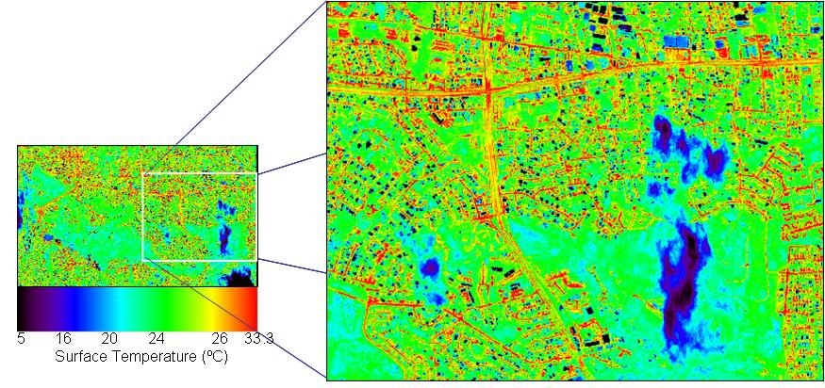
Sample Nighttime ATLAS images for San Juan
Nighttime image from ATLAS sensor, taken at 10 meter resolution. 16 February 2004. (f2.231)

Slide 15
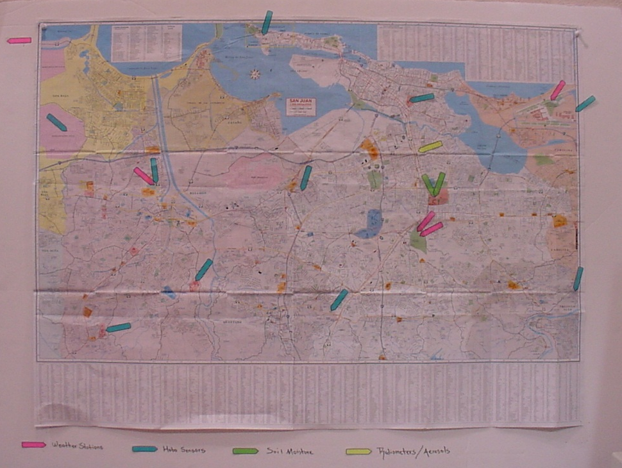
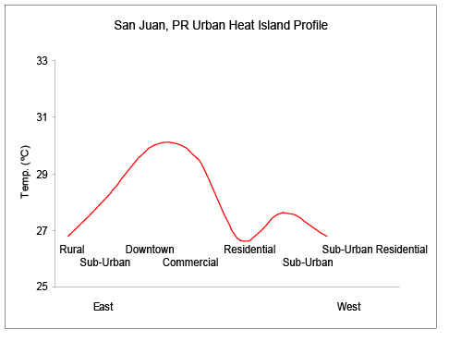
Observational Analysis for SJU
UHI Studies in San Juan
Weather stations and temperature sensors were deployed in the metropolitan area of San Juan, PR and its surroundings; data show strong UHI.

Slide 16
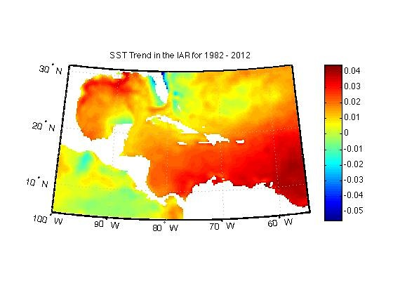
Recent Detected Changes of SSTs in the IAR Spatial Trend (degC/yr)
Glen et al. 2015, GRL
Notes:
Region that includes the Caribbean, Mexico, Central America and parts of North and South America

Slide 17
UHI & Global Warming:
Impact Analysis for SJU
Quantify impacts of the UHI on the local climate.
Answer key science question:
What are the combined effects of global climate change and LCLU in a tropical coastal region?
Method: Regional Model simulations with current vs. past urban Land-Use/Land-cover (1 km-resolution)

Slide 18
Numerical Experiments Matrix
Run ID | LCLU | Driving Conditions**
Present1* | 2000+RS | 2000-04 Atmospheric and Oceanic Conditions
Present2 | 2000+RS | 1955-59 Atmospheric and Oceanic Conditions
Past1 | 1951 | 2000-04 Atmospheric and Oceanic Conditions
Past2 | 1951 | 1955-59 Atmospheric and Oceanic Conditions
* Control run
** The timeframe for the present and past climatology were selected as to reduce the influence of the El Niño Southern Oscillation (ENSO) and the North Atlantic Oscillation (NAO) on the Caribbean Early Rainfall Season (ERS) climate, as identified by previous studies (e.g., Malmgren et al. 1998, Taylor et al. 2002), and in accordance with historical LCLU changes.

Slide 19
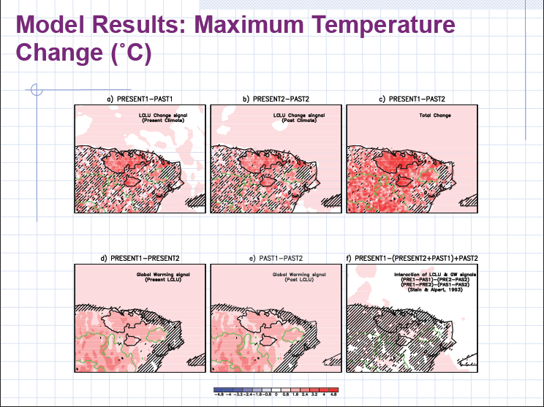

Slide 20
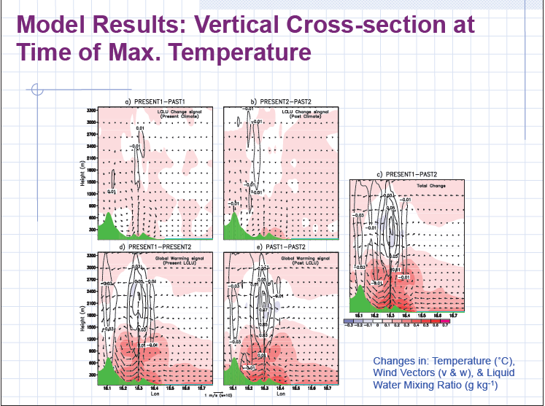

Slide 21

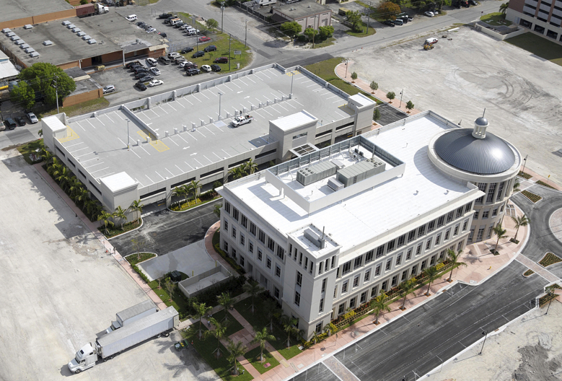

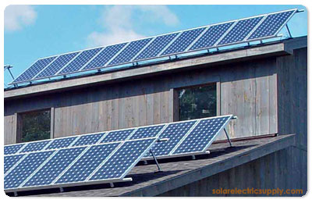
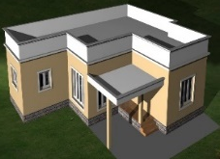
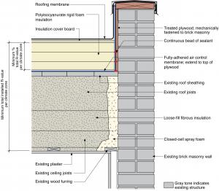
Energy Alternatives to Mitigate Peak Building Demand in the Built Environment of SJMA
For the island of Puerto Rico, the current production capacity is close to peak demand. Air conditioning accounts for 60% (commercial buildings) and 40% (residential buildings) of total electrical energy consumption.
Normal roof
Increased Insulation
Efficient
HVAC systems
Cool roof
Target indoor temperature
Tilted PV roof

Slide 22
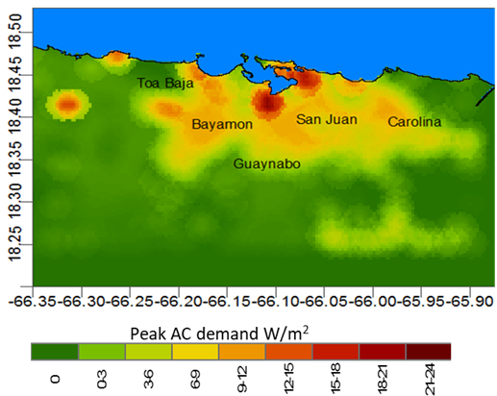
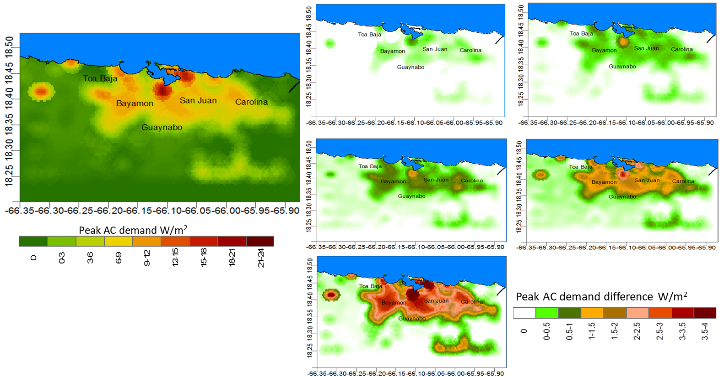
Spatial distribution of building technologies for peak AC demand -Present Climate-
b.
c.
a.
a.
d.
e.
Peak AC demand during an extreme heat day for normal roof
Peak savings normal roof- insulation
Peak savings normal roof-target temperature
Peak savings normal roof- white roof
Peak savings normal roof- COP
Peak savings normal roof- combination of all of the above
f.
(Pokhrel et al. 2019/B&E)

Slide 23
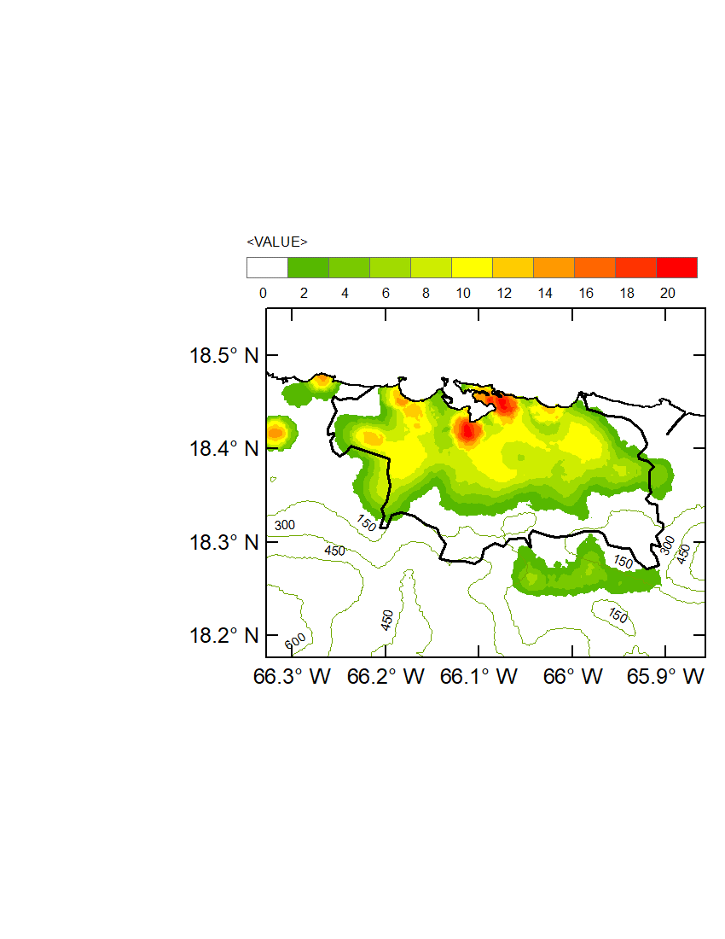
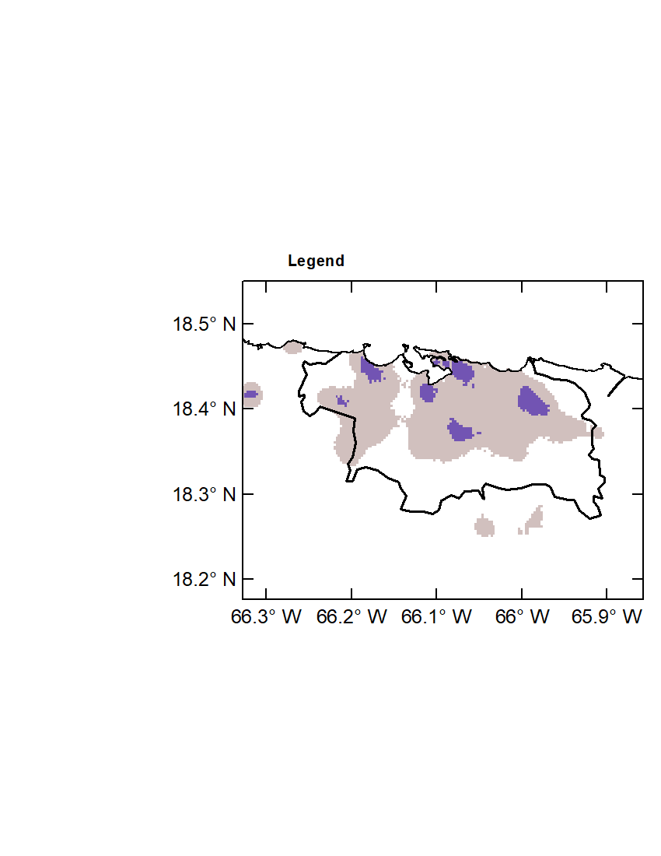
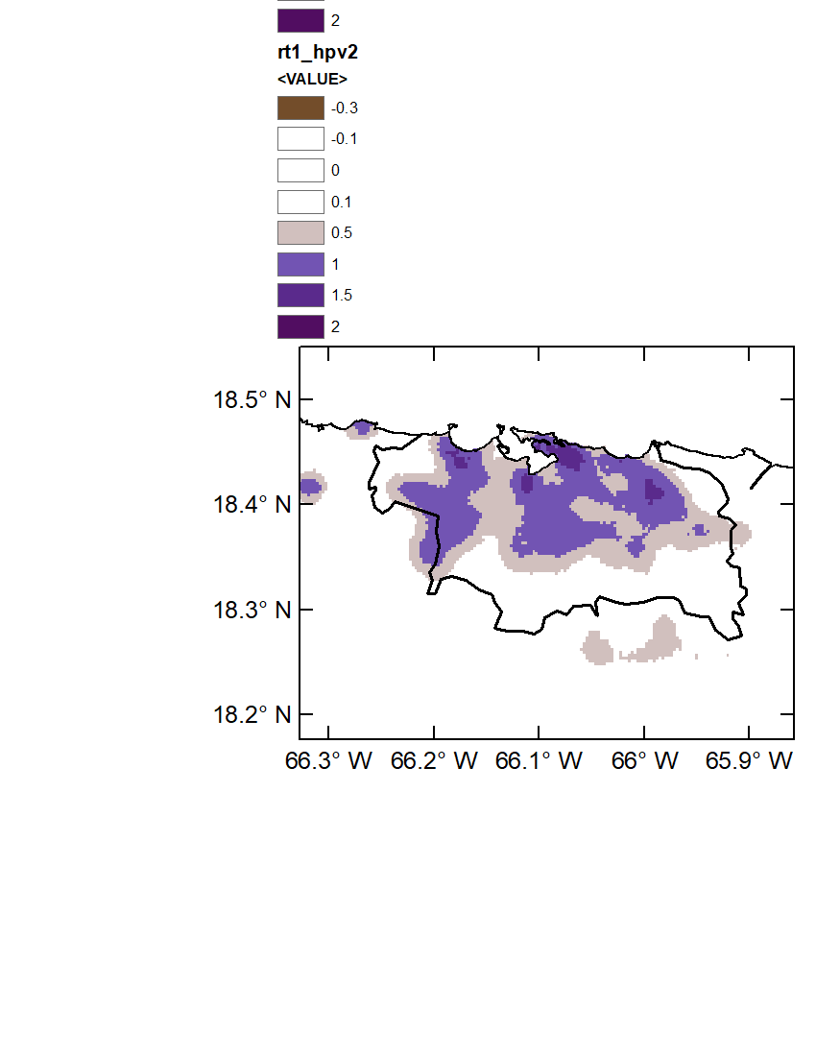
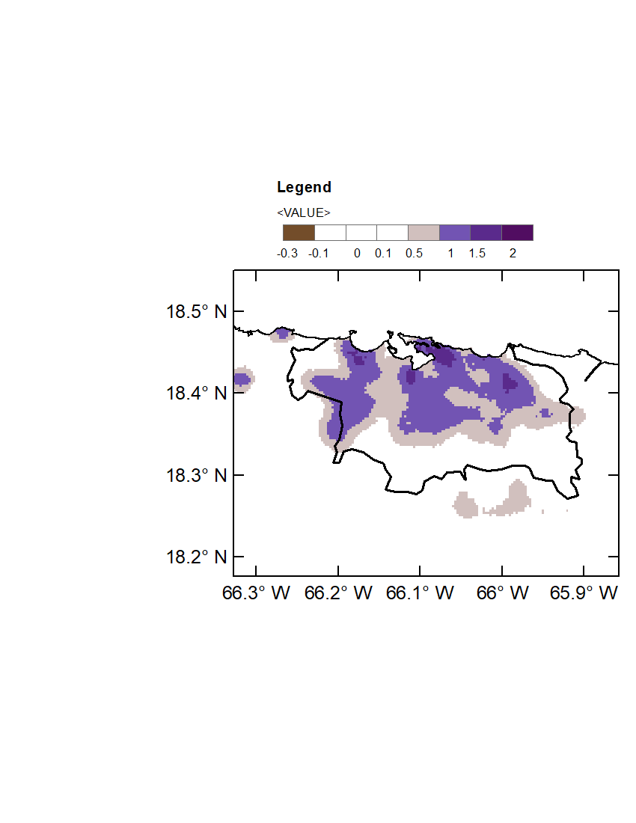
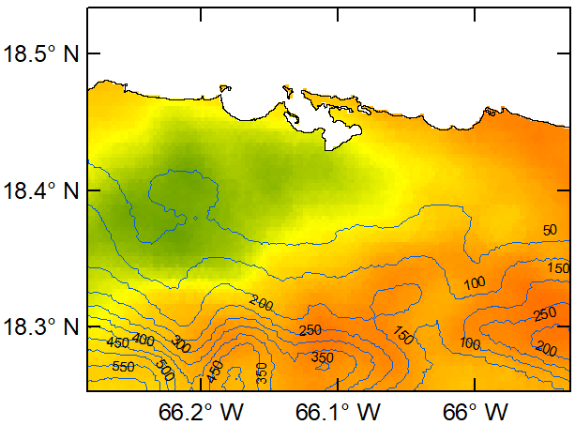
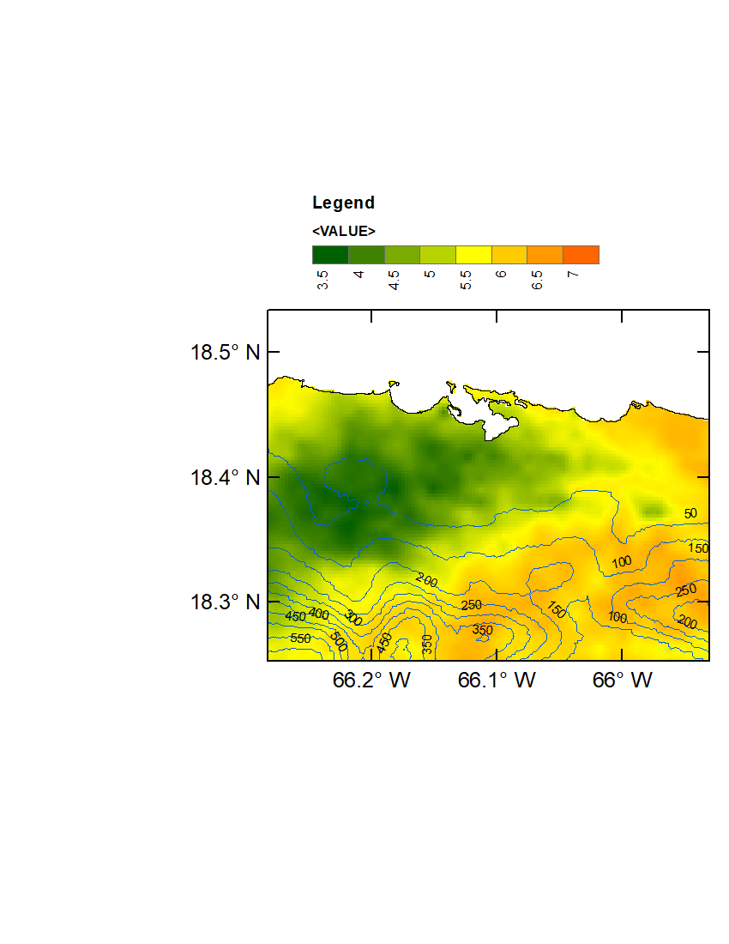
Results for SJU- Peak AC demand from integrated solar PV systems
Normal roof
Normal roof – tilted PV
Normal roof – cool roof
Peak AC demand (W/m²)
Peak AC demand difference (W/m²)
Peak AC demand for normal roof is seen to be higher at compact high rise buildings reaching 20W/m², twice than compact low rise buildings.
Peak AC demand difference indicates that PV and cool roof reduces the demand by 5% to 10% respectively.
Mean radiation on tilted PV is 5.5~6 kWh/m²/day.
Total daily radiation on tilted PV (kWh/m²)

Slide 24
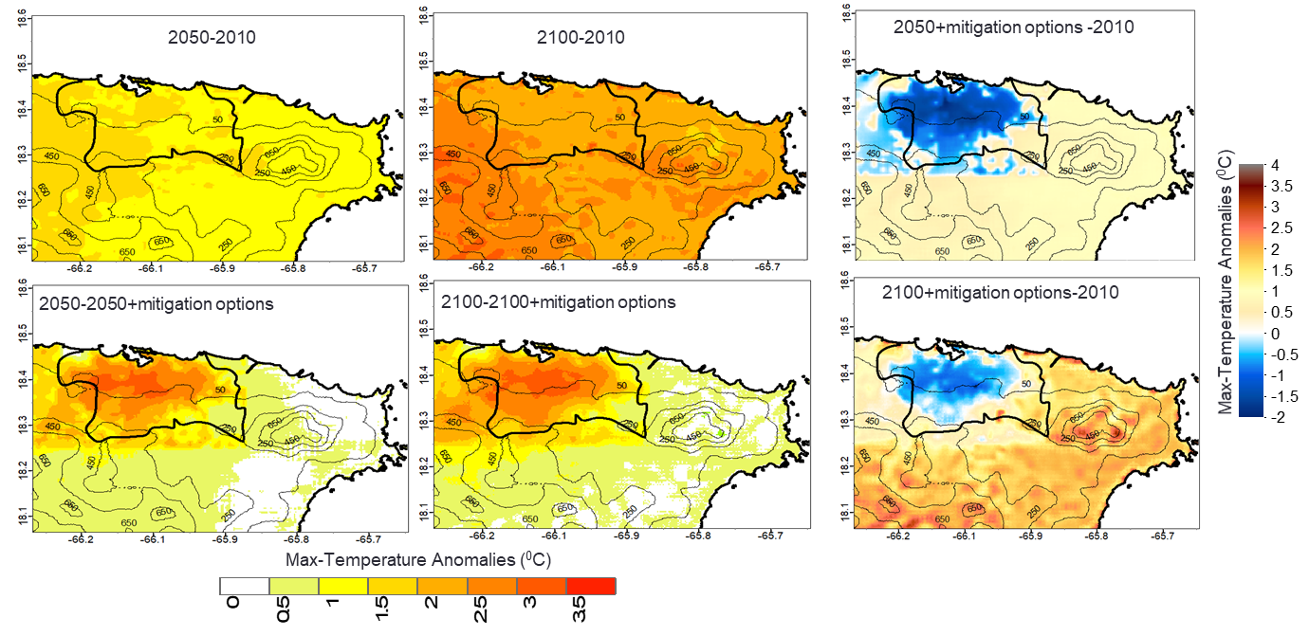
Impacts of energy mitigation options on
Future maximum temperatures (mean of 2 PM LST)
Maximum temperatures (mean of 2 PM LST) increase in 2050 is 1 to 1.5 ⁰C and more than 2⁰C for 2100.
Energy mitigation alternatives reduce the urban temperatures by 2.5 to 3⁰C for both time periods.

Slide 25
Max (2PM LST) and Min (6 AM LST) future AC demand anomalies
Peak ac -> increase by 0.5 -1 W/m² by 2050 (increase of 6- 8%) and 2 to 2.5 W/m² by 2100 (increase of 16-20%).
Increase in minimum AC demand is 0.5 to 1 W/m² (increase by 25~30%) by 2050 and 2100.
Peak AC demand reduction potential is much higher than the increase for 2050 and 2100.

Slide 26
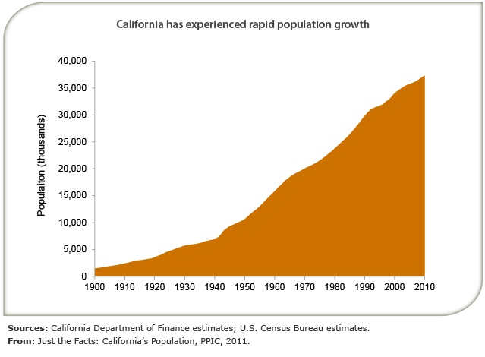
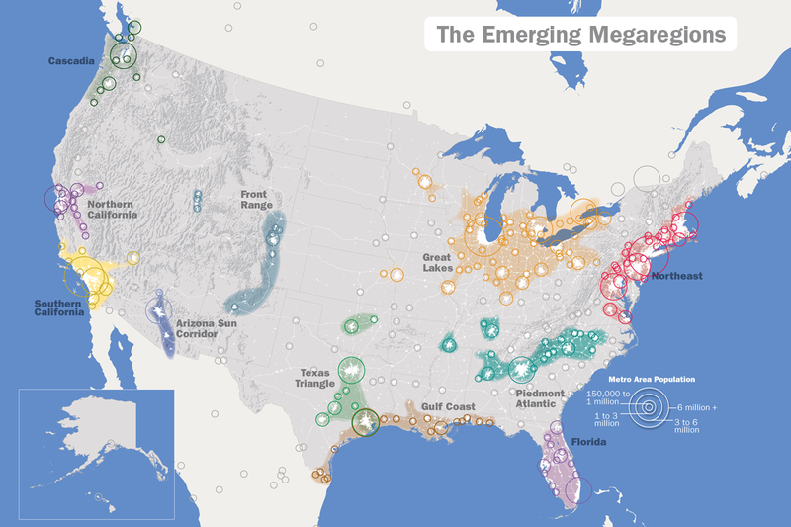
Case-II: LAX & SFBA Areas
Regional Climate in Over-populated Areas (Megapolis)
During the 20th century, California experienced, tremendous population growth (2M in 1900, 10M in 1950 and 37 in 2010).
Approx. 70% of California population lives in coastal counties (US Census 2010).
Source: America 2050

Slide 27
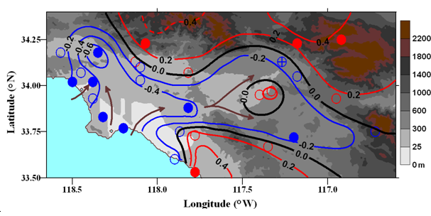
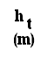
LAX-Result : Lebassi, Gonzalez,
Bornstein et al. (2009) J. of Climate
Observed 1970-2005 CA JJA max-Temp (⁰C/decade) trends in SFBA & SoCAB show concurrent:
> low-elev coastal-cooling & > high elev & inland-warming
> signif levels: solid circles >99% & open circles <90%)

Slide 28
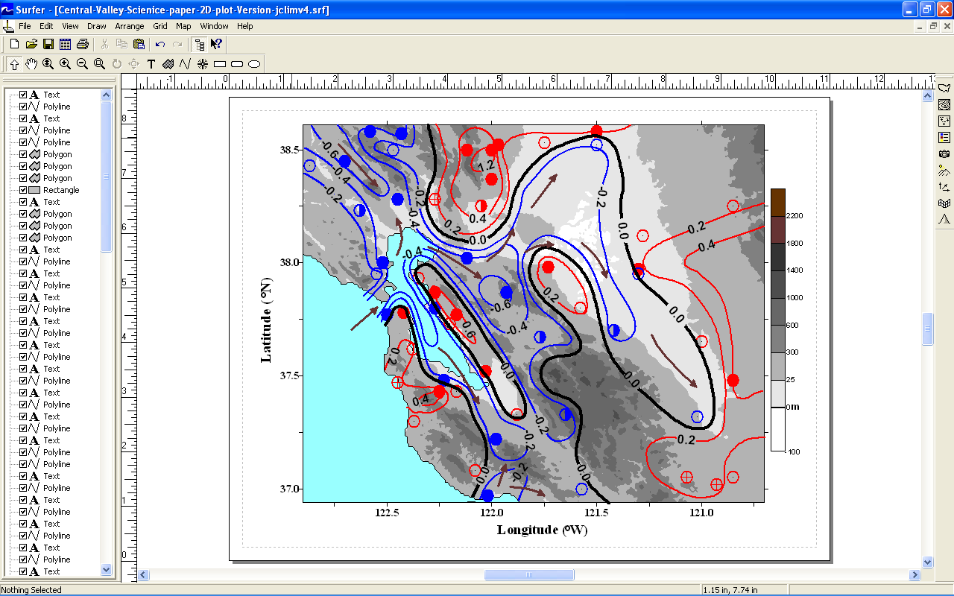
SFBA: Same for SFBA & Central Valley COOLING AREAS: MARIN LOWLANDS, MONTEREY, SANTA CLARA V., LIVERMORE V., WESTERN HALF OF SACRAMENTO V.

Slide 29
Hypothesis: Observed Calif temp trends resulted from
a. GHG WARMING/LCLU and/or
b. INCREASED INLAND WARMING →
INCREASED HORIZONTAL T- & p-GRADIENTS
(COAST TO INLAND)→
INCREASED SEA BREEZE FREQ, INTENSITY,
PENETRATION, &/OR DURATION →
COASTAL REGIONS DOMINATED BY SEA BREEZES SHOULD THUS COOL DURING SUMMER DAY-TIME PERIODS

Slide 30
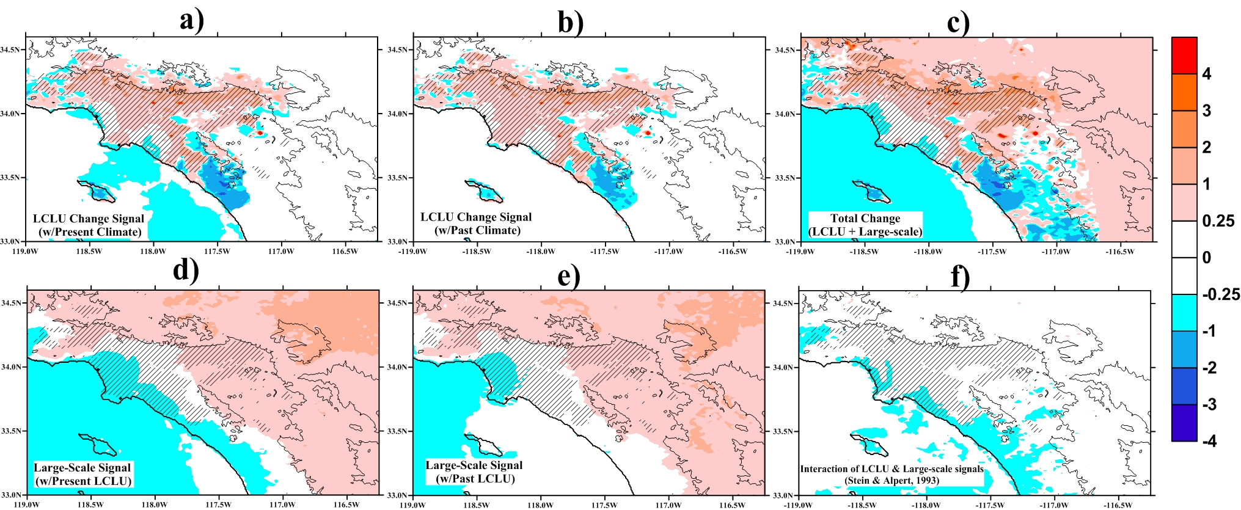
LCLU vs. GW
D3 changes at 2 PM PST in T_{max}: 2009-13 minus 1982-86
Hatched areas: 2013 urbanized; White-areas: non-significant changes, at p >5% signif. Level; Black lines indicate 700m and 2000 m MSL topography contours
a)
b)
c)
d)
e)
f)
Cooling in low-elevation coastal areas (similar results as Lebassi et al. 2011) for all scenarios
Cooling more intense (over -1°C/30 years) and more extended when looking at changes due to large-scale signals (Panels d and e) compared to changes due to LCLU (panels a and b). Clear warming of inland areas (up to 2°C/30 years) on simulations driven by large-scale signal changes (panels d and e)
TOTAL CHANGE (panel c): coastal-cooling present. Both factors contribute to the cooling. Large-scale changes dominate over LCLU changes.

Slide 31
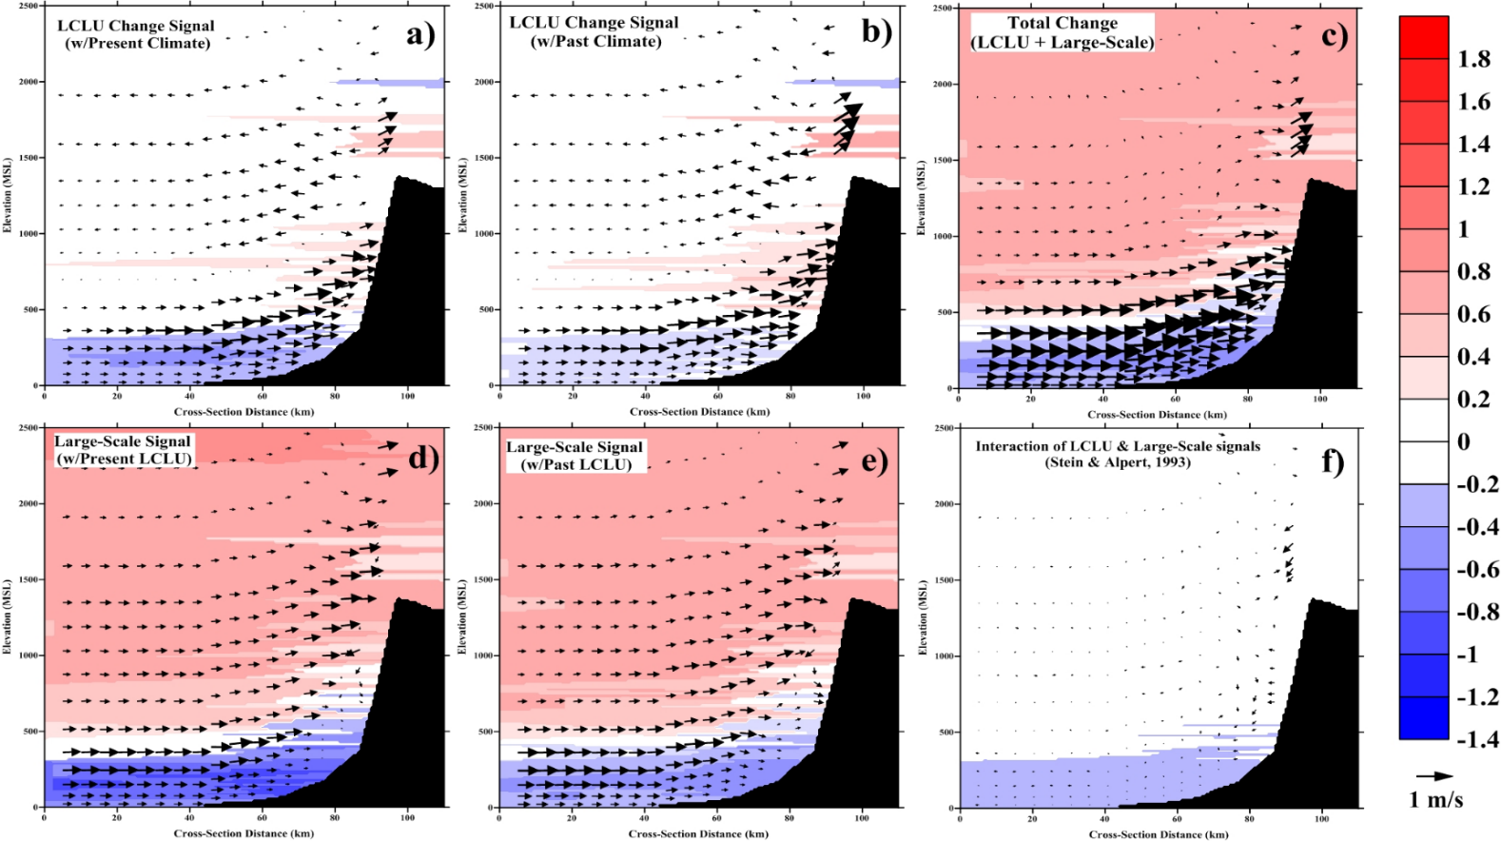
LCLU vs/or w/ GW
Changes in vertical temp. and winds at 1400LT 2009-13 minus 1982-86 (Decreasing PDO vs. LCLU)
a)
b)
c)
d)
e)
f)
Large-scale signal dominates in the total change of temperatures
Overall increasing sea-breeze in all scenarios (except the non-linear interaction).
Significant Non-linear interaction in cooling regions. Coastal-cooling is more intense at present urbanization (panel d) and present climate (panel a)
Cooling occurs b/l 600 MSL (vertical extent of the inversion layer) as detected by Lebassi et al. 2011

Slide 32
Impacts on Peak Summer Electricity-Trends for 1970-2005 (Degree Days)
Spatial distributions of 1970–2005 summer CDD trends (DD/decade, where red pluses show increasing values and blue dashes show
decreasing values) for the SoCAB (Lebassi et al. 2010).
Notes:
32

Slide 33
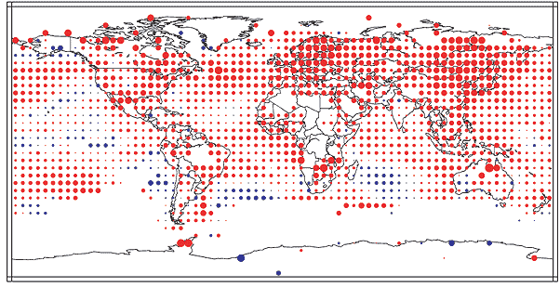
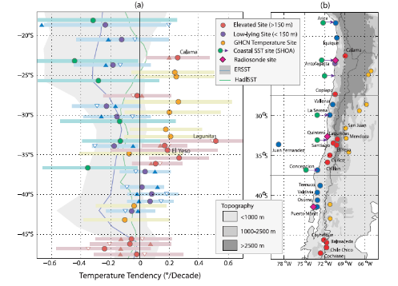
Coastal/Urban Cooling/Warming Phenomena in a Changing Planet
Similar coastal cooling effects have been reported in other regions of the world, more specifically, the South American coastline (Falvey and Garreaud, 2009; Dimitri Gutiérrez et al. 2011).

Slide 34
Case-III: NYC
Current Benchmark of Tmax @ NYC
Annual average daily maximum summer temperatures. (June, July, August) from 1970 to 2013. *Central Park trend is significant at 0.01 level, while LGA and JFK trends are positive but not significant, possibly due to shorter record length.
Source: Gonzalez et al. NPCC 2019

Slide 35
HW Mean Event Projections
Mean event duration anomalies display an almost opposite geospatial gradient compared to event intensity, likely due to sea-breeze reduction.
Source: Ortiz et al. 2019; IJoC

Slide 36
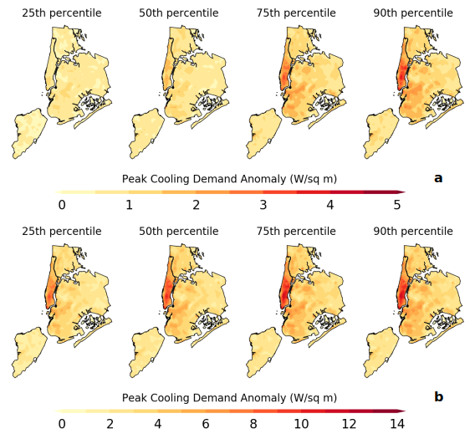
AC Peak Demand projections (2095-2099)
RCP4.5
Highest W/sq m increases over Manhattan, downtown Brooklyn across distribution
RCP8.5 increases can be up 3-4 times higher than RCP4.5
RCP8.5
Ortiz, et al., ERL, 2018.

Slide 37
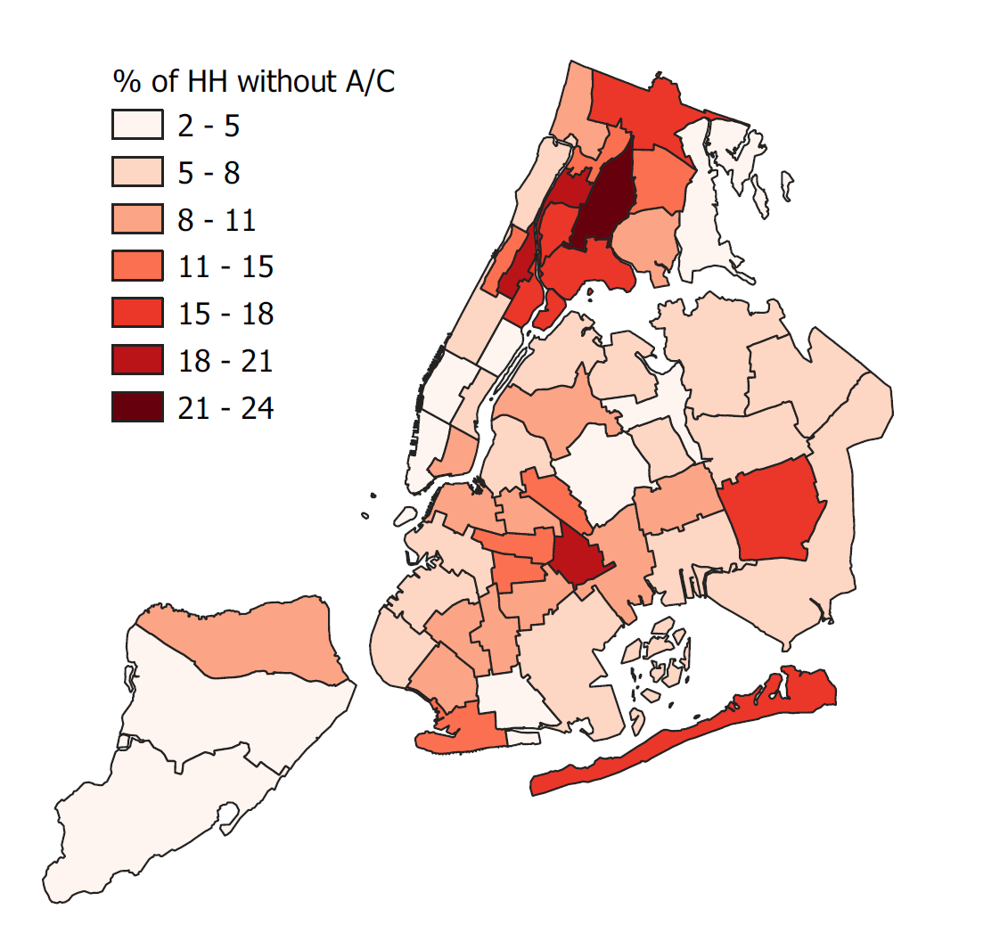
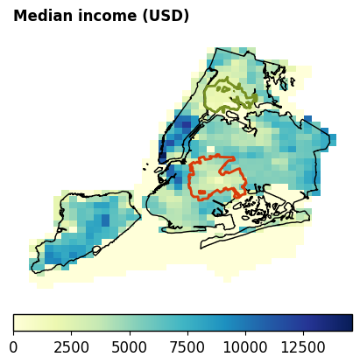
Socio-economic implications of mitigation policies
Source: NYC Housing and Vacancy Survey 2017
Socio-Economic Impacts of A/C as Mitigation Option
Percent of households without A/C
Ortiz et al. 2022 (Sus Cities & Society)

Slide 38
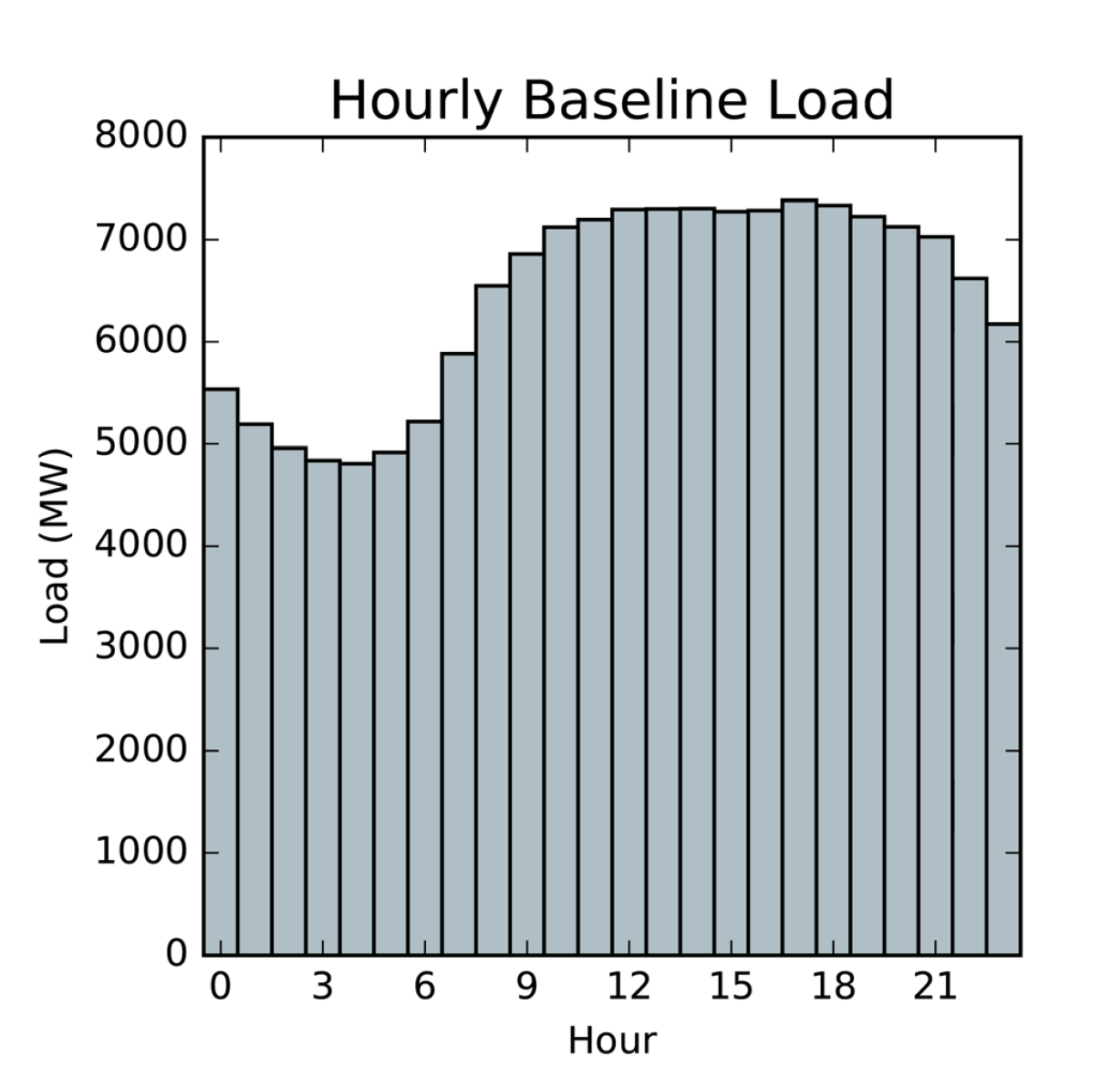
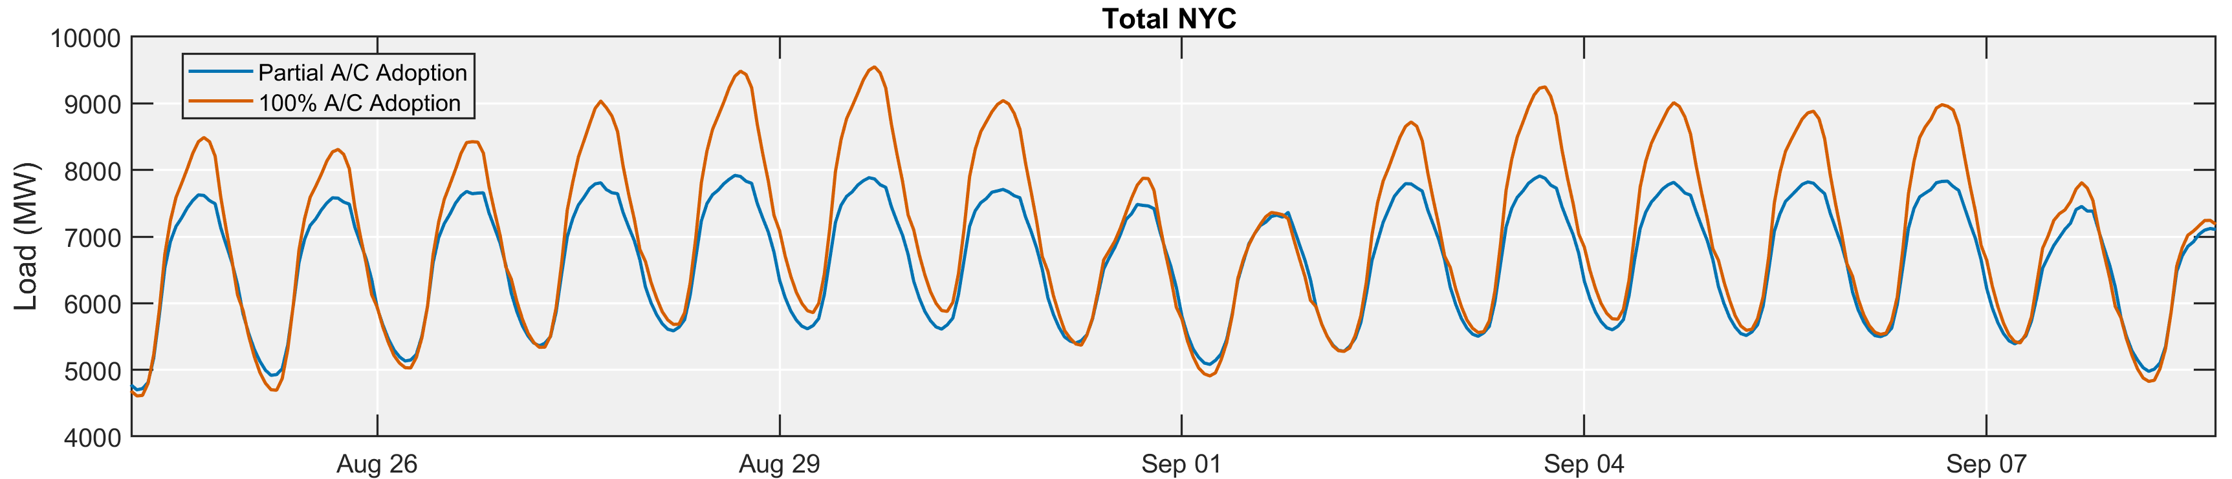
Present Time Total NYC Load
NYC Total Energy Load Prediction
Total Energy is derived from the sum of baseline Energy Demand
(Ortiz et al. 2017)
~ 20% Peak Load increase when using 100% AC

Slide 39
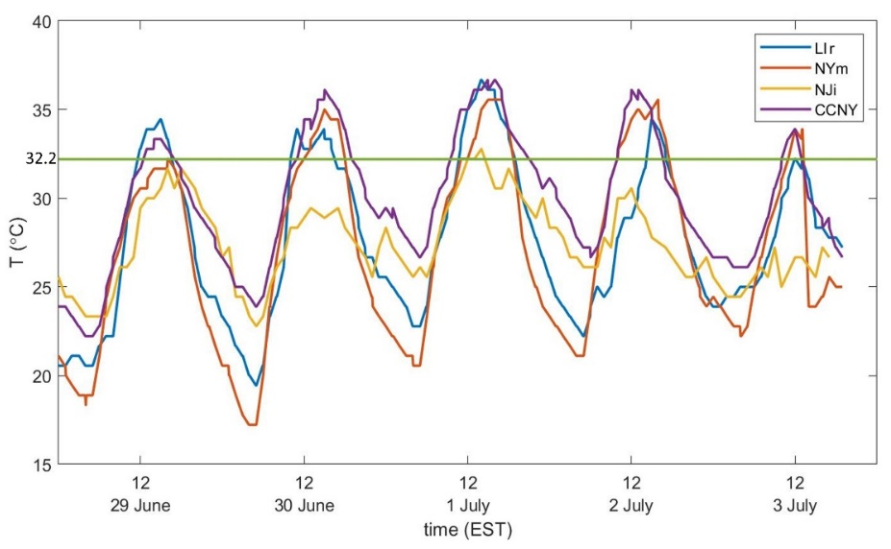
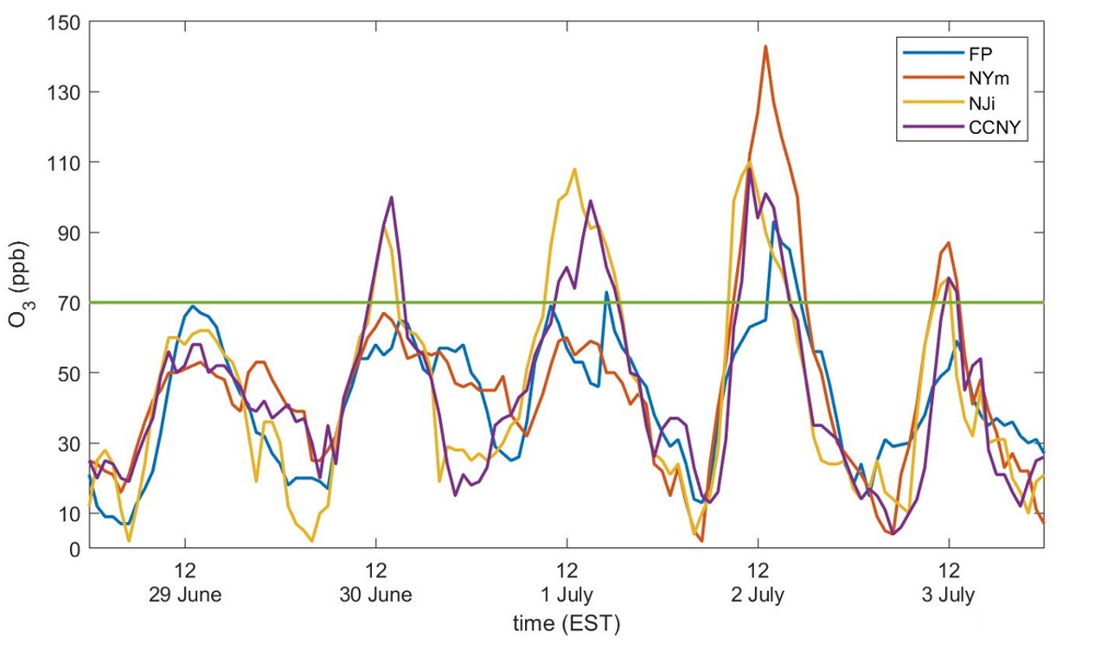
Challenges ahead for Mega Cities: Heat+Humidity+Air Quality+See Breeze Peak Ozone >100 ppb During Early July 2018 Heatwave
New science Questions
Does urban dynamics effect the distribution of air pollution along a coastal mega city?
To what extent does land-ocean thermal gradients affect coastal city air quality?
Temperature
Ozone
Han et al. Urban Climate, 2022

Slide 40
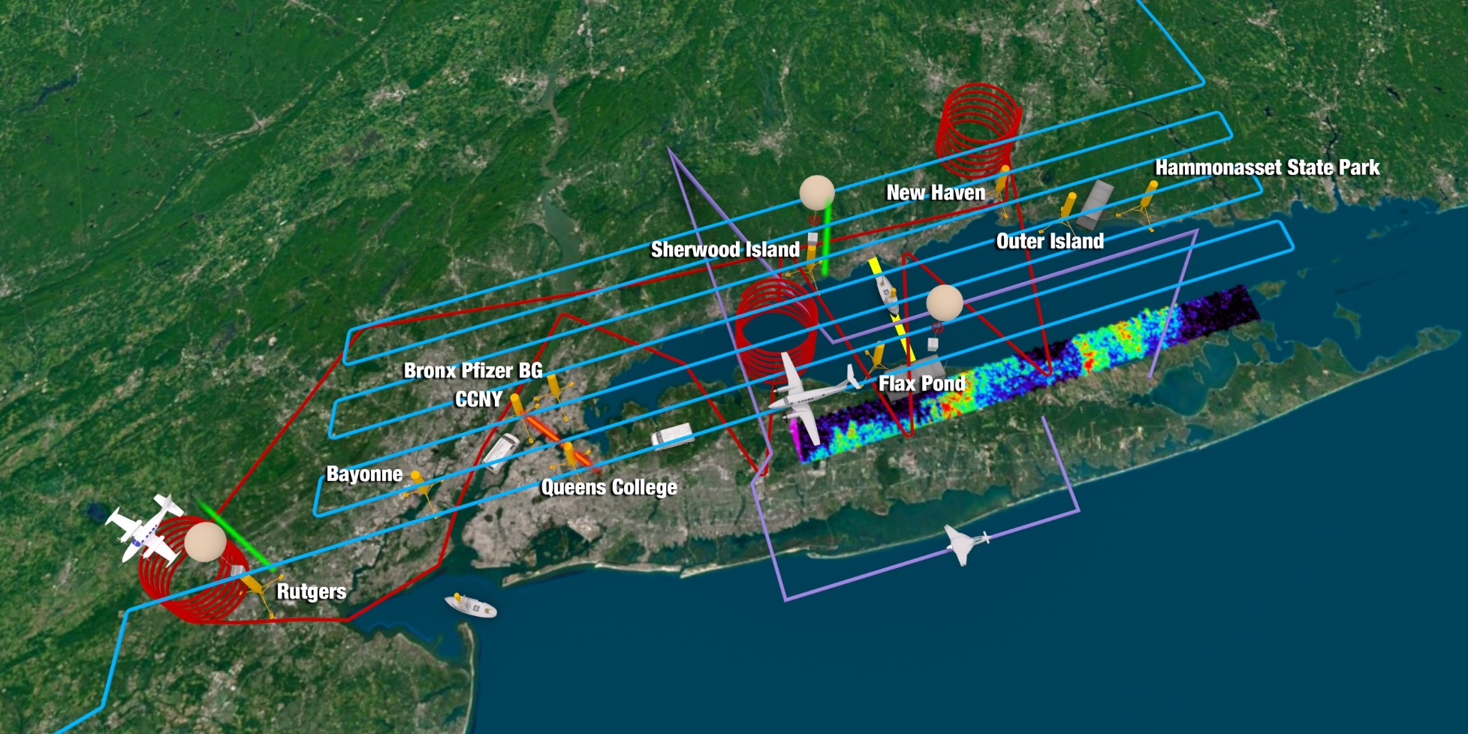
Case study: The Long Island Sound Tropospheric Ozone Study (LISTOS/2018)
https://www-air.larc.nasa.gov/missions/listos/

Slide 41
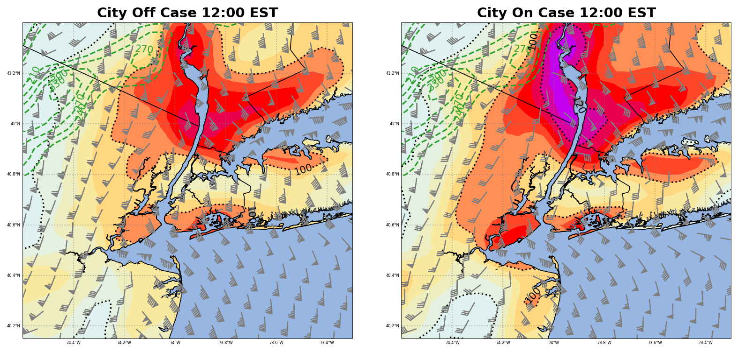
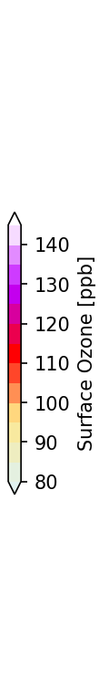

Coastal Urban Modeling Framework: Climate-AQ
Urban Dynamic Impacts on ozone distribution:
2 July 1200 EST: o3 (ppb, colors), V (kt)
Ozone peak is further northward in urban on as NYC UHI-aided (not shown) land sea temp gradient produced faster onshore flow north of SBF, which
Faster NYC winds advects precursors northwards
2 July 1400 EST: o3 (ppb, colors), V (kt)
Slower winds over NYC in Urban-on case are correct due to lack of UHI & roughness deceleration

Slide 42
Reflections for Coastal Cities on a Warming Climate
Coastal/urban regions are particularly sensitive to climate changes, and respond in unique ways to global/regional environmental changes and to local dynamics.
The assumption of positive-feedback, may not be correct.
The complex Δ(LCLU+Climate) for coastal urban environments requires both: Long-term climate records (SSTs; UA) & of land surface changes at urban scale resolutions, as minimum.
Elevating our knowledge of these combined reactions open opportunities to guide effective mitigation options of socio-technical nature.

Slide 43
Open Questions
The size and complexity of our cities along with tendencies for a warming climate have reached levels such that demand new, updated approaches for environmental forecasting including air quality and energy.
New science questions related to present may focus on understanding the overall role of Anthropogenic activity in the local environment (e.g. heat & air emissions).
New science questions related to future may focus on understanding future (climate + population) dynamics, implication of mitigation policies (such as decarbonization strategies) and consequent impacts on UHI, AQ, energy infrastructure, and people’s health and economic wellbeing.

Slide 44







Thank you!
__________________________________
Prof. Jorge E. Gonzalez
SUNY Empire Innovation Professor
Atmospheric Science Research Center
&
Presidential Professor
The City College of New York
Jgonzalez-cruz@albany.edu
http://cuerg.ccny.cuny.edu
July 4, 2010 at 15:00 Local Time.

