Slide 1

Fusing Virtual Experimental Data on Human Experiences into Building Performance Analysis
US-UK Workshop for Biosensing-Enabled, Wellbeing-Centric Sustainable Built Environment Ecosystems
Nottingham, the United Kingdom, Oct. 27-28, 2022
Yimin Zhu, Ph.D.
Professor
Bert S. Turner Department of Construction Management
Louisiana State University
Baton Rouge, LA 70803
USA

Slide 2
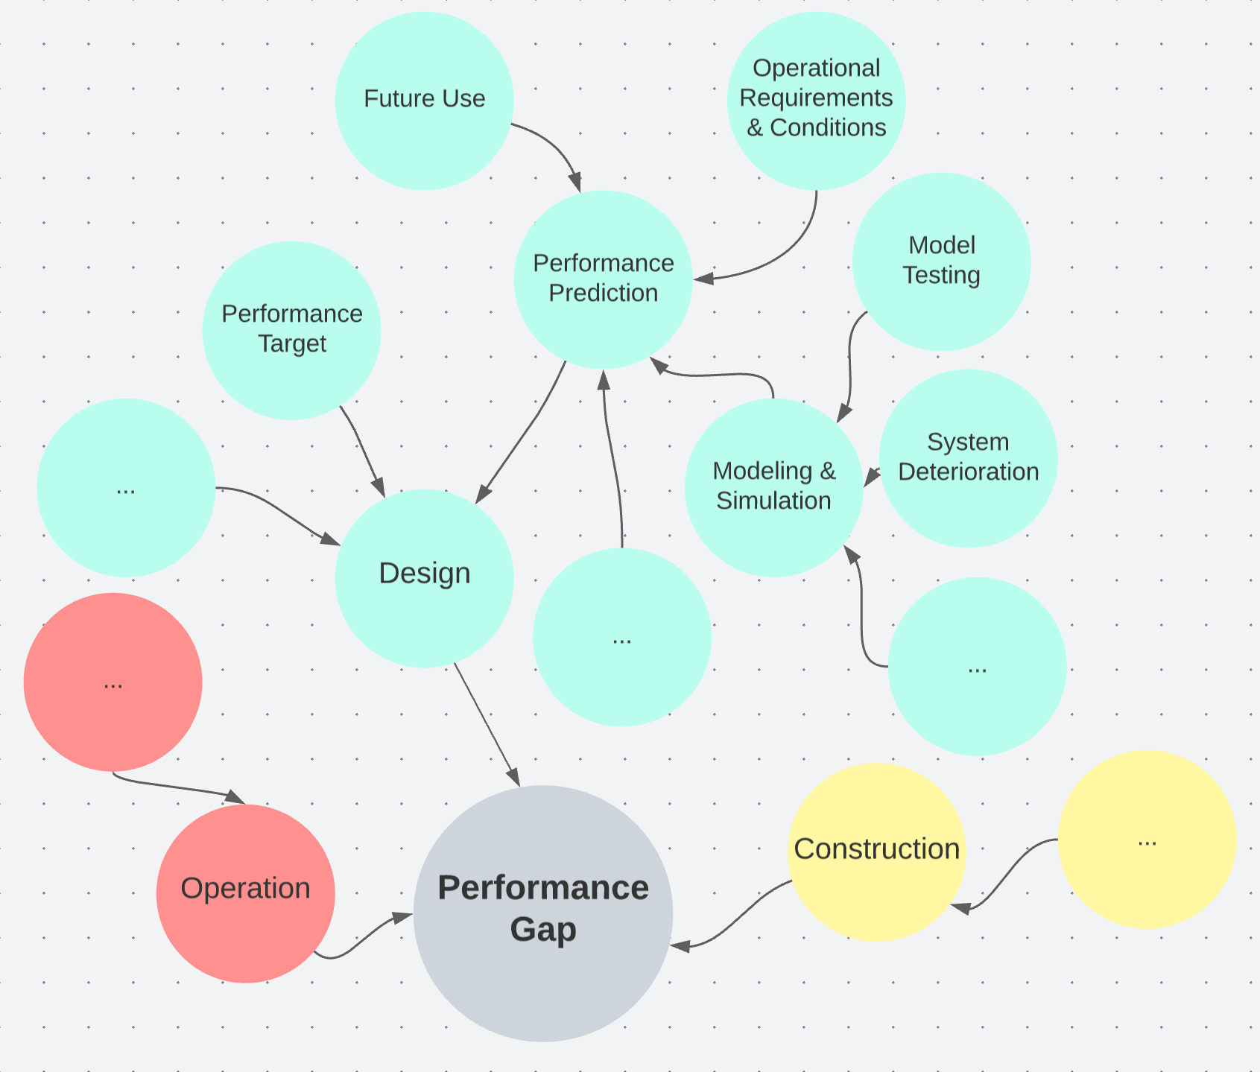
Background
Occupant energy behavior and its modeling and analysis
External validity of models
Context
P. de Wilde, “The gap between predicted and measured energy performance of buildings: A framework for investigation,” Automation in Construction, vol. 41, pp. 40–49, May 2014, doi: 10.1016/j.autcon.2014.02.009.

Slide 3
Data Context – Example 1
Definition of the metabolic equivalent of task (MET)
“…the definition of 1 MET (3.5 ml oxygen/kg/min or 4.184 kJ/kg/h, which approximately equals to 58 W/m² where body surface area is 1.8 m²) is based on measurement of only “one single ‘average’ white male person aged 40 years with a bodyweight of 70 kg” [64]”
Schweiker, M. et al. (2018) ‘Drivers of diversity in human thermal perception–A review for holistic comfort models’, Temperature. Taylor & Francis, 5(4), pp. 308–342. doi: 10.1080/23328940.2018.1534490.
Model & Context
External Validity
Notes:
1902: Willis Carrier invented the first air conditioner
1950s: Air conditioners became extremely popular in suburban homes during the middle of the century, and records show there were roughly 74,000 air conditioners installed during this time.
1970s: Central air conditioning was implemented in most commercial buildings in large cities, and many air conditioning companies popped up to help meet the demand.
https://www.washingtonenergy.com/idea-center/air-conditioning-history-and-timeline/

Slide 4
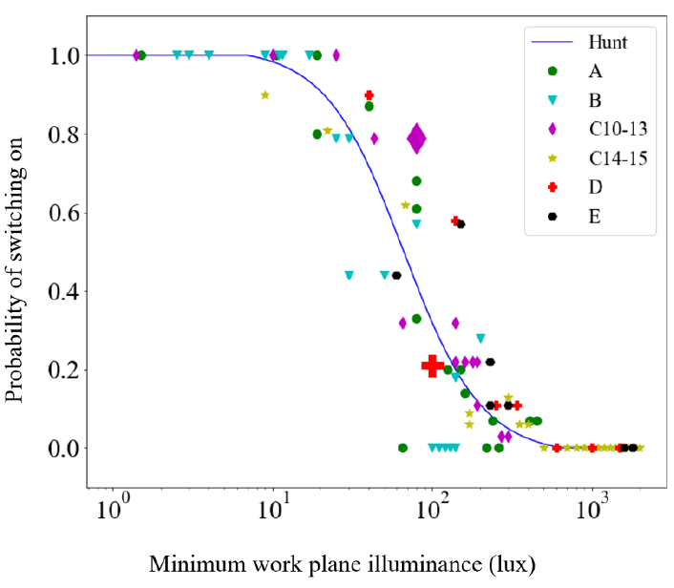
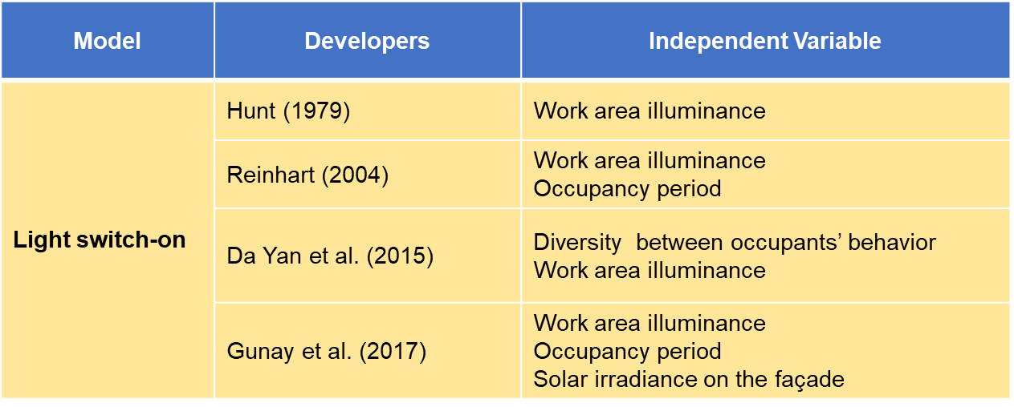
Data Context – Example 2
Notes:
How a known model should be represented and applied
Data, model, and application context need to be modeled and shared.
Groundwork – open data and computing infrastructure.

Slide 5
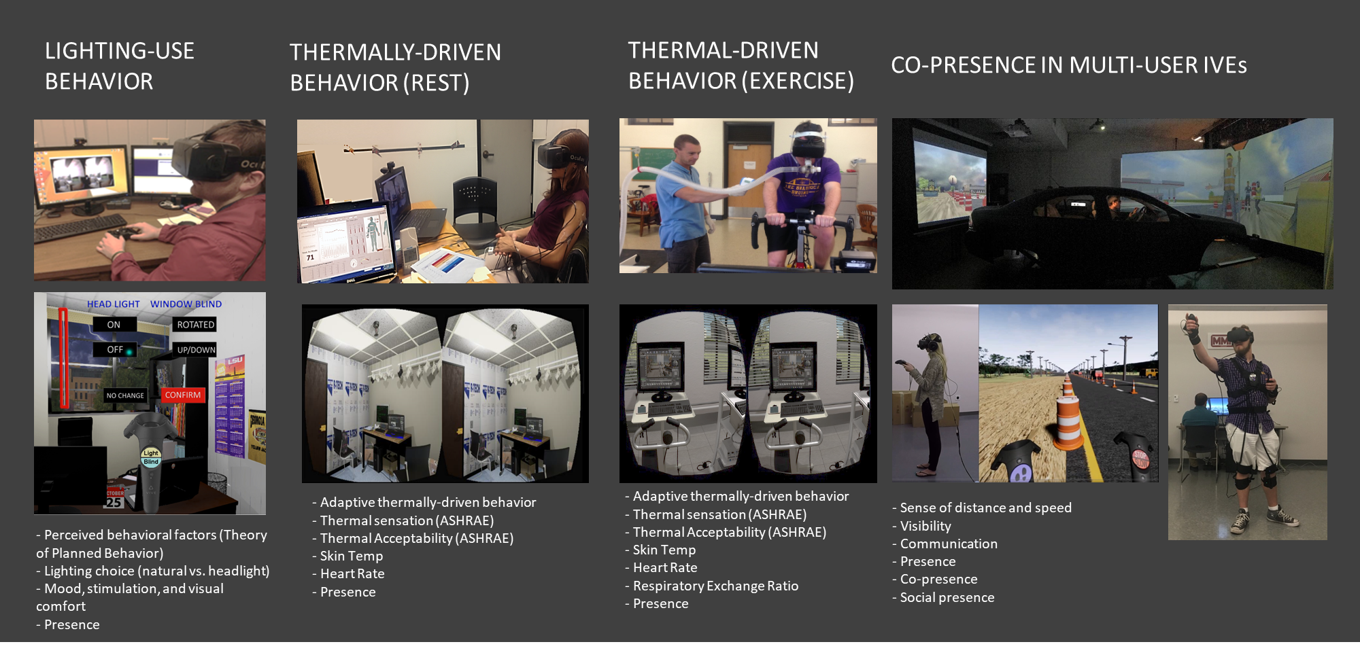
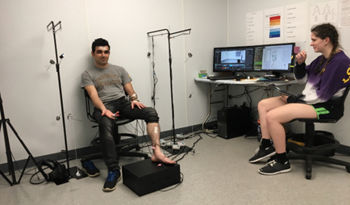
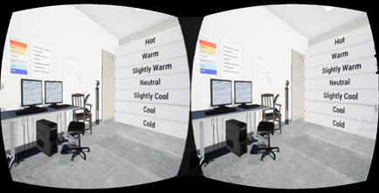
IVE-based Experiments

Slide 6
Data Assimilation using Virtual Experimental Data
Existing Buildings
Virtual Experiments
(New Design)
Data-Driven Models
(Building Performance)
Design-Specific Context-Aware Data
Machine Learning
Augmented Models

Slide 7
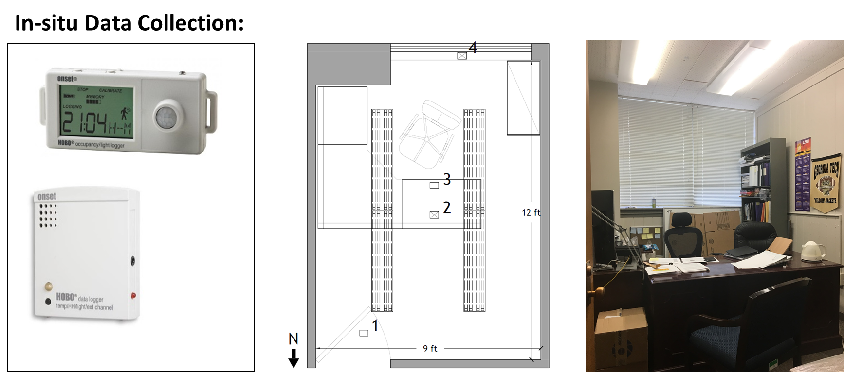
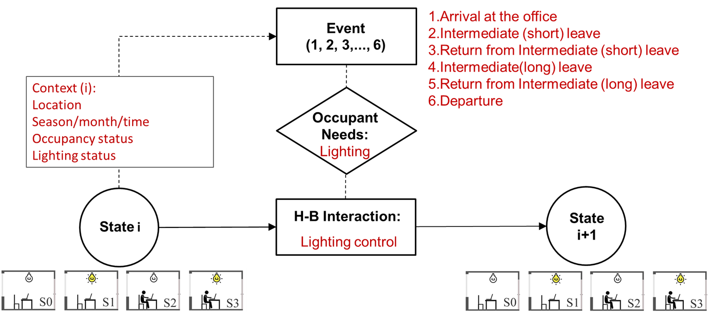
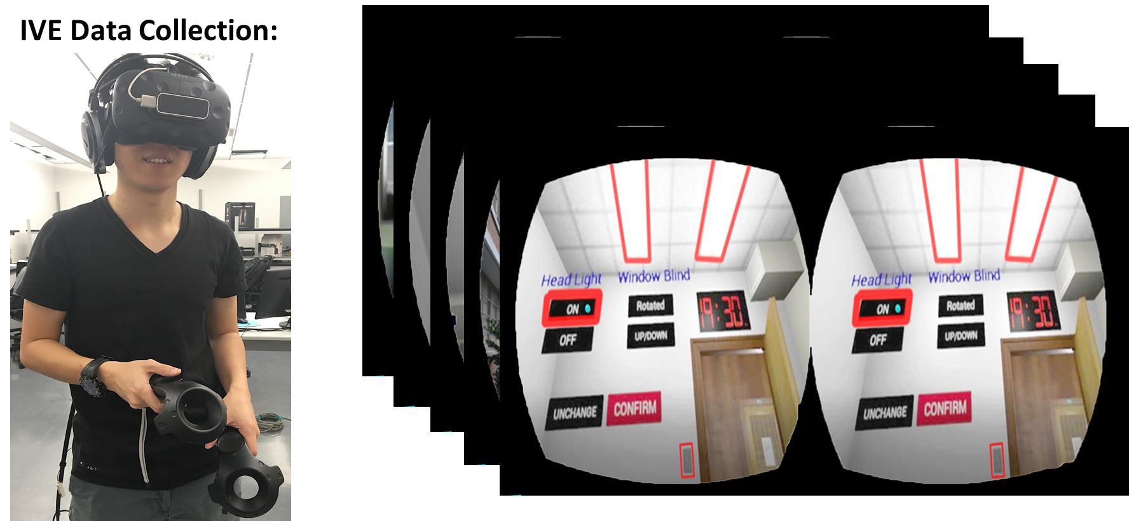
Spatial-Temporal Event Driven(STED) Modeling and Data Collection
Saeidi, S., Chokwitthaya, C., Zhu, Y., and Sun, M., “Spatial-Temporal Event-Driven Modeling for Occupant Behavior Studies Using Immersive Virtual Environment,” Automation in Construction, Vol. 94, pp. 371-382, 2018.

Slide 8
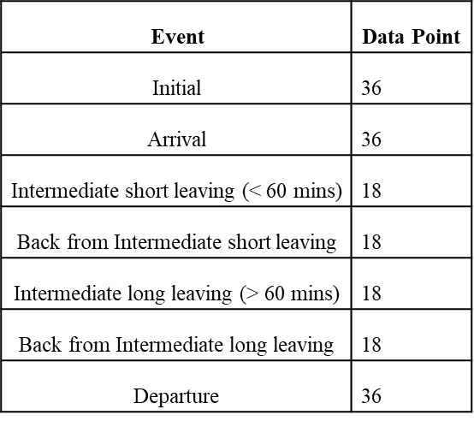
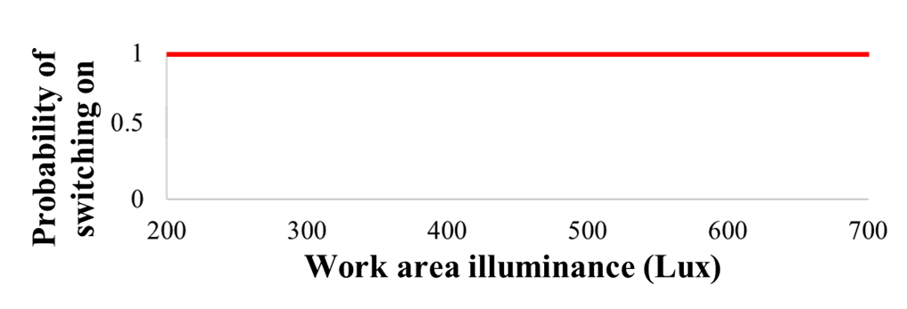
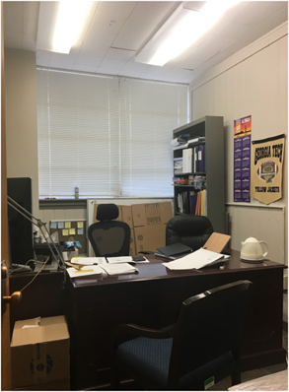
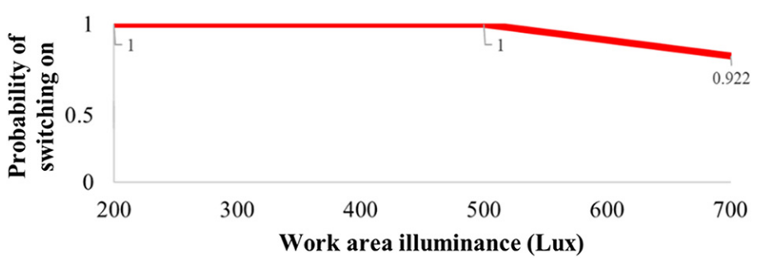
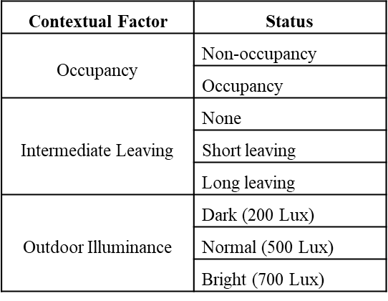
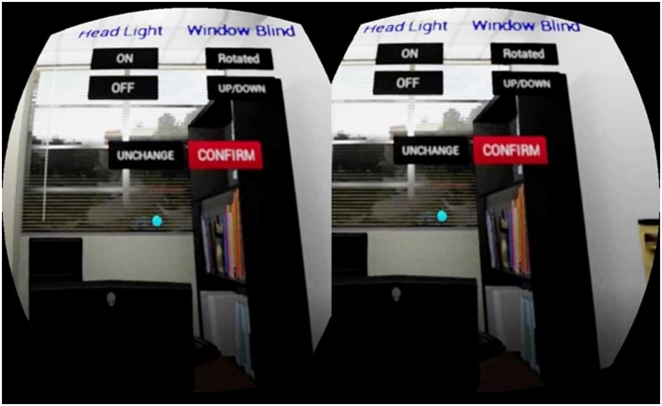
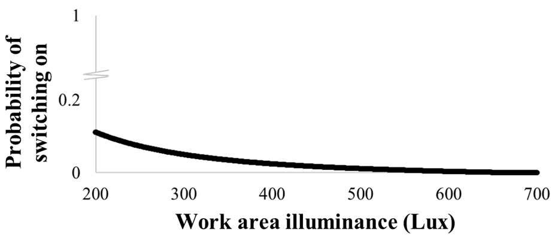
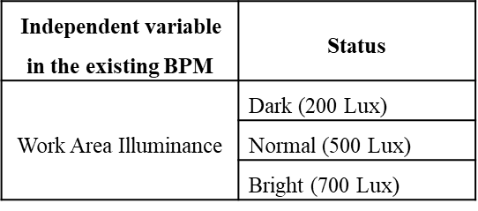
Augmented Analysis Using Machine Learning
Actual
VR
Hunt Model
Chokwitthaya, et al, “Combining context-aware design-specific data and building performance models to improve building performance predictions during design,” Autom. Constr., vol. 107, p. 102917, Nov. 2019

Slide 9
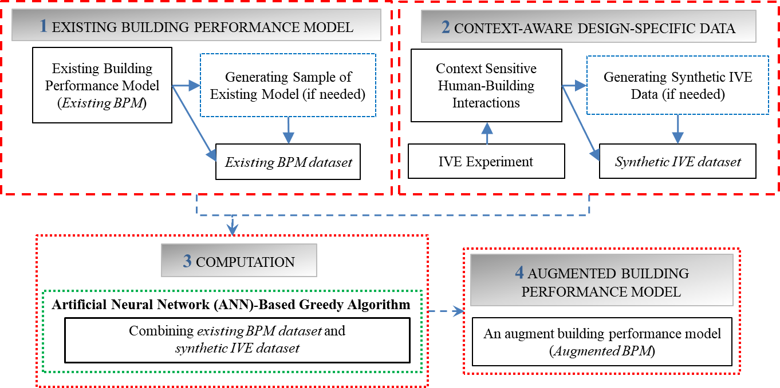
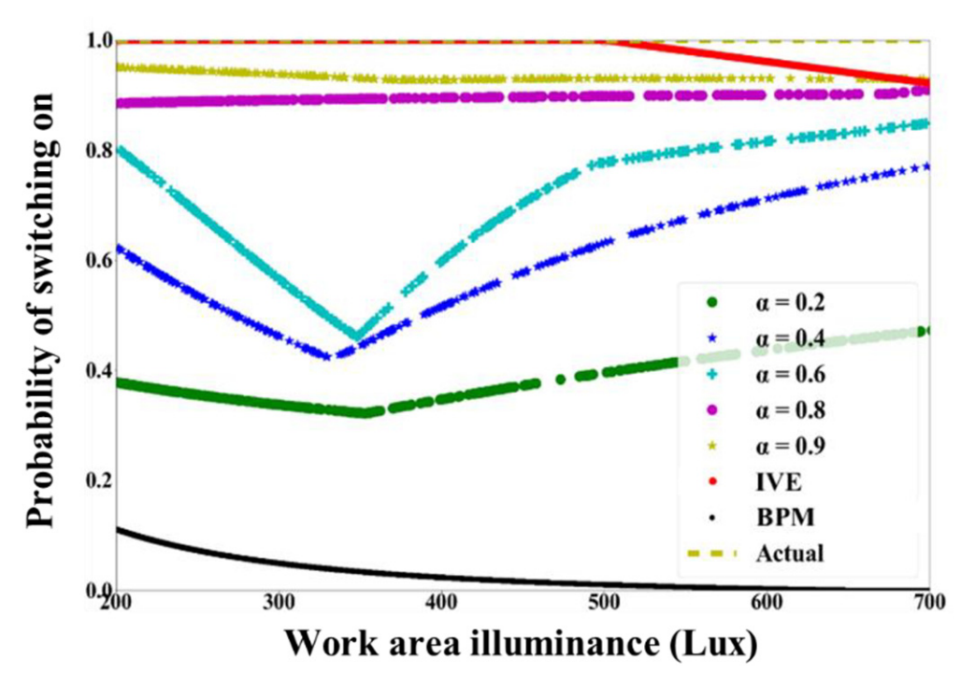
Augmented Analysis Using Machine Learning
Will analysis results improve if context-aware design-specific data is combined with an existing model?
Computational Framework – Greedy Algorithm (using Mean Absolute Error (MAE) of the existing and CADS datasets to choose the data source in each epoch)
Chokwitthaya, et al, “Combining context-aware design-specific data and building performance models to improve building performance predictions during design,” Autom. Constr., vol. 107, p. 102917, Nov. 2019

Slide 10
Augmented Analysis Using Machine Learning
Data Collection and Process
In-situ : One Month
IVE: A combination of different conditions based on event and contextual factors
The occupant of the actual office
Hypothesis
H₀: mean of E1 – mean of E2 = 0
H₁: mean of E1 - mean of E2 > 0
E1 = | The probability of switching on from the prediction of the existing BPM dataset
–
The probability of switching on from the actual data |
E2 = | The probability of switching on from the prediction of the augmented Hunt
model –
The probability of switching on from the actual data |
Results
One-tail t-test (level of significant, 0.05)
The null hypothesis is rejected.
Results of the augmented Hunt model are significantly closer to the actual data than those estimated by the original Hunt model.
This result implies that combining data reflecting design-specific contextual factors with data from the Hunt model can improve analysis.
Chokwitthaya, et al, “Combining context-aware design-specific data and building performance models to improve building performance predictions during design,” Autom. Constr., vol. 107, p. 102917, Nov. 2019

Slide 11
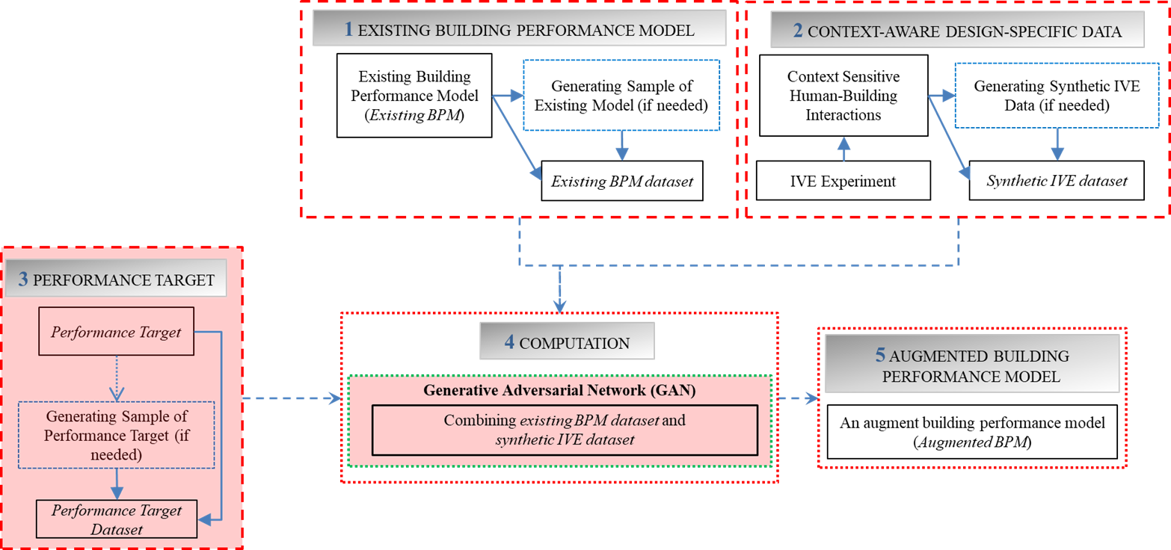
Augmented Analysis Using Machine Learning
GAN-based Framework
Can a GAN-based algorithm outperform the greed algorithm?
Existing BPM: Hunt
Performance target: Da Silva
Chokwitthaya at al. “Augmenting Building Performance Predictions during Design Using Generative Adversarial Networks and Immersive Virtual Environments,” Automation in Construction, Vol. 119, 103350, 2020.

Slide 12
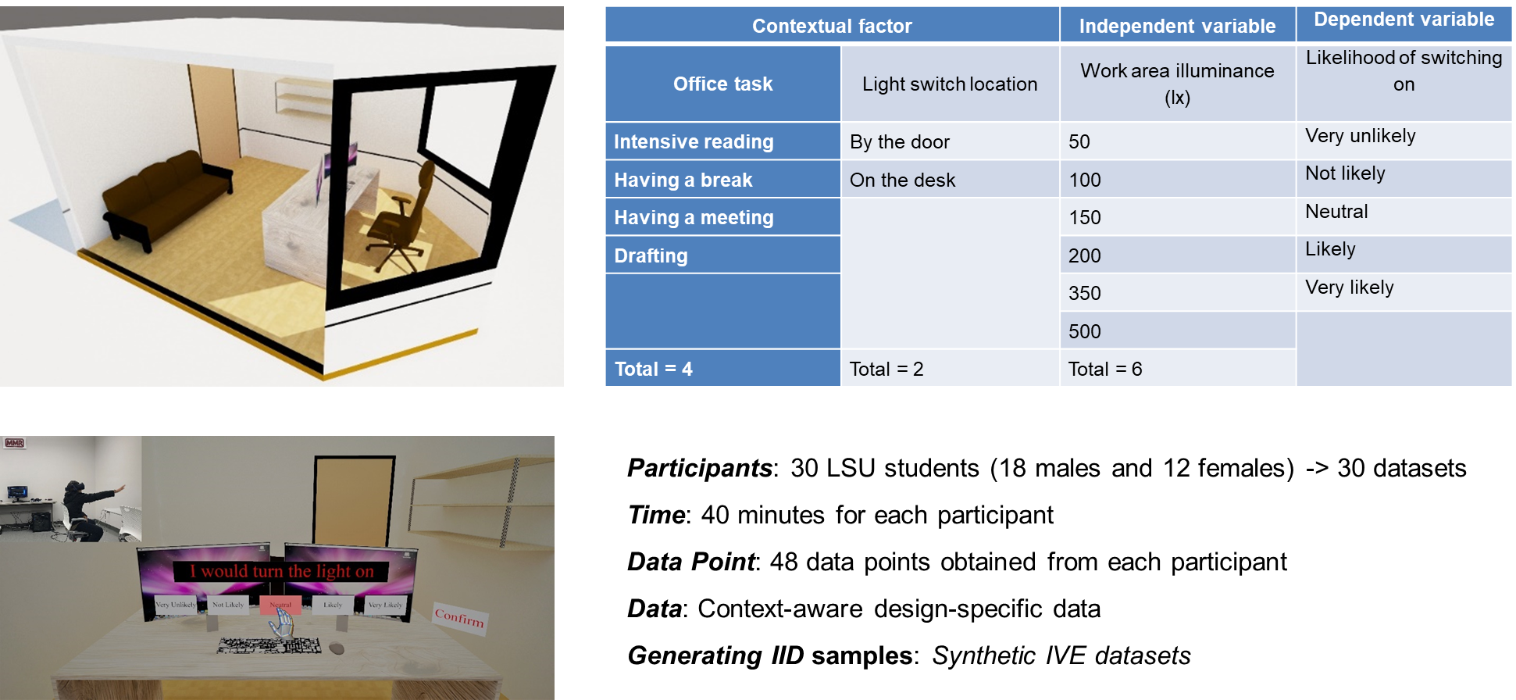
Augmented Analysis Using Machine Learning
Contextualizing behavior
Chokwitthaya at al. “Augmenting Building Performance Predictions during Design Using Generative Adversarial Networks and Immersive Virtual Environments,” Automation in Construction, Vol. 119, 103350, 2020.

Slide 13
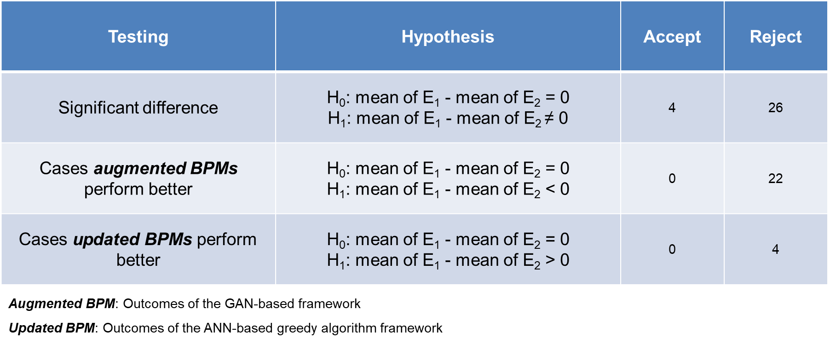
Augmented Analysis Using Machine Learning
Contextualizing behavior
Chokwitthaya et al. “Augmenting Building Performance Predictions during Design Using Generative Adversarial Networks and Immersive Virtual Environments,” Automation in Construction, Vol. 119, 103350, 2020.

Slide 14
Summary of IVE Applications
Strengths
Technology limitations (Event Specific)
Experimental Procedure (Data Sample, Stimulus Design, etc.)
ML (Blackbox)
Opportunities
Event-driven data collection
Contextualizing behavior
Collaborative experimentation
Threats
Not fully understanding the implications of IVEs
Unrealistic goals
Weaknesses
Behavior elicitation and validation in context

Slide 15
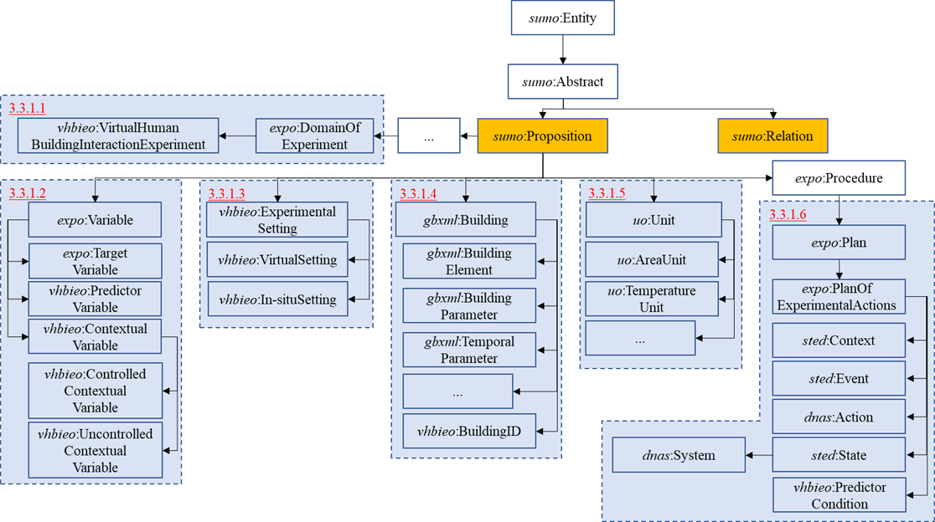
Possibilities….
Collaborative experiments combining field observational and laboratory experimental data
Virtual Human-Building Interaction Experiment Ontology (VHBIEO)
Currently under review

Slide 16
Acknowledgement
This research was supported by the NSF grants #1805914, #1855820, and #1338851. Any opinions, findings, and conclusions or recommendations expressed in this material are those of the author(s) and do not necessarily reflect the views of the National Science Foundation.

Slide 17
Questions?

