Slide 1
Evolving a New Approach to Occupants Evaluation Using Wearables
NTU Sensors Workshop
October 27-28 2022
Derek Clements-Croome
University of Reading
Joyce Chan-Schoof
University of Loughborough
www.derekcroome.com
d.j.clements-croome@reading.ac.uk

Slide 2
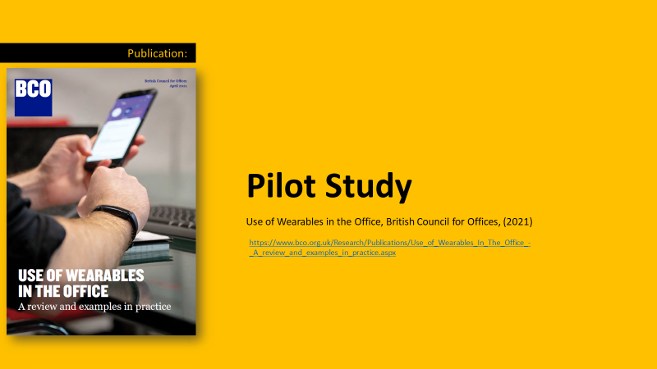

Slide 3
TEAM
PLP Architecture
Joyce Chan-Schoof
Derek Clements-Croome
Biophilia Specialists

Slide 4
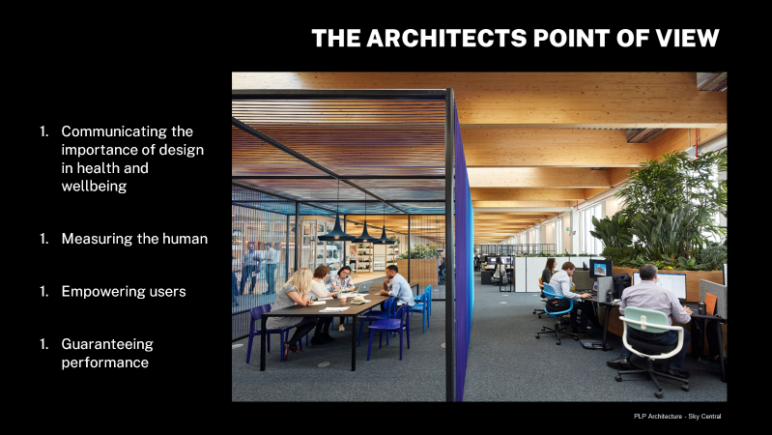

Slide 5
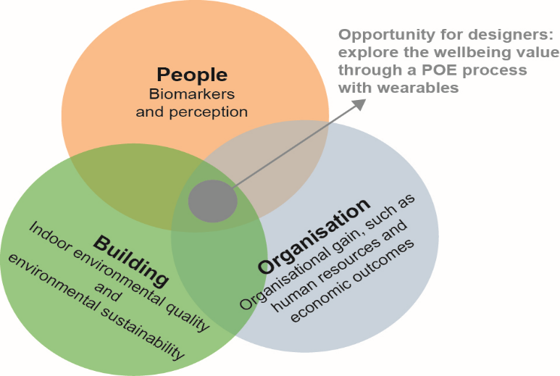
Integrated Approach

Slide 6
CONNECTED HEATH
Body and Mind Interconnected
Blood circulates oxygen
Nervous system transmits signals
Hormones effect emotional responses
All these can be assessed with wearable sensors and soon the immune system -- a defence against illness – will be easy to monitor too.

Slide 7
CURRENT MEASURES
Heartbeat patterns; activity levels
Sleep quality
Skin conductance; stress levels
Blood oxygen; alertness
Muscle tension and posture
Brain rhythms; state of mind
Diabetes is possible
DNA wristband links to heathy food.

Slide 8
WEARABLES
Worn as attachments
Embedded in clothes
Embedded in the body

Slide 9
FUTURE MEASURES
Cholesterol
Microbiome
Immunity and antibodies
Brain rhythms

Slide 10
RESEARCH
Virus detection with bio-optical sensors
Surface skin patches
Under-skin patches detect drugs in bloodstream
E-glasses measure brain EEG and eye EOG

Slide 11
IN PRACTICE
POE
Link with Augmented and Virtual Reality
Need trusted data management systems with analytics
Combine with robotics

Slide 12
PILOT STUDY
Use Fitbit Inspire 2 for heart ,sleep quality, activity levels, calories in-out and…
for posture, Upright Go 2.

Slide 13
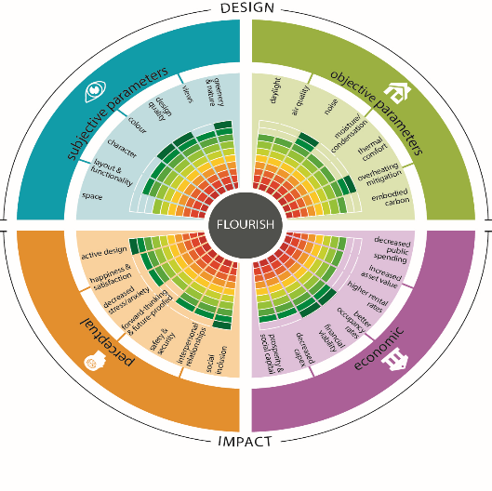
FLOURISH MODEL (Clements-Croome 2020)

Slide 14
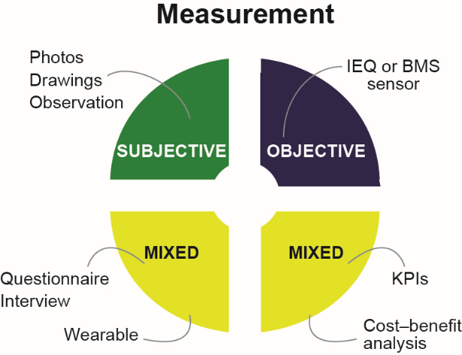
MEASUREMENT OF FLOURISH

Slide 15
QUALITATIVE DATA COLLECTION METHODS
Questionnaires and diary entries, completed by participants each day or at several points throughout the day, can capture how participants are feeling.
Questionnaires and diary entries can capture information such as:– mood– activity– posture– caffeine and water intake– sleep quality-other stressors throughout the day (e.g. commute, meetings).
Other methods for capturing the subjective elements of the study can include interviews and also participants sketching the spaces they are in or asking them to write about their experience.

Slide 16
OBJECTIVE MEASUREMENTS
Wearables assess physiological factors such as heart rate; skin conductance; sleep quality; calories; activity
Traditional environmental monitoring of temperature; air quality and other parameters

Slide 17
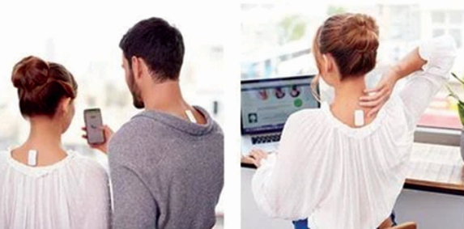
UPRIGHT GO2 SENSOR

Slide 18
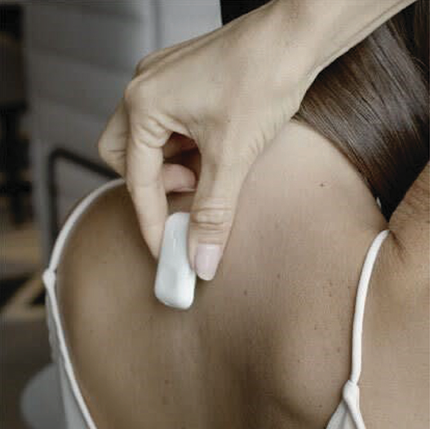
UPRIGHT GO2

Slide 19
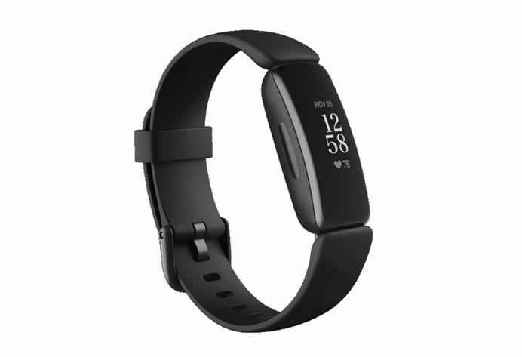
FITBIT INSPIRE 2

Slide 20
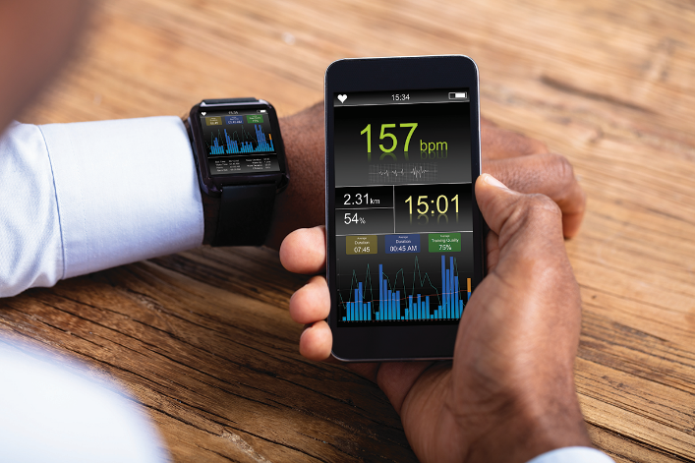
PHONE APP RECORDS DATA

Slide 21
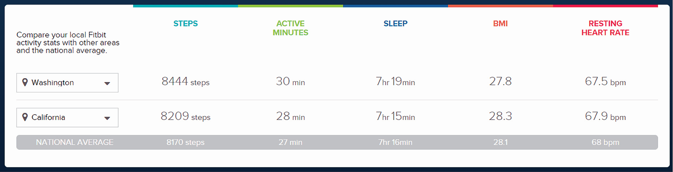

Slide 22
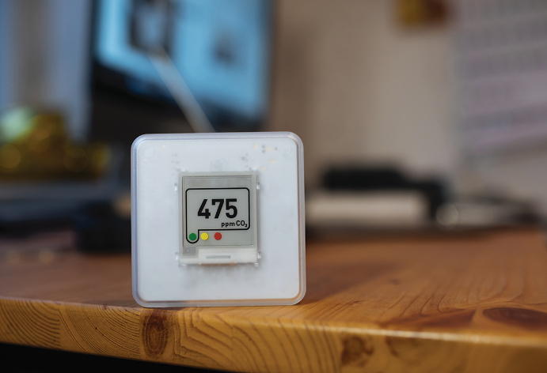
MONITORS FOR PHYSICAL ENVIRONMENT

Slide 23
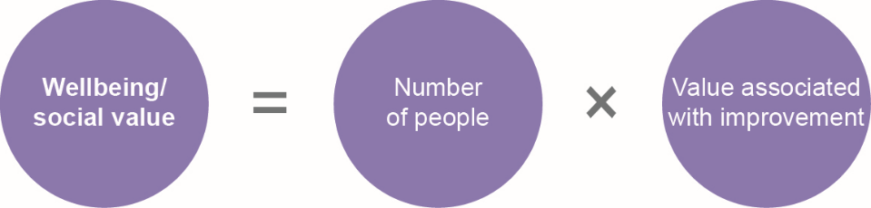
ASSESSING WELLBEING VALUE

Slide 24
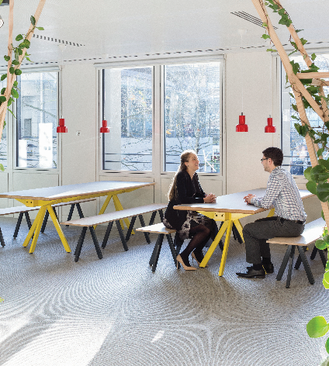
Cundalls London Office
BCO Report 2021 Use of Wearables in the Office
Biophilic office spaces with lots of daylight and views out.

Slide 25
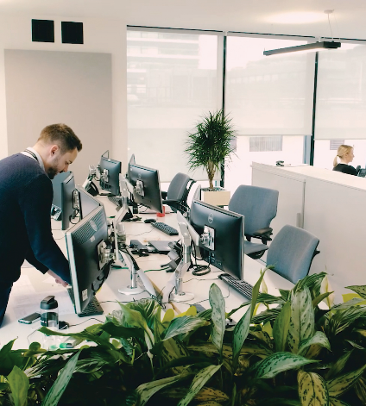
Hilson Moran –Manchester
BCO Report 2021 Use of Wearables in the Office
Company issue wearables to their employees

Slide 26
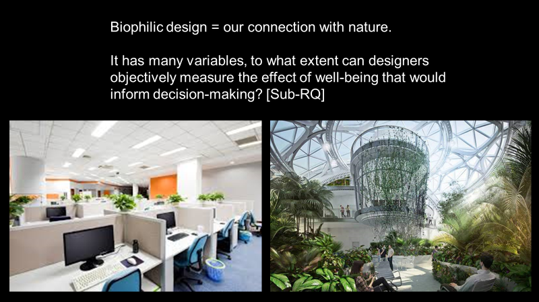

Slide 27
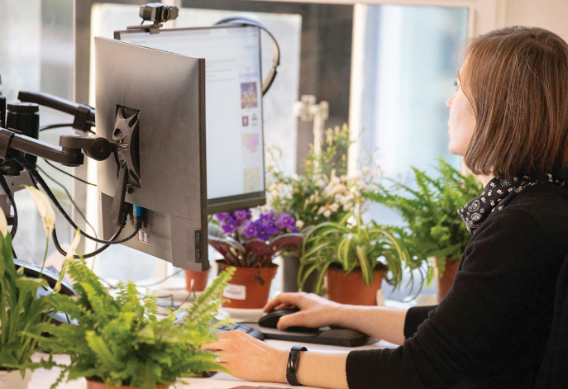
BIOPHILIC WORK PLACE

Slide 28
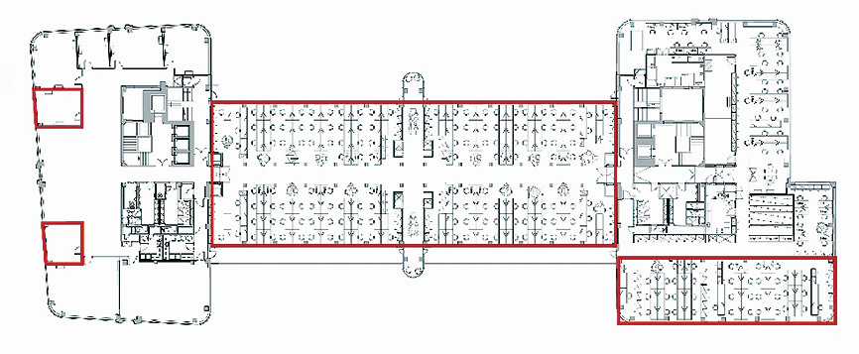
OFFICE FLOOR PLAN AT PLP Architecture

Slide 29
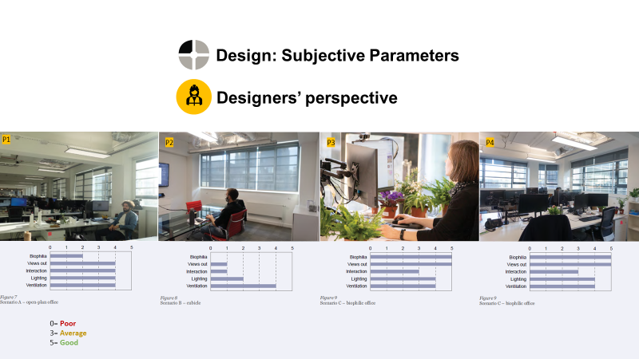
SETTINGS FOR RESEARCH

Slide 30
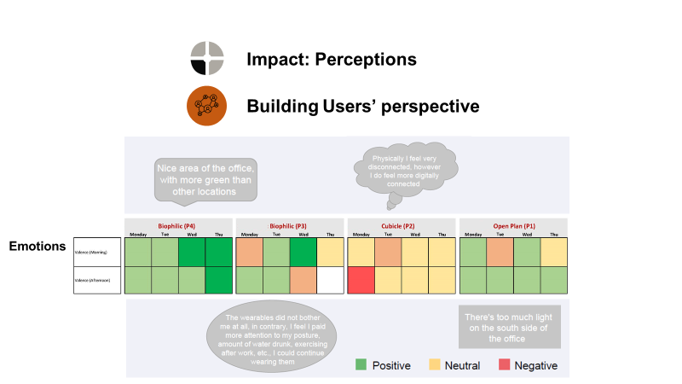
USERS COMMENTS

Slide 31
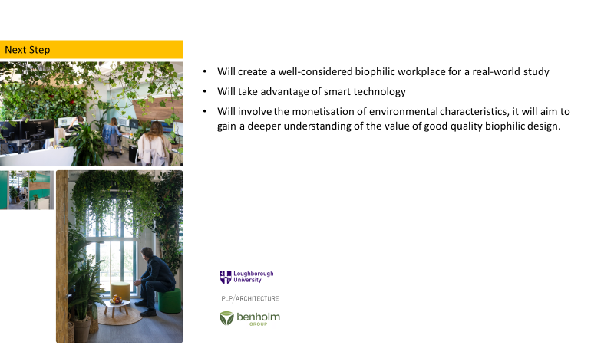
FUTURE

Slide 32
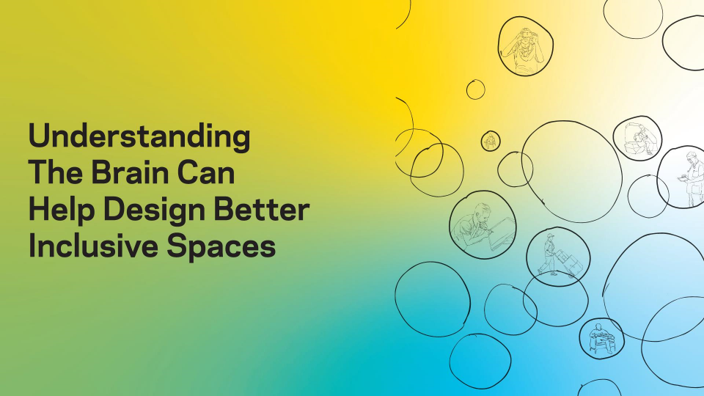
@nbbjdesign

Slide 33
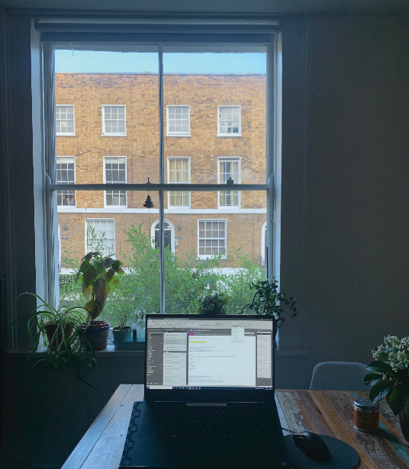
WINDOW VIEWS
Transients are important and wearables can indicate momentary changes in wellbeing.

Slide 34
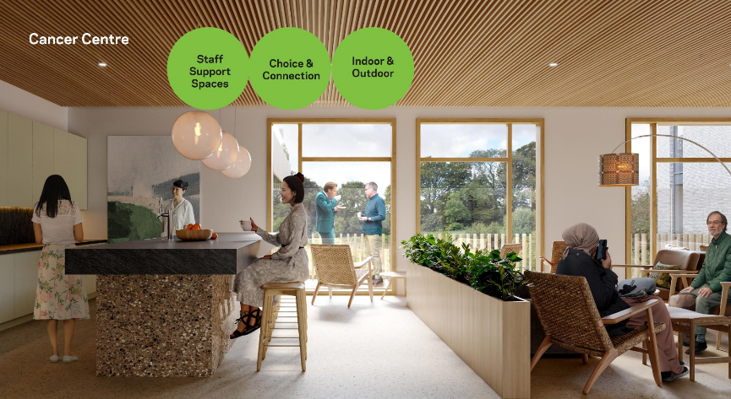
@nbbjdesign

Slide 35
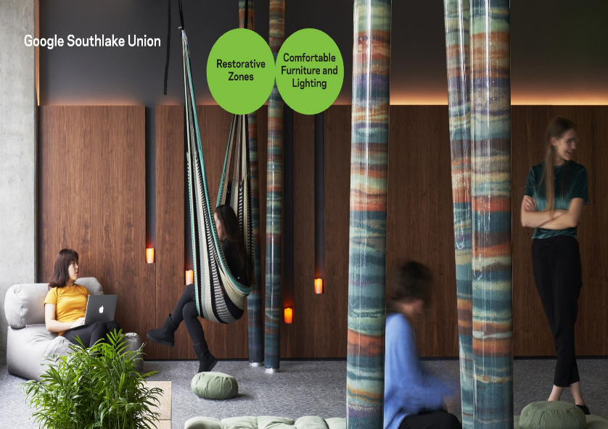
@nbbjdesign

Slide 36
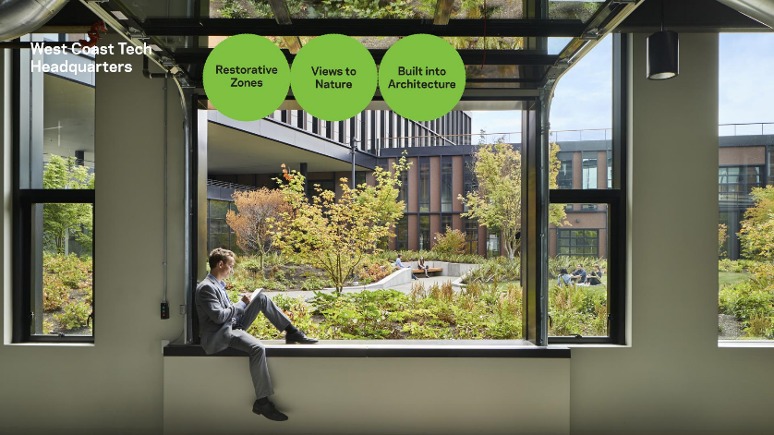
@nbbjdesign

Slide 37
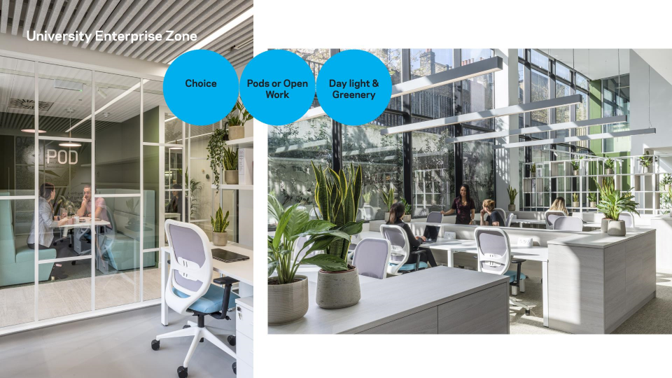
@nbbjdesign

Slide 38
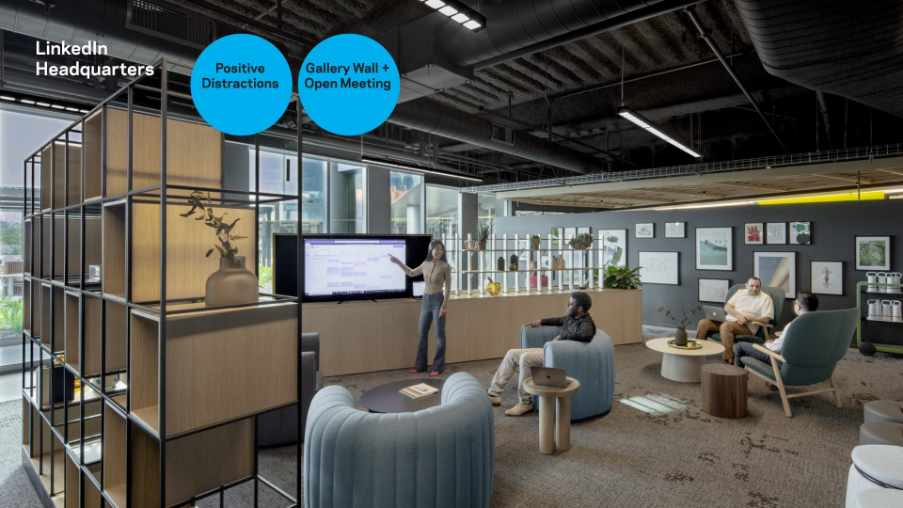
@nbbjdesign

Slide 39
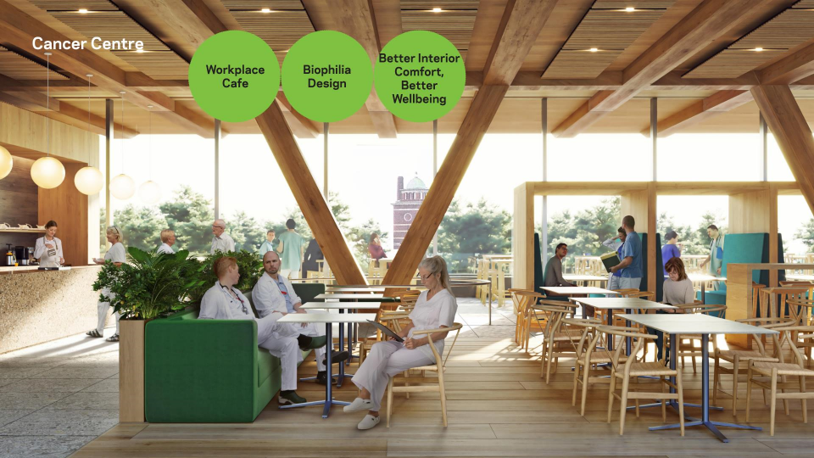
@nbbjdesign
@nbbjdesign

Slide 40
CONCLUSIONS 1
• The open-plan office and one of the biophilic scenarios have the most positive outcomes overall, and working from home also generated good wellbeing values when natural light and indoor plants were presented.
• The cubicle scenario was an enclosed solitary workspace without views out and no greenery. Although this had no impact on the subject’s physical activeness and posture, the data suggests that it negatively affected their moods and emotions.
• Perceived environmental conditions, such as aesthetics, access to light, thermal comfort and air quality, have a strong correlation with the level of valence and arousal (recorded twice a day). For example, the more satisfied the subject felt about the space, the more frequent positive emotions it attracted.

Slide 41
CONCLUSIONS 2
Most of the participants improved their UPRIGHT GO 2 scores towards the end of the week. Some found that the device bothered them initially, but not later on. Thus it appears that some types of wearables require an adaptation period.
To summarise, it is technically feasible for designers to employ wearables in the POE process to collect snapshot or longitude data, but careful planning, including a trial period, and specific research questions to compare well-defined settings are the two most important considerations in the process.

Slide 42
CONCLUSIONS 3
Wearables help us to understand how people’s physiological states vary with changing environments.
We can compare differences between individuals.
Steady state and transient conditions can be studied.
This approach enables holistic perceptual studies to be made so giving a deeper meaning to human responses to their environment.

Slide 43
Acknowledgements
BCO for financing the pilot study and printing the Report.
PLP Architecture staff for their participation
Benholm Group for providing greenery
Britni Stone of NBBJ for case studies

