Slide 1
Day 1: Breakout Session

Slide 2
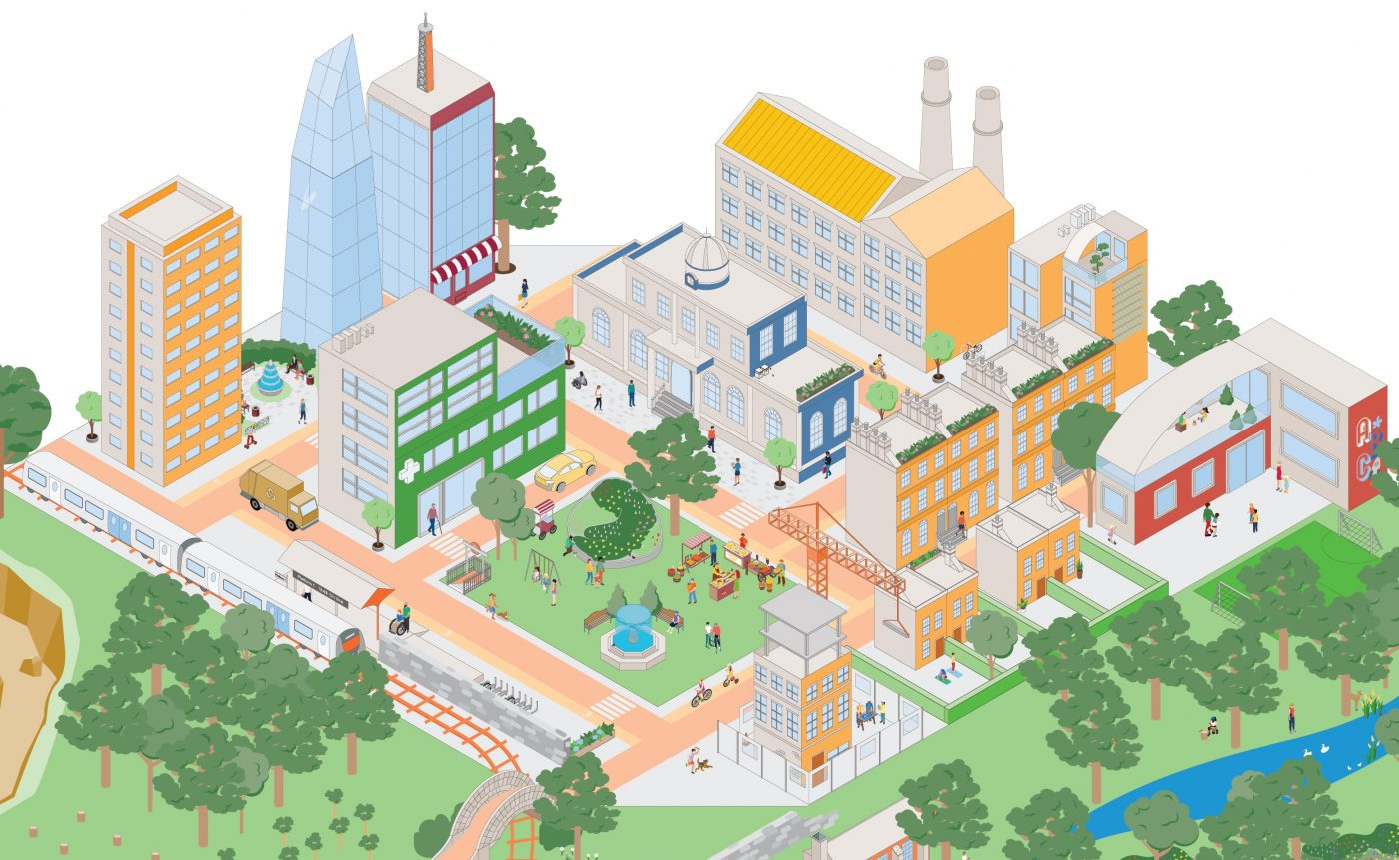
Topic 1: Research focuses on human and building interactions in the context of human well-being and future work environment
Objectives: Brainstorm a list of topics as future focuses related to the breakout session topic
Topics
A brief explanation for each
Deliverables
Each group reports their discussion outcomes
Policies
Design
Case Studies
Visualization and Sense Making
Well-being
Planning
Construction
Novel Analytics
Data
Measurements, Collection,
Sharing
Operation

Slide 3
Groups
Group 1 Yong Tao (Facilitator) Richard Bull Huanyu Larry Cheng Derek Clement-Croome Jorge Ganzalez Qinggang Meng Nina Sharifi | Group 2 Ming Sun (Facilitator) Sez Atamturk-Russcher Steven Bird David Fannon Anton Ianakiev Juan Ordonez Thomas Spiegelhalter | Group 3 Yimin Zhu (Facilitator) Anthony Adole Hiba Baroud Isaac Cho Alex Turner Yangang Xing Wangda Zuo

