Slide 1




Understanding energy hogs: Magnitude and variability in electricity use and implications for low-income and split incentive housing
Stephen Bird, Clarkson University
w/ Claudia Bustamante, Lisa Legault, Susan Powers
RCN-SEES: Predictive Modeling Network for Sustainable Human-Building Ecosystems
US-UK WORKSHOP ON BIOSENSING-ENABLED, WELLBEING-CENTRIC SUSTAINABLE BUILT ENVIRONMENT ECOSYSTEMS
October 27-28, 2022. Nottingham Trent University, Nottingham, UK

Slide 2
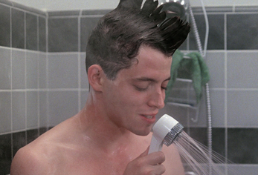
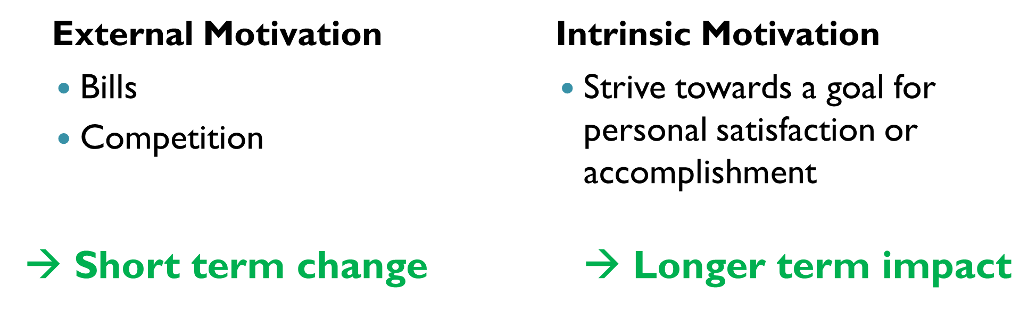
Why do people waste energy and resources?
Student housing ~ low-income & vulnerable housing
---
How to motivate energy conservation where the user of a resource is not the one who pays for it?
Split incentive problem
Lack of data
Lack of motivation
4. Because they wanna be on American Idol or The Voice??
2
Notes:
The first thing we need to understand is that people waste A LOT of energy. This wastefulness occurs despite a multitude of incentive programs, regulations, and suggestions designed to curb energy inefficiency.
There’s a big gap between what’s needed, and what people actually do.
WHY?

Slide 3
Economic Rationale: The Split Incentive Problem
U.S. energy exp. (2010):
~$1.2 trillion, 8.3% gdp
University Housing:
13 million students
Clarkson:
3,000 students
Energy: $3.5+ million / yr
Rental Housing (U.S.)
Low-income savings > $4-11 B / yr
Tenant paid energy > $11-31 B / yr
Pot. Savings (2010 $; B= billion)
Public Housing Projects (U.S.):
~2.9 million residents
Military Barracks (U.S.):
~1.5 million residents
22% of energy consumption in residential sector
Heat, Electricity, and Water Bills paid by Landlord / Agency / University
Residents have little or no incentive to conserve or behave efficiently
Bird, Stephen, and Diana Hernández. “Policy Options for the Split Incentive: Increasing Energy Efficiency for Low-Income Renters.” Energy Policy 48 (September 2012): 506–14. https://doi.org/10.1016/j.enpol.2012.05.053.

Slide 4
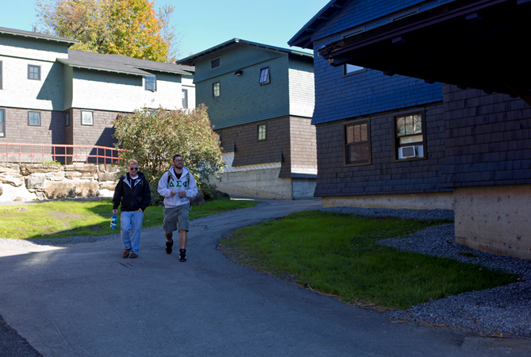
Smart Housing Project - Background
Clarkson’s Woodstock Village: 4 building testbed
real-time energy feedback
Individualized motivational components
resource use education
Goals
Reduce electricity and water consumption
Model energy use of buildings & integrate technology and behavior
New analytic techniques & predictive algorithms
Real-world consumption data and patterns
Objective:
Demonstrate potential of combining feedback technology, motivation psychology, and education
Notes:
Clarkson is recognized among the finest universities in the nation, according to such diverse measures as U.S. News & World Report, the Association for Independent Technological Universities, and corporate recruiters. Clarkson focuses on providing a rigorous professional experience, connecting discovery and engineering innovation with enterprise, and developing a collaborative community for students, faculty and staff.

Slide 5
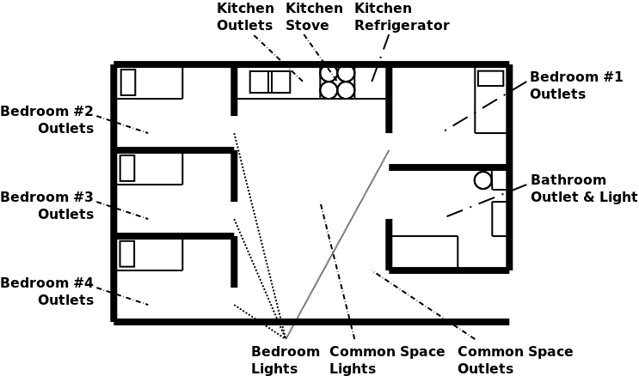
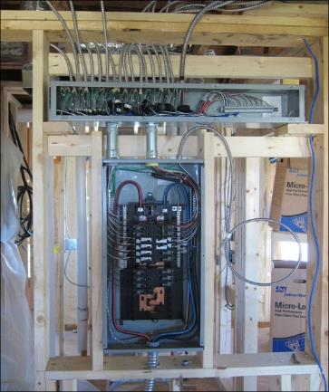
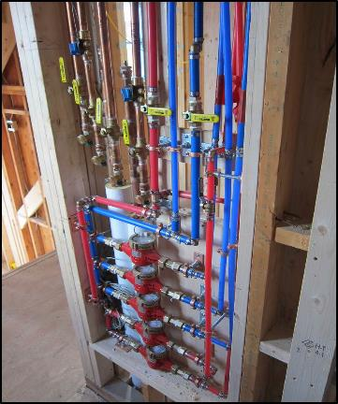
Data Collection
5 years, ~125 students/yr,
4 buildings, 77 apts.
2GB data/week @ minute level
Large surveys on behavior, knowledge, demographics, psychology & ideology
Type | Breakdown
Electricity | Lights
 | Outlets
 | Stove/Oven
 | Refrigerator
 | Other/Misc.
Env. Quality | CO/CO₂
 | Particulate Matter
 | Temperature
 | Relative Humidity
Water | Hot
 | Cold
 | Overall
Notes:
So how exactly do we go about studying utility use in Woodstock? With about 200 meters distributed throughout our 4 buildings, each collecting and recording utility use every single minute!
This data infrastructure allows us to:
1. Identify priorities for renovation and design
→Data-driven decisions
→Test proposed changes in building energy model (e.g., thermal controls, appliances, mechanicals, renovations)
2. Understand & quantify typical consumption among students (identify opportunities for conservation)→ of which there are many!

Slide 6
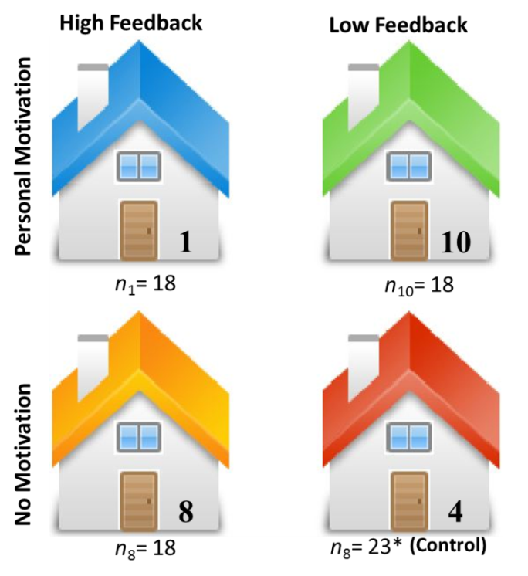
Experimental design
For electricity and water:
High Feedback vs. Low Feedback
Personal Motivation vs. No Motivation
Combined Motivation + Feedback vs. Control
Compared across 77 apts
Electricity & water use recorded over semester
Baseline vs. Post-intervention usage

Slide 7
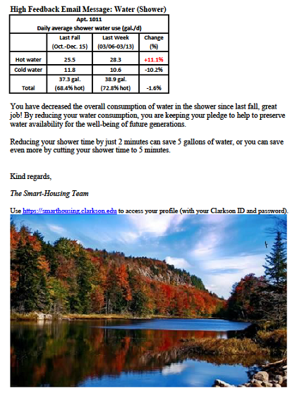
Feedback Mechanisms for electricity and water
Wall Screen
1. Resource Summary: navigation between resource type (electricity, water, and temperature)
2. Specific Usage Breakdown: navigation between five specific areas of consumption
3 a. Bar Chart: Total resource use (electricity or water) with a comparison to baseline
b. Pie Chart: Breakdown of electricity/water usage across different areas or appliance groups
4. Date Range: Switch the time period view
Notes:
From the metered sensor data, we were able to record utility data up to the minute.
This information was fedback to students, in near real time, their electricity and water use. This information was displayed on a screen mounted in their living room wall. The display showed them how much they were using and when, but also, we mapped this usage onto specific behaviors, like shower duration or living room light use, so that students could see the effects of their own actions.
We showed them how to read and interpret the displays in an introductory workshop.

Slide 8
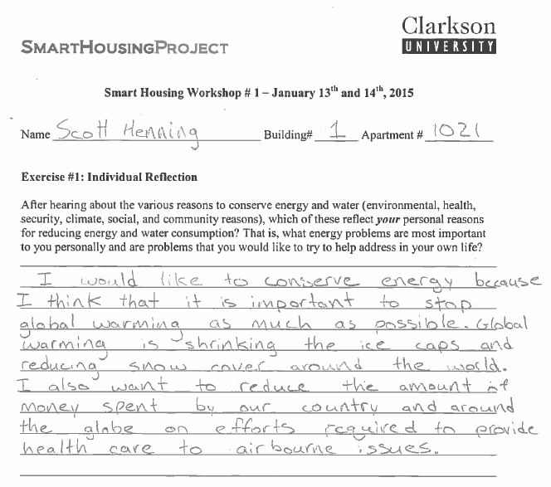
Education & Workshops: Targeting personal motivation for conservation
Reflected on and wrote about their own reasons for wanting to conserve energy and water
Health concerns
Environmental destruction
Climate change
Financial cost
Preserving the earth for future generations
Energy security
Set group electricity and water goals
Pledged commitment to their goals
Motivational “nudges” throughout spring semester
Notes:
…how did we manipulate motivation?
Students attended a motivational workshop
Reflected on and wrote about their own reasons for wanting to conserve energy and water (lots of students haven’t really thought much about this before, so it’s a matter of connecting the behavior – turning off the lights, taking short showers, using and turning off power strips, etc. – with the reasons for doing it!!)
People are different, and might want to conserve energy for different reasons. For instance….
Health concerns? → environmental diseases like asthma, linked to air pollution
Environmental destruction? → degradation of the natural landscape and natural habitats like forests and ocean reefs. Depletion of natural resources, like fresh water; becoming harder to find…
Climate change? → effects on our 4 seasons, and the ripple effect it has
Financial cost? → students might not pay, but if Clarkson were to save money on energy costs, then
Preserving the earth for future generations?
Energy security?
→ (ask them to think about what resonates with them?)
Set electricity and water goals as a group
Pledged their commitment
Motivational “nudges” throughout the spring semester

Slide 9
Effects of motivation + feedback on resource consumption
Hi/Hi 20% less than Control
Motivation 20.6% less than No Motivation
Gallons/day/person
Wh/day/person
Legault, Lisa, Stephen Bird, Susan E. Powers, Amanda K. Sherman, Alan Schay, Daqing Hou, and Kerop Janoyan. “Impact of a Motivational Intervention and Interactive Feedback on Electricity and Water Consumption: A Smart Housing Field Experiment.” Environment and Behavior, 2018, 27. https://doi.org/10.1177/0013916518811433.
Notes:
Impact of motivation not significant
Impact of feedback significant,
F(1,73)=4.73, p=.03, η²_{p}=.06
Hi/Hi group significantly different
from control group,
F(1,39)=4.88, p=.033, η²_{p} =.11
No other differences
Impact of motivation, F(1,67)=6.523, p<.013, η²_{p}=.09
No effect of feedback
control buildings used significantly more hot water than the High Motivation/High feedback buildings, F(1,37)=4.247, p=.046, η²_{p}=.10, and the High Motivation-Low Feedback buildings, F(1,37)=5.53, p=.024, η²_{p}=.13.
No difference between buildings 4 (control) and 8 (Low motivation/High Feedback), F<1, suggesting that there was no unique effect of feedback.
Results support an overall effect of motivation on reducing hot water consumption, regardless of feedback.

Slide 10
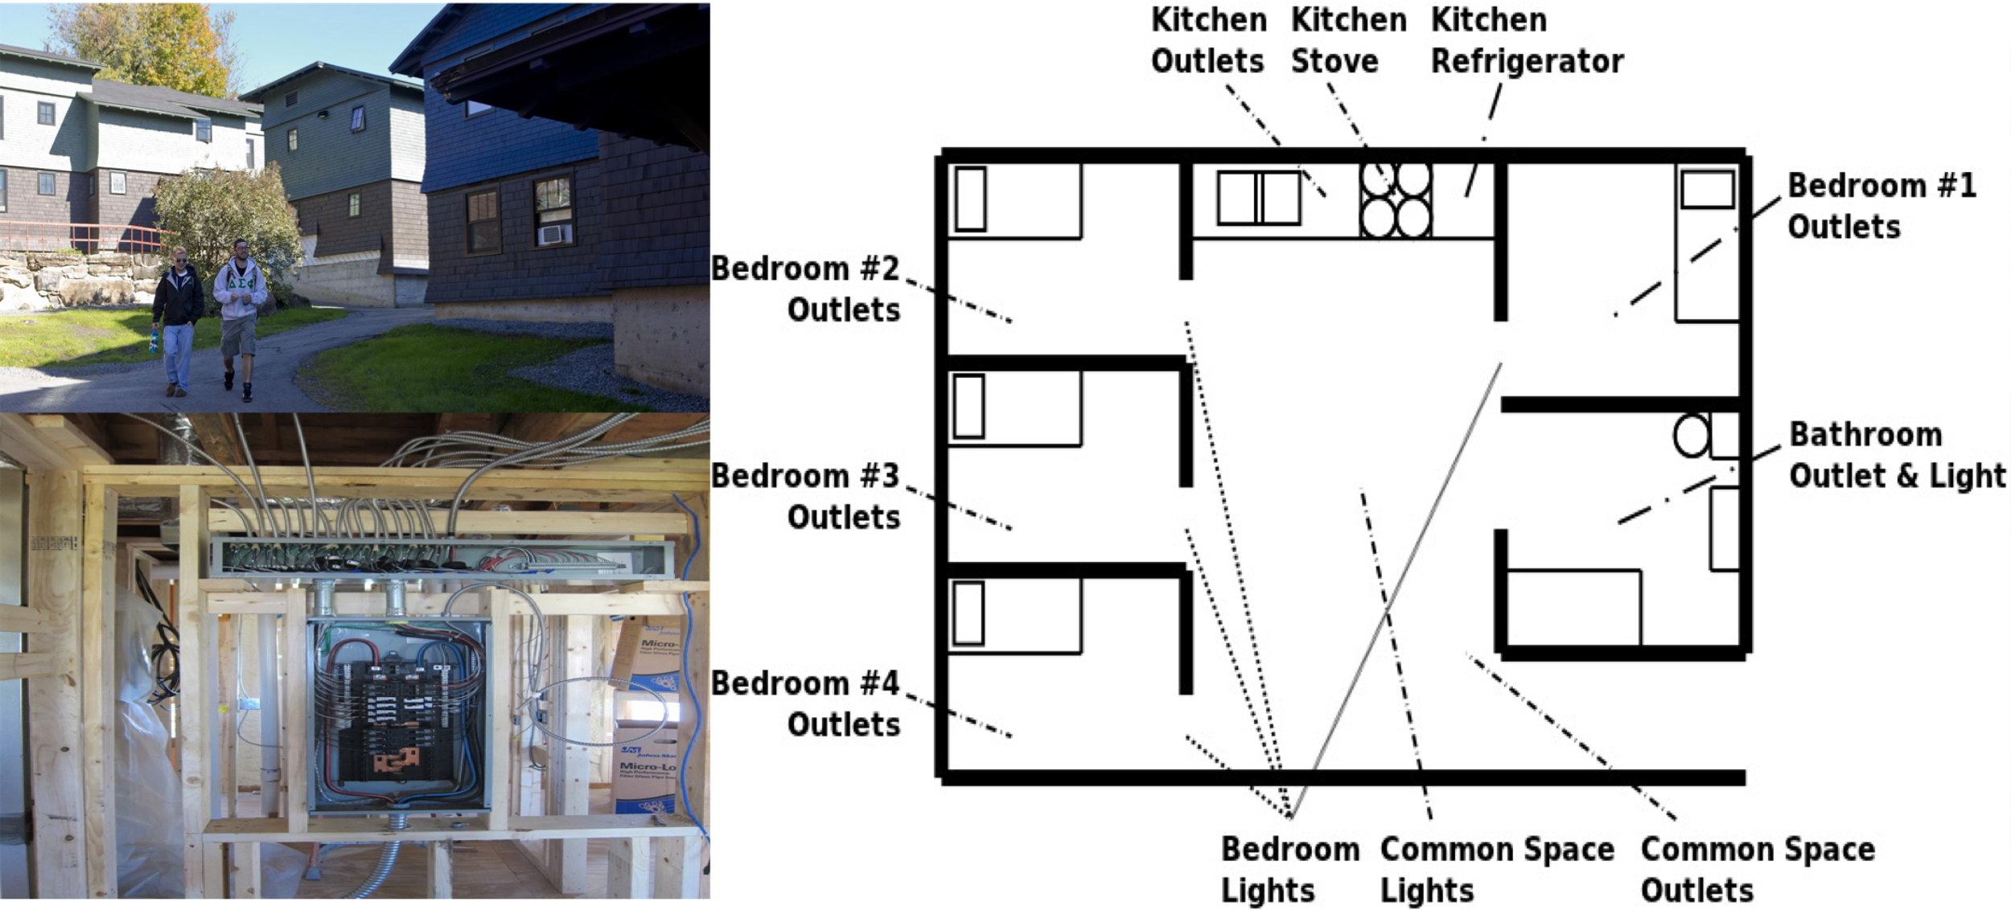
Newer Work (2019 -) – Investigating the bedroom (!)
A rare opportunity to study specifically attributable energy use
electricity use at the bedroom level (N=312)
Notes:
3 The Clarkson Smart Housing project was created to address this gap.
In 2012, Clarkson did renovations in student housing apartments which allows the University to implement detailed meters for electricity and water in each four to six-person apartment providing high levels of specific utility use information.
The electricity meters at SHP measure the electricity consumed on each circuit of one apartment.
In this presentation, we provide the first insights and the implications into electricity use at the bedroom level of 312 students living in apartments during the Fall semesters from 2013 to 2019.
Now you may be wondering why is that we choose to analyze electricity use at the bedroom level?

Slide 11
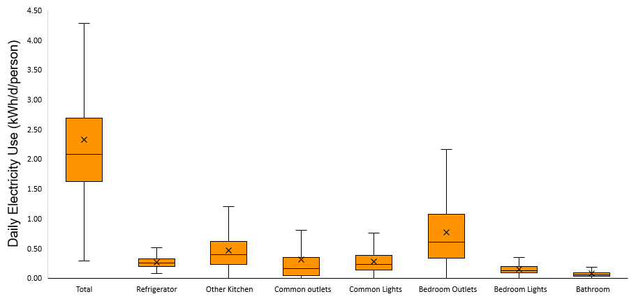
Bedrooms: highest single use & most variability
Per Capita Daily Electricity Consumption, all days, all years
75th
Avg.
Mdn.
25th
Apartment
Notes:
4 To answer this question, let’s look at this first graph
In this boxplot, we find the distribution of the per capita daily electricity consumption over 6 years. If we take a look at the total apartment, we find the median electricity consumption to be around 2.08kWh/d/person.
The granularity in the data allows us to see electricity use in each area of the apartment (signal y-axis and x-axis).
As we can see the bedroom outlets have the highest median. but it also has a wide range or variability indicating that individuals are behaving quite differently.
And this finding is what motivates us

Slide 12
Motivation and Goals
Understand and quantify individual electricity consumption at a granular level
Identify attributes to characterize individual electricity consumption behaviors
Evaluate implications of high individual electricity use on policy making
Notes:
5 to understand and quantify individual electricity consumption at a granular level. specifically at the bedroom level
To identify Attributes to characterize individual electricity consumption. That is variables that help us classify users based on their electricity use
And Ultimately Evaluate the implications of high individual electricity use on policymaking

Slide 13
Methods
Data preparation
Identify users for which bedroom is not an accurate measure of their electricity consumption
Principal Component Analysis
312 students after data cleaning
Cluster Analysis
Low
Moderate
Hog
Super Hog
MAGNITUDE
Median daily electricity use
Exploratory Factor Analysis
Subcluster Analysis
Hog
Super Hog
VARIABILITY
90th -10th hourly electricity use
Takeaway?
Magnitude & Variability
4 subgroups
4 subgroups
Notes:
6 The first step was to work on the data preparation.
the data preparation process we wanted to identify the students for which bedroom electricity use is not an accurate measure of the individual electricity consumption. For this we work with three main variables related to the number of hours a student does not consume electricity over a day, the number of days over the fall semester they don’t consume electricity use, and the 10th percentile of their electricity consumption.
Based on these three measures out of the 348 students after data cleaning we had 312 students.
We then performed a principal component analysis to identify the main variable that can help us differentiate individual electricity use. Out of 16 variables considered, the results show that the magnitude of electricity consumption measured by the median daily electricity use is the main variable to differentiate individual electricity consumption.
Then we use the logarithmic transformation of the magnitude to cluster users. Using k-means clustering we identify the optimal number of clusters to be 4. Being C1 the low energy users, C2 middle energy users, C3 high energy users, and C4 super high energy users
We then performed an exploratory factor analysis to quantify the variability among high users (C3, C4).Out of the 3 variables considered. The results show that the variability in hourly electricity use given by the difference between the 90th-10th percentile of their electricity consumption is the second variable that can help us differentiate individual electricity consumption among high users.
Based on this variability we performed a subcluster analysis to differentiate individual behaviors towards electricity consumption among the high user group.
Now let’s look at the main findings:

Slide 14

“Super Hogs”: 18% of Residents consume 48% of the electricity (!)
Reduction Opportunity!
Reduction Opportunity!
Notes:
7 In this graph we see the daily electricity consumption of 312 students,
Using k-means clustering we classify these students into 4 clusters. In this graph, we can see the students organized from the lowest cluster to the highest cluster of users, and each person is represented by one dot in terms of their median consumption over the course of a fall semester.
Although most users present a moderate consumption, the top 18% of users account for 48% of total electricity use. Moreover, the median electricity consumption for the high group, from now on the “Super hogs” is 12times the median electricity consumption for low users.
This finding emphasizes the impact a small number of users have on electricity use.
Therefore we identified the median electricity consumption as an important Attribute that represents the magnitude of electricity consumption among users.
But we also see that the groups with high energy use that is the “hogs” and the “SUPER HOGS” present more variability that is a wide range in daily electricity consumption in comparison with other groups. To understand this variability, we analyze how high energy users use electricity OVER THE COURSE OF A DAY, so we wanted to look at the hourly rate.

Slide 15
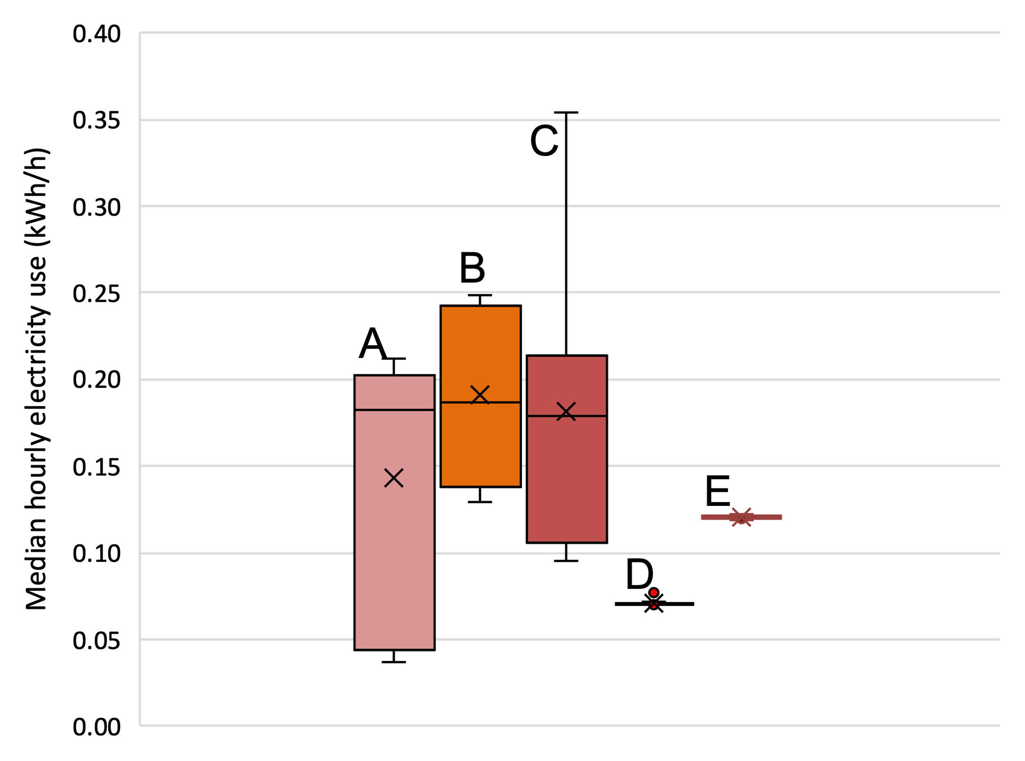
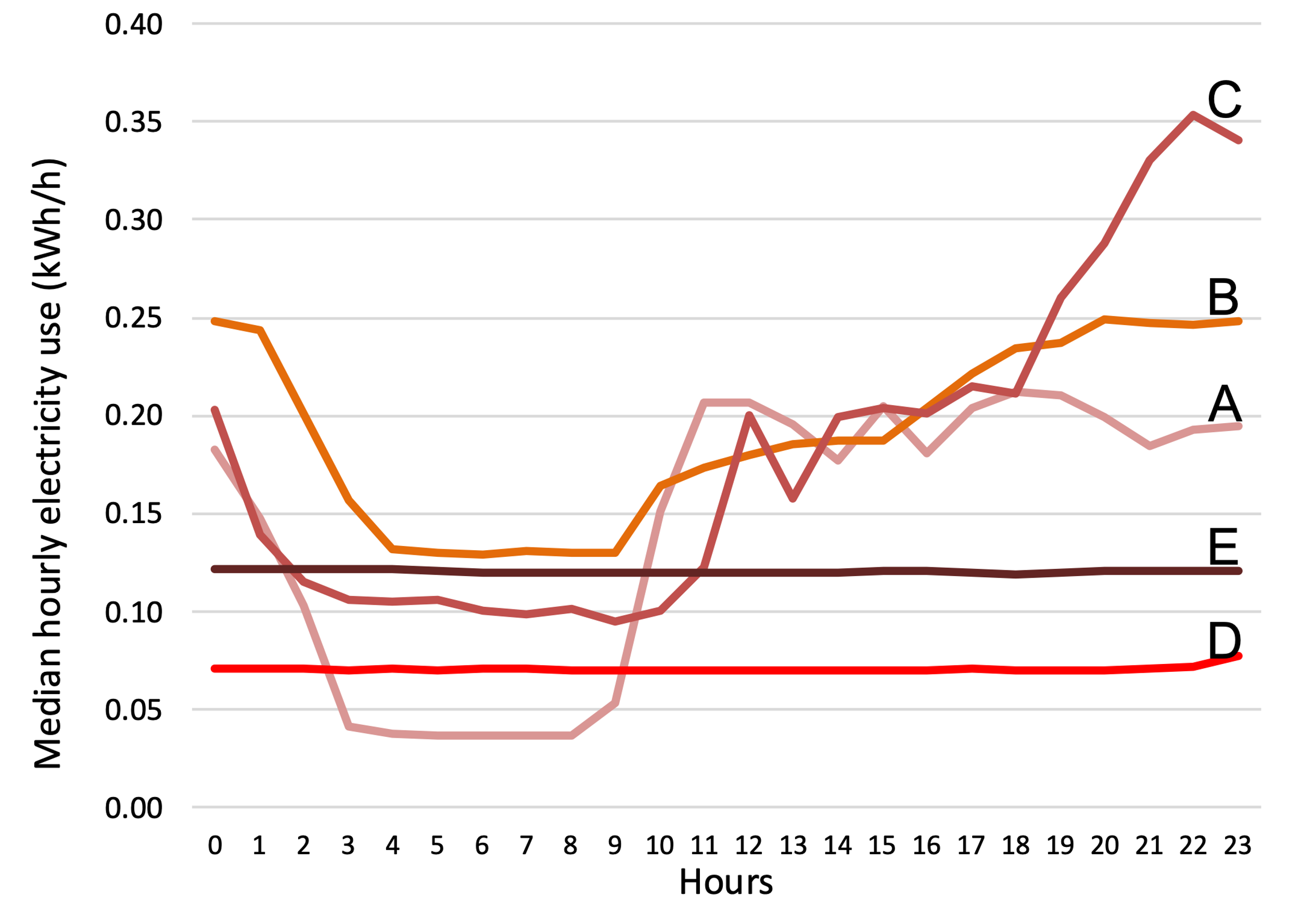
Hourly usage: variability in electricity consumption patterns
Variability: range in electricity consumption
Notes:
​​​​The hourly patterns give us insight into the variability of electricity use for the super energy hogs.
We found that super hogs users present more variability and can have a different electricity use over a day
For instance, in the first graph, we can see super hogs have a different variability.
if we look at user E we see that this is an energy hog that shows less variability(small range) and these users use electricity at a high level constantly throughout the day. In contrast user, C shows more variability(wide range) on their electricity use and appears to turn off at least some of their appliances over the course of a day.
Now a,b, and c are very similar, it is apparent that there are users that turn off things at night versus E and D that constantly use electricity
Thus, an important secondary variable is the variability of their electricity consumption because This implies a significant difference in how they think about and how they use electricity.

Slide 16
Superhogs differentiated by variability
Notes:
9 In this graph we can see the entire group of super energy hogs.
From left to right this graph shows 4 color-coded subcluster formations based on the hourly variability. And each group is order based on the median electricity use
The main takeaway from this graph is that even in the 18% super energy hogs we find users that present different types of behavior towards electricity use.
For instance, a person that uses a lot of energy but has little variability will be an example of what? Maybe someone that has appliances on all the time.
Where someone that uses a ton of energy at some times in the day may be having energy-intense activities like bitcoin mining or maybe playing video games.

Slide 17
Magnitude and variability over the course of a day are clearly different and important attributes.
Notes:
10To recAp:
We identify two main Attributes: magnitude that helps us classify users and differentiate them
variability as a second main attribute to differentiate “super hogs” users or users that have a high electricity consumption
Two big characteristics emerge from our research, the first is that we have just seen that a small number of people are responsible for an enormous amount of energy use
And secondly that among those large energy users there is variability on their electricity consumption patterns and those have all sorts of implications for policymaking.

Slide 18





Policy implications:
Turn off your appliances or you will pay a penalty fee!
Super Hogs
Let’s figure out how to help you reduce high evening usage?
Hogs
Interventions towards energy conservation
Middle
Tailored messages to motivate conservation
Good job!
Low
6
Notes:
11 ​​ ​​One of the potential implications is in the improvement of interventions toward energy conservation.
The understanding of specific behaviors can help to frame messages based on user type. For instance, for the students that have low electricity use, perhaps we want to use a positive reinforcing message like a good job! or nice work! instead of telling them that they should conserve energy because they are already having a conservation behavior but there are other students that use a lot more and should receive a different message. For example, we can tailor information focused on their behavior. If they have appliances on all the time, a message telling them to turn off their appliances can help. Or if they engage in high-energy intensive activities such as playing video games, we can tailor messages to address specific activities at specific times during the day.
we can also set campus policies to reduce excessive behaviors such as penalty fees for energy-intensive users or limiting the number of appliances each student can have.
Thus, there is the need to tailored messages to motivate conservation targeted on you as an individual based on your patterns, on your energy consumption. This is a potential direction for our project. But to tailored them are key component is granular data that give us insights on
how much electricity students are using and to identify the super energy hogs.
So let me summarize the conclusions of our study:

Slide 19
Conclusion
OBJECTIVES
RESULTS
1
Understand and quantify individual electricity consumption at a granular level
high electricity use and variability at the bedroom level
18% users account for 48% of total electricity consumption
2
Identify attributes to characterize individual electricity consumption
magnitude and variability
3
Evaluate implications of high individual electricity use on policy making
tailored interventions towards energy conservation
Notes:
12 So let me summarize the conclusions of our study:
we have seen that
1The per capita electricity consumption shows high electricity use and variability at the bedroom level
1high users account for a substantial part of electricity consumption.
2We identify two main Attributes to classify users based on their electricity use are the magnitude and variability
3Highly granular data has the potential to provide information about individual electricity use that can help to tailored interventions toward energy conservation
Overall, the smart housing project has been really valuable in the understanding of electricity use, we will continue to evaluate this data in the future to save energy and to provide solutions that help to promote energy conservation.

Slide 20





Next steps
1
2
3
Combine individual electricity data and self-reported behaviors to better understand and characterize the different types of users: gender, socioeconomic status, energy literacy, conservation behaviors and climate change attitudes
Test tailored messages for energy-intensive users in residential housing
Ultimately? Move this work into the real world, and test it in a scaled up application.
Notes:
13In this presentation, we find two important attributes related to individual electricity use but we also know there are other potential attributes that help to describe these users.
Thus our next steps involve the use of individual electricity data and self-reported behaviors that help us to better understand and characterize the different types of users and Get to know the social aspect that renders and motivates energy consumption in each group. We will work with variables such a year, gender, socioeconomic status, energy literacy, conservation behaviors and climate change attitudes between others.
We also want to make use of this information to create tailored messages to assess energy-intensive users in residential housing.
That concludes my presentation
Thank you very much!

Slide 21
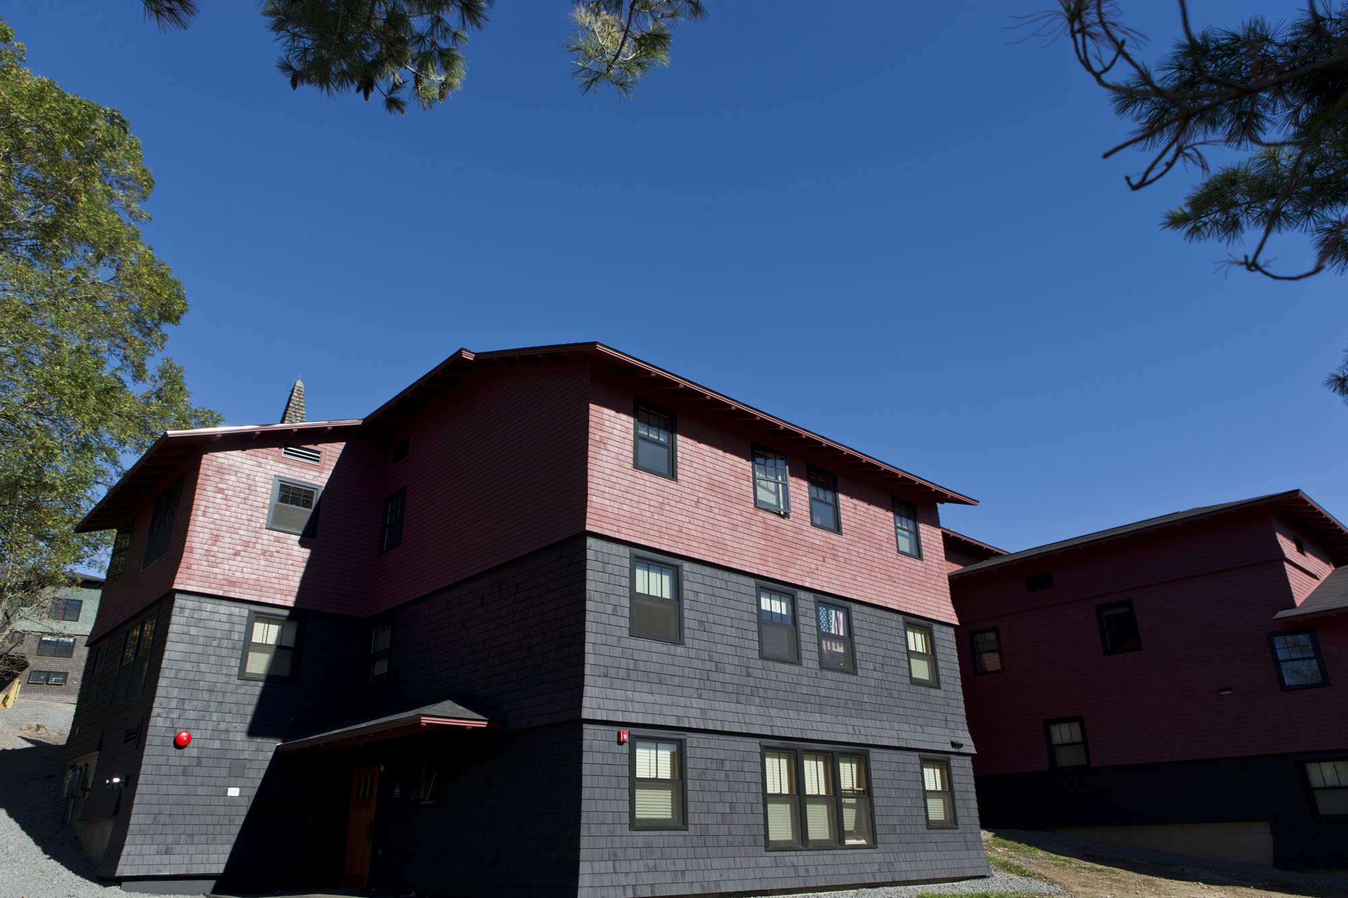

Thank you! sbird@Clarkson.edu

