Slide 1
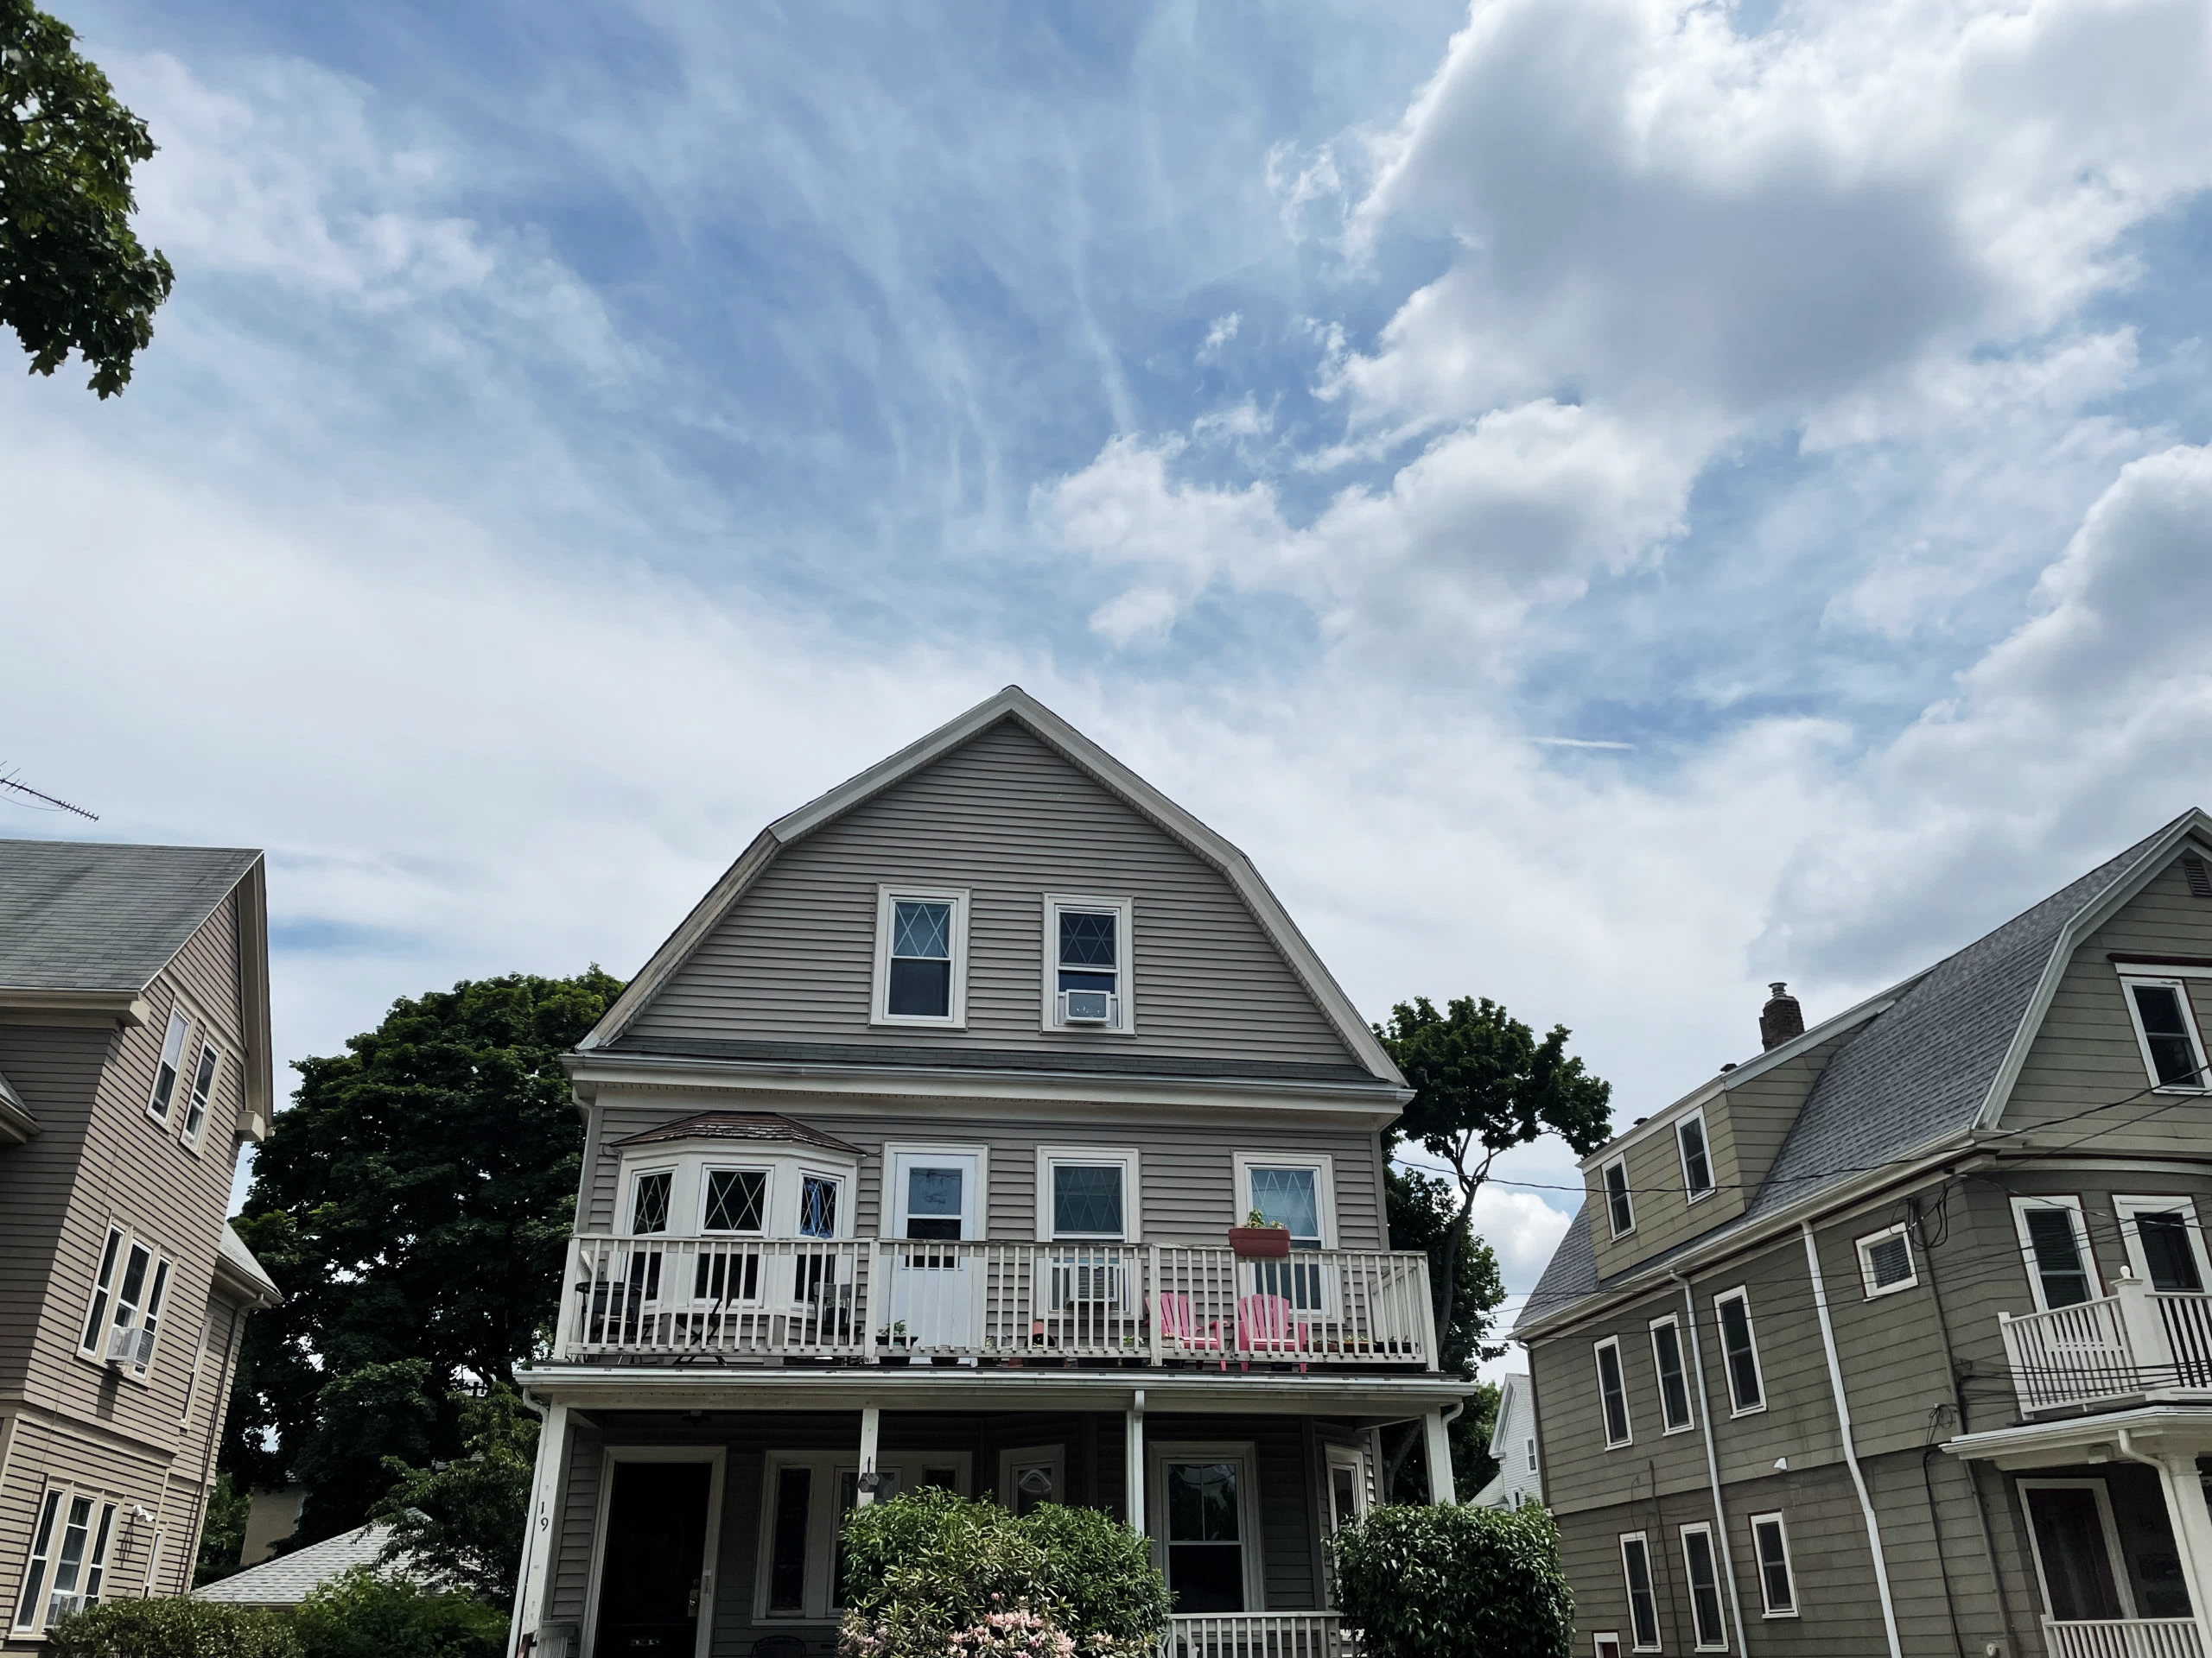
HUMAN-IN-THE LOOP THERMOSTAT
DAVID FANNON
Northeastern University, Boston, MA, USA
Notes:
David Fannon, From Northeastern
Some of you may know a it about this project from previous Annex 79 meetings, the Whole Energy Homes project team has set up sensors in homes across the US and currently collecting an extensive database on occupant-building interactions and indoor thermal environment in homes.

Slide 2
How can knowledge about the interaction among the occupant, building, and HVAC systems improve controls and provide residential load flexibility?
How can knowledge about the interaction among the occupant, building, and HVAC systems improve controls and provide residential load flexibility?
How can knowledge about the interaction among the occupant, building, and HVAC systems improve controls and provide residential load flexibility?
Notes:
One of the questions motivating this study and the data analysis is:
---
There are two parts to this data collection. First improve our understanding the patterns and mechanisms behand the human building interactions
And second, use this improved knowledge and the data itself to develop DR controls that improve the reliability for the grid and improve comfort for the occupants
As we pursue these goals, we are also wanting to capture the occ building and HVAC system together as none of these work independently. Successful controls involves the interaction of these all….
Project Background ~1
As you may remember from past Annex 79 meetings, the Whole Energy Homes gionProject is an effort to collect a novel dataset on residential occupant interaction with HVAC systems
Many questions trying to answer, but
What are the main influences of human-building interaction?
How do occupant behavior and occupant perception relate?
Whole Energy Homes Project to learn more about:
What influences human-building interaction
How occupant behavior and perception relate, and
In the context of improving residential HVAC DR – and THIS is important for aiding the decarbonization of the grid
20 single-family homes, 2 climate zones to collect sensor data on for 2 years
Data collection in first house started October 2021

Slide 3
context

Slide 4
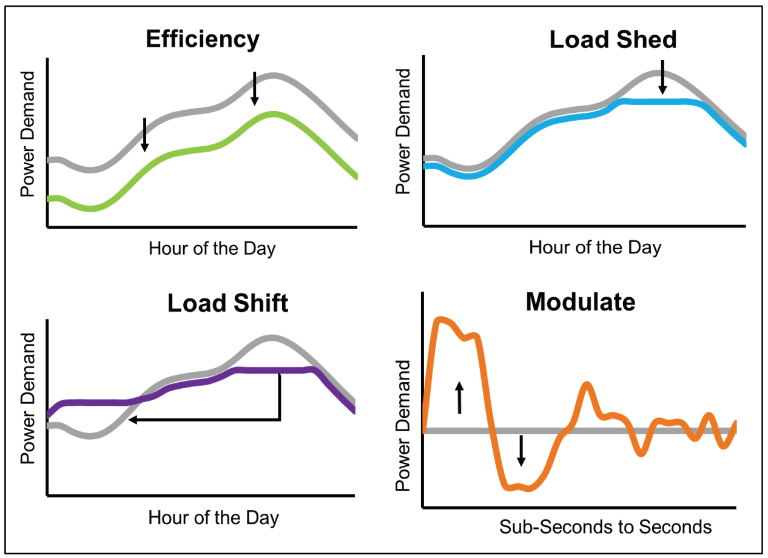
Importance of Load Flexibility:
By 2030, the benefits of load flexibility could exceed $15 billion/year in US¹
Need for Reliability:
Annual penalties assessed to DR resources: $13 Million in 2010/2011²
State of the Art
Utility remotely adjusts thermostat setpoints to modify load of HVAC, same setpoint changes applied to all participants³
R. Hledik, “The National Potential for Load Flexibility: Value and Market Potential Through 2030,”
PJM LLC, “Load Management Performance Report,” Aug. 2018.
Seiden K, Olig C, Max D, Sherman M. National Grid Smart Energy Solutions Pilot - Final Evaluation Report. Worcester, MA: National Grid; 2017
US. Department of Energy, Grid-interactive Efficient Buildings: Overview
Notes:
Evolving Grid, particularly more renewables, which requires transitioning from meeting a highly variable demand by tightly controlling supply, to a model that incorporates greater variability in supply by controlling the time and magnitude of demand.
That’s where grid-interactive efficient buildings come in.
I’m sure many of you are aware of traditional demand response programs where a utility will remotely adjust thermostat setpoints across a large group of homes to reduce the load on the grid
But these existing policy, programs, and technology seeking to reduce peak electric demand and increase building-grid load flexibility do not always achieve their goals.
Previous studies of grid-service programs see up to 30% of customers overriding controls during these demand response events
Overrides and opt-outs lead to significant penalties grid-service aggregators
Potentially a $15 Billion/year value in flexibility alone in the next decade.

Slide 5
method

Slide 6


Study Design
20 Single-Family Homes
41 Participants
20 30 Single-Family Homes
41 60 Participants
2 3 Climate Zones
11 24 Months of Data
2 Climate Zones
11 Months of Data
Notes:
Just to recap, currently
20 single-family homes, 40 participants
in two climate zones
Some homes have ~11 months of data
Planning to extend to …
And will have at least 24 months of data by the end of the study
The data collected so far is just the start of an even bigger, more well rounded database.
And all of the data that we are going to look at today, is the start of the analysis of the start of this growing database.

Slide 7
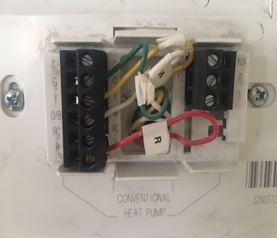
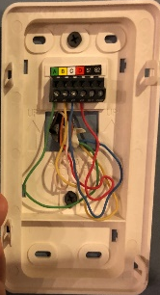
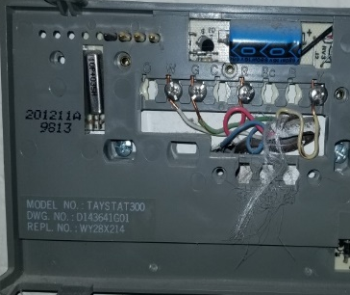
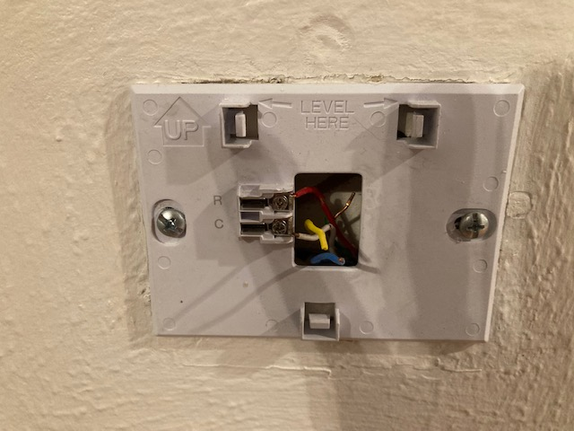
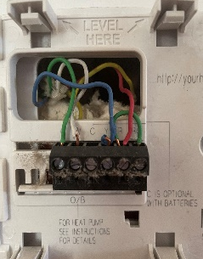
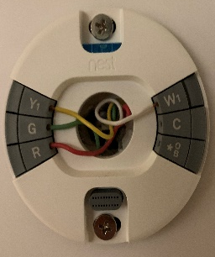
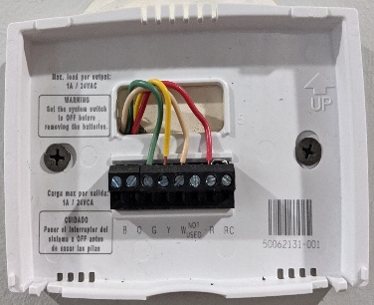
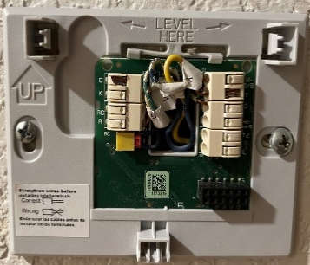
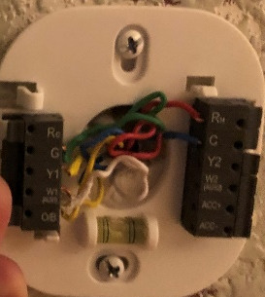
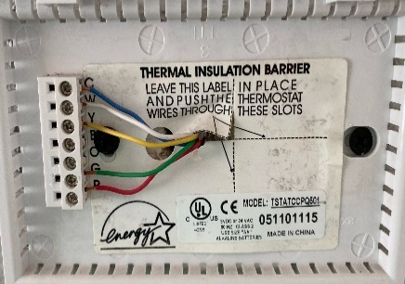
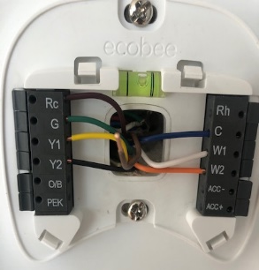
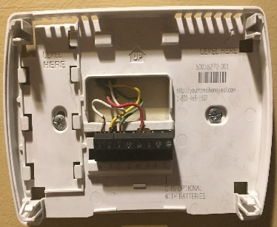
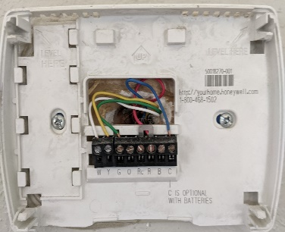
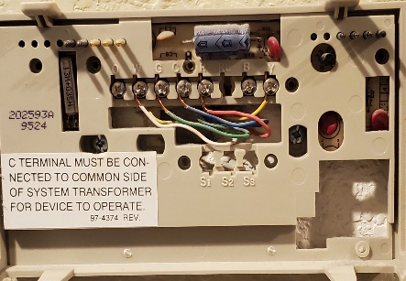
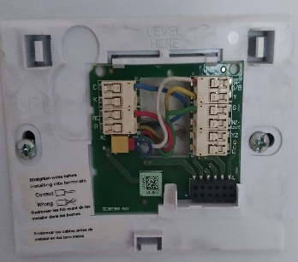
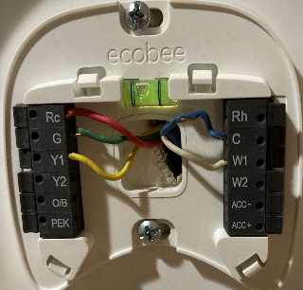
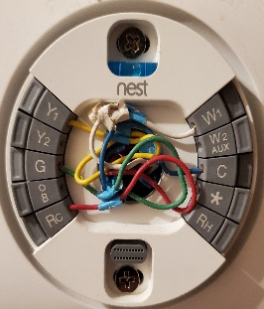
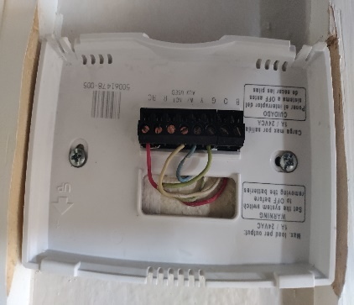
Notes:
So who are the people, and what are the homes?
SFD homes
w/ central forced-air heating and cooling
And existing thermostat wiring that is compatible with an ecobee smart thermostat
Get to keep the new thermostat
Compensation after initial audit and interview, plus increasing compensation each quarter for remaining enrolled.
Mostly passionate about energy and their homes (not representative, in some cases, best case)

Slide 8
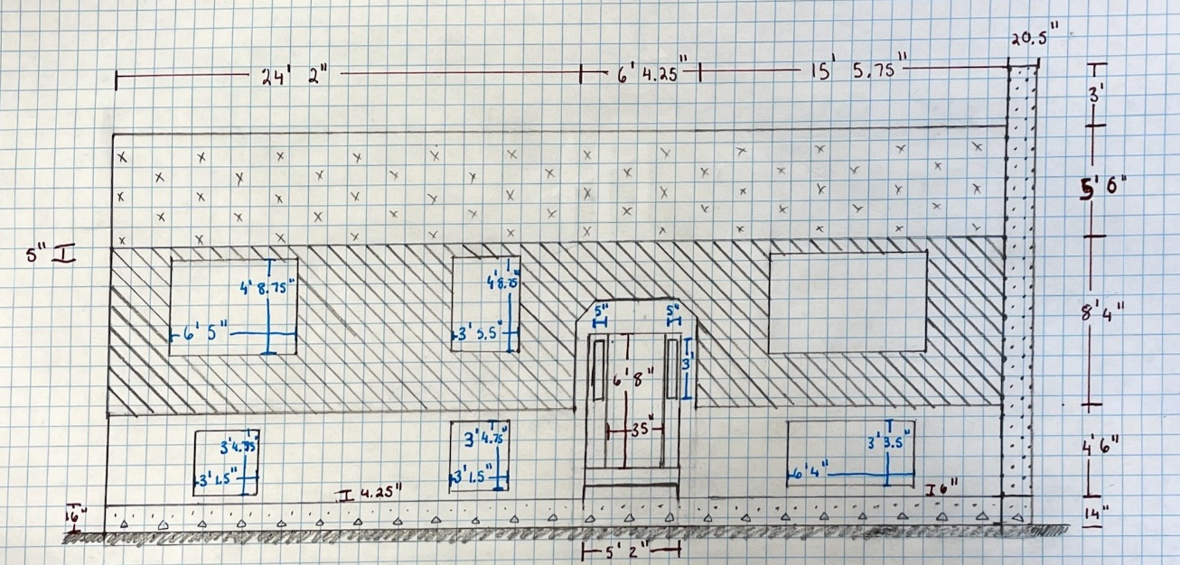
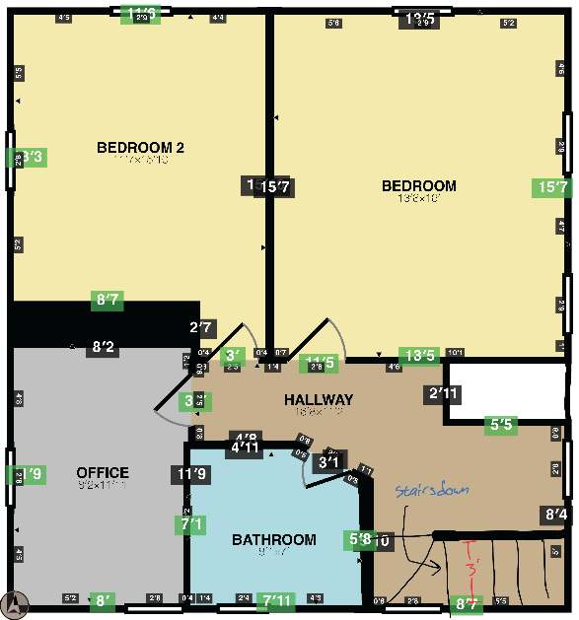
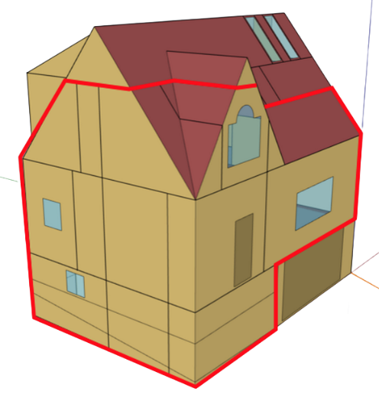
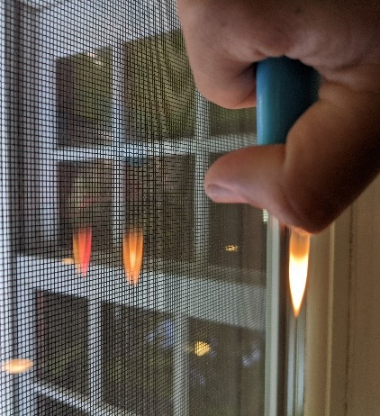
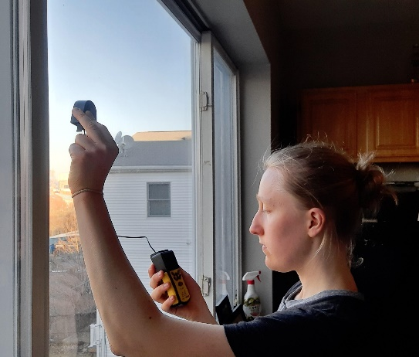
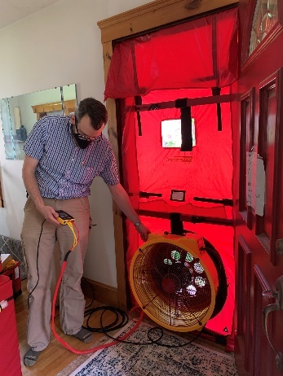
Audit
Notes:
Home documentation & energy audit:
Geometry: elevation drawings, interior floor plan, and site plan
Blower door test: measure infiltration
Constructions:
Windows: type, materials, panes/coatings, VLT
Walls: depth, probes
Roof/attic: entered space when accessible, probes
Build a Digital Twin of each home for testing alternative controls

Slide 9
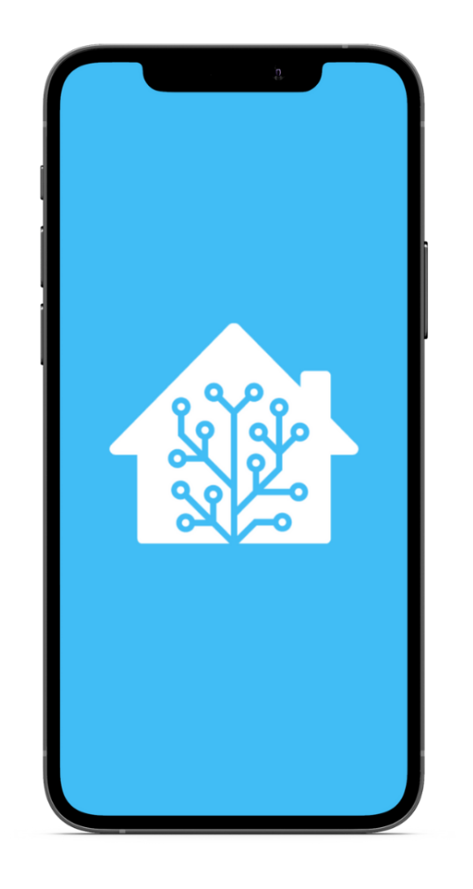
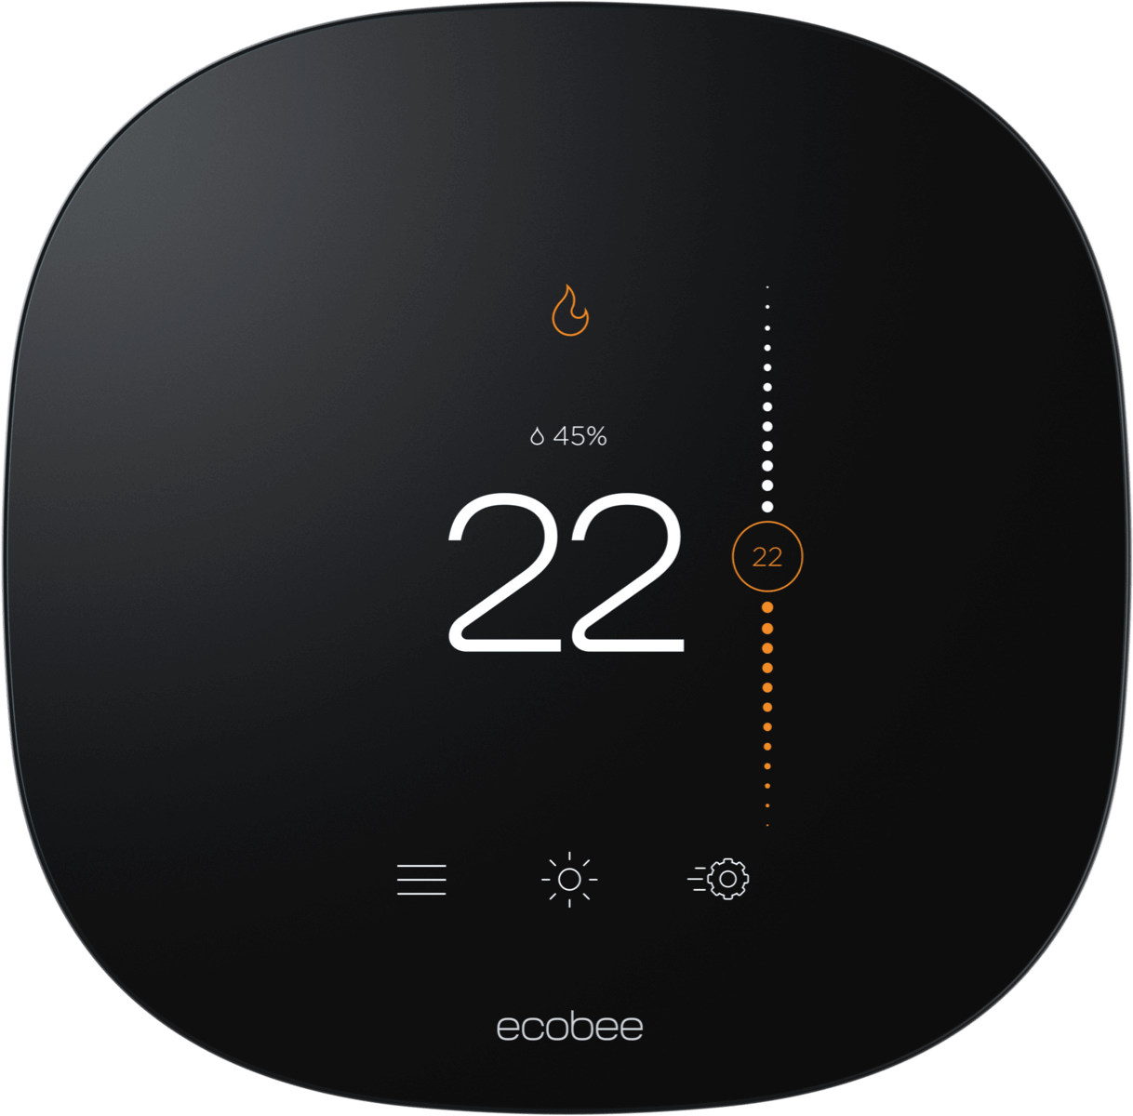
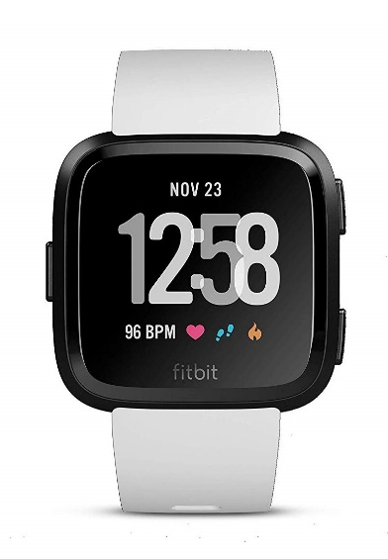
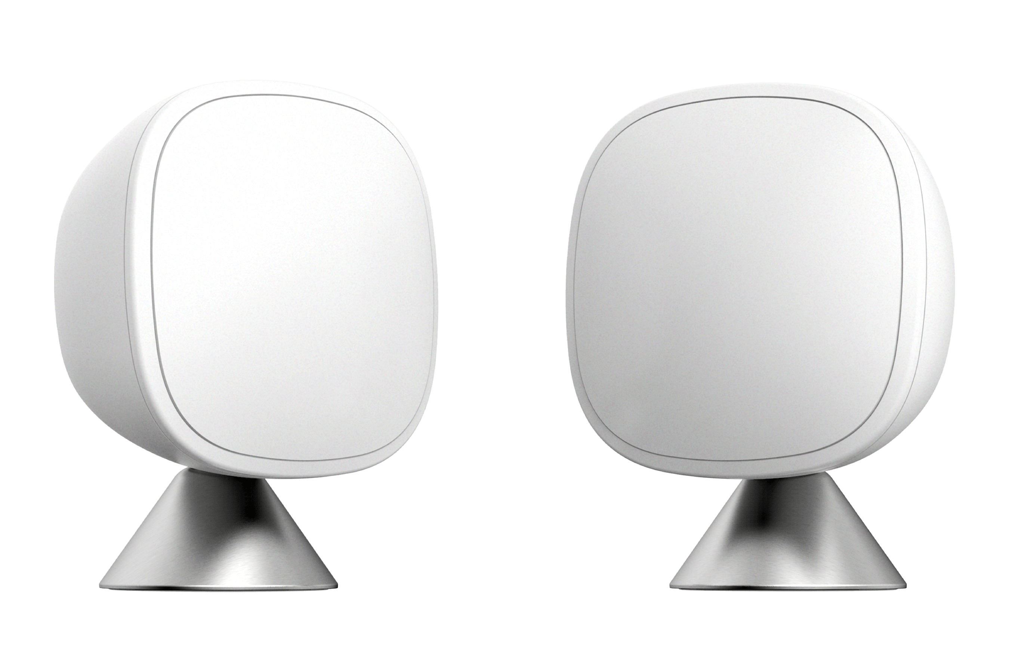
Sensors
9
Notes:
So the actual project is “collect a dataset” and we’re collecting lots of information, and lots of types of information.
Smart thermostat is the core: We’re providing an Ecobee as part of the study and as a benefit (they get to keep it) not only collect air temperature, humidity, and occupancy, but also the current setpoint and run-cycles of the HVAC equipment.
We then heavily instrument the house with other sensors,
Remote sensors placed in rooms across the house. Each has additional PIR occupancy sensors and temperature sensors
Also, have sensors to collect data on the opening and closing of doors and windows, the activity level of the occupants and power usage of prtable space conditioning devices…
And that gives us the house-side. But more relevant perhaps to this conversation, we’re also using…
Phone connection allows us to collect data on who is change the setpoint and to what value while also allowing us to use geofencing to identify if the participant is home or not and VERY IMPORTANTLY, send the participants just intime surveys to ask about thermal experience
Connected to SmartWatch for Metabolic Rate, survey prompts, some home control (this is a little patchy just now…)
That not only monitors the people but records their interaction with the building (adjusting set point)
https://www.ecobee.com/en-us/smart-thermostats/smart-wifi-thermostat-with-voice-control/
https://www.ecobee.com/en-us/accessories/smart-temperature-occupancy-sensor/
https://www.ecobee.com/en-us/accessories/smart-door-window-sensor/
https://cdn.shopify.com/s/files/1/0018/2521/0421/files/U133T.pdf?v=14915309573559959467
https://pisces.bbystatic.com/image2/BestBuy_US/images/products/6464/6464604cv12d.jpg
https://store.storeimages.cdn-apple.com/4982/as-images.apple.com/is/42-alu-silver-sport-white-nc-s3-grid?wid=540&hei=550&fmt=jpeg&qlt=90&.v=1594259786000
https://www.home-assistant.io/

Slide 10
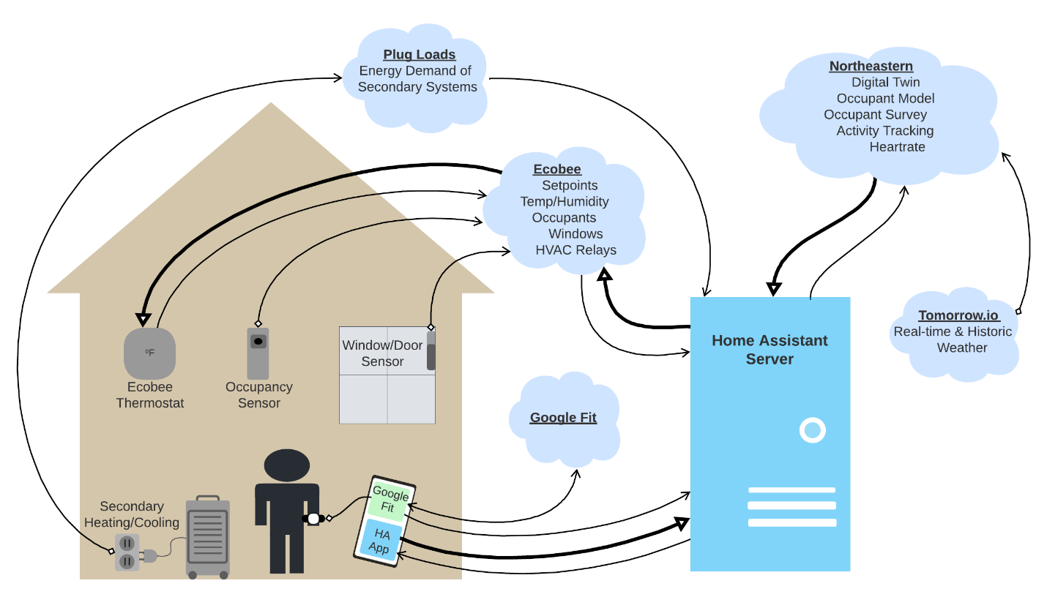
IoT Cloud Infrastructure
Notes:
Figure 3. Integrated data collection schematic.

Slide 11
Smart-Device Data Collection
Smart Device | Mfr & model | Comm. Protocol | No. Installed | Sensor | Data Collected
Thermostat | ecobee EB-STATE5-01 | Wi-Fi | 27 | HVAC Mode | Heat/Cool/Auto
 |  |  |  | System run time | Minutes
 |  |  |  | Air temp | ºF
 |  |  |  | RH | %
 |  |  |  | Occupancy (PIR) | Detected
SmartSensor – Occupancy | ecobee EBERS41 | 915 MHz | 157 | Occupancy (PIR) | Detected
 |  |  |  | Air temp | ºF
SmartSensor – Window/Door | ecobee EBDWC01 | 915 MHz | 102 | Windows/doors | Open/Close
Plug Load | BN-Link/Tuya | Wi-Fi | 26 | Voltage | Volts
 |  |  |  | Current | Amps
 |  |  |  | Power | Watts
Notes:
Table 1. IoT devices installed in participating homes (n = 20)
^{[1]} https://www.ecobee.com/en-us/smart-thermostats/smart-wifi-thermostat-with-voice-control/
^{[2]} https://www.ecobee.com/en-us/accessories/smart-temperature-occupancy-sensor/
^{[3]} https://www.ecobee.com/en-us/accessories/smart-door-window-sensor/
^{[4]} https://cdn.shopify.com/s/files/1/0018/2521/0421/files/U133T.pdf?v=14915309573559959467

Slide 12
Interviews
Researcher 1:
All right, let's see. Typically, how do you think about balancing the goals of being comfortable, saving money, and saving energy in terms of the important factors in your heating and cooling use?
Participant CO16a:
Yeah, I think we, like I said, we're happy to layer up instead of trying to heat the house wearing t-shirts and shorts. On days where it's not necessarily breaking 70 degrees, we will have windows open, especially in Participant CO16b's office. She'll open up the windows to get that room to cool down a little bit. I don't know how much Participant CO16b really thinks about this, but Xcel Energy just gave us, I guess, tiers or time to use charges for electricity. As far as I know not gas. And then like I said, having an air conditioner is new to me from the sense that my last two houses didn't have air conditioning. Most recently we've had a swamp cooler and before that I didn't have anything. I used a window air conditioner. What was I going to say on that?
Personal Adaptation
Building Interaction
Time of Use
Notes:
Conducted interviews with one participant from each household to give us insights into qualitative factors related to thermostat behavior such as environmental attitudes and future orientation. Coding and analyzing, classic qualitative methods.
In this excerpt from an interview, the participant explains:
Personal adaptation
Building interaction
Utility time of use rates
Also using a standard instrument about overall life satisfaction and major life stress/changes so we can control for those things.

Slide 13
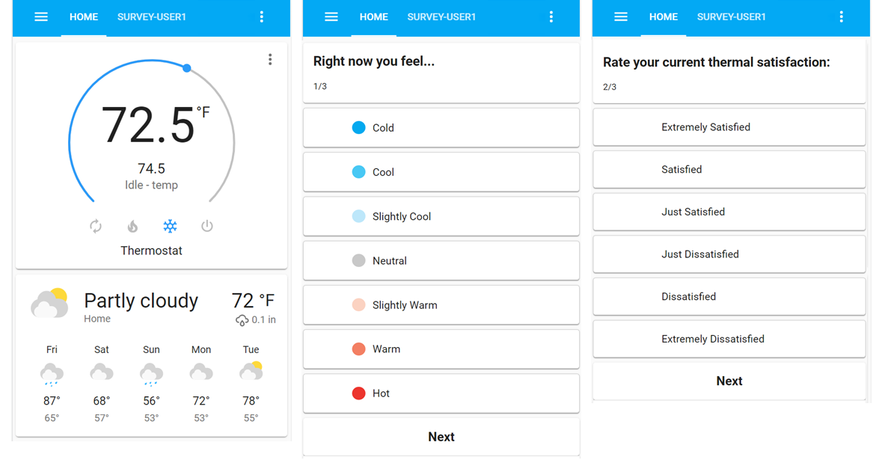
Surveys
Notes:
Ecological Momentary assessment
Randomly distributed when home
Now prompting based on interactions
Working on a more-targeted prompt based on study design.

Slide 14
Results

Slide 15
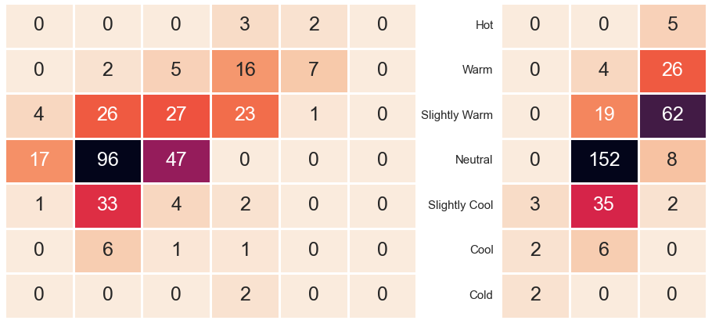
Neutral ≠ Comfortable
Hot
Warm
Slightly Warm
Neutral
Slightly Cool
Cool
Cold
Extremely Satisfied
Satisfied
Just Satisfied
Just Dissatisfied
Extremely Dissatisfied
No Change
Dissatisfied
Warmer
Cooler
Notes:
Approaching 3,000 EMA responses!
59% median response rate per person!
POINT: Show relationship between the (classic) thermal sensation question and compare how it relates to the other 2 questions. Also to give general overview of EMAs (what was asked and number of responses in this period

Slide 16
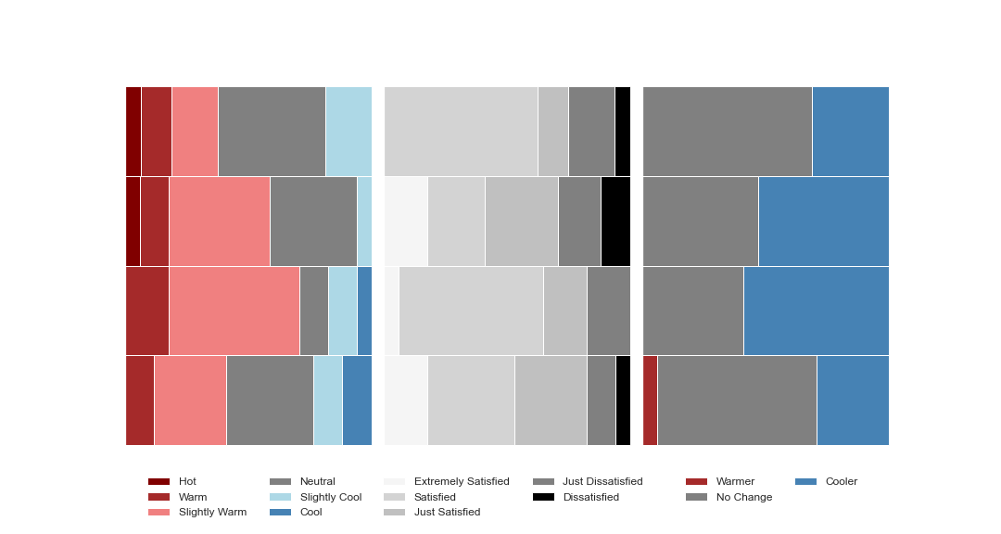
How do we ask about comfort?
Thermal Sensation
Thermal Satisfaction
Thermal Desire
85.0
80.8
78.0
Temperature (°F) Quartile Bins
76.4
Notes:
POINT: Last graph shows variation in comfort temperature, this shows how, across the sample, the responses to each question change with the indoor temperature. This is not earth-shattering: we expect comfort should depend on temperature!
The y axis is the temperature quartile rage for what the tstat measured at the time the survey was taken.
The first data we see are the standard 7-point thermal sensation scale. So we see a sort of curve, maybe the inverted U of de Dear’s model.
Perhaps more to the point that what people feel, is how they feel about it, their satisfaction with the environment.
And indeed, if we’re ultimately trying to control, then we’d like to know if they’re going to do anything about it, i.e. what would they Desire

Slide 17
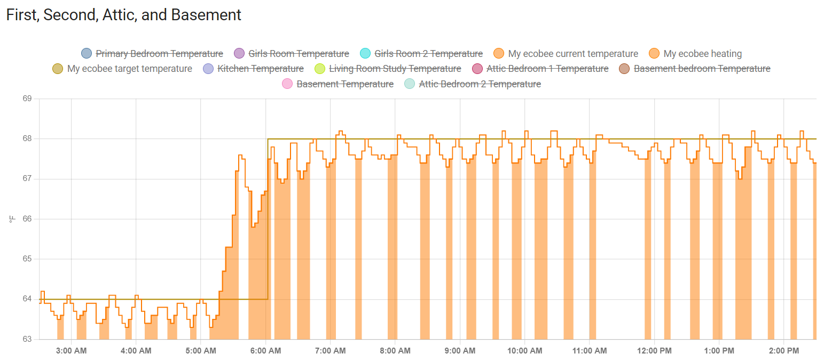
HVAC Operation
Setpoint Temperature
Temperature @ TStat
Heating
Notes:
You can see the thermostat working to warm up in advance of the setpoint
See the irregular decay profile warm up, then allow the decay within dead band, then warmup again.
Present challenge is working on this transience, or really, dynamic. Derek’s point

Slide 18
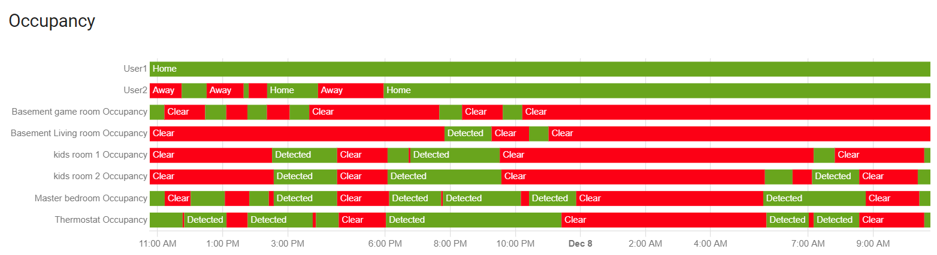
Detecting Humans
Mobile Phone Geofence
Notes:
In addition to the temporal variations, this is more complex by not knowing where people are within the home, yet significant variation across the home, and people can move

Slide 19
Acknowledgements
Co-PIs:
Mike Kane, Misha Pavel
Post-Docs
SungKu Kang, Elizabeth Allen
PhD Students: Katherine Bassett; Emma Casavant, Maharshi Pathak, Kunind Sharma
NREL:
Bethany Sparn
Sugirdhalakshmi Ramaraj
Industry Partner:
Ecobee
Support:
This material is based on work supported by the US Department of Energy award DE-EE0009154
This material is based in part on work supported by the National Science Foundation under CAREER award 2047317
Disclaimer:
Opinions, findings, and conclusions or recommendations expressed in this material are those of the authors and do not necessarily reflect the views of the Department of Energy or the National Science Foundation.

Slide 20
Thank you!
David Fannon d.fannon@northeastern.edu

